Slide 1
Predict Closed Questions on Stack Overflow with Naive Bayes Classification
Implemented in Hadoop MapReduce, Mahout, and Spark
Team 5: Yan Long, Min Xu & Xiaoguang Mo

Slide 2

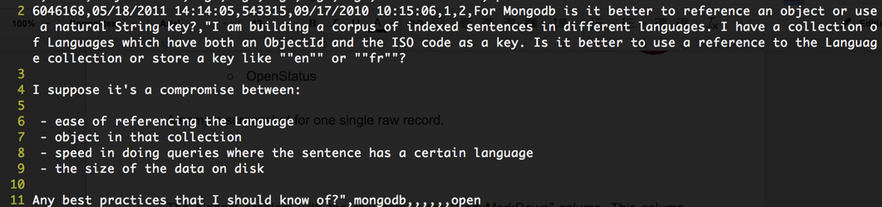
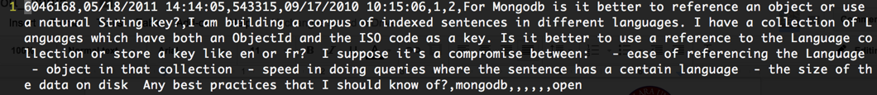
Introduction
Problem Predict which new questions asked on Stack Overflow will be closed.
Algorithm Naive Bayes Classification
Data Set Description
Features: 14 PostId,PostCreationDate,OwnerUserId,OwnerCreationDate,ReputationAtPostCreation,OwnerUndeletedAnswerCountAtPostTime,Title,BodyMarkdown,Tag1,Tag2,Tag3,Tag4,Tag5,PostClosedDate
Label: OpenStatus
Data-Preprocessing Convert raw data into CSV format data.
Raw data
CSV

Slide 3

Mahout
Features Considered
Post Body
Post Title
Tags
Convert csv data into hadoop sequence file(Key-Value)
Using 60% as training data. 40% as test data.
Calculate the word frequency in each label(open, close) using tfidf, and convert the sequence file into mahout-vector.
Train model
Test model

Slide 4

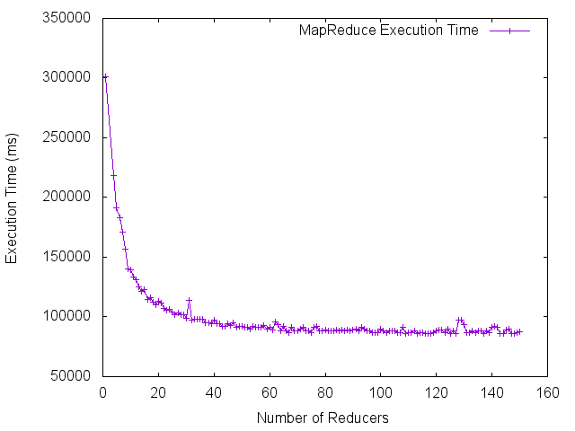
Implementing Naive Bayes Classifier using
Hadoop MapReduce
Training Set Size | 3,628,208 posts / 4.0 GB
Vocabulary Size | 5,317,949 words
Unique Tags | 44,061 tags
Accuracy | 87.86%
Features Considered
Post Body & Post Title (Bag-of-words model)
Tags
Reputation of Owner
Undeleted Answers by Owner
Caveats for Tokenization
Remove all kinds of punctuations
Remove stop words
Convert all letters to lowercase (negative impact)
Bigrams (negative impact & model too large)
PostMapReduce - building the classifier.
Count # of occurrences of each feature in open/closed/all posts respectively.
Count # of unique words & tags.
PostPredictor - applying the classifier.
Load MapReduce outputs into a HashMap.
Calculate probabilities for each category.
Runtime Performance
Execution Time vs. # of Reducers

Slide 5

Spark
Feature considered:
title, body, tag
Tokenization:
stopword
rare word
TF-IDF(term frequency-inverse document frequency)
create a hash of all keywords and frequencies
calculate the TF-IDF
Randomly split input file to 60% training data and 40% test data
Train data with TF-IDF to get the model
Run test model

Slide 6
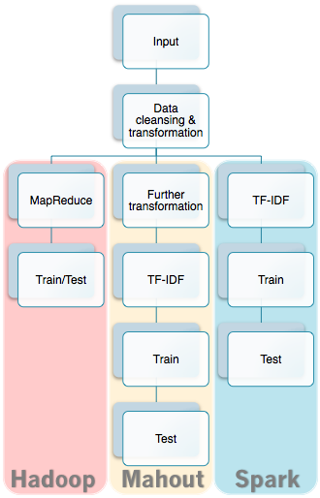
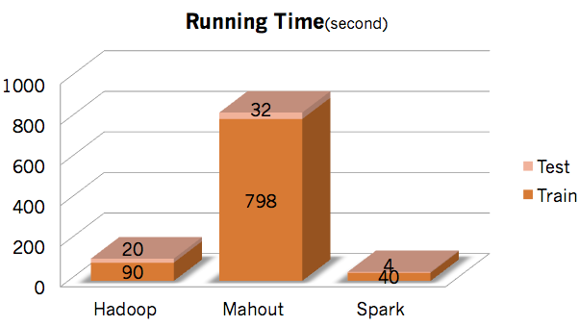
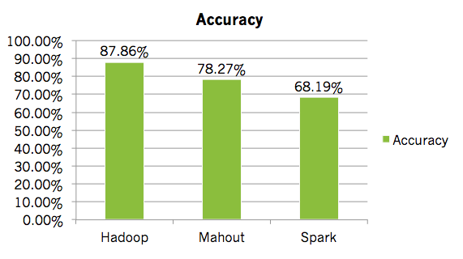
Comparison
(half data size)

