Slide 1
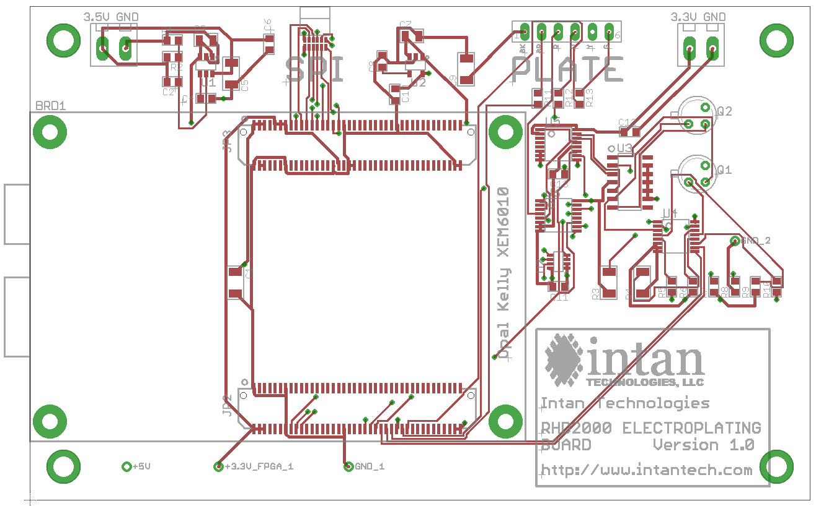
RHD2000 Plating Board
FR-4, 0.062” thick, gold immersion finish
Through-hole components and SMDs (no smaller than 0603) on top side only
(see BOM for details)
0.125” holes in all four corners
4.65”
2.95”
actual size

Slide 2

SMD Components (36 total)
Omnetics A79623
1 μF
1 μF
30.1 kΩ (1%)
100 nF
10 nF
56.0 kΩ (1%)
22 μF
TPS79301
22 μF
TPS79333
15 pF
100 nF
100 Ω
10 nF
100 nF
74HC4053
Samtec BTE-040-01
100 nF
OPA4170
74HC4053
74HC4052
AD5662
22 μF
100 nF
100 kΩ (1%)
100 kΩ (1%)
1.00 MΩ (1%)
1.00 MΩ (1%)
10.0 MΩ (1%)
10.0 MΩ (1%)
100 MΩ (1%)
100 MΩ (1%)
Samtec BTE-040-01

Slide 3
Through-Hole Components (4 total)
Place terminal blocks with openings towards outside edge of board
ED1514
ED1514
2N3964
BC107

