Slide 1
Analyze the correlations between stock market and the keywords under news
Presented by: Xiao Jia

Slide 2

Background
Natural Language Processing: a technique used by a computer to understand and manipulate natural languages.
Morgan Stanley and Stanford NLP group are using NLP techniques to evaluate past data pertaining to the stock market and world affairs of the corresponding time period, in order to make predictions in stock trends.

Slide 3
Motivation
Scraped the titles and dates from the finance, economy and tech news of CNBC.
Try to find the correlations between the stock market and the keywords under the news.

Slide 4
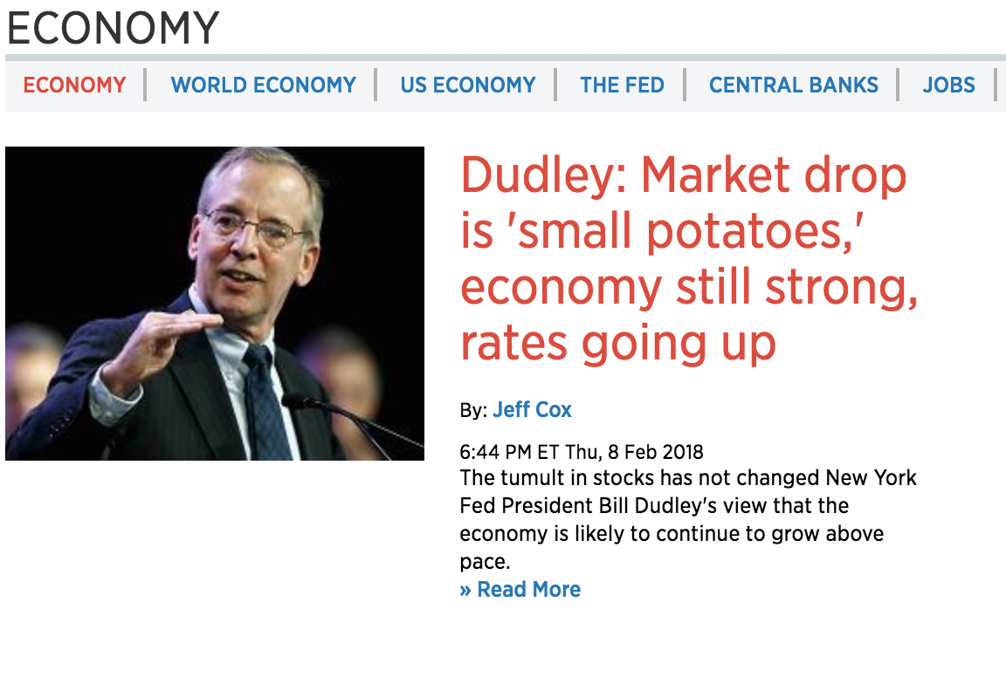
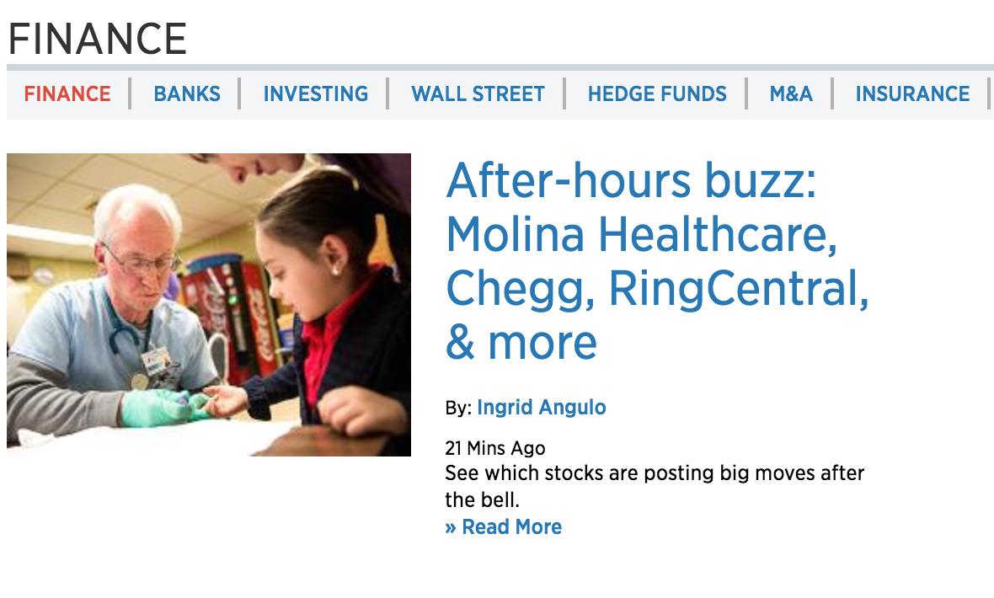
Step 1: Scrapy
Scraped data from 15 subcategories news fromhttps://www.cnbc.com/news/

Slide 5
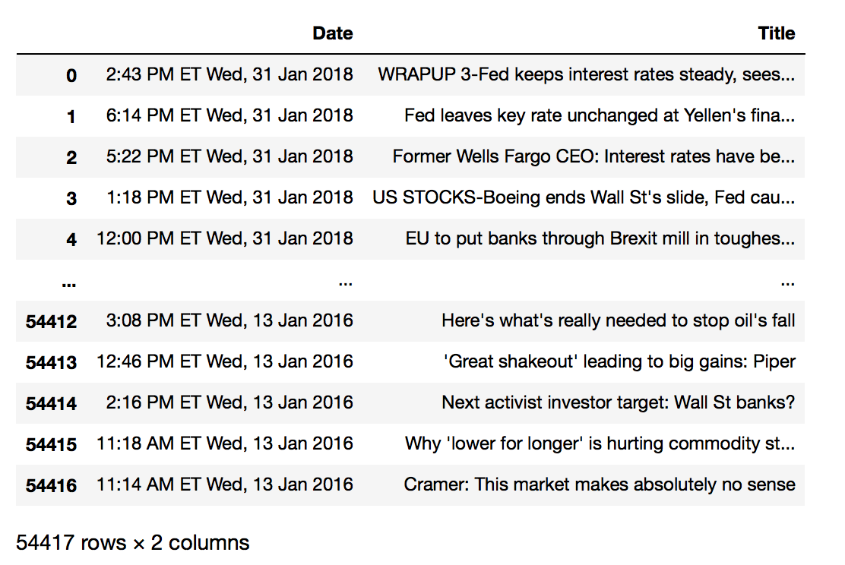
Step 2: Data Cleaning

Slide 6
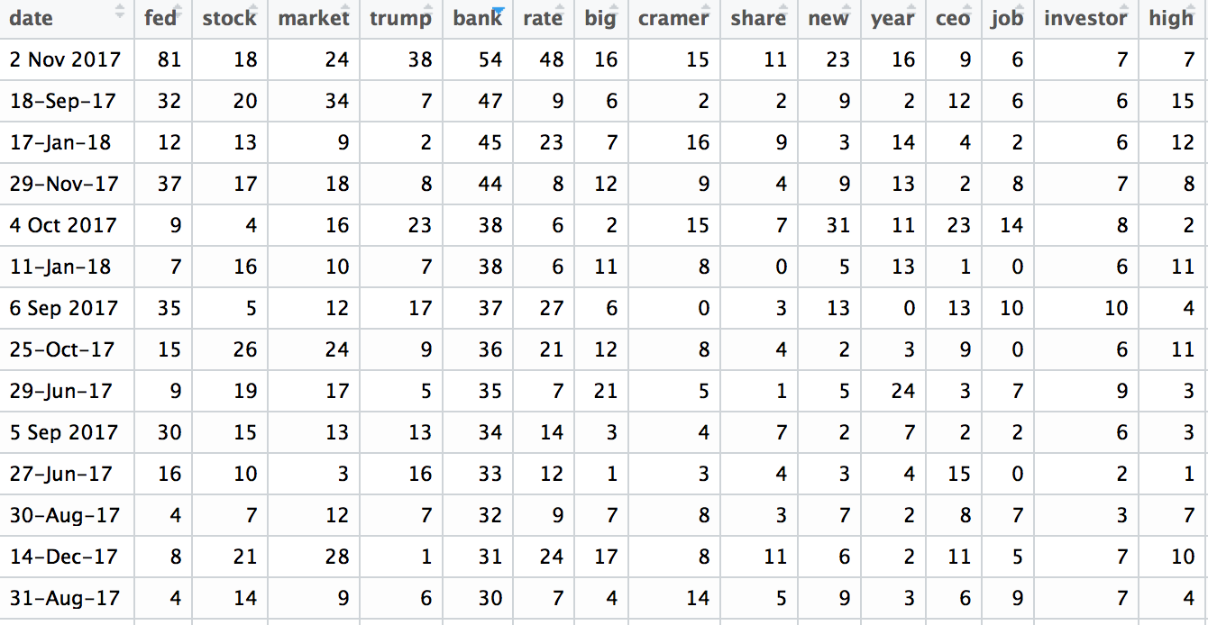
Step 3: NLP(Natural Language Processing)

Slide 7
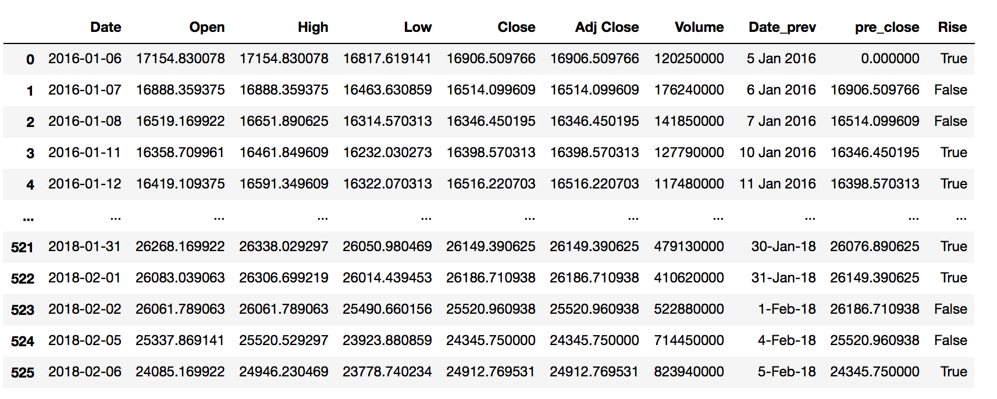
Step 4 : Stock Price (from https://finance.yahoo.com)

Slide 8
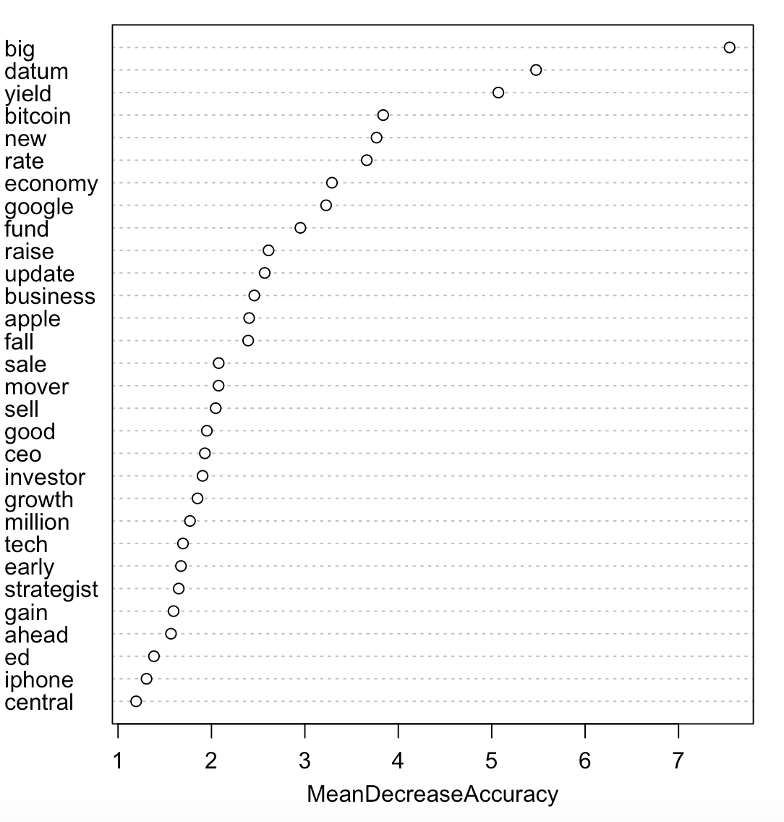
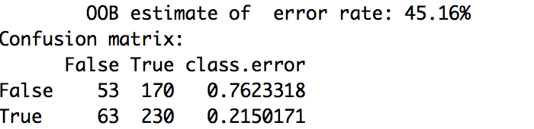
Step 5: Make Model with Random Forest

Slide 9
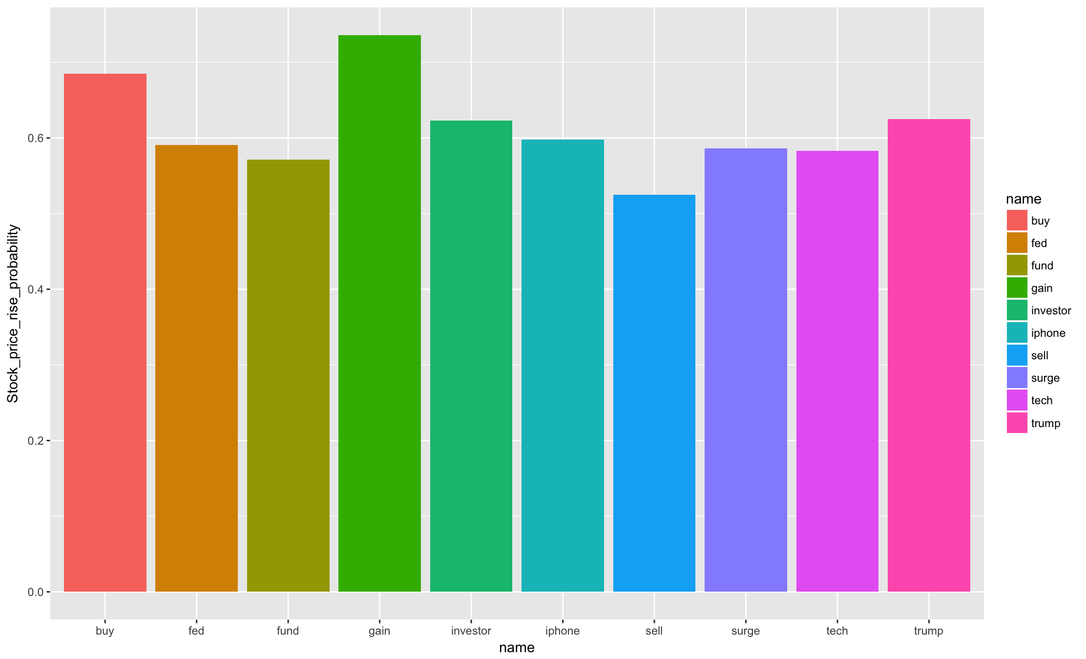
Step 6: Correlation Between the Keywords and Stock Fluctuation
a

Slide 10
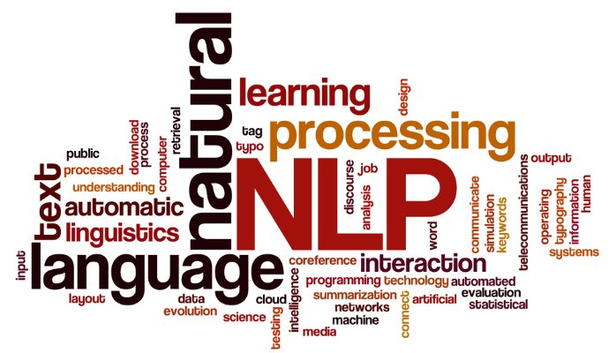
Future Work
Use TF-IDF(term frequency–inverse document frequency)
Get more news content
Add more features
More observations

