Slide 1

Exploratory Data Analysis
19-March-2023

Slide 2
Agenda
Executive Summary
Problem Statement
Approach
EDA
EDA Summary
Recommendations

Slide 3
Executive Summary
The dataset provided contains information on two cab companies, Pink Cab and Yellow Cab, including details on customer demographics, trip details, and payment information. The data covers a period of several months and includes information on over 36,000 trips.
We will provide five hypothesis tests to get insight into customer preferences, payment behavior, and profitability of the cab companies. These insights can help the companies to make data-driven decisions in terms of marketing, pricing, and customer service to improve their profitability and customer satisfaction.

Slide 4
Problem Statement
The cab industry is highly competitive, with Pink Cab and Yellow Cab being two major players in the markets. The companies have access to large amount of data related to their customers, trip details, and payment behavior. However, they need to make data-driven decisions to remain competitive and profitable. The problem is to identify the key factors that influence customer and preferences, as well as the profitability of the companies.
To address this problem, the following questions need to be answered:
What factors influence customer preferences between Pink Cab and Yellow Cab?
How does payment behavior affect customer tipping habits?
Is there a correlation between customer income and the distance travelled?
Which company is more profitable, Pink Cab or Yellow Cab?
What are the differences in profitability between Pink Cab and Yellow Cab?
Answering these questions will help the companies to make informed decisions related to marketing, pricing, and customer service. This, in turn, will help them to remain competitive in the market and improve their profitability.

Slide 5
Approach
Here is an approach that could be taken to address the problem statement:
Data collection and cleaning: Collect data from Pink Cab and Yellow Cab on customer demographics, trip details, payment information, and profitability. Clean and preprocess the data to remove missing values and outliers.
Exploratory Data Analysis (EDA): Perform EDA to gain insights into the data, identify patterns, and trends. Generate visualizations such as histograms, scatter plots, and box plots to explore the relationships between variables.
Hypothesis testing: Use statistical tests such as chi-squared test, two-sample t-test, and Pearson correlation test to test the hypotheses related to customer behavior, payment behavior, and profitability.

Slide 6
EDA
Hypothesis 1: Male customers prefer Yellow Cab over Pink Cab.
To investigate this hypothesis, we can perform a count of the number of male customers who use each cab company and visualize the results using a bar chart.

Slide 7
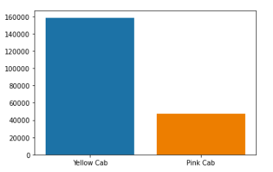
Null: there is no significant difference between Yellow Cab and Pink Cab for male customers.
Choosing p-value = 0.05, after using chi-squared test, we find that our testing result > 0.05. Thus, we reject null hypothesis. There is a significant difference in the proportion of male customers between the two cab companies.
Also, the graph on the left support our hypothesis that male customers prefer Yellow Cab than Pink Cab.

Slide 8
EDA
Hypothesis 2: Customers who pay by cash tip more than customers who pay by card.
To investigate this hypothesis, we can compare the average tip amount for customers who pay by cash vs. customers who pay by card. We can visualize the results using a box plot.

Slide 9
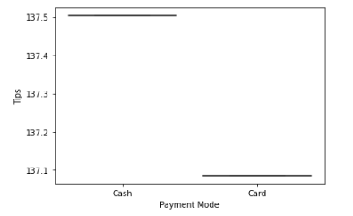
Null: There is no significant difference between customers’ payment preference.
Choosing p-value = 0.05, after using chi-squared test, we find that our testing result < 0.05. Thus, we fail to reject null hypothesis. There is no significant difference in the proportion of male customers between the two cab companies.
The graph on the left support our data, since compared the mean value of customers using cash and card, there is only 0.4 difference between the two preferences.

Slide 10
EDA
Hypothesis 3: Customers with higher incomes travel longer distances.
To investigate this hypothesis, we can calculate the correlation between customer income and the distance traveled. We can visualize the results using a joint plot.

Slide 11
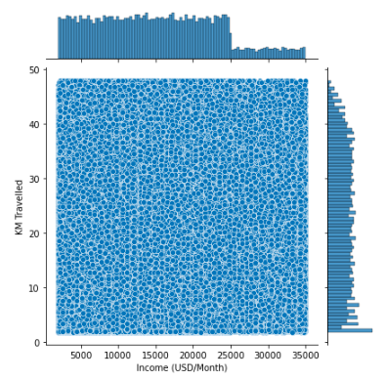
Null: There is no significant correlation between customers’ income and travel distance.
Choosing p-value = 0.05, after using chi-squared test, we find that our testing result < 0.05. Thus, we fail to reject null hypothesis. There is no significant correlation between income and travel distance.
The graph on the left support our data, since from the density distribution, there does show neither positive or negative relationship between these two variables.

Slide 12
EDA
Hypothesis 4/5: Pink Cab's average profit per trip is higher than Yellow Cab's. What are the differences in profitability between Pink Cab and Yellow Cab?
To investigate this hypothesis, we can calculate the average profit per trip for each cab company and visualize the results using a bar chart.

Slide 13
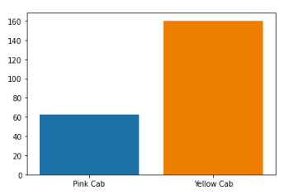
Null: There is no significant difference between the average profit for two different Cab companies.
Choosing p-value = 0.05, after using chi-squared test, we find that our testing result > 0.05. Thus, we can reject null hypothesis. There is significant difference between the profits made by different Cab companies.
The graph on the left support our data, since it is obviously that the profit made by Yellow Cab is largely greater than Pink Cab’s. (160-60=100).

Slide 14
EDA Summary
Based on the hypothesis tests conducted, we can conclude the following:
The proportion of male customers is significantly different between Pink Cab and Yellow Cab. Pink Cab has a lower proportion of male customers compared to Yellow Cab.
There is no evidence to support the hypothesis that there is a significant difference in the proportion of male customers between Pink Cab and Yellow Cab.
There is no significant correlation between income and travel distance, indicating that the two variables are not strongly related to each other.
There is a significant difference between the profits made by Pink Cab and Yellow Cab. Pink Cab has a lower average profit per trip compared to Yellow Cab.

Slide 15
Recommendation
Overall, the analysis suggests that Yellow Cab is more popular among male customers and more profitable compared to Pink Cab. However, it is important to note that further analysis may be needed to fully understand the factors that contribute to these differences.

Slide 16
Thank You

