Slide 1
Hand-written Digits Classification and Letter Recognition
Group 10
Sixiang Ma, Yuan Xiao, Xiaokuan Zhang

Slide 2
Problem Description
Classifying hand-written digits (0-9)
Classifying black-and-white rectangular pixel displayed capital letters (A-Z)
Two datasets retrieved from UCI ML repository

Slide 3
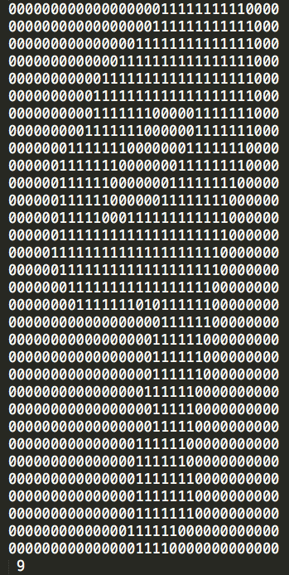
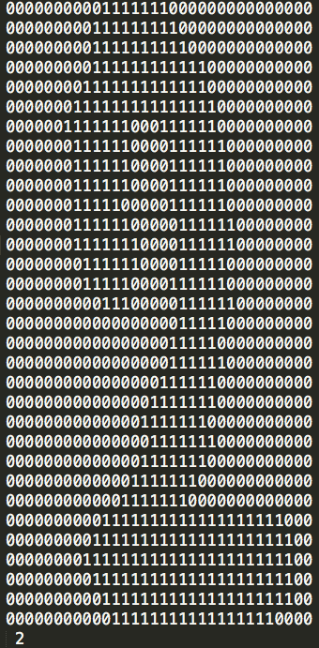
Hand-written Digits Dataset
Number of instances: 5620
Number of attributes: 1024 (32x32)
Attribute info: 0 / 1
Class: 0 ~ 9

Slide 4
Hand-written Digits Dataset
Transformation: 32x32 → 8x8
Number of attributes: 64
Attribute info: 0 ~ 16
Class: 0 ~ 9

Slide 5
Capital Letter Dataset
Number of instances: 20000
Number of attributes: 16
Attribute info: 0 ~ 15
Class: A ~ Z

Slide 6
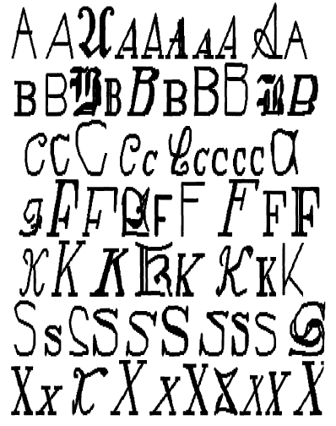
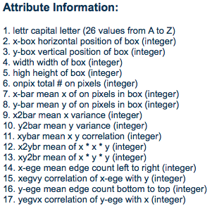
Capital Letter Dataset
Notes:
Source: 20 fonts

Slide 7
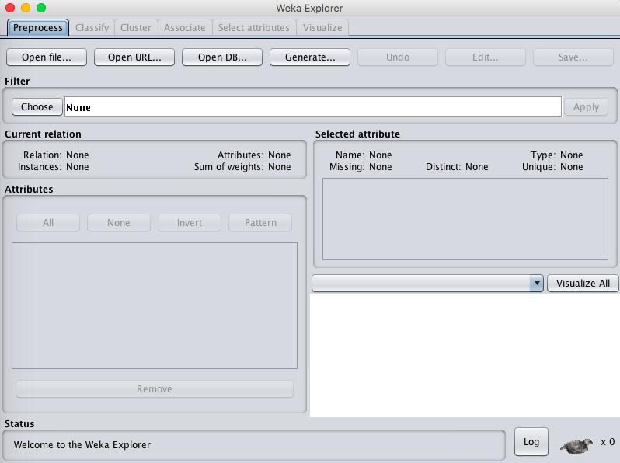
Training Procedure
Tool: Weka 3.8.0
Choose Classifiers
Naïve Bayes, SVM, Multi-layer Perceptron

Slide 8
Classifier Tuning
Naïve Bayes
K: whether to use kernel estimator
D: whether to use supervised discretization
Support Vector Machine
Multi-layer Perceptron

Slide 9
Naïve Bayes
K: whether to use kernel estimator
D: whether to use supervised discretization
K = False, D = False
K = True, D = False
K = False, D = True

Slide 10
Classifier Tuning
Naïve Bayes
Support Vector Machine
Complexity Parameter C
The C parameter tells SVM optimization how much misclassification should be avoided in training.
For large values of C, optimization tends to choose a smaller-margin hyper-plane if it does a better job in classifying training data.
Multi-layer Perceptron

Slide 11
Support Vector Machine
-C 0.5 -L 0.001 -P 1.0E-12 -K PolyKernel
-C 1.0 -L 0.001 -P 1.0E-12 -K PolyKernel
-C 1.5 -L 0.001 -P 1.0E-12 -K PolyKernel
-C 2.0 -L 0.001 -P 1.0E-12 -K PolyKernel
C means complexity parameter

Slide 12
Classifiers Tuning
Naïve Bayes
Support Vector Machine
Multi-layer Perceptron
learningRate -- The amount the weights are updated.
trainingTime -- The number of epochs to train through. If the validation set is non-zero then it can terminate the network early
validationThreshold -- Used to terminate validation testing.The value here dictates how many times in a row the validation set error can get worse before training is terminated.
Other parameters include momentum, seed, nominalToBinaryFilter, hiddenLayers etc.

Slide 13
Multilayer Perceptron
-L 0.3 -M 0.2 -N 500 -V 0 -S 0 -E 20 -H a
-L 0.6 -M 0.2 -N 500 -V 0 -S 0 -E 20 -H a
-L 0.3 -M 0.2 -N 200 -V 0 -S 0 -E 20 -H a
-L 0.3 -M 0.2 -N 500 -V 0 -S 0 -E 10 -H a
-L 0.3 -M 0.2 -N 500 -V 0 -S 0 -E 30 -H a
Notes:
Only change one parameter at a time to see its effect.

Slide 14
Test Setup
Cross-validation
The classifier is evaluated by cross-validation, 10 folds are used.
Cross validation aims to define a dataset to "test” in the training phase, in order to limit problems like overfitting.
It gives an insight on how the model will generalize to an independent dataset.[*]
[*] https://en.wikipedia.org/wiki/Cross-validation_(statistics)

Slide 15
Test result analysis

Slide 16
Test Results w/ Different Parameters Naïve Bayes

Slide 17
Least Correct Class
Parameters | Class (character) | Correctness
K = F, D = F | S | 29.4%
 | H | 30.5%
 | Y | 33.1%
K = T, D = F | H | 57.4%
 | S | 64.2%
 | X | 64.3%
D = F, K = T | H | 57.5%
 | E | 60.7%
 | X | 64.4%

Slide 18
Test Results w/ Different Parameters Naïve Bayes

Slide 19
Test Results w/ Different Parameters SVM

Slide 20
Test Results w/ Different Parameters SVM

Slide 21
Least Correct Class
Parameters | Class (character) | Correctness
C=0.5 | H | 57.6%
 | S | 72.1%
 | Q | 72.5%
C=1.0 | H | 68.2%
 | S | 73.3%
 | G | 74.1%
C=1.5 | H | 60.9%
 | S | 74.5%
 | O | 74.5%
C=2.0 | H | 61.9%
 | S | 73.8%
 | O | 74.5%

Slide 22
Test Results w/ Different Parameters SVM

Slide 23
Test Results w/ Different Parameters Multi-layer Perceptron

Slide 24
Least Correct Class
Parameters | Class (character) | Correctness
Default | G | 69%
 | H | 64.4%
 | S | 65%
L=0.6 | G | 68.2%
 | H | 69.1%
 | S | 64%
N=200 | G | 69.3%
 | H | 65.1%
 | S | 64.4%

Slide 25
Test Results w/ Different Parameters Multi-layer Perceptron

Slide 26
Special case: L=0.6 (Digit -- Multi-layer Perceptron)

Slide 27
Conlusion
Naïve Bayes performs badly in letter recognition when K=f, D=f. With other parameter settings, the correctness is around 75% with small deviation among different letters.
SVM seems generally not suitable for letter recognition. The classes that cannot be correctly classified are: H, S, Q, G, O.
Artificial Neural Network is heavily influenced by the parameters that control the stochastics. But generally speaking, it has a relatively stable performance. Weak in classifying: G, H, S.

