Slide 1
Evading the Machine Learning Detector: A Virus’ Perspective
Group 10
Yuan Xiao, Xiaokuan Zhang

Slide 2

Problem Description
How should a virus disguise itself to fool the detector?
What are the important features of malicious executables?
Notes:
a bunch of anti-virus software, detecting malicious apps/binaries
No interested in detecting , but
However, to learn how to evade detection, first,

Slide 3
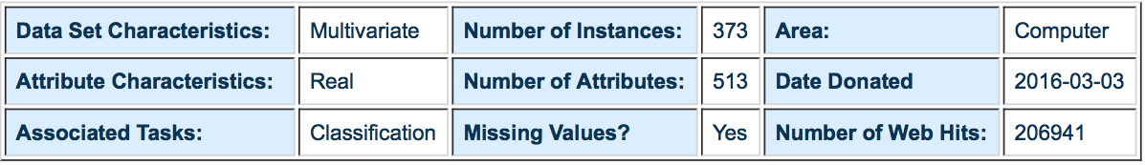
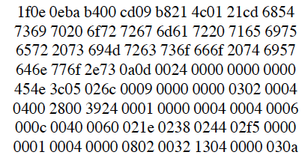
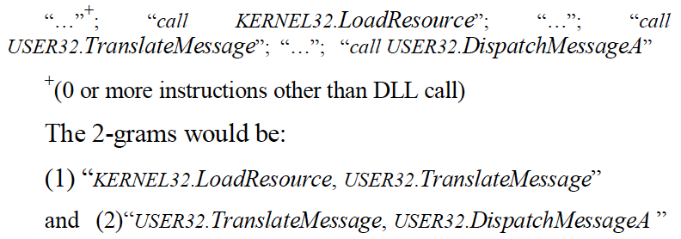
Malicious Executable Dataset
Dataset retrieved from UCI ML repository
500 hex features, 13 DLL features
Notes:
NO many dataset we can find.

Slide 4
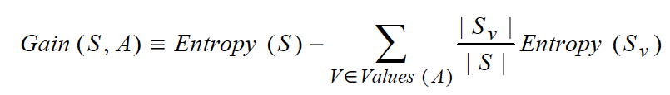
Related Work
N-gram Feature
a1b2c3d4 → 3-gram: a1b2c3 & b2c3d4
Binary/Assembly/DLL N-gram Feature Set
Hybrid model: Combine the three
Best 500 features for each set based on Gain
Algorithm: libSVM
Masud, Mohammad M., Latifur Khan, and Bhavani Thuraisingham. "A hybrid model to detect malicious executables." Communications, 2007. ICC'07. IEEE International Conference on. IEEE, 2007.

Slide 5
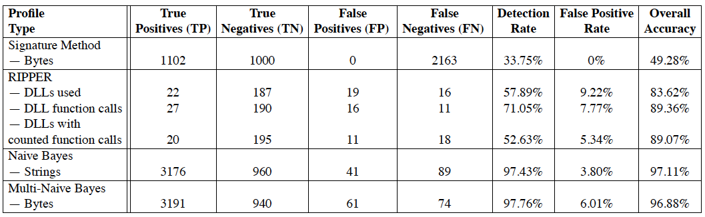
Related Work
Features: DLLs/GNU Strings/Byte Sequence(hex)
Algorithm: RIPPER/NB/Multi-NB
Best: Multi-NB (97.76%)
Schultz, Matthew G., et al. "Data mining methods for detection of new malicious executables." Security and Privacy, 2001. S&P 2001. Proceedings. 2001 IEEE Symposium on. IEEE, 2001.

Slide 6
Highlights & Originality
New method: Clustering for popularity prediction
New direction: How to become a top-hit more easily? -> Known popularity, predict another attribute?

Slide 7

Methods
Use WEKA + libSVM to train a model
Generate new virus data points and test

Slide 8
Data Preprocessing (Known popularity)
Turn ”popularity” from Class into Attribute
Turn ONE TYPE of the Attributes into Class eg. weekday_is_*: when is the best time to publish a top hit?

Slide 9
Challenge
Make reasonable use of unsupervised method (clustering) to solve problem
Put more weights on popularity than on unmodified attributes

Slide 10
Evaluation
Prediction accuracy: use known popularity
Performance comparison: compare prediction results with previous work
Statistics analysis: compare with statistical result about attributes

Slide 11
Classification
Support Vector Machine
Random Forest

