Slide 1

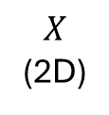

$$X$$
(2D)
rgb
(3D)
PE
(L=16)
ReLU
Sigmoid
Linear
(256)
Linear
(3)
$×$10

