Slide 1
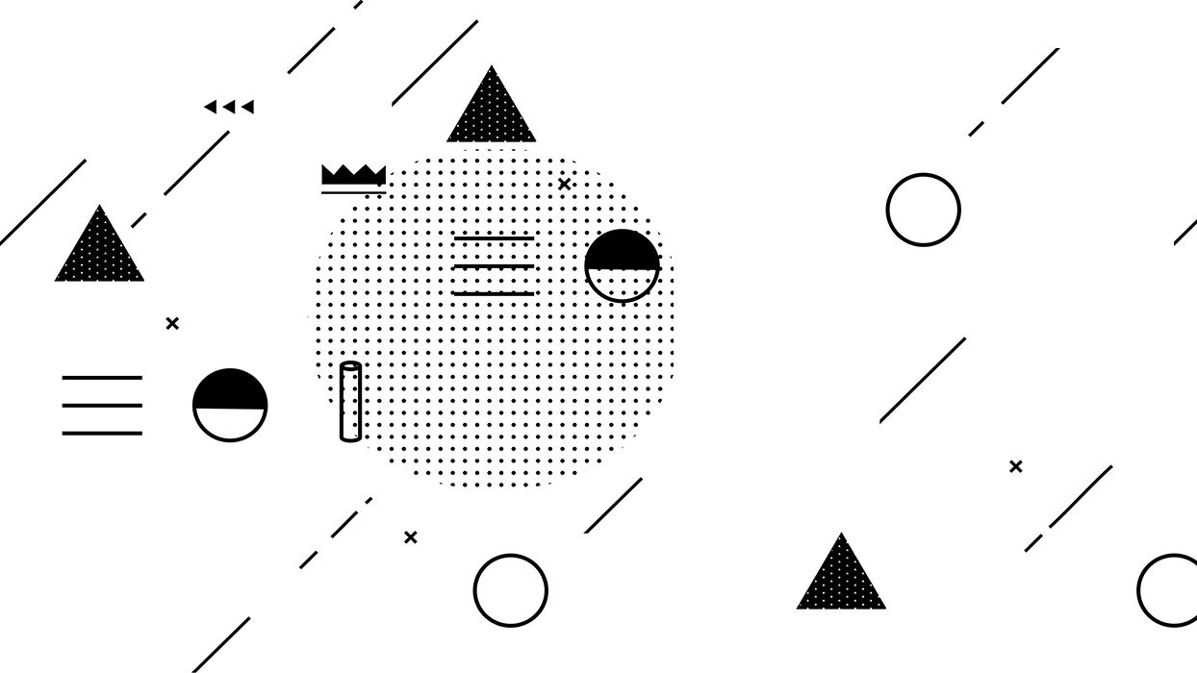
KMP算法

Slide 2
选题背景
问题
s1 = “hello and python and java and sql and scala”
s2 = “and”
s2是否是s1的字串
方法1
方法2
方法3
s1.find('and’)
s1.rfind('and')
s1.index('and’)
s1.rindex('and')
if s2 in s1:
…

Slide 3
选题背景
新问题: 这些方法底层又是如何实现字符串匹配
换个问法: 如果让你自定义一个函数实现字符串匹配,如何实现

Slide 4
底层实现
S1 | a | b | c | a | b | a | b | c | a | b | c | h | o | n
S2 | a | b | c | a | b | c

Slide 5
底层实现
S1 | a | b | c | a | b | a | b | c | a | b | c | h | o | n
S2 | a | b | c | a | b | c

Slide 6
底层实现
S1 | a | b | c | a | b | a | b | c | a | b | c | h | o | n
S2 | a | b | c | a | b | c

Slide 7
底层实现
S1 | a | b | c | a | b | a | b | c | a | b | c | h | o | n
S2 | a | b | c | a | b | c

Slide 8
底层实现
S1 | a | b | c | a | b | a | b | c | a | b | c | h | o | n
S2 | a | b | c | a | b | c

Slide 9
底层实现
S1 | a | b | c | a | b | a | b | c | a | b | c | h | o | n
S2 | a | b | c | a | b | c

Slide 10
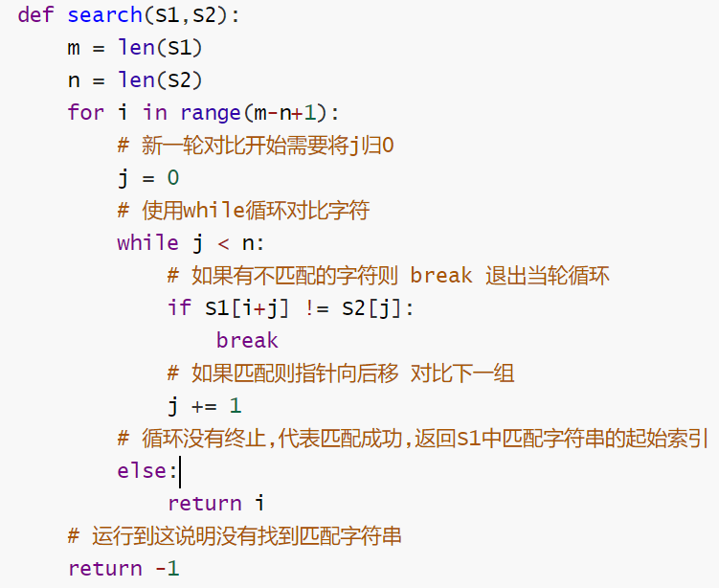
底层实现
i | 0 | 1 | 2 | 3 | 4 | 5 | 6 | 7 | 8 | 9 | 10 | 11 | 12 | 13
S1 | a | b | c | a | b | a | b | c | a | b | c | h | o | n
m = 14
n = 6
m-n+1 =9
range(9)
S2 | a | b | c | a | b | c
j | 0 | 1 | 2 | 3 | 4 | 5
i 代表 每轮对比 S1 起始索引位置
j 代表 每轮对比中 对比到了第 j+1 个字符

Slide 11
底层实现
i | 0 | 1 | 2 | 3 | 4 | 5 | 6 | 7 | 8 | 9 | 10 | 11 | 12 | 13
S1 | a | b | c | a | b | a | b | c | a | b | c | h | o | n
m = 14
n = 6
m-n+1 =9
range(9)
S2 | a | b | c | a | b | c
j | 0 | 1 | 2 | 3 | 4 | 5
i 代表 每轮对比 S1 起始索引位置
j 代表 每轮对比中 对比到了第 j+1 个字符
时间复杂度 O(m*n)

Slide 12
选题背景
新问题: 上述方式思想简单但是时间复杂度较高, 如何进行优化

Slide 13
思考1
S1 | a | b | c | d | e | a | n | d | p | y | t | h | o | n
S2 | a | b | c | d | f

Slide 14
思考1
S1 | a | b | c | d | e | a | n | d | p | y | t | h | o | n
S2 | a | b | c | d | f

Slide 15
思考2
S1 | w | w | w | . | a | b | b | c | a | b | c | h | o | n
S2 | w | w | . | a | b | c
S1 | w | w | w | . | a | b | b | c | a | b | c | h | o | n
S2 | w | w | . | a | b | b

Slide 16
思考2
S1 | w | w | w | . | a | b | b | c | a | b | c | h | o | n
S2 | w | w | . | a | b | b
S2 | w | w | . | a | b | b
S1 | w | w | w | . | a | b | b | c | a | b | c | h | o | n
S2 | w | w | . | a | b | b

Slide 17
思考3
S1 | b | b | c | b | b | c | b | b | s | b | c | h | o | n
S2 | b | b | c | b | b | s
S1 | b | b | c | b | b | c | b | b | s | b | c | h | o | n
S2 | b | b | c | b | b | s

Slide 18
思考4
S1 | a | a | a | a | a | a | a | b | s | b | c | h | o | n
S2 | a | a | a | a | a | b
S1 | a | a | a | a | a | a | a | b | s | b | c | h | o | n
S2 | a | a | a | a | a | b

Slide 19
名字由来
K
M
P
D.E.Knuth
J.H.Morris
V.R.Pratt

Slide 20
思考1
S1 | a | b | c | d | e | a | n | d | p | y | t | h | o | n
S2 | a | b | c | d | f
j | 0 | 1 | 2 | 3 | 4
n | -1 | 0 | 0 | 0 | 0
S1 | a | b | c | d | e | a | n | d | p | y | t | h | o | n
S2 | a | b | c | d | f
j | 0 | 1 | 2 | 3 | 4
n | -1 | 0 | 0 | 0 | 0

Slide 21
思考2
S1 | w | w | w | . | a | b | b | c | a | b | c | h | o | n
S2 | w | w | . | a | b | c
j | 0 | 1 | 2 | 3 | 4 | 5
n | -1 | 0 | 1 | 0 | 0 | 0
S1 | w | w | w | . | a | b | b | c | a | b | c | h | o | n
S2 | w | w | . | a | b | c
j | 0 | 1 | 2 | 3 | 4 | 5
n | -1 | 0 | 1 | 0 | 0 | 0

Slide 22
思考3
S1 | b | b | c | b | b | c | b | b | s | b | c | h | o | n
S2 | b | b | c | b | b | s
j | 0 | 1 | 2 | 3 | 4 | 5
n | -1 | 0 | 1 | 0 | 1 | 2
S1 | b | b | c | b | b | c | b | b | s | b | c | h | o | n
S2 | b | b | c | b | b | s
j | 0 | 1 | 2 | 3 | 4 | 5
n | -1 | 0 | 1 | 0 | 1 | 2

Slide 23
思考4
S1 | a | a | a | a | a | a | a | b | s | b | c | h | o | n
S2 | a | a | a | a | a | b
j | 0 | 1 | 2 | 3 | 4 | 5
n | -1 | 0 | 1 | 2 | 3 | 4
S1 | a | a | a | a | a | a | a | b | s | b | c | h | o | n
S2 | a | a | a | a | a | b
j | 0 | 1 | 2 | 3 | 4 | 5
n | -1 | 0 | 1 | 2 | 3 | 4

Slide 24
Next数组构建
S2 | a | b | c | a | b | c | a | b | c | a | b | c | c | c
j | 0 | 1 | 2 | 3 | 4 | 5 | 6 | 7 | 8 | 9 | 10 | 11 | 12 | 13
n | -1 | 0 | 0 | 0 | 1 | 2 | 3 | 4 | 5 | 6 | 7 | 8 | 9 | 0

Slide 25
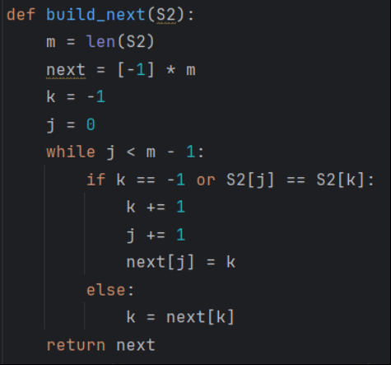
Next数组构建
S2 | a | b | c | a | b | c | c | c
i | 0 | 1 | 2 | 3 | 4 | 5 | 6 | 7
n | -1 | 0 | 0 | 0 | 1 | 2 | 3 | 0
k | -1 | 0 | -1 | 0 | -1 | 0 | 1 | 2 | 3 | 0 | -1 | 0
j | 0 | 1 | 1 | 2 | 2 | 3 | 4 | 5 | 6 | 6 | 6 | 7
n | -1 | -1 | -1 | -1 | -1 | -1 | -1 | -1

Slide 26
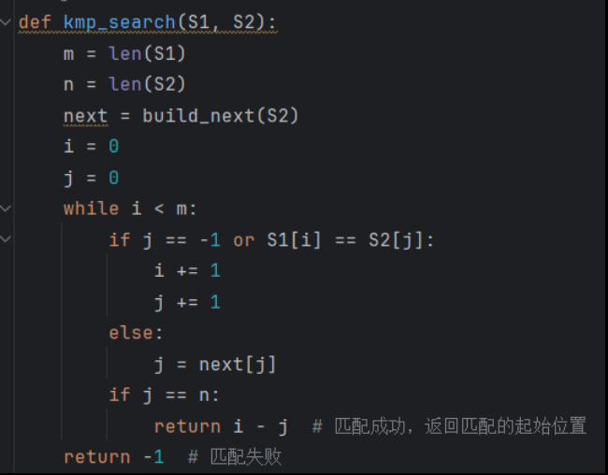
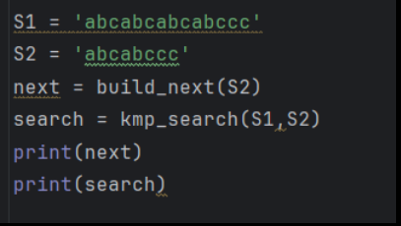
Next数组构建
n | -1 | 0 | 0 | 0 | 1 | 2 | 3 | 0
[-1, 0, 0, 0, 1, 2, 3, 0]
6

