Slide 1
KDD Cup 2017
Highway Tollgates Traffic Flow Prediction

Slide 2
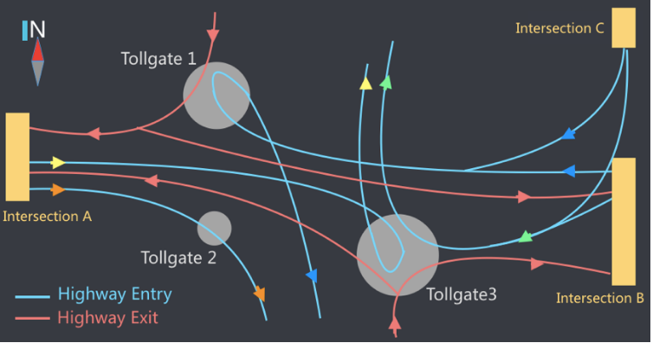
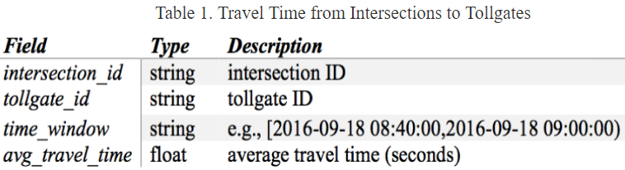
Task 1
To estimate the average travel time from intersections to tollgates (every 20 minutes interval)
A --- > 2 & 3, B --- > 1 & 3, C --- > 1 & 3

Slide 3
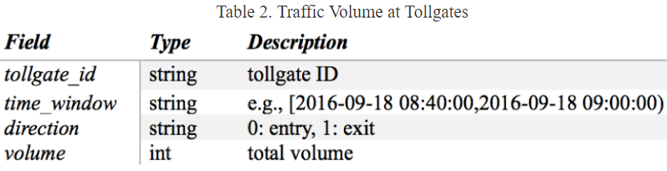
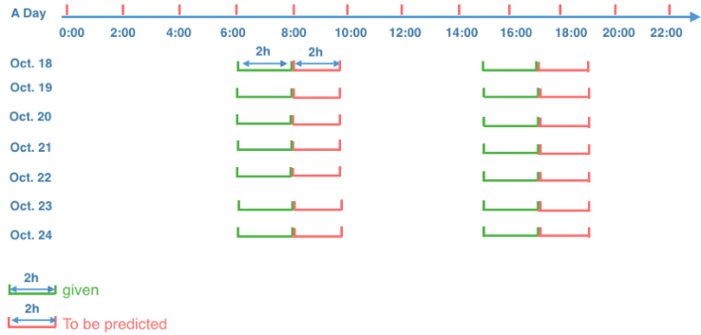
Task 2
To predict average tollgate traffic volume (every 20 minutes interval)
Gate 1, 2, 3

Slide 4
Data set
Initial set
training
Time Training set : gathered from July. 19th to Oct. 17th
Volume Training set: gathered from Sep. 19th to Oct. 17th
Testing
10/18 – 10/24
06:00-8:00(given) / predict 8:00 -10:00
15:00-17:00(given) / predict 17:00 -19:00
Additional set after May 25:
Oct. 18th to Oct. 24th ng

Slide 5
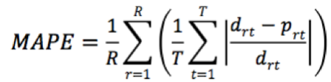
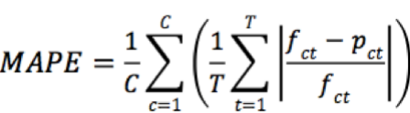
Evaluation Metrics

Slide 6
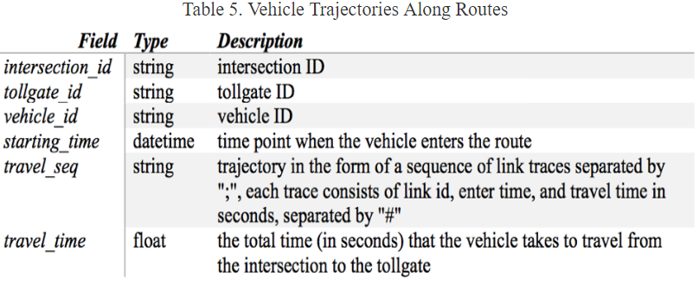
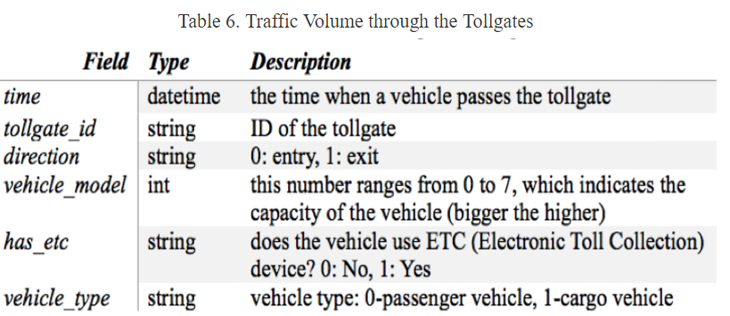
109245 records

Slide 7
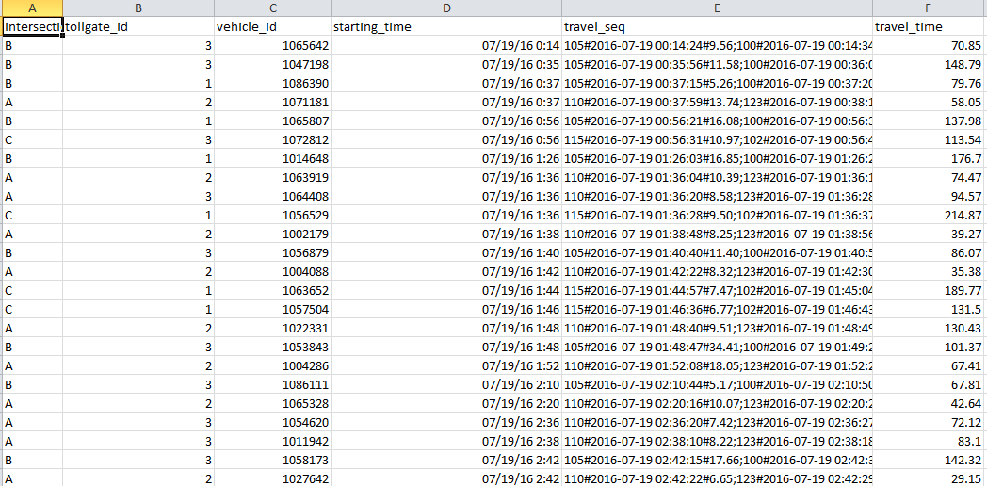
What raw data look like

Slide 8
My Method
Ave_{t0}, Ave_{t1}, Ave_{t2}, Ave_{t3}, Ave_{t4}, Ave_{t5}
Next six 20 minutes Ave Time predictions
FC (6)
Conv3 (48,3 x 1)
Example CNN
Conv2 (48,3 x 1)
Conv1 (64,1 x M)
Record 1
Record 2
:
Record n
Mean Entire time
STD Entire time
Mean Travel time
STD Travel time
Links Travel time 1
. . .
M (219)
Links Travel time n
Data within the time interval
(1,5,10 minutes)
…
T(0)
T(1)
T(n)
2 Hours Features

Slide 9
Problem
Data is sparse
Not every time interval has recorded data
My solution
Fill with zero vectors

Slide 10
Possible improvement on features
Set a fix length (200) matrix (car record for each column)
Use all records (all routes) info for training and predict.
Advantage : more data, raw level data (less feature engineering ?)

Slide 11
Suggestions ?

Slide 12
To-Do list
Use all data to train model
Then, use 5-7am, 15-17pm data to fine tune
the model
2. Fine-tune two separated models for weekdays and weekends, respectively.
3. Gated CNNs to put more attention on recent time span(recent 1 hour?)
RNN to auto-encode focus on most resent data , then fine-tune on training data
Embedding sparse input vector
Add weather information
Use 1,5,10 time interval feature concurrently.
Put raw data into matrix directly

