Slide 1
Analytical Queries with Hive: SQL Windowing, and Table Functions
Prajakta Kalmegh, Harish Butani, SAP

Slide 2
Agenda
Why
What are Partitioned Table Functions (PTFs)?
Why are they interesting?
What
Our solution
Demo
How
Details in the Hadoop Summit talk
Next steps and Summary
Notes:
PTF is the main concept of this talk

Slide 3
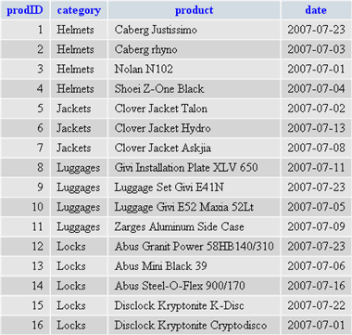
3 SQL concepts
1. Table Function
2. Partitioned Table Function
Enable User Defined Functions in the Query Data Flow
Contract for TF is Table-In/Table-Out
So opens up analysis beyond row calculations and aggregations
Syntactically function can appear anywhere a Table can in SQL.
Is a TF that processes its input by dividing it into Partitions
Processing of Partitions don’t communicate.
Intuitively like MR: processing PTF done as MR jobs.
Project
Project
Partitions Out
tableOut
Table Function
Table Function
tableIn
Partitions In
Join
Join
Select
Select
3. Windowing
Select
Select
Operate on a set of rows surrounding the current row
Windows defined like ‘5 preceding and 4 succeeding’
On the window allow aggregations; and also Navigation: lead, lag, First, Last
current
row
PTFS and Windows related
Windows imply Order
And in SQL Windows defined within Partitions.

Slide 4
If you want to do Ranking
Rank Parts within Manufacturer by price
Part
On TPCH Part table
Rank Parts within each Manufacturer by Price
MfrName | PartName | Price
Manufacturer#1 | violet almond orange lavender peach | 2095.99
Manufacturer#2 | yellow magenta gainsboro almond turquoise | 2094.99
Manufacturer#2 | papaya cream smoke yellow khaki | 2095.99
Manufacturer#1 | pink orange peach beige steel | 2094.99
Not so straightforward w/o windowing.
A possible multi step soln.:
Rank over all Rows: (Mfr, Part, Overall Rank)
Rank Min Query: (Mfr, Min(Rank) )
Join 1 & 2 on Mfr, subtract Rank from Min(Rank)
In Oracle:
Select Dept, Name,
RANK() OVER
(PARTITION BY DEPT ORDER BY SALARY DESC)
as Erank
From Employee
Manufacturer#1 | violet almond orange lavender peach | 2095.99 | 1
Manufacturer#1 | pink orange peach beige steel | 2094.99 | 2
Manufacturer#2 | papaya cream smoke yellow khaki | 2095.99 | 1
Manufacturer#2 | yellow magenta gainsboro almond turquoise | 2094.99 | 2

Slide 5
If you want to do: Time Series Analysis
Time Series Analysis on Flights Data
Flights(FLNum, OriginCity, Year, Month, Day, Arr_Delay)
Identify Flights that are often late.
To do this: one conceivable statistic to compute is to list occurrences of ‘late’ behavior.
For e.g. ‘being late 3 or more times in a row’
Use a PTF: NPath
Helps you look for patterns in Time
User specifies Labels: interesting conditions, for e.g. LATE : arr_delay > 15 mins
Then specifies Patterns on Labels. Patterns are simple Regexes. For e.g.
LATE.LATE.LATE+ → look for occurrences where a flight is 3 or more times late.
On Occurrences found (Occurrences are a set of rows) specify aggregation calculations. For e.g.
Average Delay among late occurrences
Number of delays
Note
This is a non trivial function to implement.
But from User point of view just another Function invocation. Can specify Function behavior through arguments

Slide 6
PTF Example: NPath
Find incidents where a Flight has been more than 15 minutes late 5 or more times in a row.
1. Query on FlightsData table,
In Aster: (sort of, syntax and parameters maybe incorrect)
select origin_city, fl_num, year, month, day_of_month, avgDelay, numOfDelays
from NPATH( Flights,
partition by fl_num
order by year, month, day_of_month,
[LATE : arr_delay > 15],
'LATE.LATE.LATE.LATE.LATE+',
[
( (path.sum() { it.arr_delay})/((double)count), "double", "avgDelay“),
(count, "int", "numOfDelays“)
]
)
2. Looking at data per Flight; order within partition by time
4. This is very hard in SQL. Remember the LABEL and PATTERNS are specified at Query execution time. So window of analysis is dynamic.
3.
Arg. 3 specify conditions as LABELS
Arg. 4 specify PATTERN
Arg. 5 specify AGGR. EXPRESSIONS
Origin | FlNum | Year | Month | Day | AvgDelay | NumOfDely
Boston | 1017 | 2010 | 10 | 25 | 59.37 | 8
Boston | 1017 | 2010 | 10 | 26 | 58.14 | 7
Boston | 1017 | 2010 | 10 | 28 | 30.83 | 6
Boston | 1017 | 2010 | 10 | 29 | 25.67 | 5
Pittsburgh | 1058 | 2010 | 12 | 26 | 82.62 | 8

Slide 7
Kinds of Analysis possible
Windowing based:
Aggregation, Ranking, Navigation
Cumulative Sums
Delta Analysis
Ratios
Inter row Calculations → Time Series Analysis
Find occurrences where a flight was more than 15 mins. late, five or more times in a row
Anything that fits the Table In – Table Out model:
For e.g. Aster SQL/MR Function Library
Time Series Analysis
Graph Analysis
Fraud Detection
Sessionization
…

Slide 8
Goal: make life easier for App. Developers
Sessionization
Clustering
Collaborative Filtering
Fraud detection
Time Series Analysis
Churn Analysis
1. Users want to do
HQL + PTF
4. PTF help bridge the gap
SQL interface with Table Functions.
OOB set of Functions for Mining, Graph processing, Time Series analysis
A mechanism to add new functions and bridge to new runtimes.
PTF Mechanics
Partition Function
runtime
Integration with
Giraph, Mahout, Haloop etc.
OOB Function
Library
2. But Hadoop is a toolkit not a Application Platform
HQL, Pig Latin, Giraph API, Mahout API, Custom API
3. In other DBs App developers comfortable with SQL. + Table Functions
Hadoop Cluster
Giraph
Custom MR
Jobs
Pig
Hive
Mahout

Slide 9
Our Solution + Demo

Slide 10
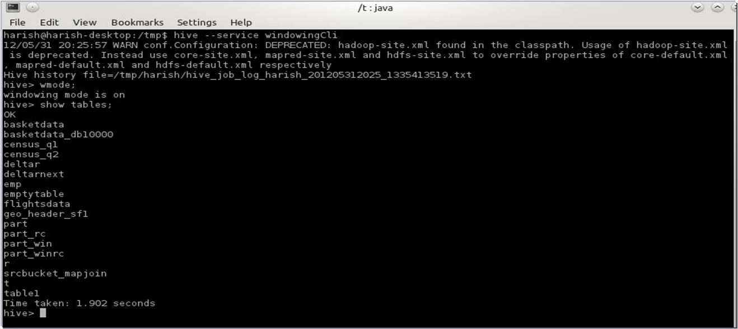
To use
Download jar from https://github.com/hbutani/SQLWindowing/wiki
Setup windowingCli.sh in bin/ext directory
Use in CLI mode
Also usable from API

Slide 11
2 additional Query Forms
From clause is a Table Function Invocation
Select and Where apply on Table Function output
Table Function call has :
Input is Hive Table, Query or another PTF => can chain PTFs
Specify partitioning and order of Input
Other Function Args.
Input can be:
Hive Table
Hive Query
Another PTF
From PartitionedTableFunction(
Input Specification
Partition by …
Order by …
Function Arguments…
)
Select (ColumnName | Expression)+
Where Expression
Not shown here:
Output of Query can be written to Hive Table or Partition

Slide 12
Windowing Clauses form
From Input Specification,
Partition by …
Order by …
with
windowing clause….,
windowing clause…
Select (ColumnName | Expression)+
Where Expression

Slide 13
Runtime characteristics
Relies on Groovy for expressions. (in the e.g. things within <>)
Expressions can apply
at Function invocation time: once per Partition
or they can apply on each row of a Partition: enables dynamic behavior
But Groovy is being phased out.
Very close to transitioning to using Hive Expressions.
Will come back to this in the Next Steps section

Slide 14
Demo
Ranking
NPATH table function
Advanced Windowing
CandidateItemSet table function

Slide 15
Summary and Next Steps

Slide 16
Our Solution: What’s available
Windowing Functions
21 functions available
For Ranking, Aggregation, Navigation and Statistics
Both Row based and Value based windows.
PTFs
Npath, Forecast, Timeline, CandidateItemSets
Others in the works: Allocation, Deallocation etc
See wiki for details.

Slide 17
Available very soon: new style queries
Checkout hive-rt branch
More standard SQL
Hive Expressions and Evaluators (Groovy is gone)
UDAFs are Windowing functions: introduced few new UDAFs
Arguments can be any Hive expression
Executed using Hive MR framework, not our custom Jobs.
select p_mfgr,p_name, p_size,
rank(p_size / 2 + 7) as r,
denserank() as dr,
cumedist() as cud,
sum(p_size) over rows between unbounded preceding and current row as s1,
sum(p_size) over range between p_size 5 less and current row as s2,
first_value(p_size, 'true') over w1 as fv1
from part
partition by p_mfgr
order by p_mfgr, p_name
where p_size > 5 and p_mfgr like 'abc%'
window w1 as rows between 2 preceding and 2 following

Slide 18
Next Steps
Fold into hive
New style queries
Introduce ‘execute PTF’ directly in HQL
Do AST transformations of HQL queries containing PTF invocations to a series of queries: one or more of these will be our style queries.
More functions.
Multi pass mechanics for iterative/recursive functions.
Market Basket Analysis
Clustering
Graph Algorithms
Bridge to Mahout, Giraph

Slide 19
PTFs: bottom-line
Enable more interesting Questions more simply in the SQL context
enable analysis not expressible in SQL
Simplify expressing analysis
Foster Reuse by providing Function Libraries and bridging to external engines.
App. Developers expect and rely on this in other DBs.
Our solution:
An attempt to provide this for Hive
Still under development

Slide 20
More information
More details/download at https://github.com/hbutani/SQLWindowing/wiki
More details in Hadoop Summit talk
Slides at http://www.slideshare.net/Hadoop_Summit/analytical-queries-with-hive
Video at: http://www.youtube.com/watch?v=CV-M8CBEyM0
Contact:
Harish Butani: harish.butani@sap.com
Prajakta Kalmegh: prajakta.kalmegh@sap.com

Slide 21
Appendix

Slide 22
If you want to Chain Analysis
Chain these things
Continuing Flight e.g.
Once Late Occurrences are identified:
for each City Rank Flights by ‘Number of Delays’, show the top 10.
SQL syntax is not exact:
select TOP(10) origin_city, fl_num, year, month, day_of_month, avgDelay, numOfDelays,
Rank() OVER (PARTITION BY OriginCity ORDER BY NumOfDelays DESC) as Drank
from NPATH( Flights
partition by fl_num
order by year, month, day_of_month,
….. Specify a Time Pattern and other args ……
)
Notes:
PTF is the main concept of this talk

Slide 23
Further: kinds of Analysis possible
A mechanism to bridge to other engines:/algorithms Graph, Machine Learning etc.
Multi Pass Algorithms → Market Basket Analysis
Find items bought frequently together
Find Web pages visited in the same session
Graph Algorithms → implemented as Recursive Queries
Find lowest cost flights between two cities
… exposed in SQL as Table Function invocations
More details on this in the Hadoop Summit talk

Slide 24
Query Example: Top N
Calculate the Top 3 Tracts(based on land area) by County.
Census Geo Header data:
Geography dimension for Census data.
Contains data from multiple hierarchies and levels.
Query on County-> Census Tract -> Census Block hierarchy
Summary Level column used to identity level
County | Tract | AreaLand | SumLev
001 | 451101 | 300 | 140
001 |  | 1200 | 120
005 | 000102 | 35 | 140
004 | 000200 | 15 | 140
from GEO_HEADER_SF1_sumlev140
partition by county
order by arealand desc
with rank() as r,
sum(arealand) over rows between unbounded preceding
and current row as cum_area,
sum(arealand) as overall_area
select county, name, arealand, r, cum_area,
<arealand/overall_area * 100.0> as percent_of_county
where <r <= 3>
1. Only output top 3 rows from each partition.
2. Sum from start of Partition up to Current row.
3. Compute a Ratio

Slide 25
Market Basket Analysis
Input is a large set of Baskets, each contains a set of Items
Find Items that occur frequently together.
Popular Alg. Starting point of Associative Mining.
No Standard Form. But typical structure is:
from FrequentItemSets(
Basket
partition by basketId order by itemName,
supportThreshold= 0.15)
select itemset
Support threshold: controls what constitutes a Frequent ItemSet
Basket
ItemSets
{"items":["apples","baguette"]}
{"items":["apples","corned_b"]}
{"items":["apples","hering"]}
{"items":["apples","olives"]}
{"items":["apples"]}
BasketId | ItemName
1 | Apples
1 | Baguette
2 | Apples
2 | Avocado
2 | Olives

Slide 26
Implementation: relation to Hive
Currently
Very Soon
hive-rt branch
Query
Query
Translator
Hive MetaData
Translator
Custom MR Job
Hive MR Job
Map or Reduce Task
Map or Reduce Task
SerDe
SerDe
SerDe
SerDe
Wdw. and Table Fns. in Groovy
Groovy expressions
Hive Exprs
Wdw Fns are UDAFs
New Fn Type: PTF
Hive Operators: new PTFOp
Hive Map and Reduce Task
HDFS
HDFS

