Slide 1
Analytical Queries with Hive: SQL Windowing, and Table Functions
Harish Butani, SAP

Slide 2
Agenda
Why
What are Partitioned Table Functions (PTFs)?
Why are they interesting?
What
Our solution
Demo
How
Our Implementation, briefly
Expand on concept of PTFs:
Multi Pass and Recursive Algorithms
Next steps and Summary
Notes:
PTF is the main concept of this talk

Slide 3
What are PTFs?

Slide 4
What are PTFs
Are Function invocations that can appear in place of a table in SQL.
Contract is Table in → Table out.
Input is partitioned (optionally ordered) .
An instance of a PTF operates on a Partition.
Partitioning drives parallel execution
Similar to MR, but predates MR.
Available in many DBs: Oracle, Aster, DB2 etc.

Slide 5
Analytics expressed using PTFs
Aggregations by Partition → Ranking, Top N.
Rank products within manufacturer by price
List three largest census tracts by area within each US county
Inter row Calculations → Time Series Analysis
Find occurrences where a flight was more than 15 mins. late, five or more times in a row
Multi Pass Algorithms → Market Basket Analysis
Find items bought frequently together
Find Web pages visited in the same session
Graph Algorithms → implemented as Recursive Queries
Find lowest cost flights between two cities
… exposed in SQL as Table Function invocations

Slide 6
Analytics expressed using PTFs
Aster SQL/MR Function Library
Time Series Analysis
Graph Analysis
Fraud Detection
Sessionization
…

Slide 7
PTFs: bottom-line
Enable more interesting Questions more simply in the SQL context
enable analysis not expressible in SQL
Simplify expressing analysis
Foster Reuse by providing Function Libraries and bridging to external engines.
App. Developers expect and rely on this in other DBs.
Our solution:
An attempt to provide this for Hive
Still under development

Slide 8
PTF Invocation Example
Example: Market Basket Analysis
Input is a large set of Baskets, each contains a set of Items
Find Items that occur frequently together.
No Standard Form. But typical structure is:
from FrequentItemSets(
Basket
partition by basketId order by itemName,
supportThreshold= 0.15)
select itemset
From clause invokes PTF: FIS
Fn. told how to partition and order Input
Other Args.: Support threshold in this case
No change in other parts of SQL
Basket
ItemSets
{"items":["apples","baguette"]}
{"items":["apples","corned_b"]}
{"items":["apples","hering"]}
{"items":["apples","olives"]}
{"items":["apples"]}
BasketId | ItemName
1 | Apples
1 | Baguette
2 | Apples
2 | Avocado
2 | Olives

Slide 9
SQL Windowing
Used to express Aggregations on Partitions
Further Window expressions enable aggregations on a Window surrounding a row. So row specific Aggregations.
Functions available:
Ranking: Rank, DenseRank, PercentRank, NTile
Aggregation: Sum, Min, Max, Avg, StdDev, Variance
Navigation: First Value, Last Value, Lead, Lag
Statistics: CoVariance, Linear Regression: Slope, Intercept
Enable expressing
Cumulative Sums
Delta Analysis
Ratios

Slide 10
SQL Windowing, as a PTF
Simple Example:
Group Sales data by Channel and Month
Within each Channel: compute Rank, DenseRank, for each Month by sales amount
Also compute Rank over all Months across Channels
select channel, month, sum(amount),
rank() over (order by sum(amount) desc) AS ra,
denserank() over (partition by channel order by sum(amount) desc) as dr,
rank() over (partition by channel order by sum(amount) desc) as r
From sales
Group by channel, month;
Key Observation:
Processing happens in 3 stages
First everything else is executed: join, group by, and having clauses
Result Set is made available to Windowing Functions: Partition by Partition.
Similar to how PTFs are executed!

Slide 11
SQL Windowing, as a PTF
If all windowing clauses have the same
partition & order expression,
then this can be expressed as a PTF
1. Assume Rank on all rows not in original Query
select channel, month, r, dr
denserank() AS dr,
rank() as r
From <Group By Query>
partition by channel order by sum(amount)
2. Form makes explicit: first everything else is executed; then do Windowing calculations.
In PTF form
Assume a PTF fn. called WindowingTableFunction
Input is the Group By Query
Args. to function are Windowing Clauses
select channel, month, s, r, dr
From WindowingTableFunction(
<select channel, month, sum(amount_sold) as s
from sales
Group by channel, month>
partition by channel
order by s,
[r : <rank()>, dr: <denserank()>] )
Our Solution:
Windowing Clause Support at this level
Can easily add multiple order support
Multiple partition support requires more thought

Slide 12
Our Solution

Slide 13
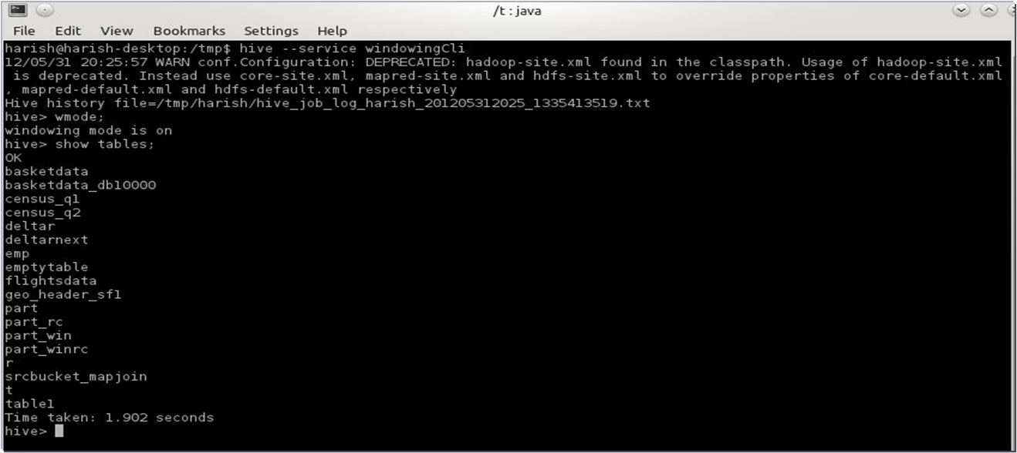
PTFs with Hive
To use
Download jar from https://github.com/hbutani/SQLWindowing/wiki
Setup windowingCli.sh in bin/ext directory
Use in CLI mode
Also usable from API

Slide 14
PTFs with Hive CLI
Windowing CLI
Hive CLI
Hive
Translator
Windowing Shell
In CLI enter HQL or PTF Queries
WindowingCLI embeds Hive
HQL passed to Hive
Windowing CLI interacts with Hive for metadata and executing embedded Hive Queries
PTF works in a similar fashion to Hive
Translates Queries into MR jobs
Metadata
Hive callbacks:
- Metadata
- Execute Embedded Hive Queries
Execute PTF Queries as MR jobs
Execute Hive Queries as MR jobs
Cluster

Slide 15
Query Structure
Query abstraction is a select statement:
Input is a Table Function Invocation
Filter & Project on Table Function output
Table Function call:
Input is Hive Table, Query or another PTF => can chain PTFs
Specify partitioning and order of Input
Other Function Args.
Input can be:
Hive Table
Hive Query
Another PTF
From PartitionedTableFunction(
Input Specification
Partition by …
Order by …
Function Arguments…
)
Select (ColumnName | Expression)+
Where Expression
Not shown here:
Output of Query can be written to Hive Table or Partition
Can this form be a SubQuery in HQL? Not yet.

Slide 16
Query Structure: Windowing Clauses
1. Windowing Clauses one variation to Simple Query form
From Input Specification,
Partition by …
Order by …
with
windowing clause….,
windowing clause…
Select (ColumnName | Expression)+
Where Expression
Syntactic sugar for
From WindowingTableFunction(
Input Specification
Partition by …
Order by …
Windowing Clauses …
)
Select (ColumnName | Expression)+
Where Expression

Slide 17
Query Examples: Basic Query
Rank Parts within Manufacturer by price
Part
On TPCH Part table
Rank Parts within each Manufacturer by Price
MfrName | PartName | Price
Manufacturer#1 | violet almond orange lavender peach | 2095.99
Manufacturer#2 | yellow magenta gainsboro almond turquoise | 2094.99
Manufacturer#2 | papaya cream smoke yellow khaki | 2095.99
Manufacturer#1 | pink orange peach beige steel | 2094.99
Not so straightforward w/o windowing because no inter row expressions
Rank over all Rows: (Mfr, Part, Overall Rank)
Rank Min Query: (Mfr, Min(Rank) )
Join 1 & 2 on Mfr, subtract Rank from Min(Rank)
from part_rc
partition by p_mfgr
order by p_mfgr, p_retailprice desc
with
rank() as r
select p_mfgr,p_name, p_retailprice, r
Manufacturer#1 | violet almond orange lavender peach | 2095.99 | 1
Manufacturer#1 | pink orange peach beige steel | 2094.99 | 2
Manufacturer#2 | papaya cream smoke yellow khaki | 2095.99 | 1
Manufacturer#2 | yellow magenta gainsboro almond turquoise | 2094.99 | 2

Slide 18
Demo

Slide 19
Query Examples: Top N
Calculate the Top 3 Tracts(based on land area) by County.
Census Geo Header data:
Geography dimension for Census data.
Contains data from multiple hierarchies and levels.
Query on County-> Census Tract -> Census Block hierarchy
Summary Level column used to identity level
County | Tract | AreaLand | SumLev
001 | 451101 | 300 | 140
001 |  | 1200 | 120
005 | 000102 | 35 | 140
004 | 000200 | 15 | 140
from <select county, tract, arealand
from geo_header_sf1
where sumlev = 140>
partition by county
order by county, arealand desc
with
rank() as r,
sum(arealand) over rows
between unbounded preceding and current row as cum_area
select county, tract, arealand, r, cum_area
where <r <= 3>
County | Tract | AreaLand | R | Cum_Area
001 | 451101 | 300 | 1 | 300
001 | 450701 | 250 | 2 | 550
001 | 441503 | 150 | 3 | 700
005 | 000102 | 450 | 1 | 450
005 | 000200 | 200 | 2 | 650
1. Input is a HQL query
3. Only output top 3 rows from each partition.
2. Sum from start of Partition up to Current row.

Slide 20
PTF Example: NPath
Now example of a PTF: NPath
Look for patterns in Time
User specifies Labels: interesting conditions, for e.g. LATE : arr_delay > 15 mins
Then specifies Patterns on Labels. Patterns are simple Regexes. For e.g.
LATE.LATE.LATE.LATE.LATE+ → look for occurrences where a flight is 5 or more times late.
On Occurrences found (Occurrences are a set of rows) specify aggregation calculations. For e.g.
Average Delay among late occurrences
Number of delays
Note
This is a non trivial function to implement.
But from User point of view just another Function invocation. Can specify Function behavior through arguments
Also Query executed in the same way: Partition input, invoke function on each Partition…

Slide 21
PTF Example: NPath
Find incidents where a Flight(to NY) has been more than 15 minutes late 5 or more times in a row.
1. Query on FlightsData table, restrict to flights to NY
from npath(<select origin_city, year, month, day_of_month, arr_delay, fl_num
from flightsdata
where dest_city = 'New York' and dep_time != ''>
partition by fl_num
order by year, month, day_of_month,
<[LATE : "arr_delay \\> 15"]>,
'LATE.LATE.LATE.LATE.LATE+',
<["origin_city", "fl_num", "year", "month", "day_of_month",
["(path.sum() { it.arr_delay})/((double)count)", "double", "avgDelay"],
["count", "int", "numOfDelays"]
]>
)
select origin_city, fl_num, year, month, day_of_month, avgDelay, numOfDelays
2. Looking at data per Flight; order within partition by time
4. This is very hard in SQL. Remember the LABEL and PATTERNS are specified at Query execution time. So window of analysis is dynamic.
3.
Arg. 3 specify conditions as LABELS
Arg. 4 specify PATTERN
Arg. 5 specify AGGR. EXPRESSIONS
Origin | FlNum | Year | Month | Day | AvgDelay | NumOfDely
Boston | 1017 | 2010 | 10 | 25 | 59.37 | 8
Boston | 1017 | 2010 | 10 | 26 | 58.14 | 7
Boston | 1017 | 2010 | 10 | 28 | 30.83 | 6
Boston | 1017 | 2010 | 10 | 29 | 25.67 | 5
Pittsburgh | 1058 | 2010 | 12 | 26 | 82.62 | 8

Slide 22
Our Solution: What’s available
Windowing Functions
21 functions available
For Ranking, Aggregation, Navigation and Statistics
Both Row based and Value based windows.
One Pass PTFs
NPath
Others in the works: Allocation, Deallocation etc. in the bucket of Lightweight Dimensional Analysis: See wiki for details.
Multi Pass PTFs
Market Basket Analysis: using Dynamic Item Set counting Algorithm.
Plans to do Generalized Transitive Closure.
Looking for your input and help implementing others

Slide 23
Our Solution: Query Evaluation

Slide 24
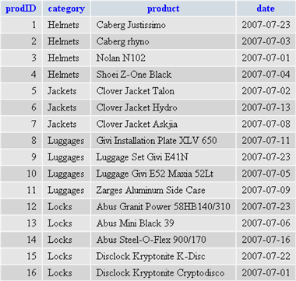
Query Evaluation: a PTF
Hopefully No Surprise
Shuffle to Partition and Sort
PTFs work on Partitions instead of Rows
PTFs use Groovy for expression evaluation today.
Input DataSet
Map Splits
Writables
+
SerDe
Shuffle controlled by partition and order specification
Output
Partition
Partition
A PartitionedTableFunction (PTF) given a Partition computes an output Partition.
An invocation of PTF specifies how input dataset should be partitioned and ordered.
A PTF defines shape of Output.
A PTF may operate on raw data before it is partitioned and ordered.
Writables
+
SerDe
PTF
Writables
+
SerDe
Partitions are containers of Rows.
List of Writables + ObjectInspector
Rows exposed as Groovy Binding; Partition exposed as Groovy iterable.
All Evaluation in context of Row and Partition and optionally Window
For details see doc. directory on GitHub

Slide 25
Multi Pass & Recursive Queries PTFs

Slide 26
Multi Pass and Recursive Queries PTFs
So far
functions perform one pass over the input
function acts on input after it is partitioned.
But other use cases require multiple passes on the input
Since each Partition executed independently:
you may need to consolidate Output
and based on consolidation revisit data.
Recursive Queries used for implementing Graph Algorithms are an important subclass of such problems
In the Context of this talk the focus is:
How do these fit into the PTF model: both from an interface perspective and also from an execution model

Slide 27
Multi Pass PTFs
Key Observation:
Execution model can be extended with following changes:
Partition input and persist
Repeat → a fixed # of iterations or dynamically determined
Map-side: operate on persisted Input partitions; do Partition → Partition
use shuffle to consolidate output across partitions.
Output from one pass read as Input in next pass.
But from Interface Perspective
End User still sees this as a PTF invocation
Multi Pass mechanics still being worked out

Slide 28
Query Evaluation: Multi Pass PTF
Input DataSet
repeat
Map Splits
Partition
Partition
Writables
+
SerDe
PTFmapside
Writables
+
SerDe
Shuffle controlled by partition and order specification
Partition and
optionally order
Partition
Partition
Input to Function is Partitioned.
Function is applied on Map-Side
Shuffle used to collect Output
Process repeated
Pass n reads output from Pass n-1
Writables
+
SerDe
PTFreduceside
Writables
+
SerDe
Output

Slide 29
PTF Example: Market Basket Analysis
Frequent ItemSets computed by doing 2 passes (the SON alg.):
Pass 1 compute Frequent ItemSets for each Partition independently and consolidate across Partitions.
Pass 2 go over input again, eliminate false negatives.
Note: computing Frequent ItemSets is complex
number of possible ItemSets is exponential
Many interesting algorithms: we have implemented Dynamic Item Counting alg.
See wiki for details….
This is not a big jump from 1 pass
Output of Pass 1 is very small relative to input; so no issue of communication cost
Only 2 passes involved.

Slide 30
PTF Example: Market Basket Analysis
Basket
Implementation and Interface needs work:
User exposed to the fact that input initially partitioned. And then output of function is partitioned.
Also Multi Pass mechanics not ready.
BasketId | ItemName
1 | Apples
1 | Baguette
2 | Apples
2 | Avocado
2 | Olives
from candidateFrequentItemSets(
<select * from basketdata
distribute by basketName
sort by basketName, itemName>
partition by itemset order by itemset,
'basketName', 'itemName', <0.15>)
select itemset
from FrequentItemSets(
Basket
partition by basketId order by itemName,
supportThreshold= 0.15)
select itemset
ItemSets
{"items":["apples","baguette"]}
{"items":["apples","corned_b"]}
{"items":["apples","hering"]}
{"items":["apples","olives"]}
{"items":["apples"]}

Slide 31
Recursive Queries as PTFs
Heart of Graph Algorithms is traversal: the discovery and selection of Paths
In SQL context Graph held in Table R(Src., Dest.) and traversal expressed as Relational Operators run iteratively to a fixed point.
Typically until no new Paths discovered.
Lot of work in DB community to parallelize these Algorithms:
Partition work
Reduce communication → naïve impl. will suffer from high comm. cost.
Of late revival of interest:
HaLoop project: Relation based implementation. Based on tweaking MR mechanics: changes to JobTracker and TaskTracker.
Giraph project: Matrix based Direct Algorithms

Slide 32
Recursive Queries as PTFs
In PTF context:
A Graph Algorithm involves
An Input Relation R(Source, Destination)
Output contains Paths that meet a certain criteria.
A Recursive Query is processed in a fashion very similar to a Multi Pass Algorithms
Partition input and persist ← Partition R by Destination
Repeat
operate on persisted partitions ← Do map-side Join of R with newly discovered Paths
use partitioning to consolidate output across partitions. ← partition output of join (the new Paths) by Source. Dedup; output only new Paths.
But for End User still sees this as a PTF invocation
Under the covers could use HaLoop or Giraph to implement Alg.?

Slide 33
PTF Example: Transitive Closure
Flights
Simple example
List all possible Routes
Source | Destination
New York | London
New York | Paris
London | Bombay
London | Dubai
Dubai | Bombay
from transitiveClosure(
<select * from Flights
distribute by Dest>
partition by Src,
‘Src', ‘Dest’)
select Src, Dest
Source | Destination
New York | London
New York | Paris
London | Bombay
London | Dubai
Dubai | Bombay
New York | Bombay
New York | Dubai

Slide 34
PTF Example: Generalized TC
But TC Mechanics can be generalized.
Specify:
Path Joining Condition: how to generate new Paths
Path Attributes: how to calculate Aggregation attributes on Paths → Sets of Edges
Path selection criteria: how to pick from multiple Paths between a Source and Destination.
More Interesting example:
Input: FlightsTable(Src, Dest, ArrTm, DepTm, Cost)
Find me the best routes from any airport in New York to Bombay.
The waits at intermediate points must be between 2 to 5 hours.
Pick the lowest cost flight, but for a direct flight I am willing to pay a $100 premium.
from GeneralizedTC(
<select * from Flights
distribute by Dest>
partition by Src,
SourceColumn,
DestColumn,
Path Joining Condition,
[Path Attributes],
Path selection condition,
select Src, Dest,….
Where …
from GeneralizedTC(
<select * from Flights
where Src = ‘New York’
distribute by Dest>
partition by Src,
‘Src’,
‘Dest’,
Path Joining Condition = <Dest = Path.Src &&
ArrTm <= Path.DepTm - 120 &&
ArrTm >= Path.DepTm - 300>,
Path Attributes = [
totalCost: <sum(Price)>,
hops : <count(*)>
],
Path selection condition = <
p1.cost <= p2.cost ||
(p1.hops == 0 && p1.cost <= p2.cost + 100)
>,
select Src, Dest,….
Where Dest = ‘Bombay’
Google for ‘Shaul Dhar Generalized Transitive Closure in SQL.’
1993 Phd thesis from Univ. of Wisconsin, Madison.

Slide 35
Summary and Next Steps

Slide 36
Benefits
Enable more interesting Questions more simply in the SQL context
enable analysis not expressible in SQL
Simplify expressing analysis
Foster Reuse by providing Function Libraries and bridging to external engines.
App. Developers expect and rely on this in other DBs.

Slide 37
Next Steps
Make Windowing clauses closer to standard SQL
Use Hive Expressions Evaluation at runtime instead of Groovy
So why cannot this be part of Hive?
Yes makes a lot of sense. See wiki for a step-by-step plan.
Build out Multi-Pass and Recursive Query mechanics
Enhance PTF interface. Ensure simple ifc for End User. No leakage of implementation.
Investigate using HaLoop/Giraph as execution model
Flush out function library

Slide 38
More information
More details/download at https://github.com/hbutani/SQLWindowing/wiki
Contact:
Harish Butani: harish.butani@sap.com

Slide 39
Appendix

Slide 40
So Why PTFs?
Usability
Table Functions: enable more interesting Questions more simply
Enable analysis not expressible in SQL
Simplification of existing queries: both syntactically and in performance
replace self-joins with intra row computations
Reusability
Functions are parameterized, so reusable in wide range of contexts
Functions can reshape Output Schema at runtime
Bridge
Since ifc to SQL engine is coarse, execution of PTFs may involve other MPP engines (multi-pass)
Speed
Partitioned Table Functions enable working at scale by breaking down dataset into manageable Partitions

Slide 41
So Why PTFs?
Use Cases:
Time Series Analysis: NPath
Market Basket Analysis
Lightweight Dimensional Analytics
Graph Algorithms: Transitive Closure
Sessionization
SQL Windowing Clauses
Can be treated as a PTF if all windowing clauses are on the same Partition.

Slide 42
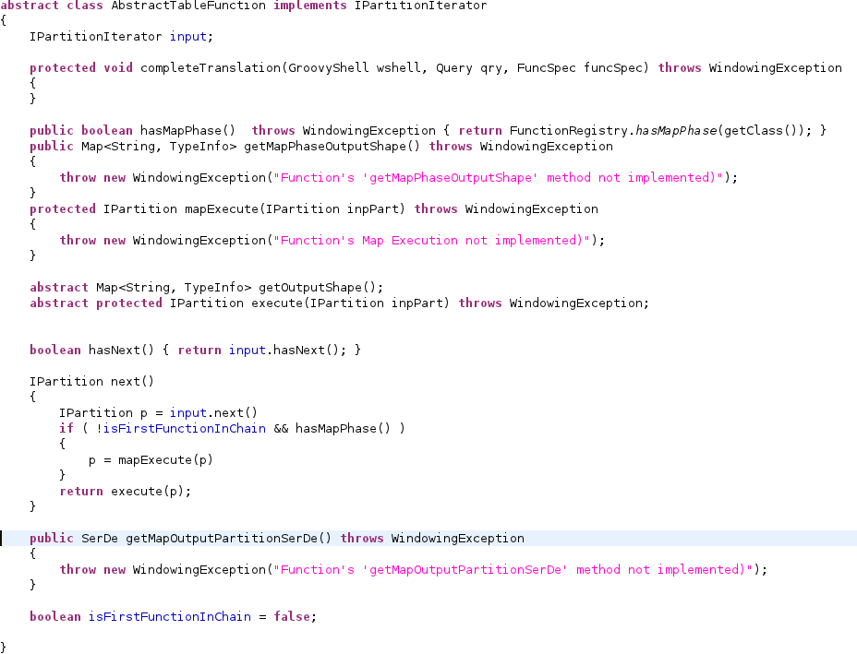
PTF Interface
3. Function may have Map side processing
1.
Controls Shape of Output
Responsible for Output
2. Enables chaining of Functions

Slide 43
Partitioned Table Function Mechanics
Node
Partition input into n partitions, optionally order partitions
distribute over set of processing nodes
execute Fn. at each node
merge data from all instances and stream merged result to next Operator
Input DataSet
Partition 0
Func.
Node
Partition and
optionally order
Partition 0
Next Operator
Func.
.
.
.
Node
Why?
for Performance: enables parallel operation on large datasets
for providing advanced analytics
Partition 0
Func.
This is not the same as Hive UDTF
Supported in many Databases: Oracle, DB2, Aster etc.

Slide 44
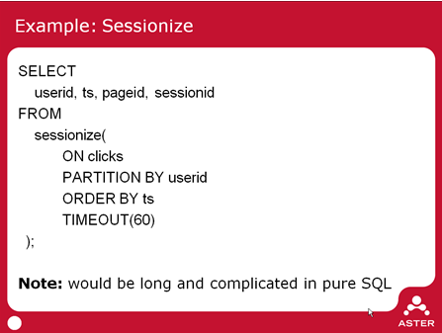
Support in RDBMS: Aster SQL/MR
Problem: Group clickstream data into sessions
Consider all rows of a User as a Partition
Order rows by time
Group rows within 60 seconds of each other as belonging to a Session.
Benefits
Work at Scale: designed to work over 100s of terabytes
Usability and Reusability:
SQL/MR looks like a table, it can appear anywhere a table can appear in SQL
Enable analysis not expressible in SQL
Simplification of existing queries
Functions are parameterized so usable in wide range of contexts.
Aster Function Library
Time Series Analysis
Graph Analysis
Fraud Detection
Sessionization
....

Slide 45
Support in RDBMS : Oracle
FUNCTION test_ptf (p_cursor IN t_parallel_test_ref_cursor)
RETURN t_parallel_test_tab PIPELINED
PARALLEL_ENABLE(PARTITION p_cursor BY HASH (id));
END parallel_ptf_api;
SELECT sid, count(*) FROM TABLE(test_ptf(CURSOR(SELECT * FROM input) ) ) t2 GROUP BY sid;

Slide 46
Hive Script Operators
But one can do PTFs in Hive using Script Operators
From
(From clicks
Select transform(userid, pageid, ts)
Using ‘/bin/cat’
As (userid, pageid, ts)
Distribute by userid
Sort by userid, ts) map_output
Select transform(userid, pageid, sessionId)
Using ‘your java pgm/python script/… pass in args..’
As (userid, pageid, sessionId)
But
Not as Usable
compare to Aster Query
Painful for App. Developer to use. Imagine trying to chain functions.
Not very Reusable
arg passing embedded in strings that spawn process
And implementation artifacts
Data streamed across process boundaries.
Type information passing limited: tab separated files.
Analogy
Integration via stdin stdout
Vs
An embedded Func Library

Slide 47
PTF Example: Hierarchical Evaluation
For a Country, State, City Geo hierarchy compute: % of Country Sales, Top City Sales, Avg. City Sales
from hierarchyEvaluate(
< select Country, State, City, sum(Sales) from Sales group by Country, State, City>
partition by Country
order by Country, State, City,
<['Country', 'State', 'City']>,
<[
["Sales / Ancestor('Country', 'Sales') * 100.0", "% Country"],
["TopN(Descendants('City'), 'Sales', ,1)", "Top City"],
["Avg(Descendants('City'), Sales)", "Avg. City"]
]>)
select Country, State, City, '% Country', 'Top City', 'Avg. City'

Slide 48
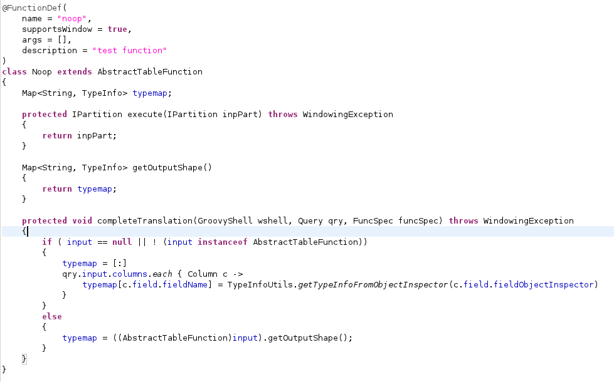
Simple PTF implementation
Annotation specifies Function Args, Name, behavior
Shape based on Function before it in chain; or the Query Input if this is the first function.

Slide 49
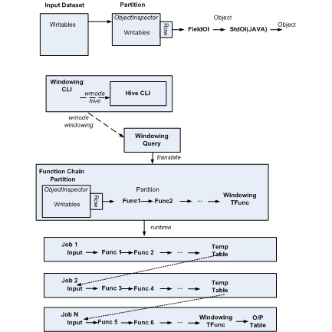
Query Evaluation: complete picture
A Query is a chain of PTFs.
Input of chain is a Hive Query or table
Windowing clauses are syntax sugar for the special Windowing Table function.
Query translated to a series of Jobs. Each Job executes part of the Function Chain
For intermediate steps: the output is written to hdfs and exposed as a Temporary Table to be used by the next Job in the Chain.

Slide 50
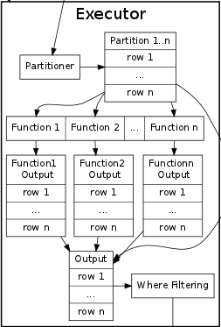
Query Evaluation: Windowing Clauses
Input DataSet
Map Splits
Writables
+
SerDe
Shuffle controlled by partition and order specification
Output
Partition
Partition
Windowing Table Function:
Pass Partition to each Agg. Function
If Window Clause specified, pass a Window also
Collect output from each Agg. Function
Union over all Agg. Functions + Input used to evaluate select list
Writables
+
SerDe
PTF
Writables
+
SerDe

Slide 51
Query Eval.: Market Basket Analysis
Based on the 2 pass SON algorithm as described in the Mining Massive Datasets book.
Job 1
Node
Apply Dynamic Item Counting with support appropriately scaled down.
Output Candidate IS from each Mapper.
Input Basket DataSet
Partition 0
Node
Partition 0
Map
Reduce
.
.
.
Distribute by itemset
Partition by basket
Order by basket, item
Candidate
ItemSets
Job 2
Node
Partition 0
Node
Scan baskets for Candidate Itemsets
Partition 0
Map
Reduce
Final
ItemSets
Distribute by itemset

Slide 52
Query Eval.: Transitive Closure
Sample invocation
From transitiveClosure(<select X, Y from InputTable cluster by Y>
partition by X)
Select X, Y;
In the ith iteration:
On the Map side a partition of T is joined with the corresponding deltaR; this is similar to a MapJoin in Hive. Generates new Paths.
On the Reduce side the new paths from deltaNextR are held in a searchable structure; the rows of the corresponding R partition are streamed to mark any rows in deltaNextR that are duplicates. At the end a new file is stored in the correponding R partition with the new paths
First Pass:
Cluster:
Create ith Partition of R
Distribute by X
Node j
Node i
Map Function:
O/P (X, Row)
ReduceFunction:
O/P Row
R(i, Y)
T(X, i)
repeat
ith Pass:
Cluster:
Read in R(i, Y)
Perform dRnext – R
Add dR rows to R
Create ith deltaR file
in R(i, Y)
Read in dR(I, Y)
Perform dR join T
Node j
Node i
Map Function:
O/P (X, Row)
ReduceFunction:
T(X, i)
3. Distribute by X
Can we use HaLoop or Giraph to do Graph Processing?

Slide 53
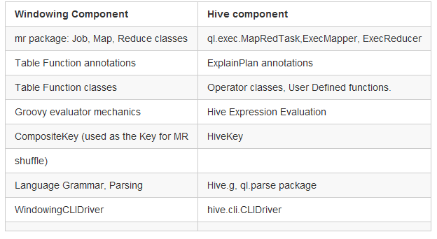
Can this be part of Hive?
There are undeniable reasons for doing this, briefly:
end users would want this functionality inside Hive for reasons of consistent behavior, support etc.
use of a consistent expression language. For e.g. reuse of Hive functions in Windowing clauses.
Implementation wise:
Windowing is orders of magnitude simpler than Hive, and can benefit from using equivalent components that are in Hive.
Avoid the trap of constantly chasing changes in the Hive code base.
Folding in Table function mechanics may open up optimizations not possible with the approach today.

Slide 54
Path to folding into Hive
Possible Path to moving into Hive ( Details here)
Step 1: Move to Hive MR mechanics for Job execution
Step 2: Move to Hive Evaluators and Expressions
Step 3: Introduce the concept of Partition Table Functions in Hive; allow users to invoke PTFs via an exec Function mechanism.
Step 4: Allow Table function invocations to appear in Table Expressions; do AST transformations to translate to HQL followed by exec PTF.
Step 5: Extend HQL with Windowing Clauses

