Slide 1
RDMA
1140379039 刘晓宁
1140379069 李 烁
1140379029 杜振伟

Slide 2
Member’s Roles in This Project
1140379039 刘晓宁
  Design & Coding
  Debugging, Presentation
1140379069 李 烁
  Quality Mangement, Code review, Debugging
  Slides Making
1140379029 杜振伟
  Investigation and research, Debugging
  Documenting

Slide 3
Introduction
What has been done?
  Data transfering between server and client based on socket
  Event channel, shared memory region
  Operation: Read
  Operation: Write
  Request queue & completion queue for client sides
What will be done?
  Send-receive queue on both sides

Slide 4
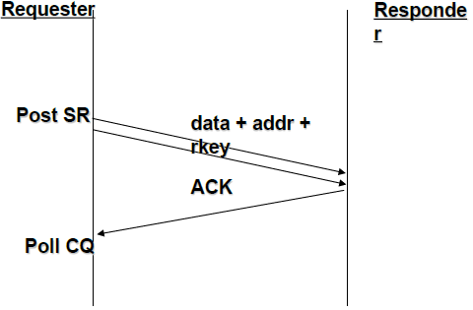
RDMA opcodes: Write
The requester Post Send Request
  Data and remote memory attributes are sent
  Responder is passive
  Immediate data can be used to consume RRs at the responder side
ACK is sent only in reliable transport types

Slide 5
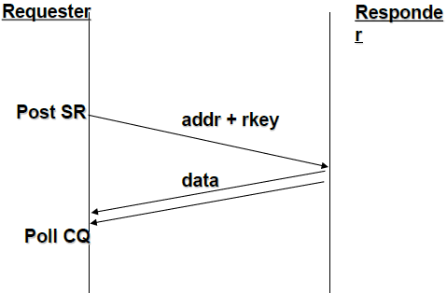
RDMA opcodes: Read
The requester Post Send Request
  Data and remote memory attributes are sent
  Responder is passive
Data is sent from the responder
  Available only in reliable transport types

Slide 6
Demo

Slide 7
offset | data | char
0
1
2
3
4
5
6
7
8
9
10
11
12
13
14
15
16
17
18
19
20
offset | data | char
0
1
2
3
4
5
6
7
8
9
10
11
12
13
14
15
16
17
18
19
20
Client
34 uchar* mem = (uchar*)malloc(memSize * sizeof(uchar));
35 memset(mem, 0, sizeof(uchar) * memSize);
36 res = client.registerMemory(mem, memSize);
Server
41 uchar* mem = (uchar*)malloc(memSize * sizeof(uchar));
42 memset(mem, 0, sizeof(uchar) * memSize);
43 res = server.registerMemory(mem, memSize);

Slide 8
offset | data | char
0 | 0x48 | H
1 | 0x65 | e
2 | 0x6c | l
3 | 0x6c | l
4 | 0x6f | o
5 | 0x20 | [SPACE]
6 | 0x42 | B
7 | 0x6f | o
8 | 0x74 | t
9 | 0x00 | \0
10
11
12
13
14
15
16
17
18
19
20
offset | data | char
0
1
2
3
4
5
6
7
8
9
10
11
12
13
14
15
16
17
18
19
20
Client
Server
46 const char *str1 = "Hello Bot"; // 10 bytes
47 strcpy((char*)mem, str1); // set mem[0] - > mem[9] to string "Hello Bot"

Slide 9
offset | data | char
0 | 0x48 | H
1 | 0x65 | e
2 | 0x6c | l
3 | 0x6c | l
4 | 0x6f | o
5 | 0x20 | [SPACE]
6 | 0x42 | B
7 | 0x6f | o
8 | 0x74 | t
9 | 0x00 | \0
10
11
12
13
14
15
16
17
18
19
20
offset | data | char
0
1
2
3
4
5
6
7
8
9
10
11
12
13
14
15
16
17
18
19
20
Client
Server
48 client.write(0, 0, strlen(str1) + 1); // write local memory mem[0]-mem[9] to remote memory [0]-[9]

Slide 10
offset | data | char
0 | 0x48 | H
1 | 0x65 | e
2 | 0x6c | l
3 | 0x6c | l
4 | 0x6f | o
5 | 0x20 | [SPACE]
6 | 0x42 | B
7 | 0x6f | o
8 | 0x74 | t
9 | 0x00 | \0
10
11
12
13
14
15
16
17
18
19
20
offset | data | char
0 | 0x48 | H
1 | 0x65 | e
2 | 0x6c | l
3 | 0x6c | l
4 | 0x6f | o
5 | 0x20 | [SPACE]
6 | 0x42 | B
7 | 0x6f | o
8 | 0x74 | t
9 | 0x00 | \0
10
11
12
13
14
15
16
17
18
19
20
Client
Server

Slide 11
offset | data | char
0 | 0x48 | H
1 | 0x65 | e
2 | 0x6c | l
3 | 0x6c | l
4 | 0x6f | o
5 | 0x20 | [SPACE]
6 | 0x42 | B
7 | 0x6f | o
8 | 0x74 | t
9 | 0x00 | \0
10
11
12
13
14
15
16
17
18
19
20
offset | data | char
0 | 0x48 | H
1 | 0x65 | e
2 | 0x6c | l
3 | 0x6c | l
4 | 0x6f | o
5 | 0x20 | [SPACE]
6 | 0x42 | B
7 | 0x6f | o
8 | 0x74 | t
9 | 0x00 | \0
10
11
12
13
14
15
16
17
18
19
20
Client
Server
51 client.read(strlen(str1) + 1, 0, strlen(str1) + 1); // read remote memory to local memory

Slide 12
offset | data | char
0 | 0x48 | H
1 | 0x65 | e
2 | 0x6c | l
3 | 0x6c | l
4 | 0x6f | o
5 | 0x20 | [SPACE]
6 | 0x42 | B
7 | 0x6f | o
8 | 0x74 | t
9 | 0x00 | \0
10 | 0x48 | H
11 | 0x65 | e
12 | 0x6c | l
13 | 0x6c | l
14 | 0x6f | o
15 | 0x20 | [SPACE]
16 | 0x42 | B
17 | 0x6f | o
18 | 0x74 | t
19 | 0x00 | \0
20
offset | data | char
0 | 0x48 | H
1 | 0x65 | e
2 | 0x6c | l
3 | 0x6c | l
4 | 0x6f | o
5 | 0x20 | [SPACE]
6 | 0x42 | B
7 | 0x6f | o
8 | 0x74 | t
9 | 0x00 | \0
10
11
12
13
14
15
16
17
18
19
20
Client
Server
53 uchar *memPointer = mem + strlen(str1) + 1;
54 char str2[strlen(str1) + 1];
55 strncpy(str2, (char*)memPointer, strlen(str1) + 1);
56 cout<<"str2: "<<str2<<endl;

Slide 13
offset | data | char
0 | 0x48 | H
1 | 0x65 | e
2 | 0x6c | l
3 | 0x6c | l
4 | 0x6f | o
5 | 0x20 | [SPACE]
6 | 0x42 | B
7 | 0x6f | o
8 | 0x74 | t
9 | 0x00 | \0
10 | 0x48 | H
11 | 0x65 | e
12 | 0x6c | l
13 | 0x6c | l
14 | 0x6f | o
15 | 0x20 | [SPACE]
16 | 0x42 | B
17 | 0x6f | o
18 | 0x74 | t
19 | 0x00 | \0
20
offset | data | char
0 | 0x31 | 1
1 | 0x32 | 2
2 | 0x33 | 3
3 | 0x34 | 4
4 | 0x35 | 5
5 | 0x36 | 6
6 | 0x37 | 7
7 | 0x38 | 8
8 | 0x39 | 9
9 | 0x00 | \0
10
11
12
13
14
15
16
17
18
19
20
Client
Server
59 char newStr[10] = "123456789";
60 strcpy((char*)mem, newStr);

Slide 14
offset | data | char
0 | 0x48 | H
1 | 0x65 | e
2 | 0x6c | l
3 | 0x6c | l
4 | 0x6f | o
5 | 0x20 | [SPACE]
6 | 0x42 | B
7 | 0x6f | o
8 | 0x74 | t
9 | 0x00 | \0
10 | 0x48 | H
11 | 0x65 | e
12 | 0x6c | l
13 | 0x6c | l
14 | 0x6f | o
15 | 0x20 | [SPACE]
16 | 0x42 | B
17 | 0x6f | o
18 | 0x74 | t
19 | 0x00 | \0
20
offset | data | char
0 | 0x31 | 1
1 | 0x32 | 2
2 | 0x33 | 3
3 | 0x34 | 4
4 | 0x35 | 5
5 | 0x36 | 6
6 | 0x37 | 7
7 | 0x38 | 8
8 | 0x39 | 9
9 | 0x00 | \0
10
11
12
13
14
15
16
17
18
19
20
Client
Server
58 cout<<"client begin reading from remote twice"<<0<<" "<<strlen(str1) + 1<<endl;
59 client.read(0, 0, strlen(str1) + 1); // read remote memory [0]-[5] to local memory [6]-[12]

Slide 15
offset | data | char
0 | 0x31 | 1
1 | 0x32 | 2
2 | 0x33 | 3
3 | 0x34 | 4
4 | 0x35 | 5
5 | 0x36 | 6
6 | 0x37 | 7
7 | 0x38 | 8
8 | 0x39 | 9
9 | 0x00 | \0
10 | 0x48 | H
11 | 0x65 | e
12 | 0x6c | l
13 | 0x6c | l
14 | 0x6f | o
15 | 0x20 | [SPACE]
16 | 0x42 | B
17 | 0x6f | o
18 | 0x74 | t
19 | 0x00 | \0
20
offset | data | char
0 | 0x31 | 1
1 | 0x32 | 2
2 | 0x33 | 3
3 | 0x34 | 4
4 | 0x35 | 5
5 | 0x36 | 6
6 | 0x37 | 7
7 | 0x38 | 8
8 | 0x39 | 9
9 | 0x00 | \0
10
11
12
13
14
15
16
17
18
19
20
Client
Server
62 char str3[strlen(str1) + 1];
63 strncpy(str3, (char*)memPointer, strlen(str1) + 1);
64 cout<<"str3: "<<str3<<endl;

Slide 16
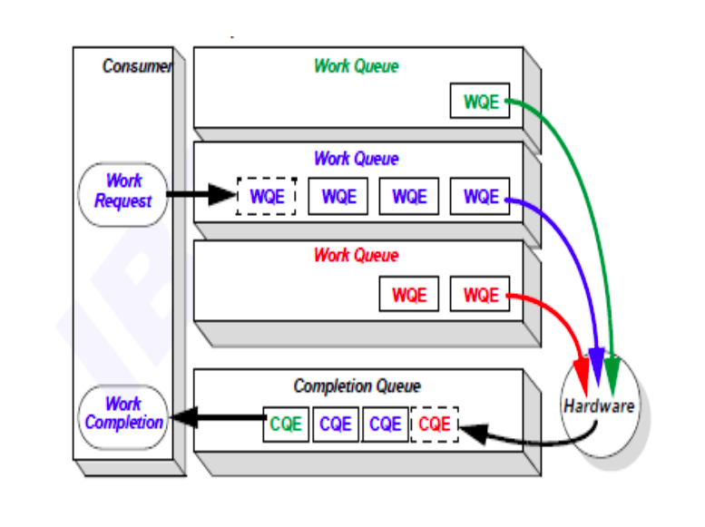
Difficulties & Solutions
TCP Packet splicing(粘包)
  Add 'Ack' between COMMAND and DATA
Confict & Concurrence for server dealing with N clients request
  Locks or other Synchronization mechanism

