Slide 1
Statelite/Aerial Image Retrieval
Xiaopei Zhang A20302816
Yong Yang A20372244
Jiaqi Li A20308642
Lifeng Xu A20346380

Slide 2
The problem
Write a program using Bing maps tile system to automatically download aerial imagery (maximum resolution available) given a lat/lon bounding box.

Slide 3
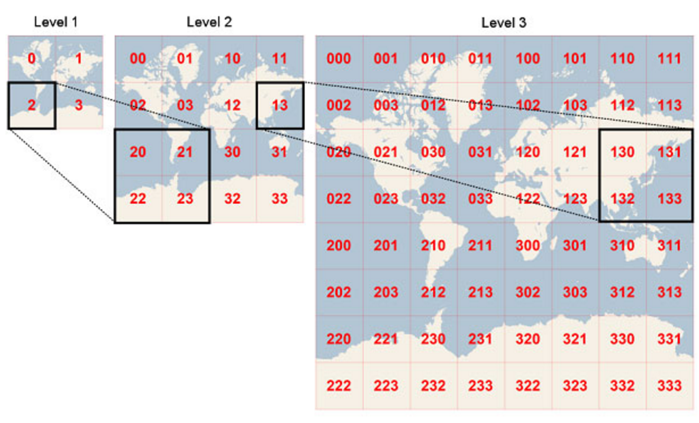
The solution
This is tile form database of map. This can help to speed up searching.

Slide 4
Algorithm
Start from level 1.
Use a recursive function to search the corresponding tile. It will face two conditions whether the bonding area is within a tile or not.
Terminate if next level doesn’t have the certain image and store the maximum level it can get.
Stitch the tiles in the maximum level overlapping with the bounding area and crop the area out of the boundary.

Slide 5
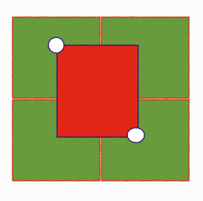
Case 1
Bonding area covers multiple tiles

Slide 6
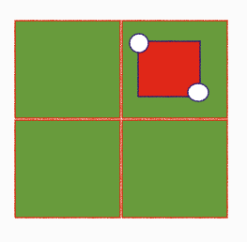
Case 2
Bonding area covers a single tile

Slide 7
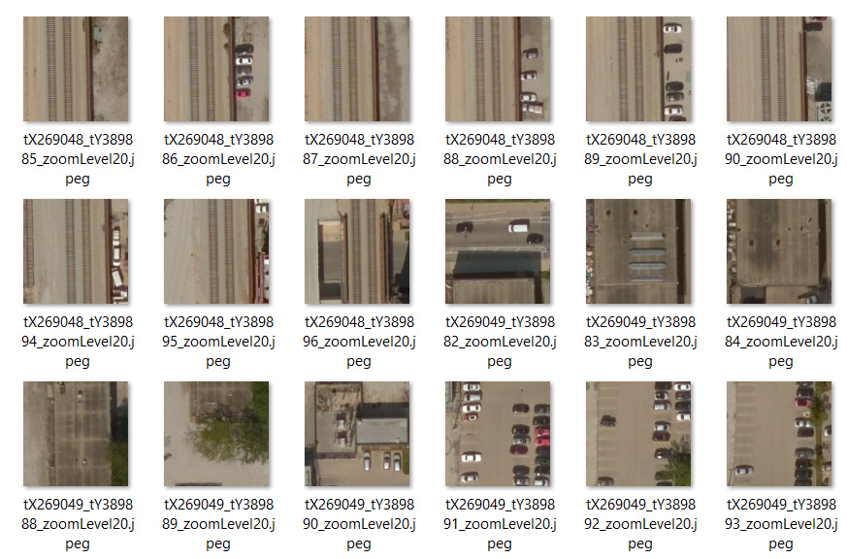
Result 1: All tiles

Slide 8
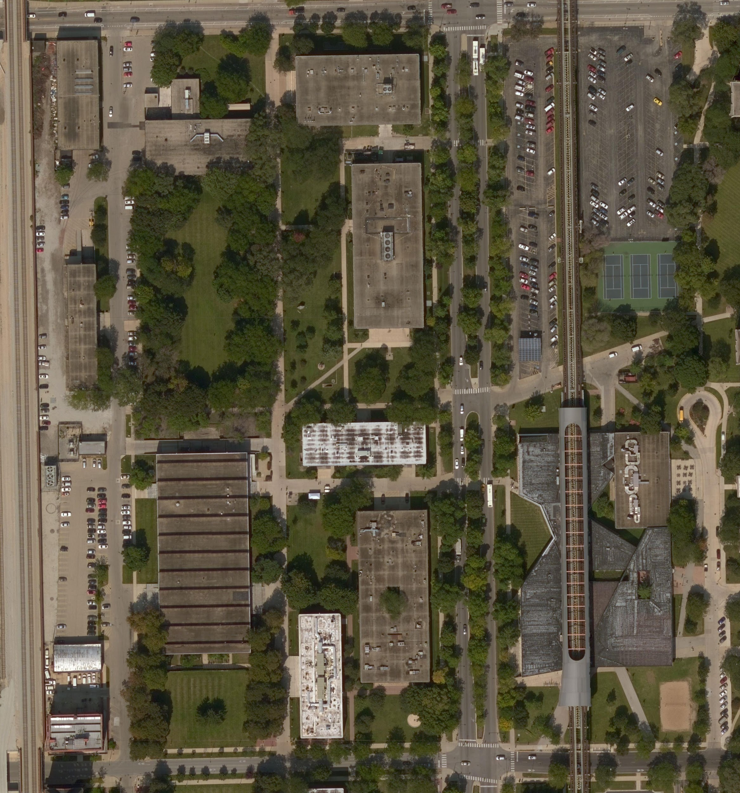
Result 2: stitched

Slide 9
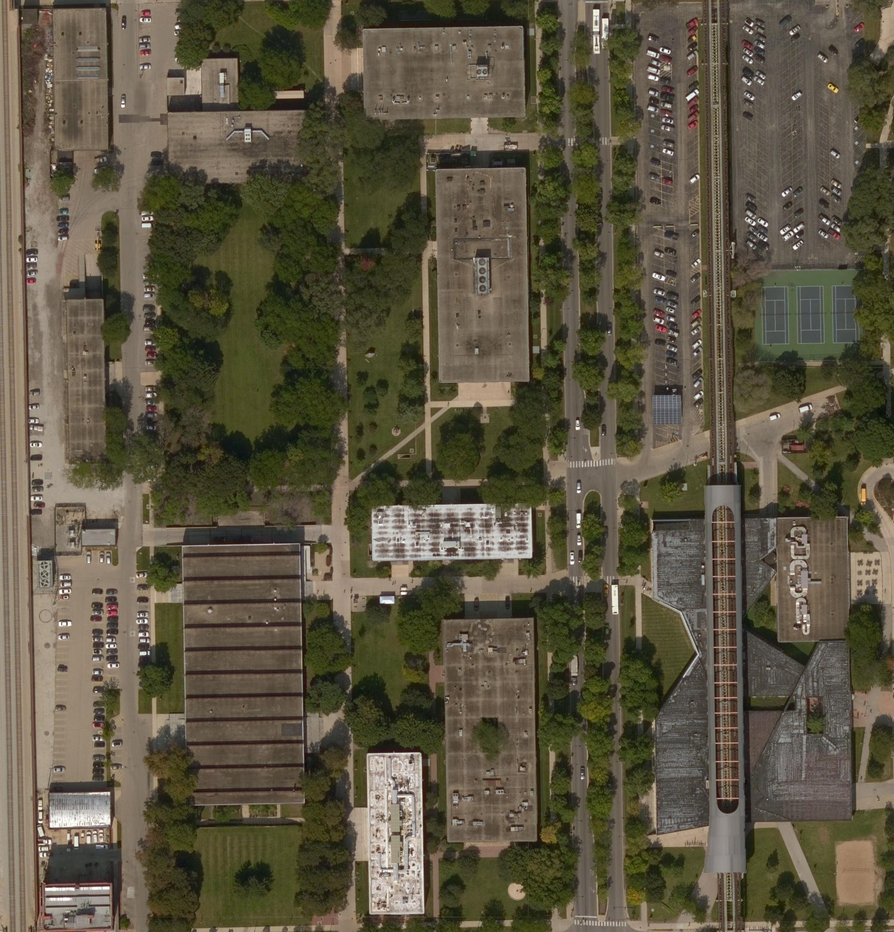
Result 3:cropped

Slide 10
Thanks!

