Slide 1
Tutorial1: Intro to Python & Regression
SDSC2005
Computational Social Science

Slide 2
Content
Python Environment Setting (Slides)
Introduction to Python (Code)
Regression (Code)

Slide 3
Python Environment Setting 1. Python Introduction 2. Python Code Execution

Slide 4

Introduction : What is Python
Python is a clear and powerful object-oriented programming language, comparable to Perl, Ruby, Scheme, or Java.
The world Fastest growing programming language.
Welcome to Python.org

Slide 5
Introduction : What is Python
Some of Python's notable features
Uses an elegant syntax
Is an easy-to-use language that makes it simple to get your program working.
Comes with a large standard library that supports many common programming tasks
Runs anywhere, including Mac OS X, Windows, Linux, and Unix, with unofficial builds also available for Android and iOS.
Free software.
etc.

Slide 6
Introduction : What is Python
Application of Python
Data Analysis
AI/ML
Automation
Web Apps
Mobile Apps
Desktop Apps
Testing
Hacking
Notes:
Multi-purpose language

Slide 7
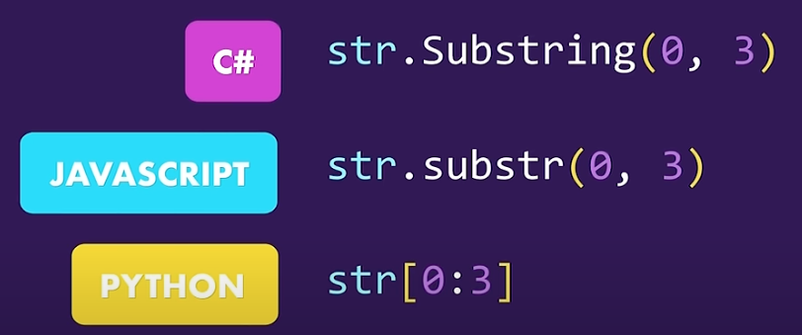
Introduction : Why Python
Reason1: Solve complex problems in less time with fewer lines of code.
Example:
Extract first three letters of “Hello World”.
Reason2: High level
Example:
No need to worry about memory management.
Notes:
Multi-purpose language

Slide 8
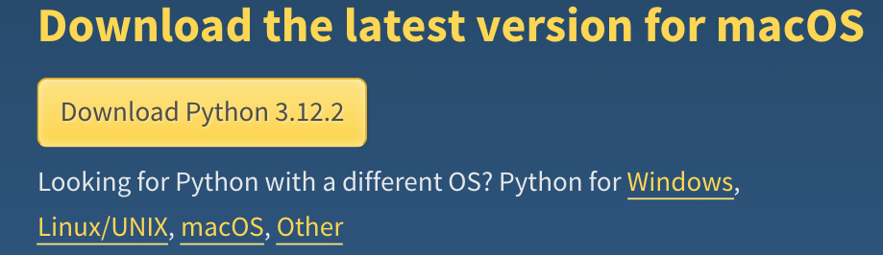
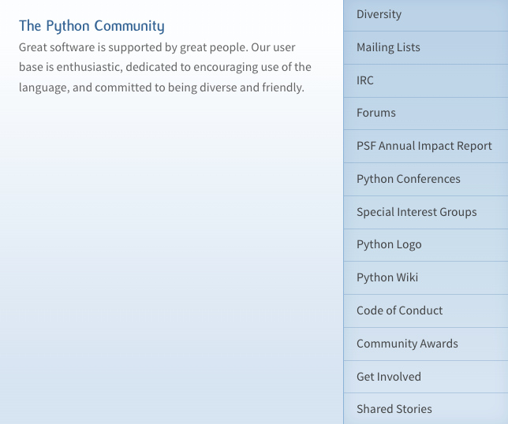
Introduction : Why Python
Reason3: Cross Platform
Example:
Reason4: Large Ecosystem
Example:
Notes:
Multi-purpose language

Slide 9
Python Code Execution
Method1: Execution on personal PC
Method2: Execution online on Google-Colaboratory (Recommended)
Notes:
Multi-purpose language

Slide 10
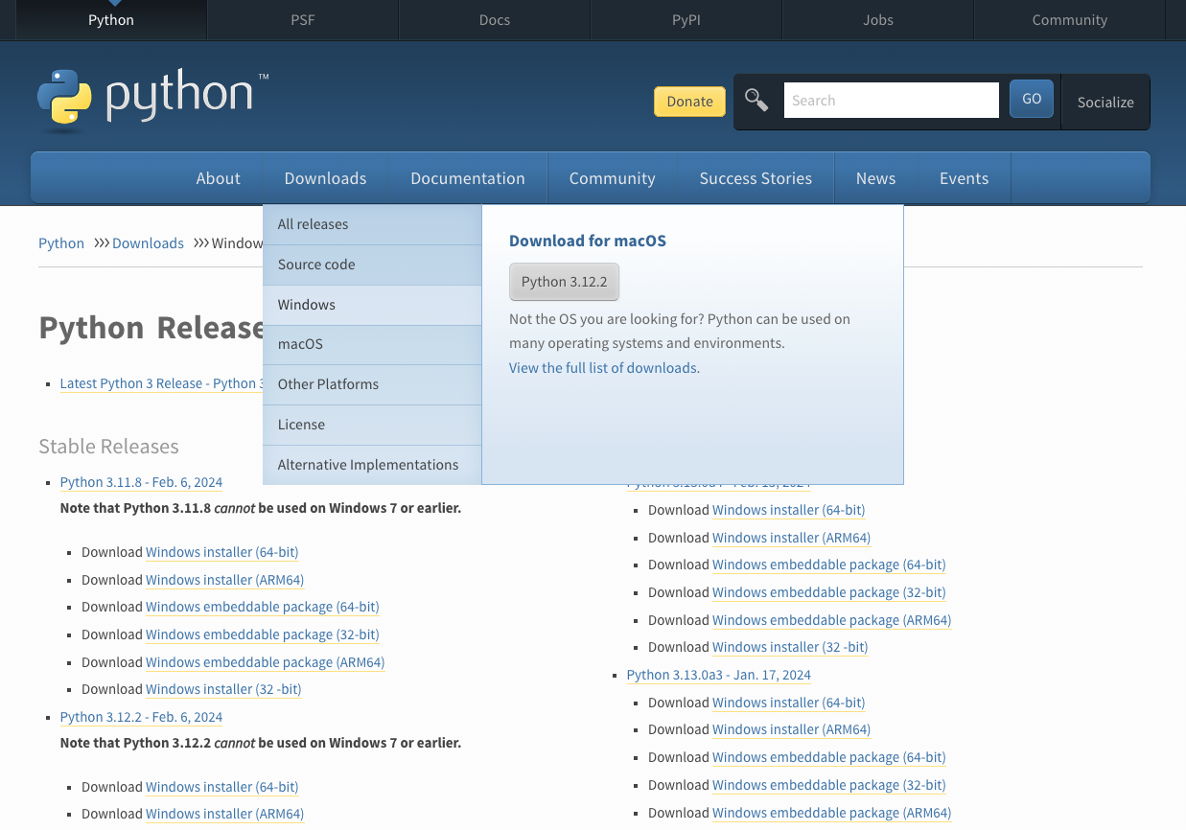
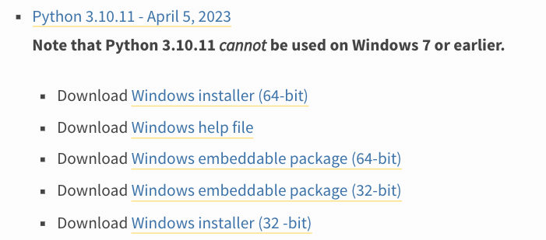
Python Code Execution on Personal PC
Example for Windows
Step1: Open official website(Python Releases for Windows | Python.org), select Downloads-windows
Step2: Choose proper package according to your PC, then download.
Notes:
Multi-purpose language

Slide 11
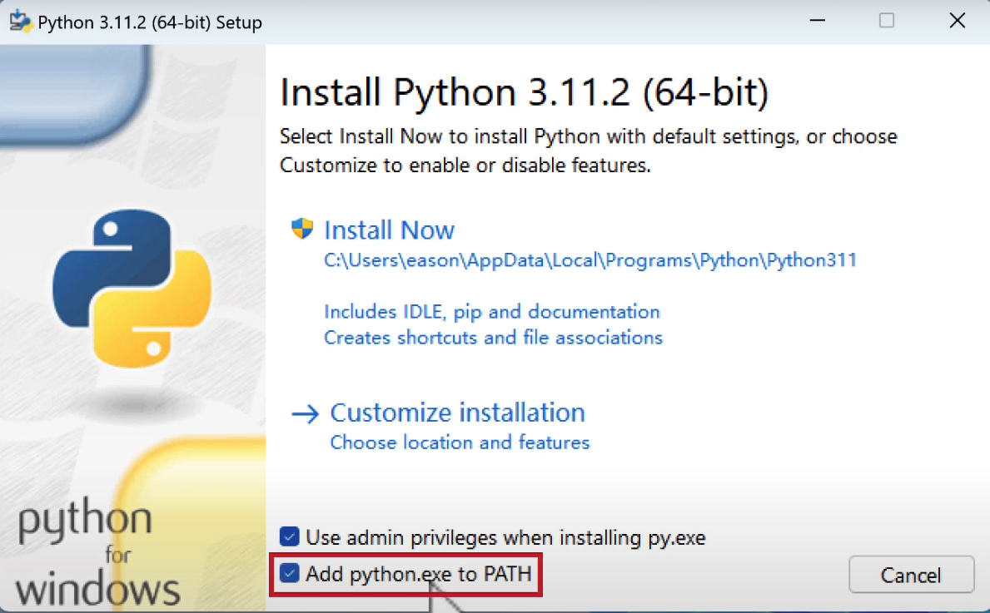
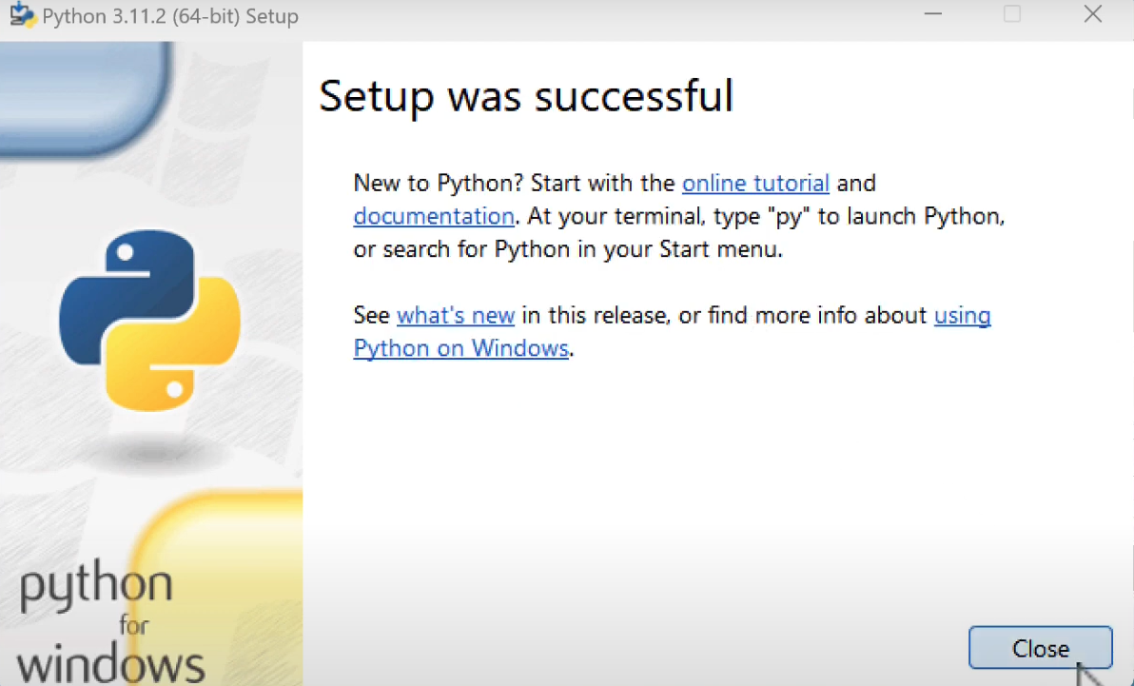
Python Code Execution on Personal PC
Example for Windows
Step3: Install Python. (Remember to Add python.exe to PATH)
Step4: Finish setup.
Notes:
Multi-purpose language

Slide 12
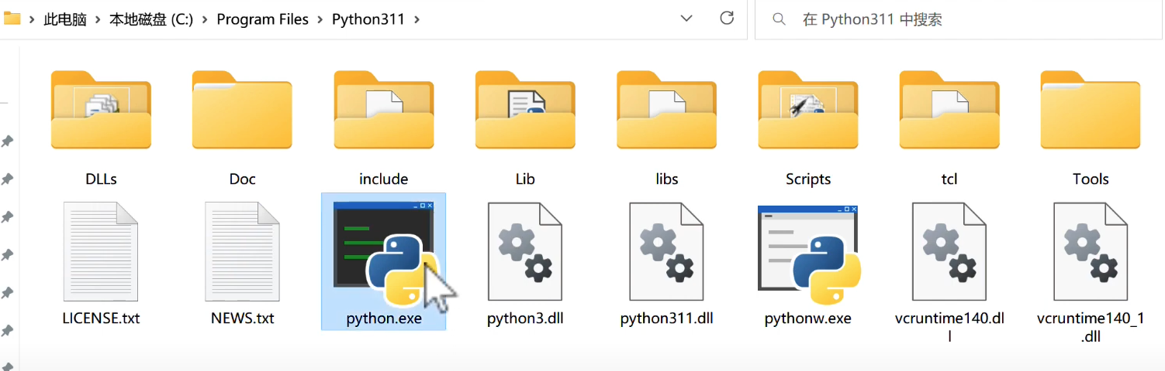
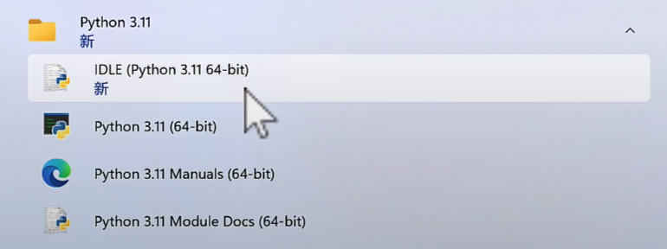
Python Code Execution on Personal PC
Example for Windows
Step5: Check all the files. (If python.exe exists)
Step6: Open IDLE in Control panel.
Notes:
Multi-purpose language

Slide 13
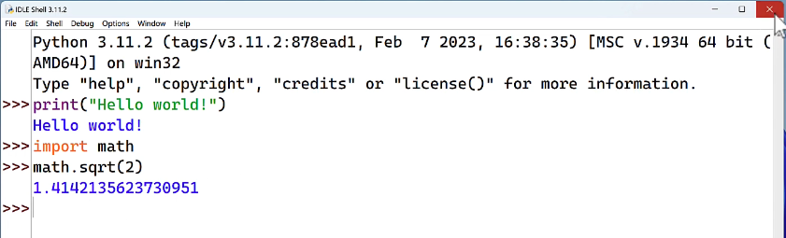
Python Code Execution on Personal PC
Example for Windows
Step7: Type in the following code to execute.
Notes:
Multi-purpose language

Slide 14
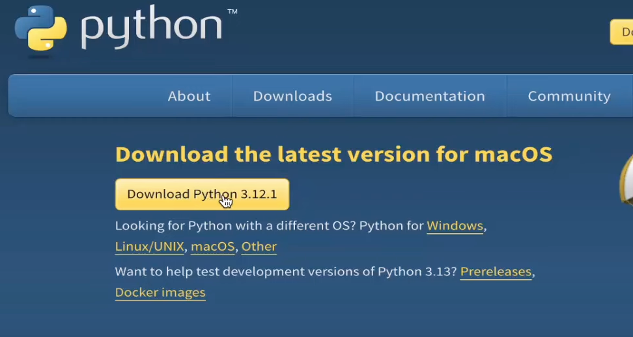
Python Code Execution on Personal PC
Example for MacOS
Step1: Open official website(Python Releases for Windows | Python.org), select Downloads-macOS
Notes:
Multi-purpose language

Slide 15
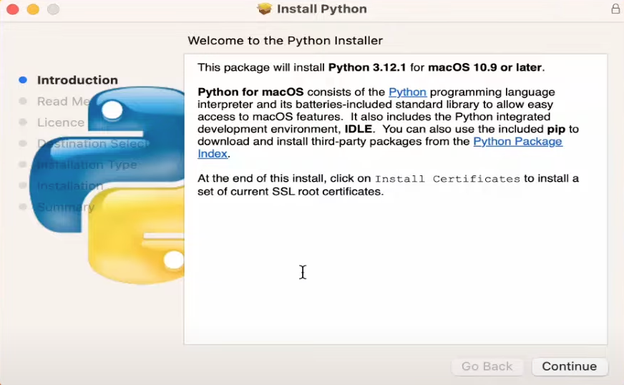
Python Code Execution on Personal PC
Example for MacOS
Step2: Install Python package.
Notes:
Multi-purpose language

Slide 16
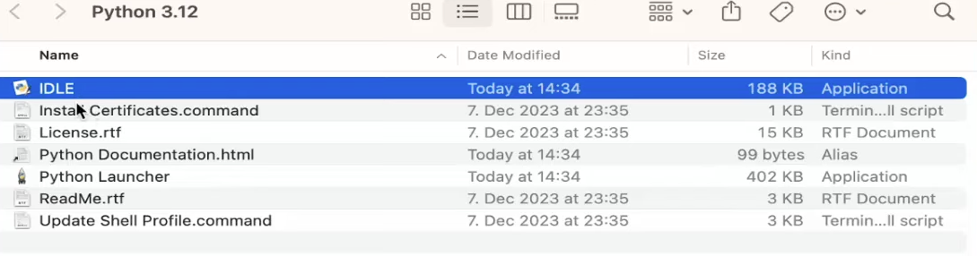
Python Code Execution on Personal PC
Example for MacOS
Step3: Once you finished installment, check the files.
Notes:
Multi-purpose language

Slide 17
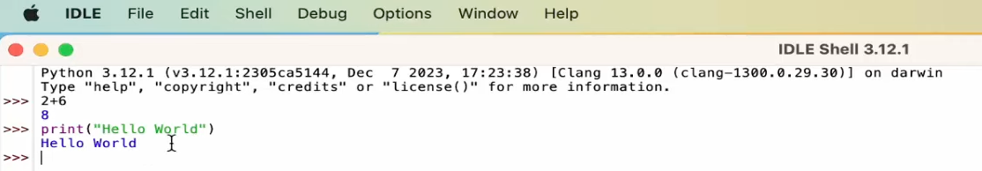
Python Code Execution on Personal PC
Example for MacOS
Step4: Open IDLE, and type in the following code to execute.
Notes:
Multi-purpose language

Slide 18
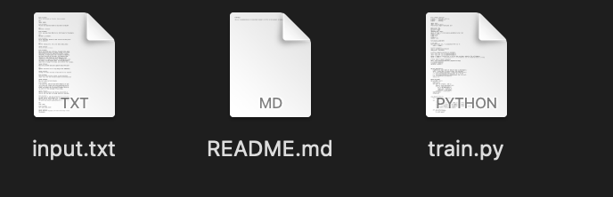
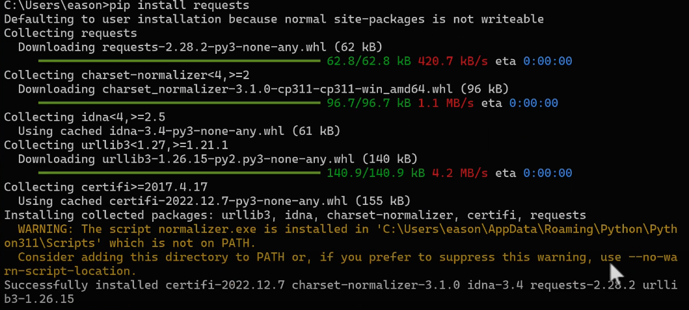
Python Code Execution on Personal PC
Others you need to know
1. All the python files are end in .py format.
2.If you want to install a third-party python package, like requests, openai, install with pip install package_name .
Notes:
Multi-purpose language

Slide 19
Python Code Execution on Google-Colab (Recommended)
Google Colaboratory: https://colab.google
What is Colab:
Colab, or "Colaboratory", allows you to write and execute Python in your browser, with
Zero configuration required
Access to GPUs free of charge
Easy sharing
Introduction video: https://www.youtube.com/watch?v=inN8seMm7UI
Notes:
Multi-purpose language

Slide 20
Python Code Execution on Google-Colab (Recommended)
1. Google Colab details introduction:
https://colab.research.google.com/?hl=en#scrollTo=Wf5KrEb6vrkR
All of our Tutorial code will be presented by Colab.
Notes:
Multi-purpose language

Slide 21
Introduction to Python & Regression 1. Python Fundamentals 2. Three Demos of Regression

Slide 22
Content
1. Our tutorial link:
https://colab.research.google.com/drive/1-UOEmJnN3G2HKX_8gP-iZPvW4ER8yTKY?usp=sharing
2. Our tutorial Includes the following two sections:
Python Fundamentals
Three Demos of Regression

Slide 23
Thanks

