Slide 1
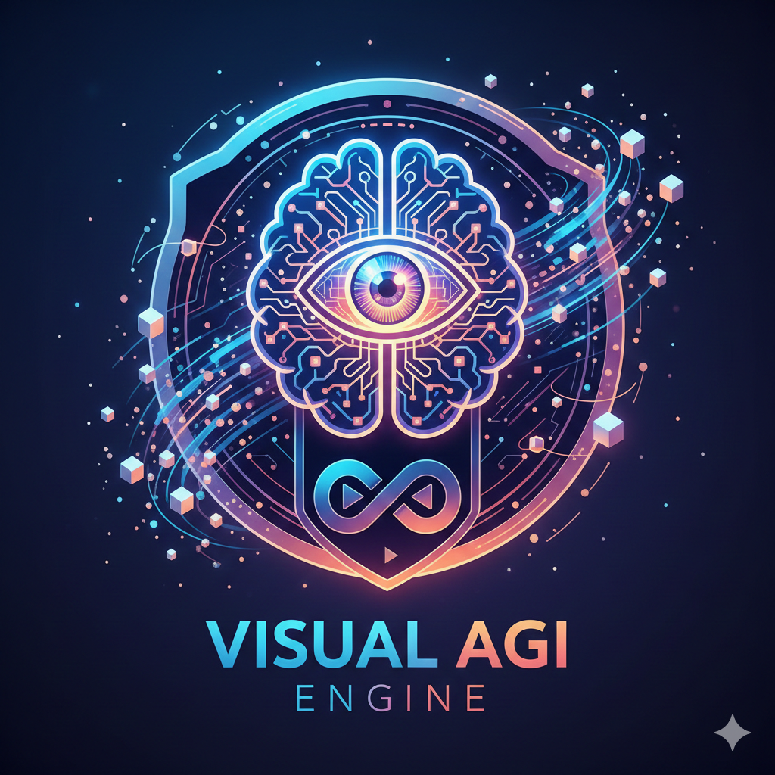
Self-driven Learning Mode
Pattern
Multi-source, Multi-task , Multi-modal, Cross-domian, Expert model, Unified model, Specific scene, General scene
AI4X (Industry, Health, Science)
AGI Engine
Unified Visual Perception System
Unification
AI4X
Application
Spider (ICML'24), GateNet (IJCV'24 & ECCV'20), UniMRSeg (NeurIPS'25), MDCNet (CVPR'24), SSLSOD (AAAI'22), OVCoser (ECCV'24) ...
Ai4Health, Ai4Industry, AI4ResearchTools, AI4Photography ...

