Slide 1
Explain variable influence in black-box models through pattern mining
Master Thesis Proposal
Xiaoqi Ma
Media-Informatics
18.06.2019

Slide 2
Outline
Introduction
Research questions
Methods
Initial experiments
Potential achievement
Time schedule
Reference

Slide 3


Introduction
Machine learning algorithms → classification & regression tasks
How to choose models?
Interpretability:
the degree to which a human can consistently predict the model’s results[1]
Performance:
accuracy, F1 score,
AUC score…
White box models Black box models
White box models: parameters are intrinsically interpretable
linear regression
decision trees
Black box models: parameters are not understandable
ensemble models
neural network

Slide 4
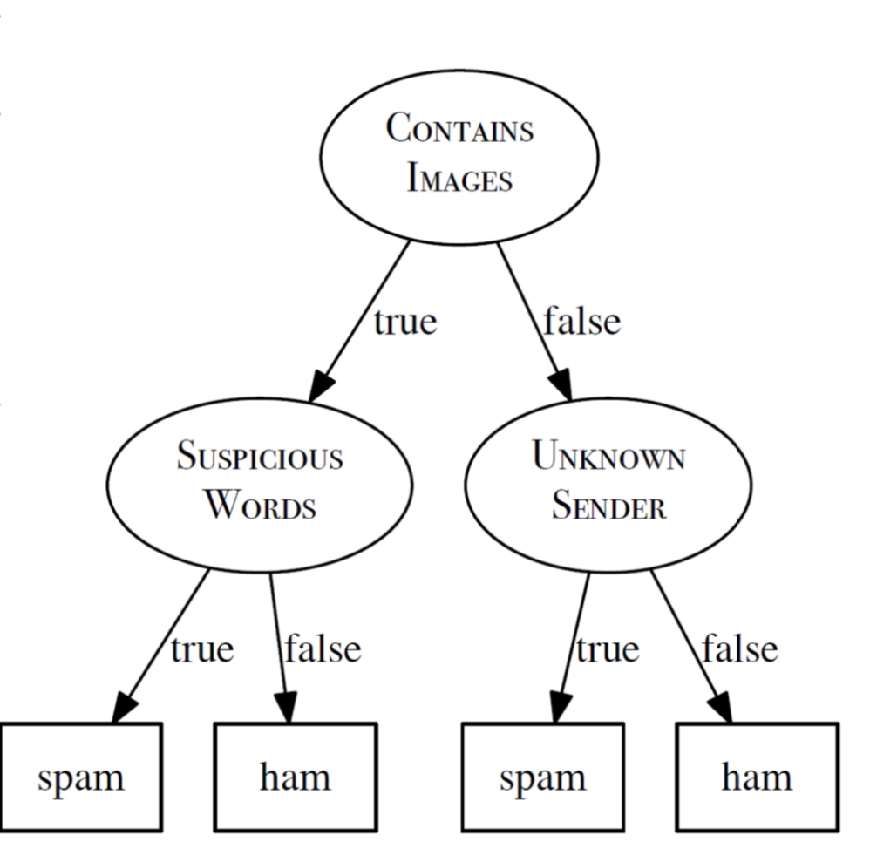
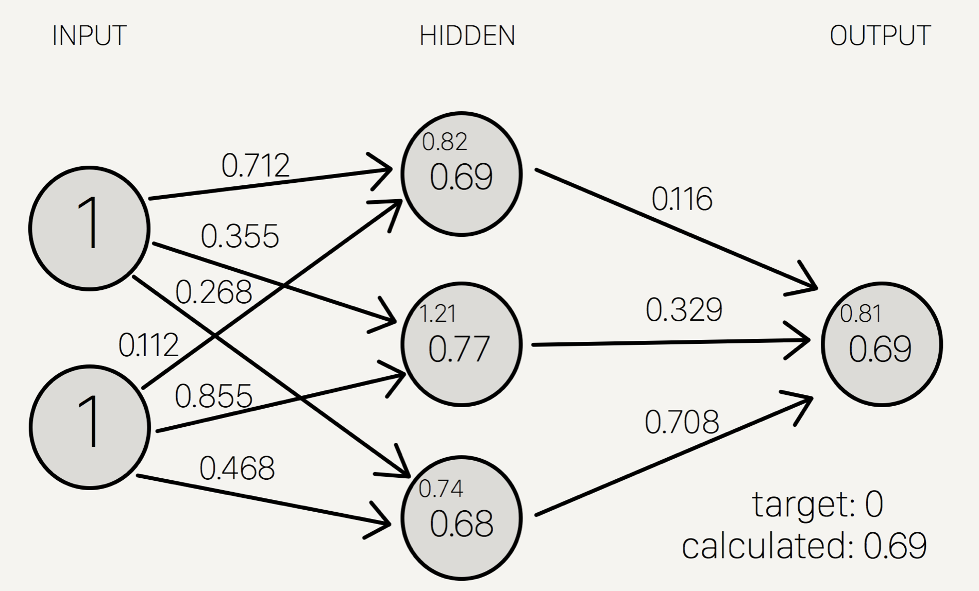
Introduction
Decision trees
Neural networks

Slide 5
Introduction
Subgroup discovery (pattern mining): A data mining technique to automatically discover statistically “interesting” subgroups [3]
Exemplary results formatted as follows:
The mean age of general population: 50
The correlation coefficient of income and age: 0.1
x
y
a
b
Subgroup: the correlation coefficient is 0.4
Subgroup: 60 years-old

Slide 6
Research questions
How to characterize the influence of a specific variable in a black box model?
Subgroup discovery technique decision trees
Training dataset testing dataset
Classification models regression models
How to discover interesting subgroups?
Avoid redundancy in discovered subgroups
Maintain stability
Select target concept and “interestingness” measure

Slide 7
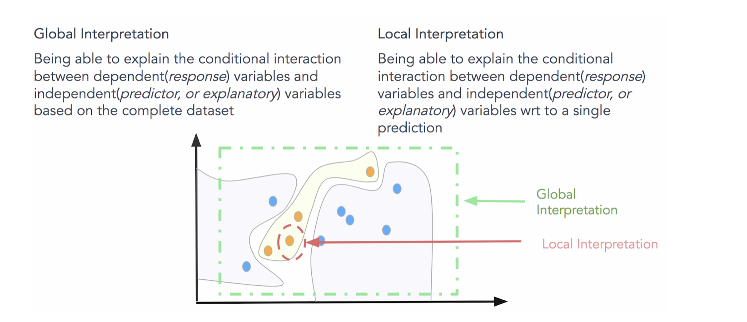
Methods
Fig. Global interpretation & local interpretation
Global interpretation methods
Partial Dependence Plot (PDP)
Feature Importance
Local interpretation methods
Local Surrogate (LIME) [4]
Shapley values [5]
Notes:
The partial dependence plot is a global method: The method considers all instances and gives a statement about the global relationship of a feature with the predicted outcome

Slide 8
Methods
Binary feature flip
Flip binary feature values and observe prediction changes
Discover interesting patterns
f1 | f2 | f3 | binary | prediction
0 | 0 | 1 | 0 | 0.1
0 | 1 | 1 | 0 | 0.2
1 | 0 | 0 | 0 | 0.4
1 | 1 | 0 | 1 | 0.3
0 | 0 | 0 | 1 | 0.5
1 | 1 | 0 | 1 | 0.3
f1 | f2 | f3 | binary | prediction
0 | 0 | 1 | 1 | 0.5
0 | 1 | 1 | 1 | 0.7
1 | 0 | 0 | 1 | 0.3
1 | 1 | 0 | 0 | 0.4
0 | 0 | 0 | 0 | 0.3
1 | 1 | 0 | 0 | 0.2
deviation
0.4
0.5
-0.1
0.1
-0.2
-0.1
avg: 0.1

Slide 9
Methods
Feature Importance
The feature importance is measured by the increase in the prediction error of the model after permuting the feature values [6]
Prediction
error
unimportant
important
Shuffling feature values

Slide 10
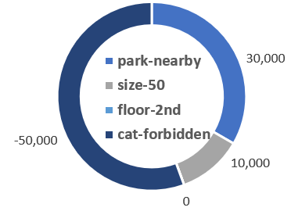
Methods
Shapley values
A method for assigning payouts to players depending on their contribution to the total payout (coalition game theory) [7]
SHAP assigns each feature an importance value for a particular prediction
game: prediction task
total payouts: actual prediction – average prediction
players: feature values
Examples: predicting apartment price
actual prediction (300,000€) → average prediction (310,000€)
SHAP values provide the unique additive feature importance measure [5]
Notes:
The “game” is the prediction task for a single instance of the dataset. The “gain” is the actual prediction for this instance minus the average prediction for all instances. The “players” are the feature values of the instance that collaborate to receive the gain (= predict a certain value).

Slide 11
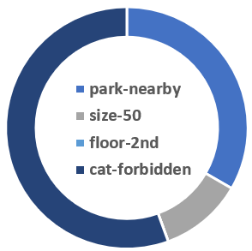
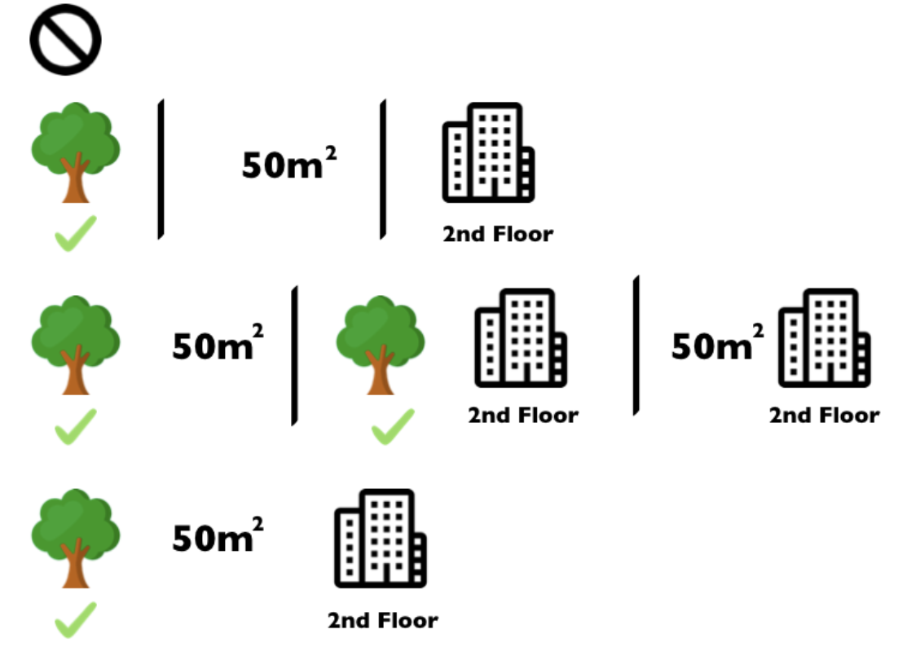

Methods
The Shapley value is the average marginal contribution of a feature value over all possible coalitions [8]
Features
8 coalitions needed for computing the exact Shapley value of the ‘cat-forbidden’ feature value
Replace other feature values that are not in a coalition with random feature values from the dataset
Compute marginal contribution:
Notes:
For each of those coalitions we compute the predicted apartment price with and without the ‘cat-forbidden’ feature value and take the difference to get the marginal contribution. The Shapley value is the (weighted) average of marginal contributions. We replace the feature values of features that are not in a coalition with random feature values from the apartment dataset to get a prediction from the machine learning model.

Slide 12


Methods
Subgroup discovery task is specified by a quadruple (D, Σ, T, Q)[9]
D is a dataset
Σ defines the search space of candidate subgroup descriptions (also called patterns), which is composed of selection expressions
conjunctive combinations of selectors:
e.g.
T represents target concept
Nominal target
Numerical target
Complex target
Q defines a set of selection criteria that depends on the target concept
binary targets: frequency, confidence, χ2 ...
numeric targets: discretization, distributional properties(mean, median…)
$$P=sel_{1}∧sel_{2}∧...∧sel_{d}$$
$$gender=male∧income>50K\$$$
Notes:
The search space Σ consists of a large set of subgroup descriptions (also called patterns). Each subgroup description is composed of selection expressions that are called selectors
Complex target: property of interest is specified by a set of attributes

Slide 13
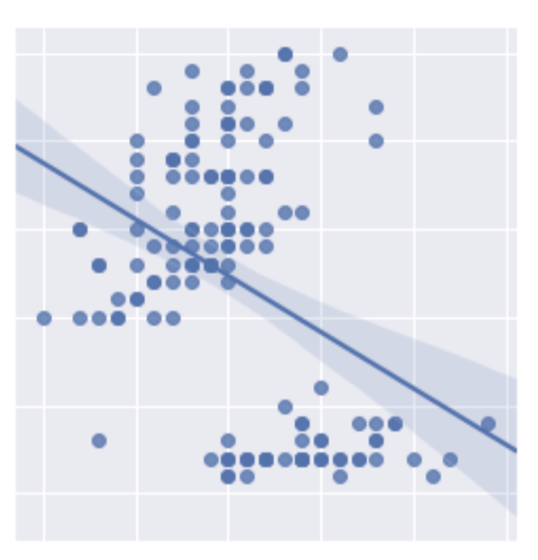
Methods
Model classes for complex target
Correlation models: two numeric variables x1 and x2, and their correlation coefficient ρ [10]
Regression models
Classification models
ρ=0.5
x2
ρ=-0.5
ρ=0.05
x1
Notes:
As an example of a model without an output attribute, we consider two numeric variables x1 and x2, and their linear association as measured by the correlation coefficient ρ. We estimate ρ by the sample correlation coefficient r:
entropy: take into account the size of the groups
significance test: quality measure: 1-p_value

Slide 14
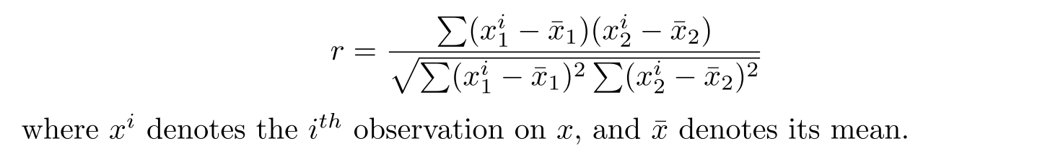



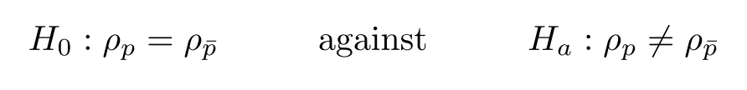
Methods
Model classes for complex target
Correlation models: two numeric variables x1 and x2, and their correlation coefficient ρ (estimated by r)[10]
Absolute difference :
Entropy:
Significance test:
Notes:
As an example of a model without an output attribute, we consider two numeric variables x1 and x2, and their linear association as measured by the correlation coefficient ρ. We estimate ρ by the sample correlation coefficient r:
entropy: take into account the size of the groups
significance test: quality measure: 1-p_value

Slide 15
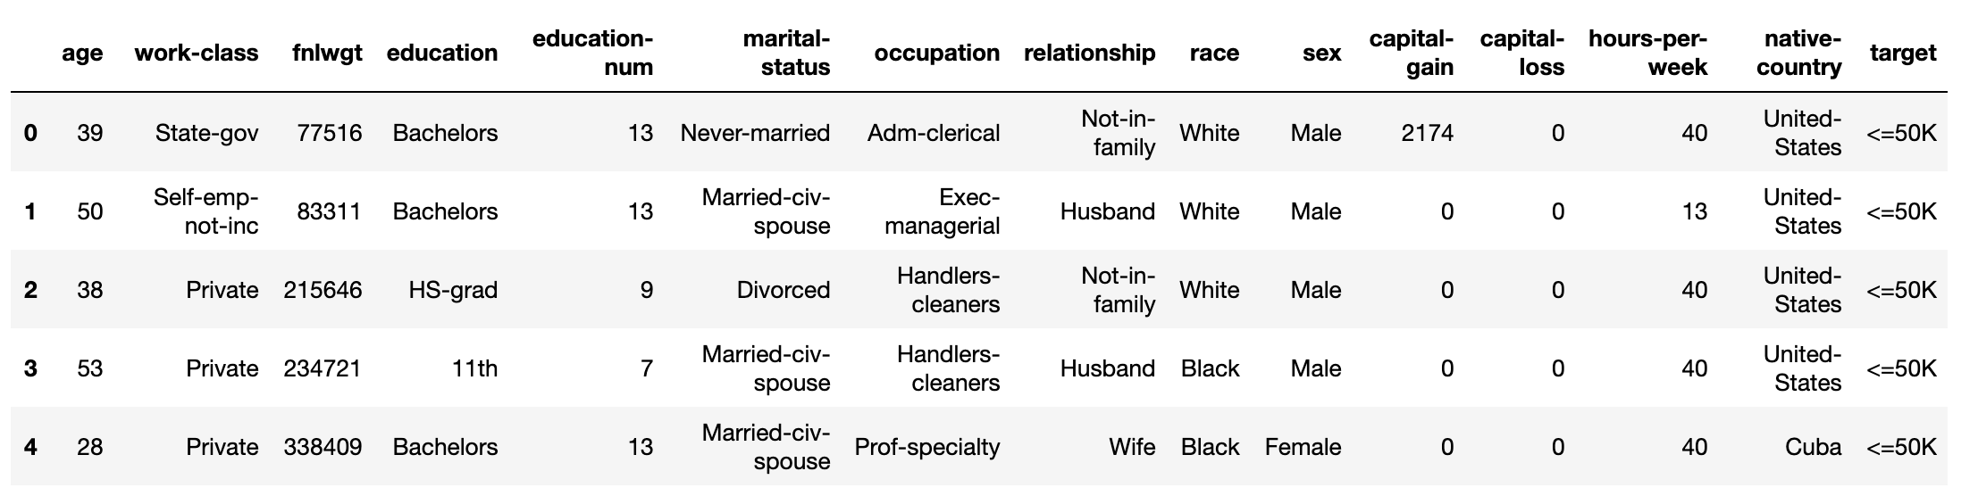
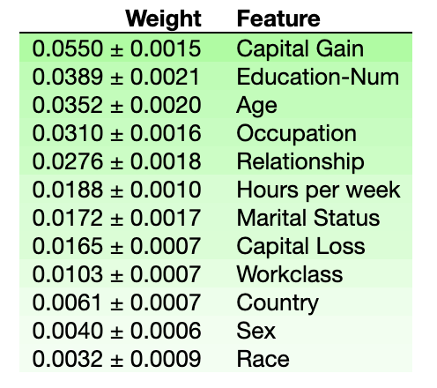
Initial Experiments
Census Income dataset
Fig. Feature importance weights for entire dataset
Notes:
model trained by xgboost

Slide 16
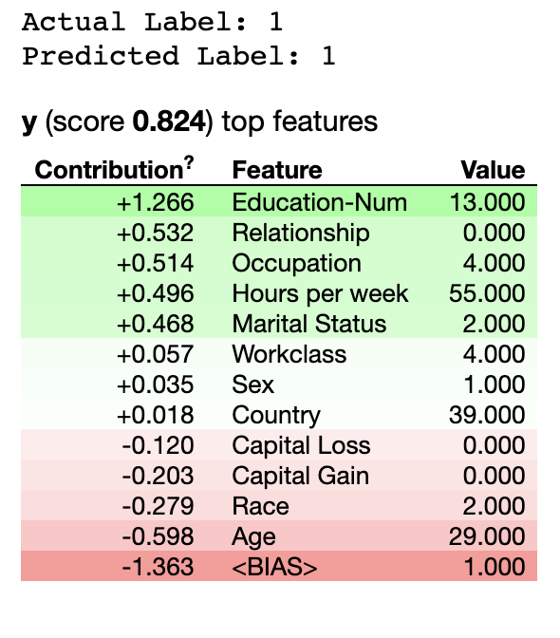
Initial Experiments
Feature Importance for a single instance
Fig. Feature importance weights for a single instance

Slide 17
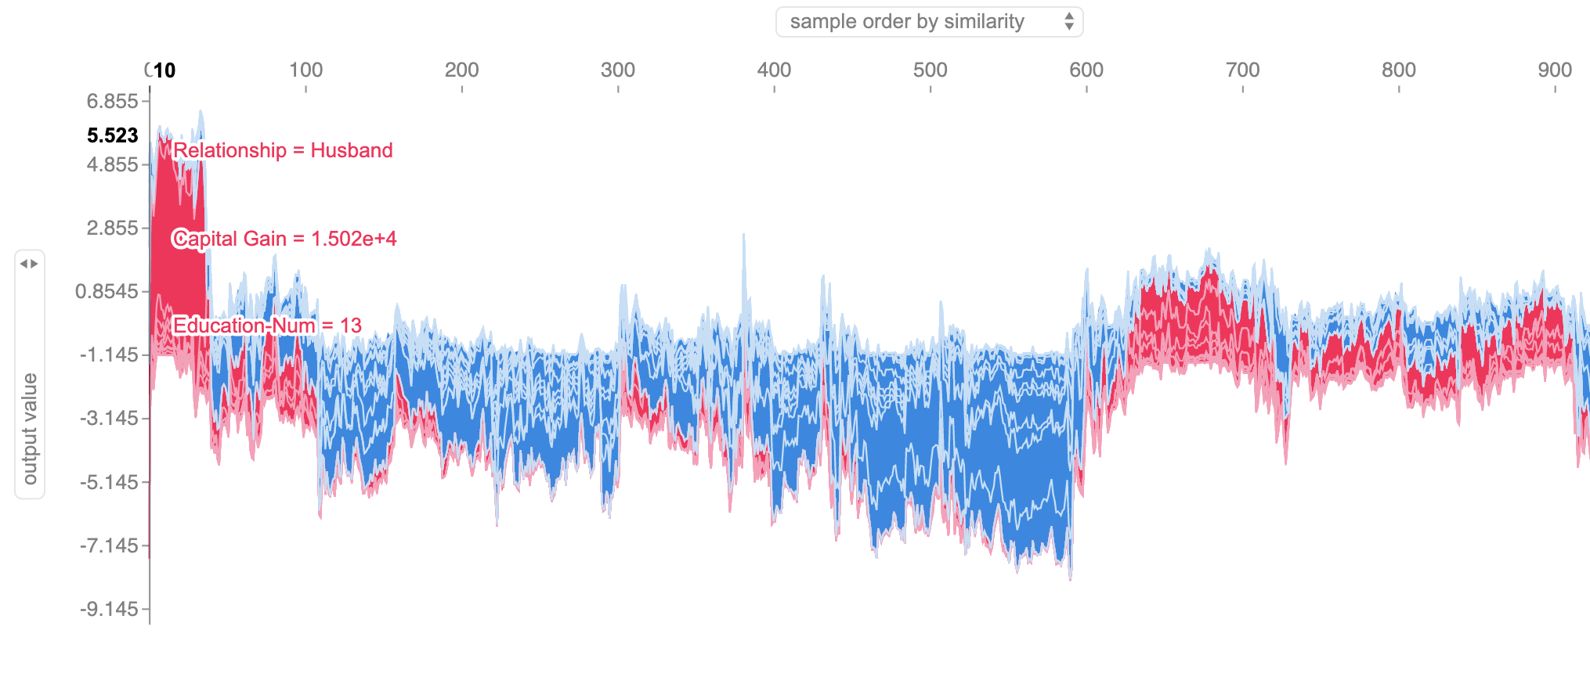
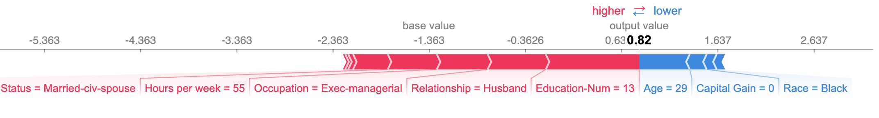
Initial Experiments
SHAP values
Fig. SHAP value for each feature of a single instance
High education level & stable relationship
Notes:
The below explanation shows features each contributing to push the model output from the base value (the average model output over the training dataset we passed) to the actual model output. Features pushing the prediction higher are shown in red, those pushing the prediction lower are in blue. It is obvious to notice that education-num, relationship and occupation dominate the prediction to some degree.

Slide 18
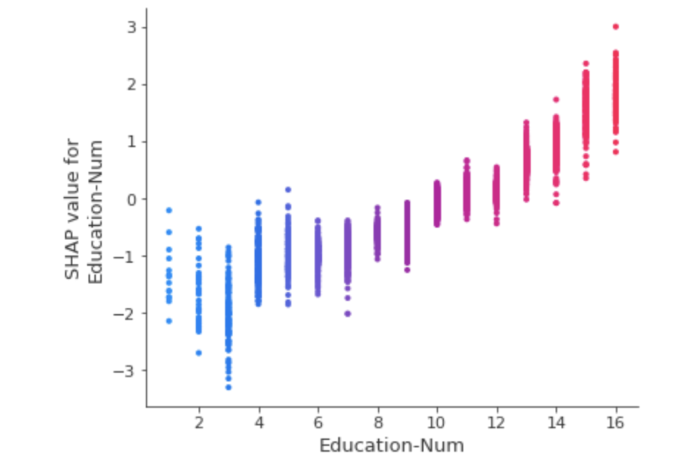
Initial Experiments
SHAP dependence plot
Fig. SHAP dependence plot for education-num
Notes:
the vertical axis represents SHAP value for education-num, and the horizontal axis indicates the feature values of education-num. Actually, another feature could be chosen for coloring dots to show feature interactions, however, for simplicity, the dependent feature is set as education-num as well. From the plot, it is noticed that the SHAP value climbs with the increment of education-num, which means higher education level generally contributes more for the prediction.

Slide 19
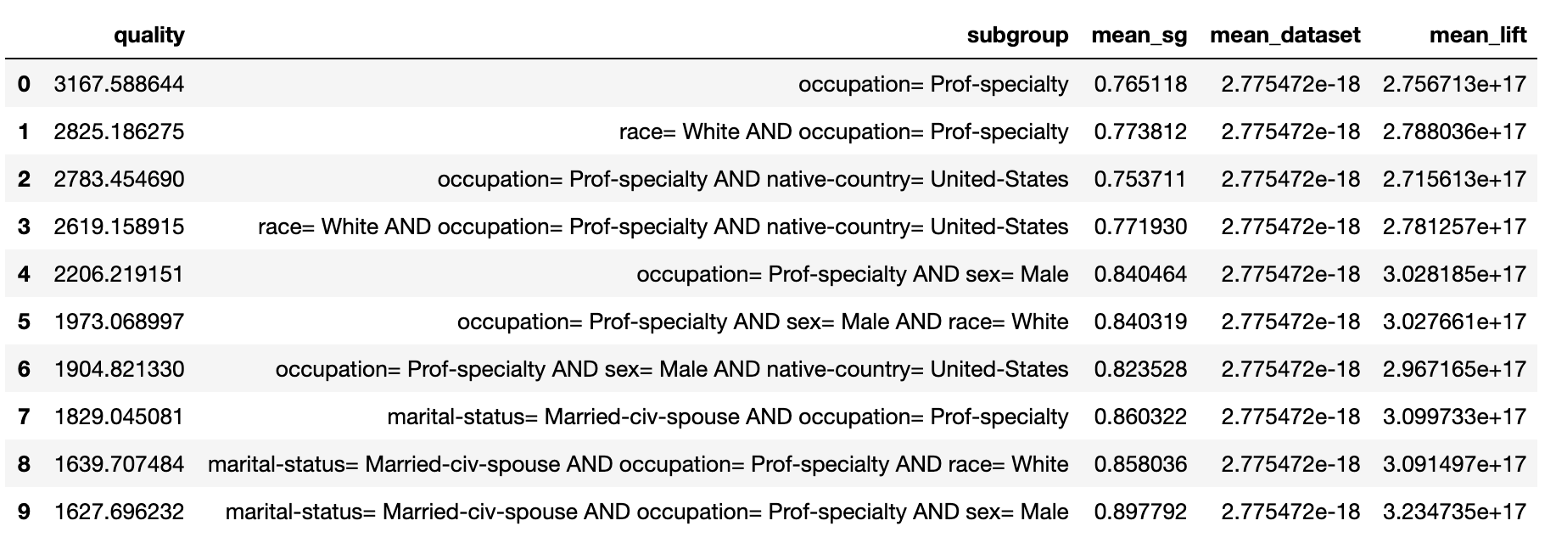
Initial Experiments
Subgroup discovery
Tab. Subgroup discovery result with SHAP value of education-num as target
average Shapley value of education-num is 0
subgroups featured with “occupation=Prof-specialty” has significantly high Shapley values
Notes:
we could conclude that people work as Prof-specialty have a stronger tendency to earn more than 50K$/year. Nevertheless, those subgroup descriptions are pretty similar, which requires further methods to reduce redundancy.

Slide 20
Potential Achievement
Goal: construct frameworks to explain variable influence in black box models through subgroup discovery technique
Explore methods to calculate feature importance
Discover subgroups relying on the feature importance/contribution
Compare interpretation results between subgroup discovery and decision trees
Identify the feature contribution using Shapley values

Slide 21
Time Schedule
Task Completed | Due Date
Topic Approved | 18-06-2019
Preliminary literature review | 02-07-2019 (2 weeks)
Initial Implementation and experiment | 16-07-2019 (2 weeks)
Prepare datasets | 23-07-2019 (1 week)
Improve implementations | 13-08-2019 (3 weeks)
Conduct experiment | 27-08-2019 (2 weeks)
Implement extensions/variations | 17-09-2019 (3 weeks)
Conduct more experiments | 01-10-2019 (2 weeks)
Writing thesis draft | 12-11-2019 (6 weeks)
Revise thesis draft | 03-12-2019 (3 weeks)
Final thesis draft submission | 17-12-2019 (2 weeks)

Slide 22
Reference
[1] Kim, Been, Rajiv Khanna, and Oluwasanmi O. Koyejo. “Examples are not enough, learn to criticize! Criticism for interpretability.” Advances in Neural Information Processing Systems (2016).
[2] P. Voigt and A. Von dem Bussche, “The eu general data protection regulation (gdpr),” A Practical Guide, 1st Ed., Cham: Springer International Publishing, 2017. [3] S. Wrobel, “Inductive logic programming for knowledge discovery in databases,” in Relational data mining. Springer, 2001, pp. 74–101. [4] S. S. Marco Tulio Ribeiro and C. Guestrin. (2019) Lime: Explaining the predictions of any machine learning classifier. [Online]. Available: https: //github.com/marcotcr/lime [5] S. M. Lundberg and S.-I. Lee, “A unified approach to interpreting model predictions,” in Advances in Neural Information Processing Systems, 2017, pp. 4765– 4774 [6] A. Fisher, C. Rudin, and F. Dominici, “Model class reliance: Variable importance measures for any machine learning model class, from the rashomon perspective,” arXiv preprint arXiv:1801.01489, 2018.
[7] L. Shapley, “A value for n-person games. contributions to the theory of games ii. ed. by hw kuhn and aw tucker,” Annals of Mathematics Studies, vol. 28, 1953.
[8] C. Molnar, Interpretable Machine Learning, 2019, https://christophm.github.io/ interpretable-ml-book/.
[9] F. Lemmerich, “Novel techniques for efficient and effective subgroup discovery,” 2014. [10] D. Leman, A. Feelders, and A. Knobbe, “Exceptional model mining,” in Joint European Conference on Machine Learning and Knowledge Discovery in Databases. Springer, 2008, pp. 1–16.
[11] F. Lemmerich and M. Becker, “pysubgroup: Easy-to-use subgroup discovery in python,” in Joint European Conference on Machine Learning and Knowledge Discovery in Databases. Springer, 2018, pp.658–662.

Slide 23
Thanks for your attention!

Slide 24
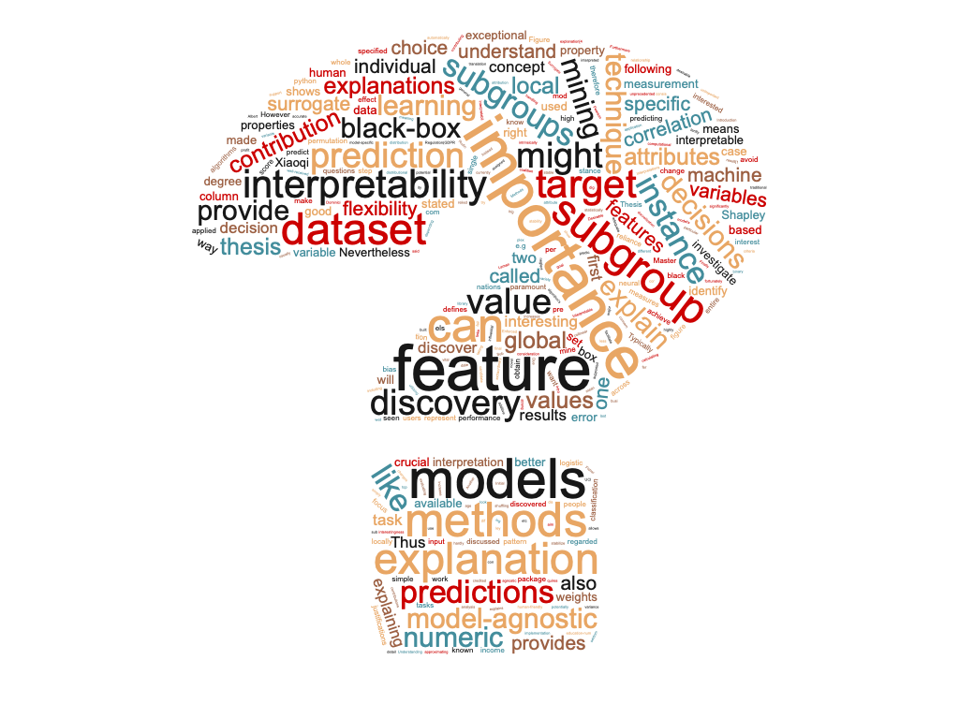

Slide 25
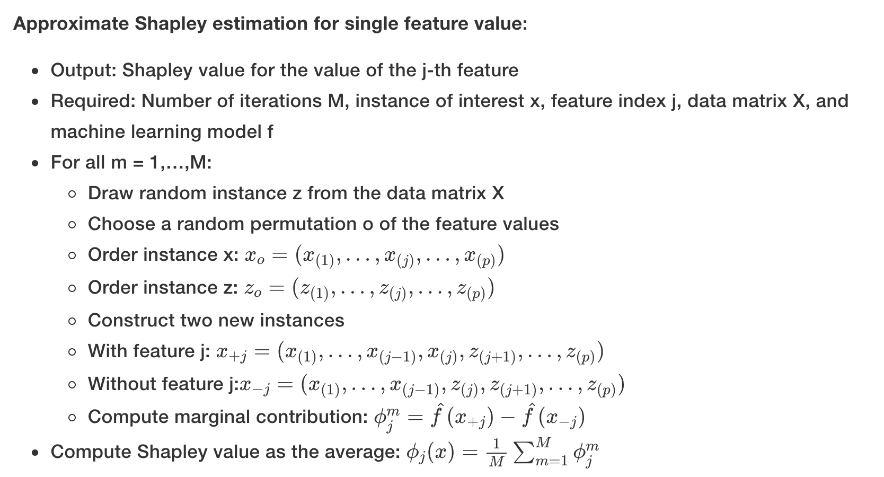
Appendix
SHAP values estimation

