Slide 1




Seminar “Data & Society”
Gender Detection on the Web
Xiaoqi Ma
Media-Informatics
04.12.2018

Slide 2
Motivation
Commercial Purposes
Conduct market basket analysis
Provide targeted advertising
Provide personalized recommendations
Offer personalized services, e.g. membership attachment
However…
Users are reluctant to provide demographic information
Or even refuse to register due to privacy

Slide 3
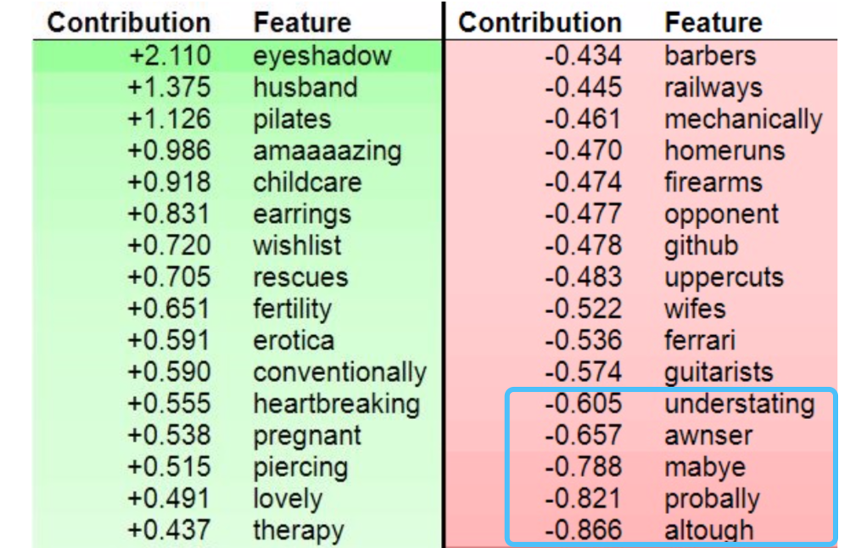
Types of Gender Prediction Data
Contextual data
Linguistics writing and speaking styles
Comments on Reddit [1]
Movie reviews
Tweets or blogs
Behavioral data
Web browsing history [2], e.g. click-through data
Web search queries [3]
Purchase data [5]
Location check-ins [6]
Independent data
Facebook likes Web search queries
Notes:
Male misspell more often
Female on average submit longer queries

Slide 4
Related Works
Author & Year | Data | Methods | Performance (F1)
Hu, et al., 2007 [2] | Web page click-through data | Bayesian framework; Smoothing Approach (LSI to find similar users) | 0.80
Kosinski et al., 2013 [3] | Facebook likes Web Search queries | Fit a common representation via Open Directory Project categories | AUC: 0.80
Do Viet Phuong et al., 2014 [4] | Web browsing history | SVM (combined feature): LDA for topic-based feature, n-gram for sequential feature | 0.81
Wang et al., 2015 [5] | Purchase Data | Structured Neural Embedding (SNE) | 0.54
Zhong et al., 2015 [6] | Location check-ins | Tensor Factorization: Spatiality, Temporality, and location-knowledge based method | 0.81
Notes:
F-score (F1 score) is the harmonic mean of precision and recall:
The ROC curves are created by plotting the ratio of true positive rate versus false positive rate at various threshold settings

Slide 5

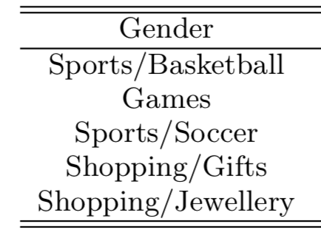
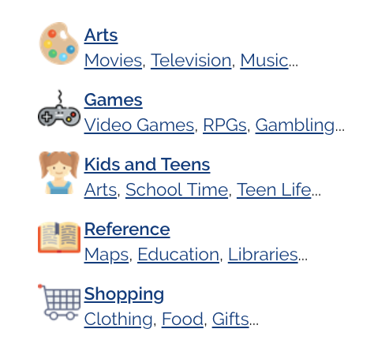


Methods
Procedure
Match Facebook and search queries with categories (coarse grained representation) → 219-dimensional vectors
Train Gender Classifier based on users’ Facebook
Apply the classifier to search query logs
Notes:
The key insight here is that we can assume that whether a user is interested in some category C or not depends on their demographics Y , independent of whether he or she is using Facebook or doing search.

Slide 6
Reference
[1] E. Vasilev, Inferring gender of Reddit users (2018). Master Thesis
[2] Hu, J., Zeng, H.J., Li, H., Niu, C., Chen, Z. (2007). Demographic prediction based on user’s browsing behavior. Proceedings of the 16th international conference on World Wide Web. Pages 151-160.
[3] B. Bi, M. Shokouhi, M. Kosinski, and T. Graepel. Inferring the demographics of search users. WWW, 2013.
[4] T. M. Phuong, and D. V. Phuong, “Gender prediction using browsing history,” Proceedings of the Fifth International Conference KSE 2013, Volume 1. pp. 271-283, 2013.
[5] P. Wang, J. Guo, Y. Lan, J. Xu, and X. Cheng, “Your cart tells you: Inferring demographic attributes from purchase data,” in Proceedings of ACM International Conference on Web Search and Data Mining (WSDM), pp. 251–260, ACM
[6] Y. Zhong, N. J. Yuan, W. Zhong, F. Zhang, and X. Xie. You Are Where You Go. In WSDM ’15: Proceedings of the 8th ACM international conference on Web search and data mining, pages 295–304. ACM Press, 2015.

Slide 7
Thank you

