Slide 1


Seminar “Data & Society”
Gender Detection on the Web
Xiaoqi Ma
Media-Informatics
22.01.2019
Xiaoqi Ma, Media-Informatics, RWTH

Slide 2
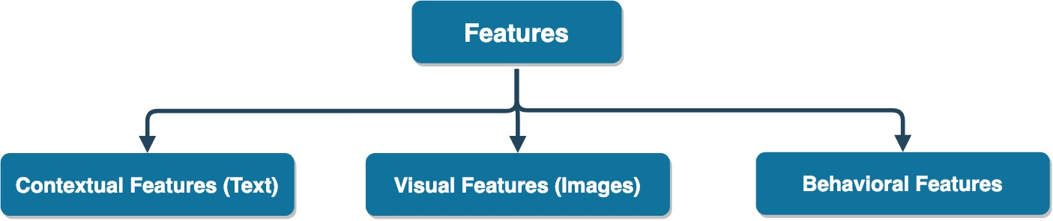
Features for Gender Detection
Web content
Tweets, Blogs
Comments, Reviews
Emails
Names
Profile Picture
User’s face image
Images posted by users
Web browsing history
Web search queries
E-commerce data
Clickstream patterns
Web hyperlinked structure

Slide 3
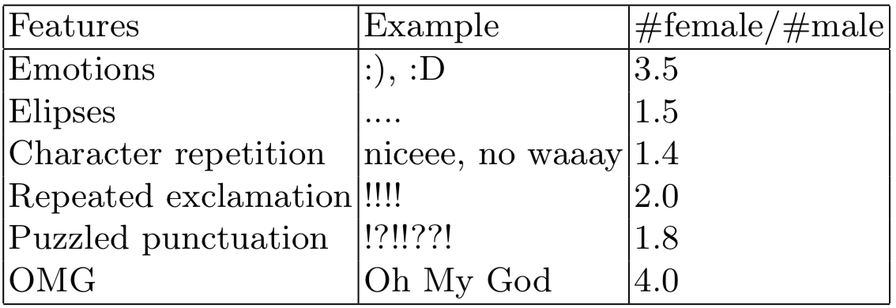
Contextual Features
Text-based social media platform
Twitter
Reddit…
Linguistics writing and speaking styles
Sociolinguistic feature model
N-gram feature model
Approach: tf-idf, neural network, CNN (character level)
Content-based and category-based
Categories: sport, gamming, shopping…
Approach: Latent Dirichlet allocation, SVM, neural network
Notes:
Female use more emotionally language; men use more references and commit more grammatical errors

Slide 4
Visual Features
Image-based social media platform
Instagram
Pinterest…
Face detection
Approach: CNN-based ensemble model
Accuracy: 97.3% for record performance
Image semantic analysis
Semantic topics: animal, baby, vehicles…
Results: males are interested in electronics, vehicles; females like to post clothes, jewelry, dogs…
Approach: Visual topic modeling

Slide 5
Behavioral Features
Input features
Clickstream patterns, including time of the visits, intensity, frequency
Time features
Sequential features…
Methods
Bayesian Framework
Tensor Factorization / SVD
SVM
Results
Males tend to change between webpage categories more frequently
Females on average submit longer queries

Slide 6
Related Works–Contextual
Author & Year | Data | Methods | Performance (F1)
E.Vasilev 2018 | Reddit Comments | BOW, Glove, CNN | 82.3%
D. Rao et al., 2010 | Tweets | Sociolinguistics, N-gram | 72.3%
W. Deitrick et al., 2012 | Emails | Neural Network | 95%
F. Karimi et al., 2016 | Names(face image) | Combine name/image-based detection | 82%(92%)
Notes:
Women tend to user more emotional languages as well as more adjectives and adverbs and apologize more frequently
Men use more references to quantity and commit a greater number of grammatical errors

Slide 7
Related Works–Visual
Author & Year | Data | Methods | Performance (F1)
M. Merler et al., 2015 | Social media images | SVM | 75.6%
Q. You et al., 2014 | Social network images | Stacked-SVM | 72%
G. Antipov et al., 2016 | Face images | Ensemble CNN | 97%

Slide 8
Related Works–Behavioral
Author & Year | Data | Methods | Performance (F1)
Hu, et al., 2007 | Webpage click-through data | Bayesian Framework | 80%
Zhong et al., 2015 | Location check-ins | Tensor Factorization | 81%
B. Bi et al., 2013 | Facebook likes/Search queries | Common Representation via ODP | 80%
T. M. Phuong et al., 2014 | Web browsing history | SVM, LDA, N-gram | 81%

Slide 9
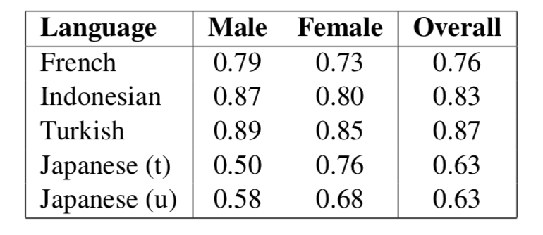
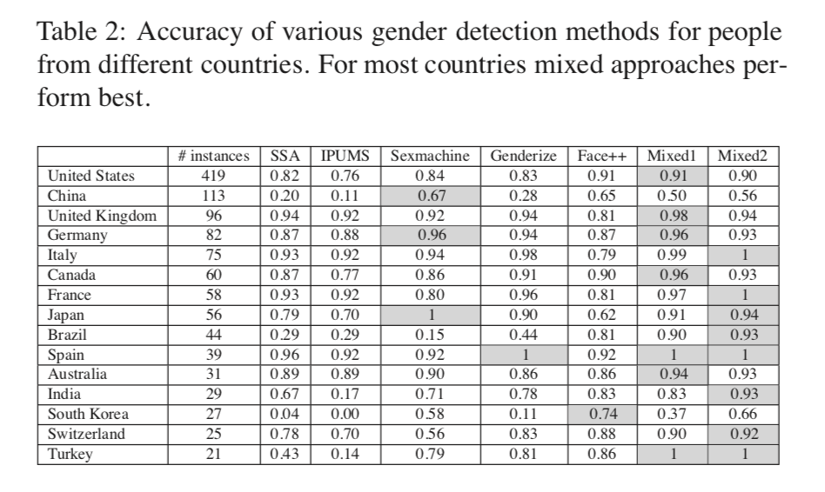
Discussions
Existing approach not generalize well to language systems [10]
E.g.
Approach can be culture biased [1]
E.g.

Slide 10
Reference
F. Karimi, C. Wagner, F. Lemmerich, M. Jadidi, and M. Strohmaier, “Inferring gender from names on the web: A comparative evaluation of gender detection meth- ods,” in Proceedings of the 25th International Conference Companion on World Wide Web. International World Wide Web Conferences Steering Committee, 2016, pp. 53–54.
P. Wang, J. Guo, Y. Lan, J. Xu, and X. Cheng, “Your cart tells you: Inferring demographic attributes from purchase data,” in Proceedings of the Ninth ACM International Conference on Web Search and Data Mining. ACM, 2016, pp. 173– 182.
Y. Zhong, N. J. Yuan, W. Zhong, F. Zhang, and X. Xie, “You are where you go: Inferring demographic attributes from location check-ins,” in Proceedings of the eighth ACM international conference on web search and data mining. ACM, 2015, pp. 295–304.
B. Bi, M. Shokouhi, M. Kosinski, and T. Graepel, “Inferring the demographics of search users: Social data meets search queries,” in Proceedings of the 22nd inter- national conference on World Wide Web. ACM, 2013, pp. 131–140.
T. M. Phuong et al., “Gender prediction using browsing history,” in Knowledge and Systems Engineering. Springer, 2014, pp. 271–283.
J. Hu, H.-J. Zeng, H. Li, C. Niu, and Z. Chen, “Demographic prediction based on user’s browsing behavior,” in Proceedings of the 16th international conference on World Wide Web. ACM, 2007, pp. 151–160.
S. Kabbur, E.-H. Han, and G. Karypis, “Content-based methods for predicting web-site demographic attributes,” in Data Mining (ICDM), 2010 IEEE 10th In- ternational Conference on. IEEE, 2010, pp. 863–868.
D. Rao, D. Yarowsky, A. Shreevats, and M. Gupta, “Classifying latent user at- tributes in twitter,” in Proceedings of the 2nd international workshop on Search and mining user-generated contents. ACM, 2010, pp. 37–44.
D. Duong, H. Tan, and S. Pham, “Customer gender prediction based on e- commerce data,” in Knowledge and Systems Engineering (KSE), 2016 Eighth In- ternational Conference on. IEEE, 2016, pp. 91–95.

Slide 11
Reference
M. Ciot, M. Sonderegger, and D. Ruths, “Gender inference of twitter users in non-english contexts,” in Proceedings of the 2013 Conference on Empirical Methods in Natural Language Processing, 2013, pp. 1136–1145.
G. Antipov, S.-A. Berrani, and J.-L. Dugelay, “Minimalistic cnn-based ensemble model for gender prediction from face images,” Pattern recognition letters, vol. 70, pp. 59–65, 2016.
Q. You, S. Bhatia, T. Sun, and J. Luo, “The eyes of the beholder: Gender pre- diction using images posted in online social networks,” in Data Mining Workshop (ICDMW), 2014 IEEE International Conference on. IEEE, 2014, pp. 1026–1030.
M. Merler, L. Cao, and J. R. Smith, “You are what you tweet pic! gender predic- tion based on semantic analysis of social media images,” in Multimedia and Expo (ICME), 2015 IEEE International Conference on. IEEE, 2015, pp. 1–6.
S. Volkova and D. Yarowsky, “Improving gender prediction of social media users via weighted annotator rationales,” in NIPS 2014 Workshop on Personalization, 2014.
W. Deitrick, Z. Miller, B. Valyou, B. Dickinson, T. Munson, and W. Hu, “Author gender prediction in an email stream using neural networks,” Journal of Intelligent Learning Systems and Applications, vol. 4, no. 03, p. 169, 2012.
E.Vasilev,“Inferringgenderofredditusers,”Master’sthesis,UniversityofKoblenz and Landau, 2018.

Slide 12
Thank you

