Slide 1
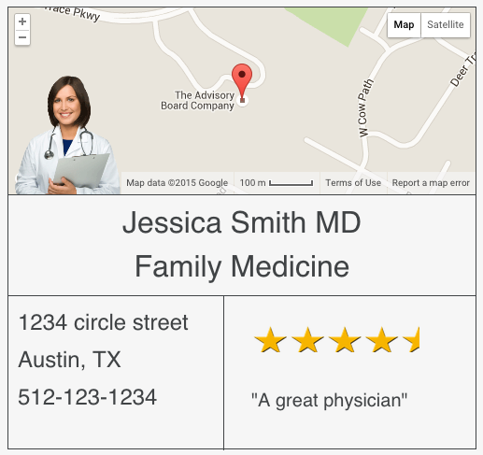
Zero-Downtime Embeddable Widgets Server
The WidgetZilla Project at Core UI
Emmanuel Narh
Xiaoqin LI
Summer Internship 2015
08/14
Notes:
Alright, first of all, I have to say, before I joined Crimson, my knowledge on deployment of software stayed in using either public or private cloud VM. People usually grab a clusters of cloud instances, configuring the VMs and deploying their project, just like what I did for my android game server. But here, Manny leads me to a new world of software deployment, which configures and deploys applications in containers. Throughout this internship, I gradually realized the awesomeness of shipping software pieces in containers.
Hello everyone, My name is …, the intern working with Manny I hope what we are presenting to you is fun and you will certainly see power behind it.
Our topic is….
60’

Slide 2
Outline
Introduction
Methods
Demo
Summary
Notes:
In next 9 mins or so, I’ll introduce you how we designed and deployed the project, and you will see a short demo after that.
10’

Slide 3
1. Introduction
Embeddable Widget
Docker Containers
Zero-Downtime Deployment
Notes:
There are three topics included in our project. So I would like to give you a very quick introduction on each of them.
The UI side is embeddable widget, basically, we serve them and you just need a short code pasted in your website, it would show up.
But what we really want to emphasize here is the design of infrastructures supporting the widget application. And I will show you what Docker container is in a minutes.
25’

Slide 4
Embeddable Widget
But why?
Notes:
But you may wonder, Why I am talking about embeddable widgets here at Crimson?
Well, for our development and production, we may also have some use cases.
10’

Slide 5

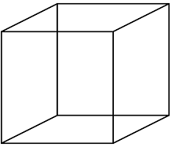


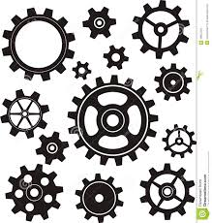
Purpose of the Service
Current philosophy:
CMA
Luna/Crux
CCC
DataHub
Luna/Crux
CCM
Data Api Services
Luna/Crux
Notes:
Let’s take a look at current philosophy of building widgets in our products
Based on datahub, We have many Data Api Services built for each team to fetch data they want. And Each team has their own frond-end engineer to make beautiful widgets with Luna/Crux.
25’

Slide 6
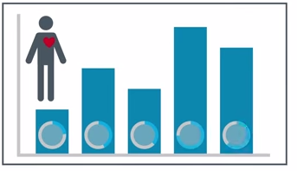

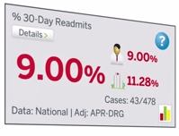
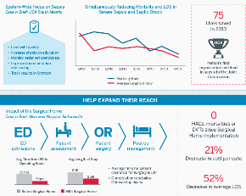
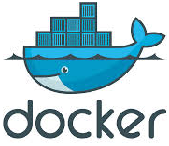
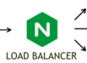
Purpose of the Service
On top of that:
CMA
DataHub
CCC
Data Api Services
CCM
less redundant work
more fuzzball game
Luna/Crux
Notes:
However, what if there are some widgets that at least more than one team need, or some widgets that they think it’s better be delivered from Core UI team, so that way Core UI team serve the widgets, and FEEs at each team don’t need to build the widget from scratch. What they may need is just customizing the style a little bit according to their needs.
So, this brings Embeddable widgets to us, that the core UI team can build on demand, and serves them in Dockers containers with a zero downtime deployment.
The major advantages here is : less redundant front-end work in each product.
45’

Slide 7
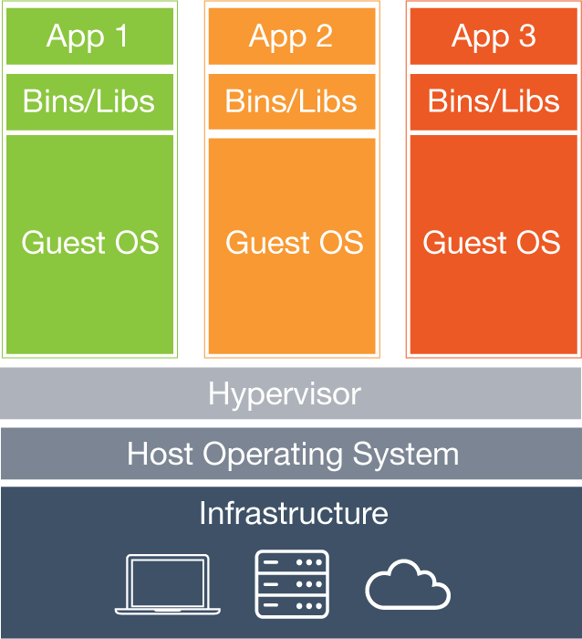
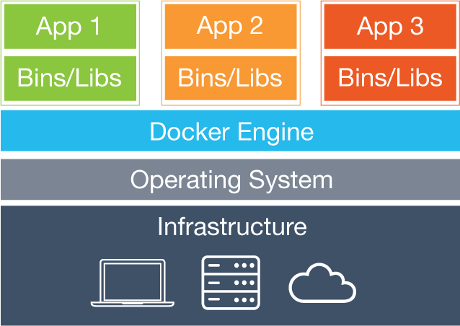
Brief Introduction of Docker and Container
Virtual Machine
Docker Container
Check www.docker.com/whatisdocker for more information.
Notes:
Alright, Docker, basically allows you to package an application in a lightweight linux file system contains just everything that application needs to run: code, runtime, system tools and any other dependencies.
This guarantees that, by shipped in docker containers, the application will always work on any other machine as designed locally, regardless of the environment the docker is running in.
Because Docker engine is not tied to any specific infrastructure. Therefore, No more worries about having to install the same configurations into a different environment. As long as you configure the docker container itself right, Application in docker containers run on any infrastructure and in any type of cloud.
55‘

Slide 8
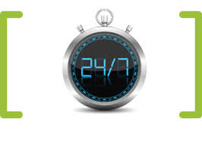
Zero-Downtime Deployment
Stop
Deploy
Well, we all know that:
Downtime isn’t an Option
Start
Notes:
So, we plan to server the embeddable widgets using docker containers, and we want to server them without any downtime, cuz nowadays, we all know that: Downtime isn’t an Option.
The key of zero downtime here is : we never stop old services before new version of service is up and running successfully.
And I will explain it more when I demo it later on.
30s’

Slide 9
2. Methods
Server Design
Continuous Deployment
Notes:
Now, it’s time to briefly show you how we design, develop and deploy our embeddable widget application in Docker.
5’

Slide 10
Server design
Container A
Reverse proxy
load balancer
Nginx
Traffic
Traffic
Container B1
Container B2
Container B3
Container B4
Node
Node
……
Node
Node
Send notification
Container C
Update and reload
Nginx configuration
Zero Downtime
File Generator
Notes:
Here Every application runs in a docker container.
NGINX is well known as a high-performance load balancer, cache, and web server. So here we use it to route and balance the traffics that come to Node application. And we can always scale the running Node application up or down on demand very easily with docker.
Here is how we do zero downtime:
Assuming we updated our node applications, we run 4 new Node containers, say B5, B6, B7, B8. The magic is from Container C, a file generator container. This guy watches any changes on node project. If there are new node container running and linking to nginx container, it will update the nginx configuration file, and send signal to nginx to reload it.
Since the time nginx spends to reload the configuration file is trivial, we could consider it is pretty much zero downtime.
70’

Slide 11















Continuous deployment design
Shell Scripting
Auto
Manual
Succeeds?
or
Succeeds?
or
or
Notes:
Ok, regarding how we deploy it, like others, we also have 3 deployment environment: Dev, QA and Prod.
But, most of things happen in a few shell scripts we wrote, cuz we want keep the bamboo configuration as simple as we can.
40s

Slide 12
3. Demo
DemoPublisher:
https://repo.advisory.com/projects/CCUI/repos/publisher/browse
Embeddable Widget Generator:
https://repo.advisory.com/projects/CCUI/repos/generator/browse
  Deployment:
https://repo.advisory.com/projects/CCUI/repos/deployment/browse
Notes:
I only have 2 minutes for this.

Slide 13
4. Summary
not just about embeddable widgets.
more about COOL infrastructure supporting the applications in the future!
Notes:
10s’

Slide 14
Advantages
For Development
For Users
For E-tech
For DevOps
.
Notes:
Speaking of advantages, there are few:
For development in each team: Embeddable widgets may save time from redundant front-end work.
For users: it guarantees Zero downtime under any modifying or updating.
For E-tech: Shipping applications to them faster and easier. Before and currently, to deploy production, e-tech people may use several VM, they read long-page wiki, try installing a lot of application dependencies like DB, Reddis for caching, NPM and so on, which is kind of painful. But running application with docker containers, all relevant dependencies are taken care by contains from development teams
For DevOps: Applications running in Docker containers are easy to modify, update and scale without bothering neighboring containers. The lightweight containers can spin up in a matter of seconds without consuming a lot of resources.
60s

Slide 15


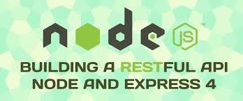





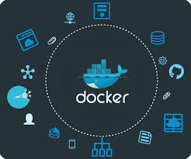




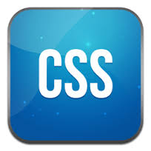
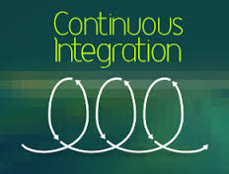
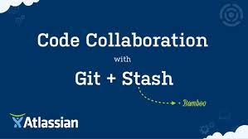



What I have learned?
Notes:
I’ve learned a lot this summer.
The biggest is Docker. And learned a bit on a lot of frond-end tools by messing with node. Also learned useful skills to deploy software, especially Shell Scripting.
10s.

Slide 16

The End

