Slide 1

DATA1030 midterm
Xiaoqing Yao
Data Science Institution
2024/10/23
Github Link:https://github.com/XiaoqingYao12/DATA1030project

Slide 2
Predict release speed based on different pitch types
Regression problem
This project focuses on Clayton Kershaw. Clayton Kershaw is an American professional baseball pitcher for the Los Angeles Dodgers of Major League Baseball (MLB). He is a ten-time All-Star, the 2014 NL Most Valuable Player. He is widely regarded as one of the greatest pitchers in baseball history.
Dataset is from BaseballSavant and collected by Statcast system, advanced tracking technology and metrics in every baseball field.
Datasets from 2017 season to 2023 season, exclusive 2020 season

Slide 3
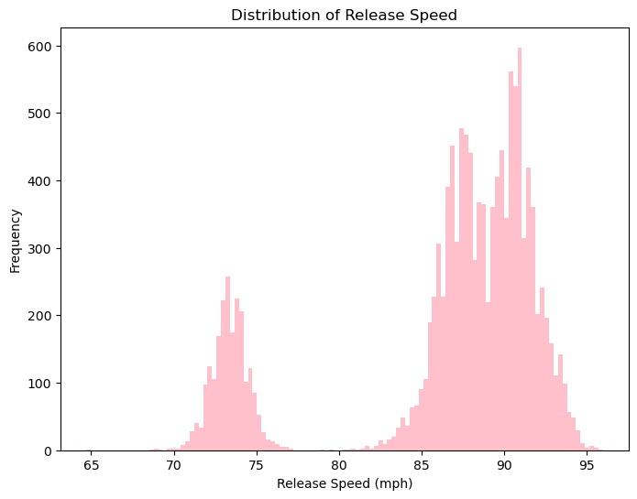
Eda:
Distribution of target variable
Two peaks

Slide 4
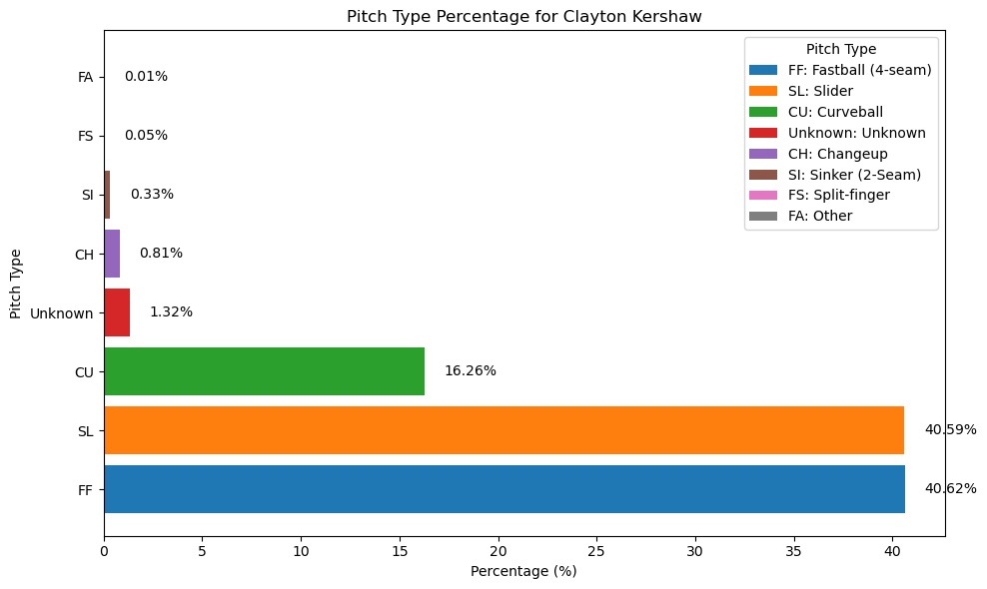
The percentage of each pitch type

Slide 5
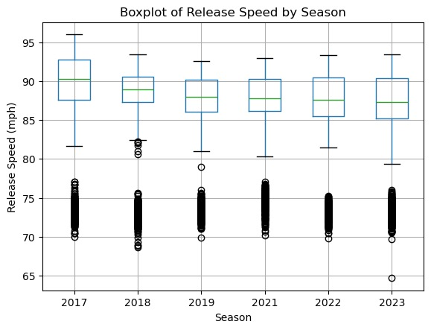
Distribution of release speeds in different seasons
Find out whether the player’s performance was affected after having COVID-19 in 2020

Slide 6
Splitting:
This is an non iid dataset and is based on pitch type.
GroupShuffleSplit to make sure the points from the same pitch type are in the same set and split the test set (20%)
GroupKFold to split the other two sets, train set and test (validation) set
I choose n_split = 3 folds to do this splitting, since the dataset has 8 groups. 3 is a reasonable choice.

Slide 7
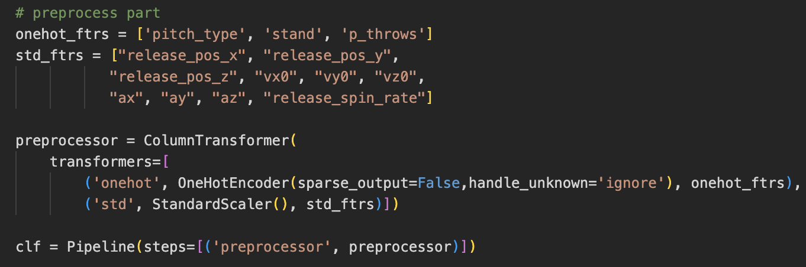
Preprocessing:
 | Before | After
Fold 1 | (5661, 13) | (5661, 18)
Fold 2 | (5664, 13) | (5664, 18)
Fold 3 | (10745, 13) | (10745, 15)

Slide 8
Thank you for listening

