Slide 1
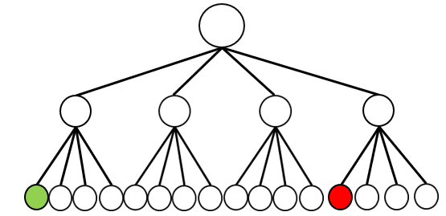
Initial State
Goal State

Slide 2
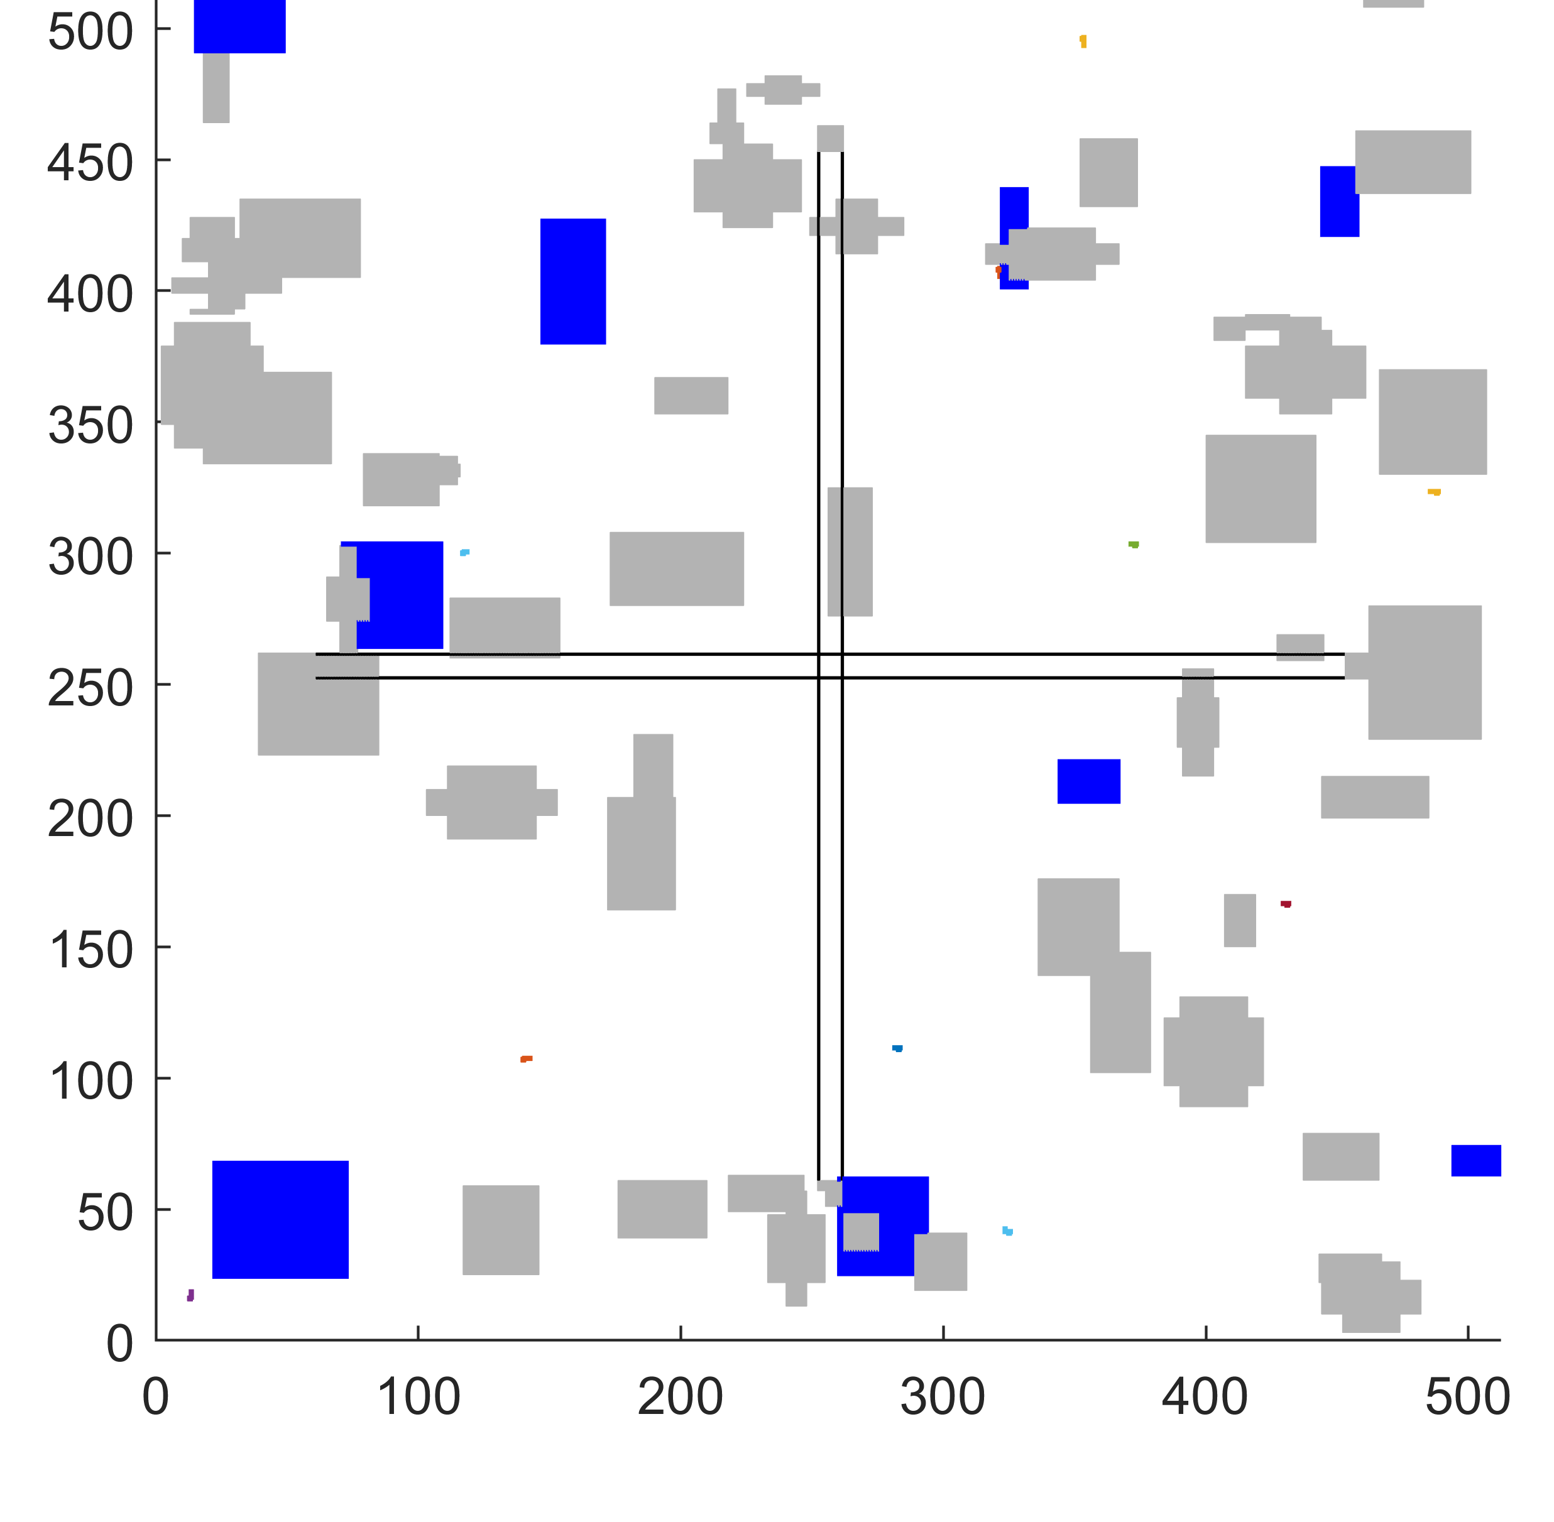
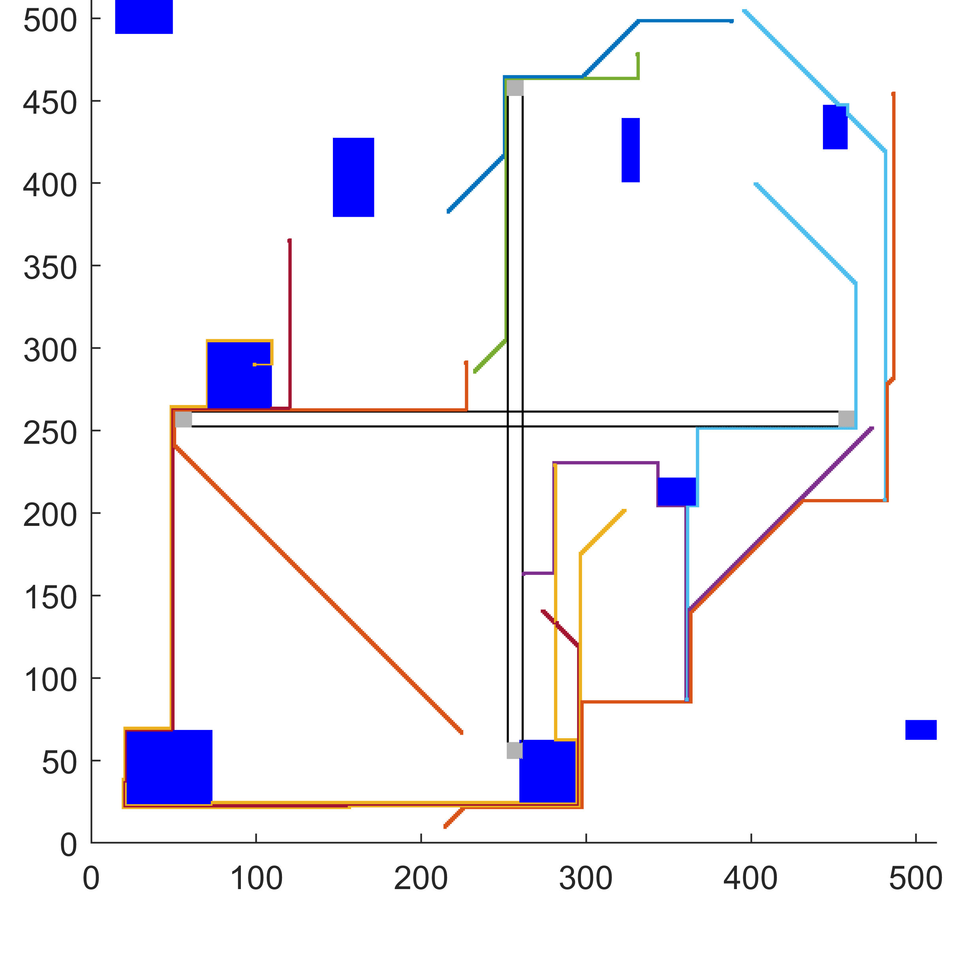
Permanent No-fly Zone(PNZ)
High Risk Zone(HRZ)
Out-network Flight(OF)
Reserved Zone(RZ) by
Different Agents

