Slide 2
Update of Q-table with H-J safety update rule

Slide 3
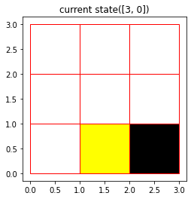
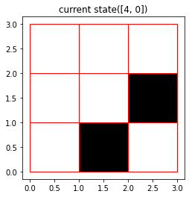
One sample iteration
(1, 0)
What is the l(s[4,0])?
l(s([4,0])) < 0 because s([4,0]) is a failure state

Slide 4
Complexity Analysis
Theoretical Possible state = 2^8 = 256
possible action: 7
Q-table size: 256 * 7 = 1792

Slide 5
Results:
Training time(i7-9750H): 3.17seconds
Training iteration: 300,000
Recognized State: 124 out 256
easy mode: reach 990 in 655 steps
(less than 0.5 obstacle per line)
Mid mode: crash at 133
(less than 1 obstacle per line)
Hard mode: crash at 14
(1 obstacle per line)

Slide 6
Training improvement to achieve better results
Wide training cases
Bigger observation
Bigger action range
Future improvement
Dynamic environment
Control acceleration instead velocity like real world driving.

Slide 7





Slide 8
0 | 0 | 0 | 0 | 0 | 0 | 0 | 0 | 0 | 0 | 0 | 0 | 0 | 0 | 0 | 0
0 | 0 | 0 | 0 | 0 | 0 | 0 | 0 | 0 | 1 | 0 | 100 |  |  |  | 0
0 | 0 | 0 | 0 | 0 | 0 | 0 | 99 |  | 1 | 0 |  |  |  |  | 0
0 | 0 | 0 | 0 | 0 | 0 | 0 |  |  | 1 | 0 |  |  |  |  | 0
0 | 0 | 0 | 0 | 0 | 0 | 0 | 0 | 0 | 1 | 0 |  |  |  |  | 0
0 | 0 | 0 | 0 | 0 | 100 |  |  | 0 | 1 | 1 | 1 | 1 | 1 | 1 | 0
0 | 0 | 0 | 0 | 0 |  |  |  | 0 | 0 | 0 | 0 | 0 | 0 | 1 | 0
0 | 0 | 99 |  | 0 |  |  |  | 0 | 0 | 0 | 0 | 99 |  | 1 | 0
0 | 0 |  |  | 101 | 101 | 101 | 101 | 101 | 101 | 101 | 101 |  |  | 1 | 0
0 | 0 | 0 | 1 | 1 | 1 | 1 | 1 | 1 | 1 | 1 | 1 | 1 | 1 | 1 | 0
0 | 0 | 0 | 1 | 0 | 0 | 0 | 0 | 0 | 0 | 0 | 0 | 0 | 0 | 0 | 0
0 | 0 | 0 | 1 | 0 | 0 | 0 | 0 | 0 | 0 | 0 | 0 | 0 | 0 | 0 | 0
0 | 0 | 0 | 1 | 0 | 0 | 0 | 99 |  | 0 | 0 | 0 | 0 | 0 | 0 | 0
0 | 0 | 0 | 0 | 0 | 0 | 0 |  |  | 0 | 0 | 0 | 0 | 0 | 0 | 0
0 | 0 | 0 | 0 | 0 | 0 | 0 | 0 | 0 | 0 | 0 | 0 | 0 | 0 | 0 | 0
0 | 0 | 0 | 0 | 0 | 0 | 0 | 0 | 0 | 0 | 0 | 0 | 0 | 0 | 0 | 0

