Slide 1
Learning-accelerated A* Search for Risk-aware Path Planning
Jun Xiang, Ph.D. Student
Junfei Xie, Associate Professor
Jun Chen, Assistant Professor
Department of ECE and AE, SDSU
AIAA SciTech Forum 2024
Copyright © 2024 Jun Xiang, Junfei Xie and Jun Chen . Published by the American Institute of Aeronautics and Astronautics, Inc., with permission.
Notes:
Hi, my name is Jun Xiang, and I will be presenting the dynamic unmanned aerial system traffic volume reservation based on Multi-Scale A*. This work was done by Victor Amaya, Dr. Chen and myself. From the department of aerospace engineering, San Diego State University.

Slide 2
Background
safety
efficiency
Safety is the most critical factor to operate Unmanned Aerial Vehicles (UAVs) in the airspace while efficiency is also essential.
Therefore, we want to find the flight path with the lowest cost while avoiding high-risk area.
Finding the most efficient path with safety constrained is a Constrained Shortest Path(CSP) problem
Notes:
Background: Two most critical factors of the path planning are safety and efficiency. Therefore, we want to find the flight path with the lowest cost while avoiding high-risk area.

Slide 3
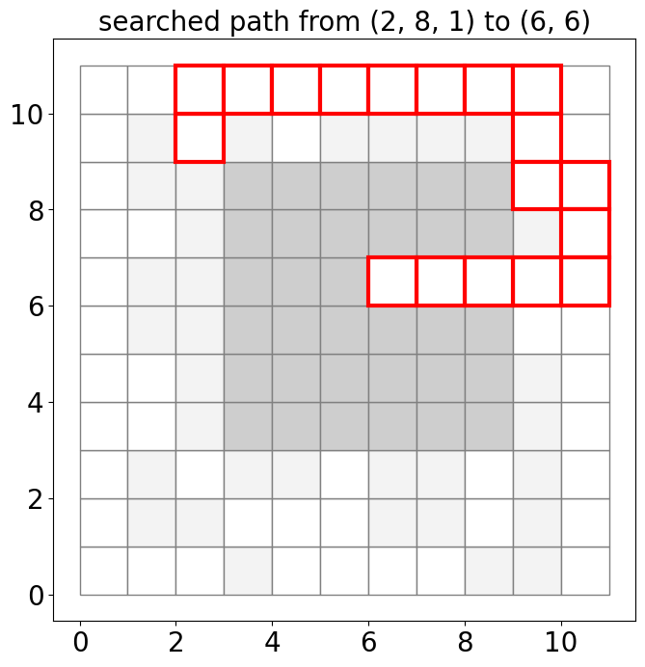
Problem Statement
Constrained Shortest Path(CSP)
Notes:
Let us look at this grid map, the grid map include grids and edges, grids are those small boxes, edges are the path connect between adjacent boxes. In this paper, we assume there are four path for each grid, up, down, left and right. We also assume the cost to move from one grid to another grid is uniform.
Each grid has a risk score, the darker the color is , the risk is higher.
Therefore, the CSP problem can be modeled as this optimizing problem.
We want to minimize the total cost of the path. C is the cost of moving from grid u to grid v. z is a binary variable determining if the agent passes edge from the grid u and grid v.
If we find that the agent fly from this grid to this grid, the z value will be 1. and we find the agent didt fly from this grid to this grid, the z value will be 0.
The minizine problem is subjective to the following constrains.
The first constrain enforces the number of edges leading towards a grid is equal to the number of edges leaving the grid. Unless the grid is the start grid or destination.
The second constrain is the safety constrain.
The third constrain will help us to eliminates the sub-tour. It not important to this paper. We will just skip it.

Slide 4
Traditional Way to Solve CSP
CSP is NP-hard but solve it is solvable
Dynamic programming via the labeling of nodes[1]
Lagrangian Relaxation[2]
Kth-shortest path[3]
……
all of those methods are very slow even with the accelerating algorithm
reference: [1] Desrochers, M. and Soumis, F., “A generalized permanent labelling algorithm for the shortest path problem with time windows,” INFOR: Information Systems and Operational Research, Vol. 26, No. 3, 1988, pp. 191–212.
[2] Handler, G. Y. and Zang, I., “A dual algorithm for the constrained shortest path problem,” Networks, Vol. 10, No. 4, 1980, pp. 293–309.
[3] Dumitrescu, I. and Boland, N., “Improved preprocessing, labeling and scaling algorithms for the weight-constrained shortest path problem,” Networks: An International Journal, Vol. 42, No. 3, 2003, pp. 135–153.
Notes:
Although CSP is a np-hard, it is still solvable by many previous methods.
However, all of those methods are very slow.

Slide 5
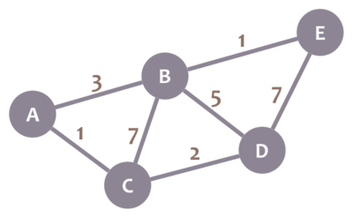
A* algorithm
A* algorithm is one of the most significant and widely used artificial intelligence algorithm
A* was revolutionary in its approach to incorporating Heuristics
$$f\left(n\right)=g\left(n\right)+h\left(n\right)$$
f(n) is the total estimated cost of the path through the node n
g(n) is the is the cost from the start node to the node n
h(n) is the heuristic estimated cost from n to the goal
Picture source: https://www.codingame.com/playgrounds/1608/shortest-paths-with-dijkstras-algorithm/dijkstras-algorithm
Notes:
I am going to introduce the A* algorithm briefly.
In this graph, what is the shortest way from node A to node E.
Being a human, we suddenly know ABE is the shortest way.
Image we are computer. And we start at node A, and we find we have two neibors, node B, and node C.
Apparently, C is closer. So, why do we just ignore C and still go to B. Because we knew, node B is closer to node E than node C.
To find the better node to go, we need consider both the distance from the current node, and the distance from the destination.
It leads the most equation for A* algorithm. A* explore the node with the lowest f value.

Slide 6
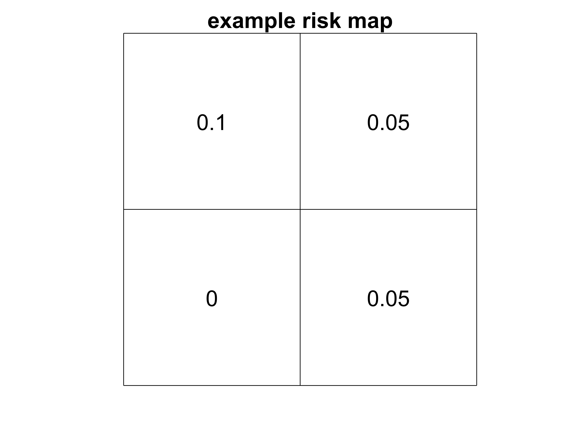
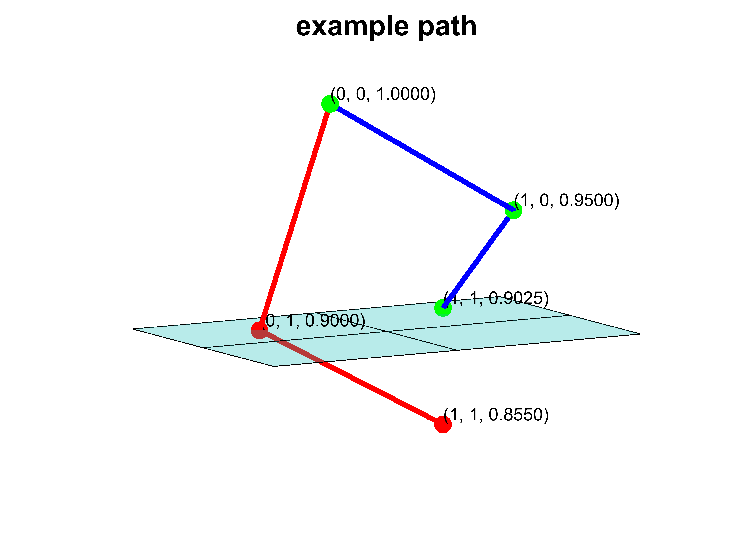
Additional Safe Dimension A* Algorithm
safety
Notes:
In this paper, we introduce a special A* algorithm to solve CSP. On a 2d graph, we introduce an additional abstract dimension. When agent move, the agent does not only move in the physical dimension. They also move in the safety dimension. For example….

Slide 7
Heuristics
Must be admissible
Monotone
Most popular heuristic include Manhattan, Euclidean, and Triangle Inequality Landmarks.
However, all of those heuristic are not very efficient in a risk map. Because many shorter ways are blocked

Slide 8
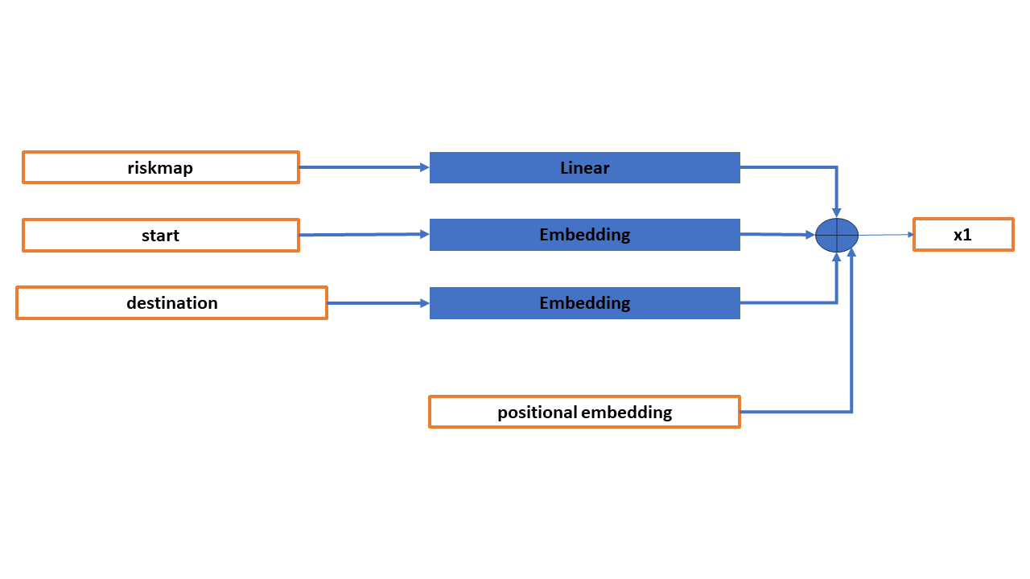
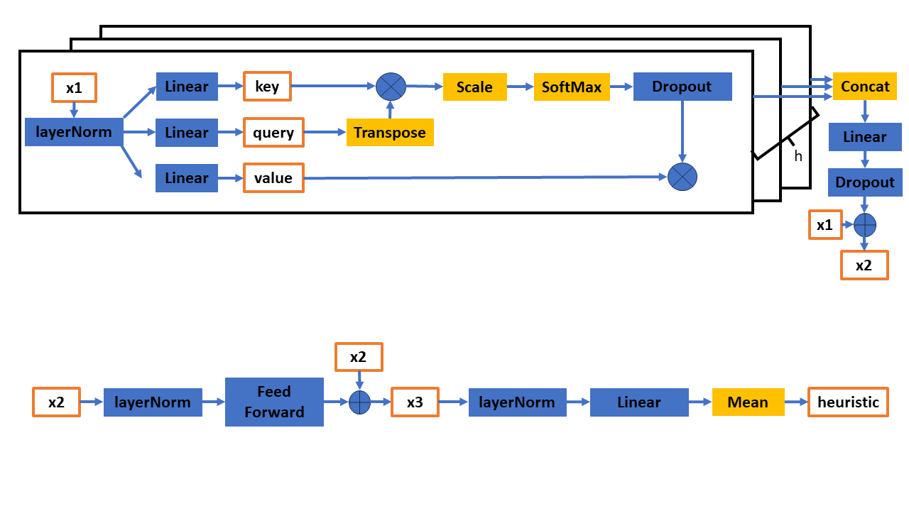
Generate Heuristic with NNs

Slide 9
Generate Heuristic with NNs(Input)

Slide 10
Generate Heuristic with NNs(Backbone)

Slide 11
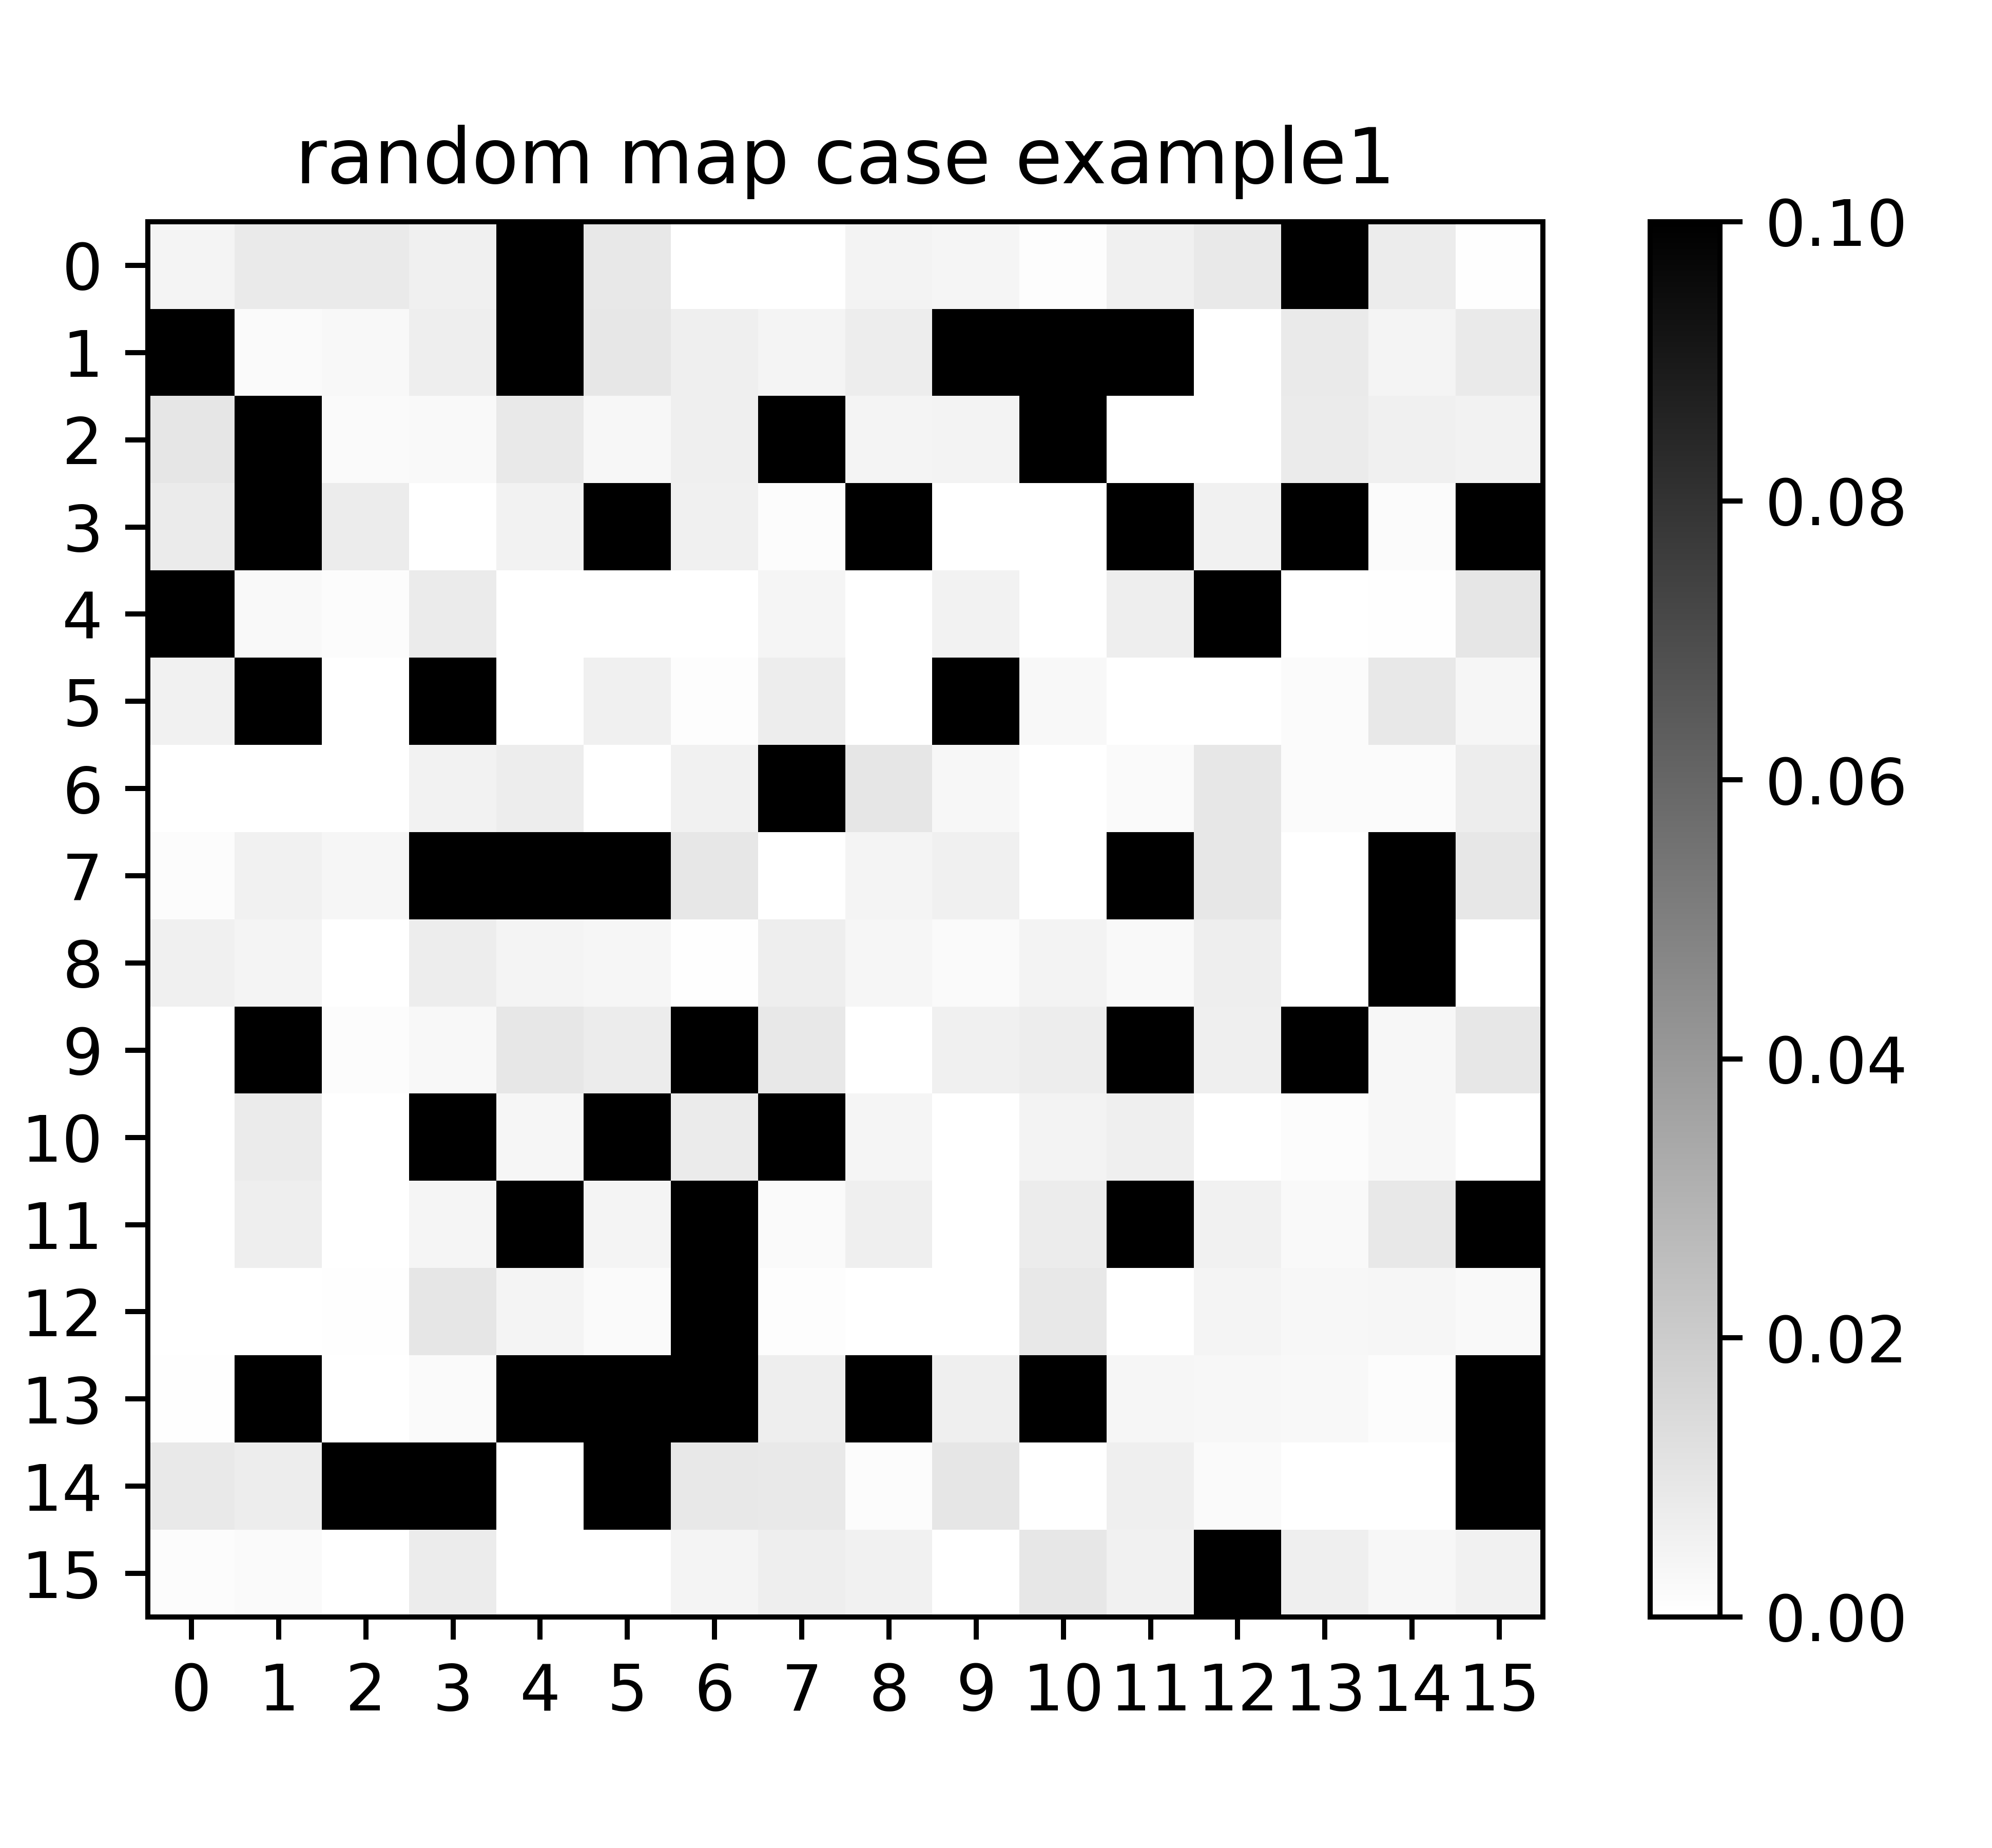
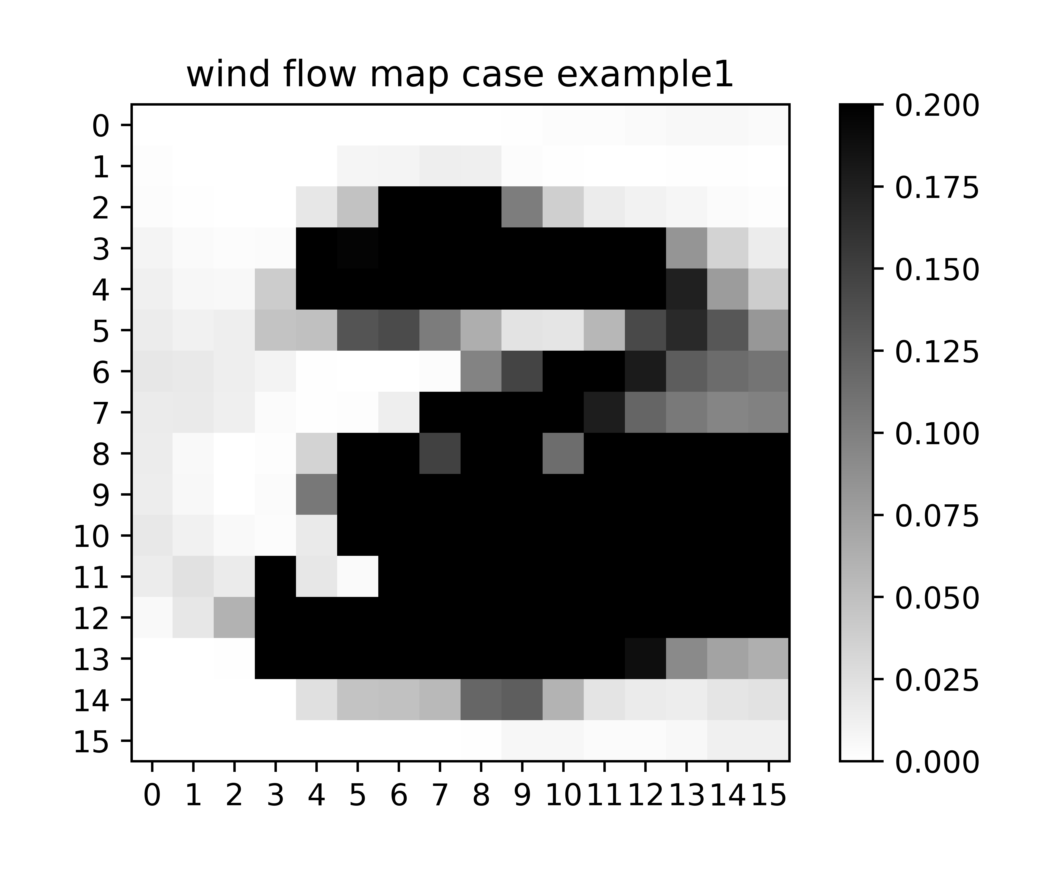
Training
Two datasets.
Random map: 471 maps and 4896699 cases for training, 52 maps and 528952 cases for test. 20% safe, 20% dangerous, 60% risky.
Wind flow map: 995 maps and 9339265 cases for training, and 84 maps and 802934 cases for test. Both map has fixed safety threshold. From a city wind flow simulator.
GPU: Nvidia RTX3090
Time: 350 hours for random and 250 hours for wind flow.

Slide 12
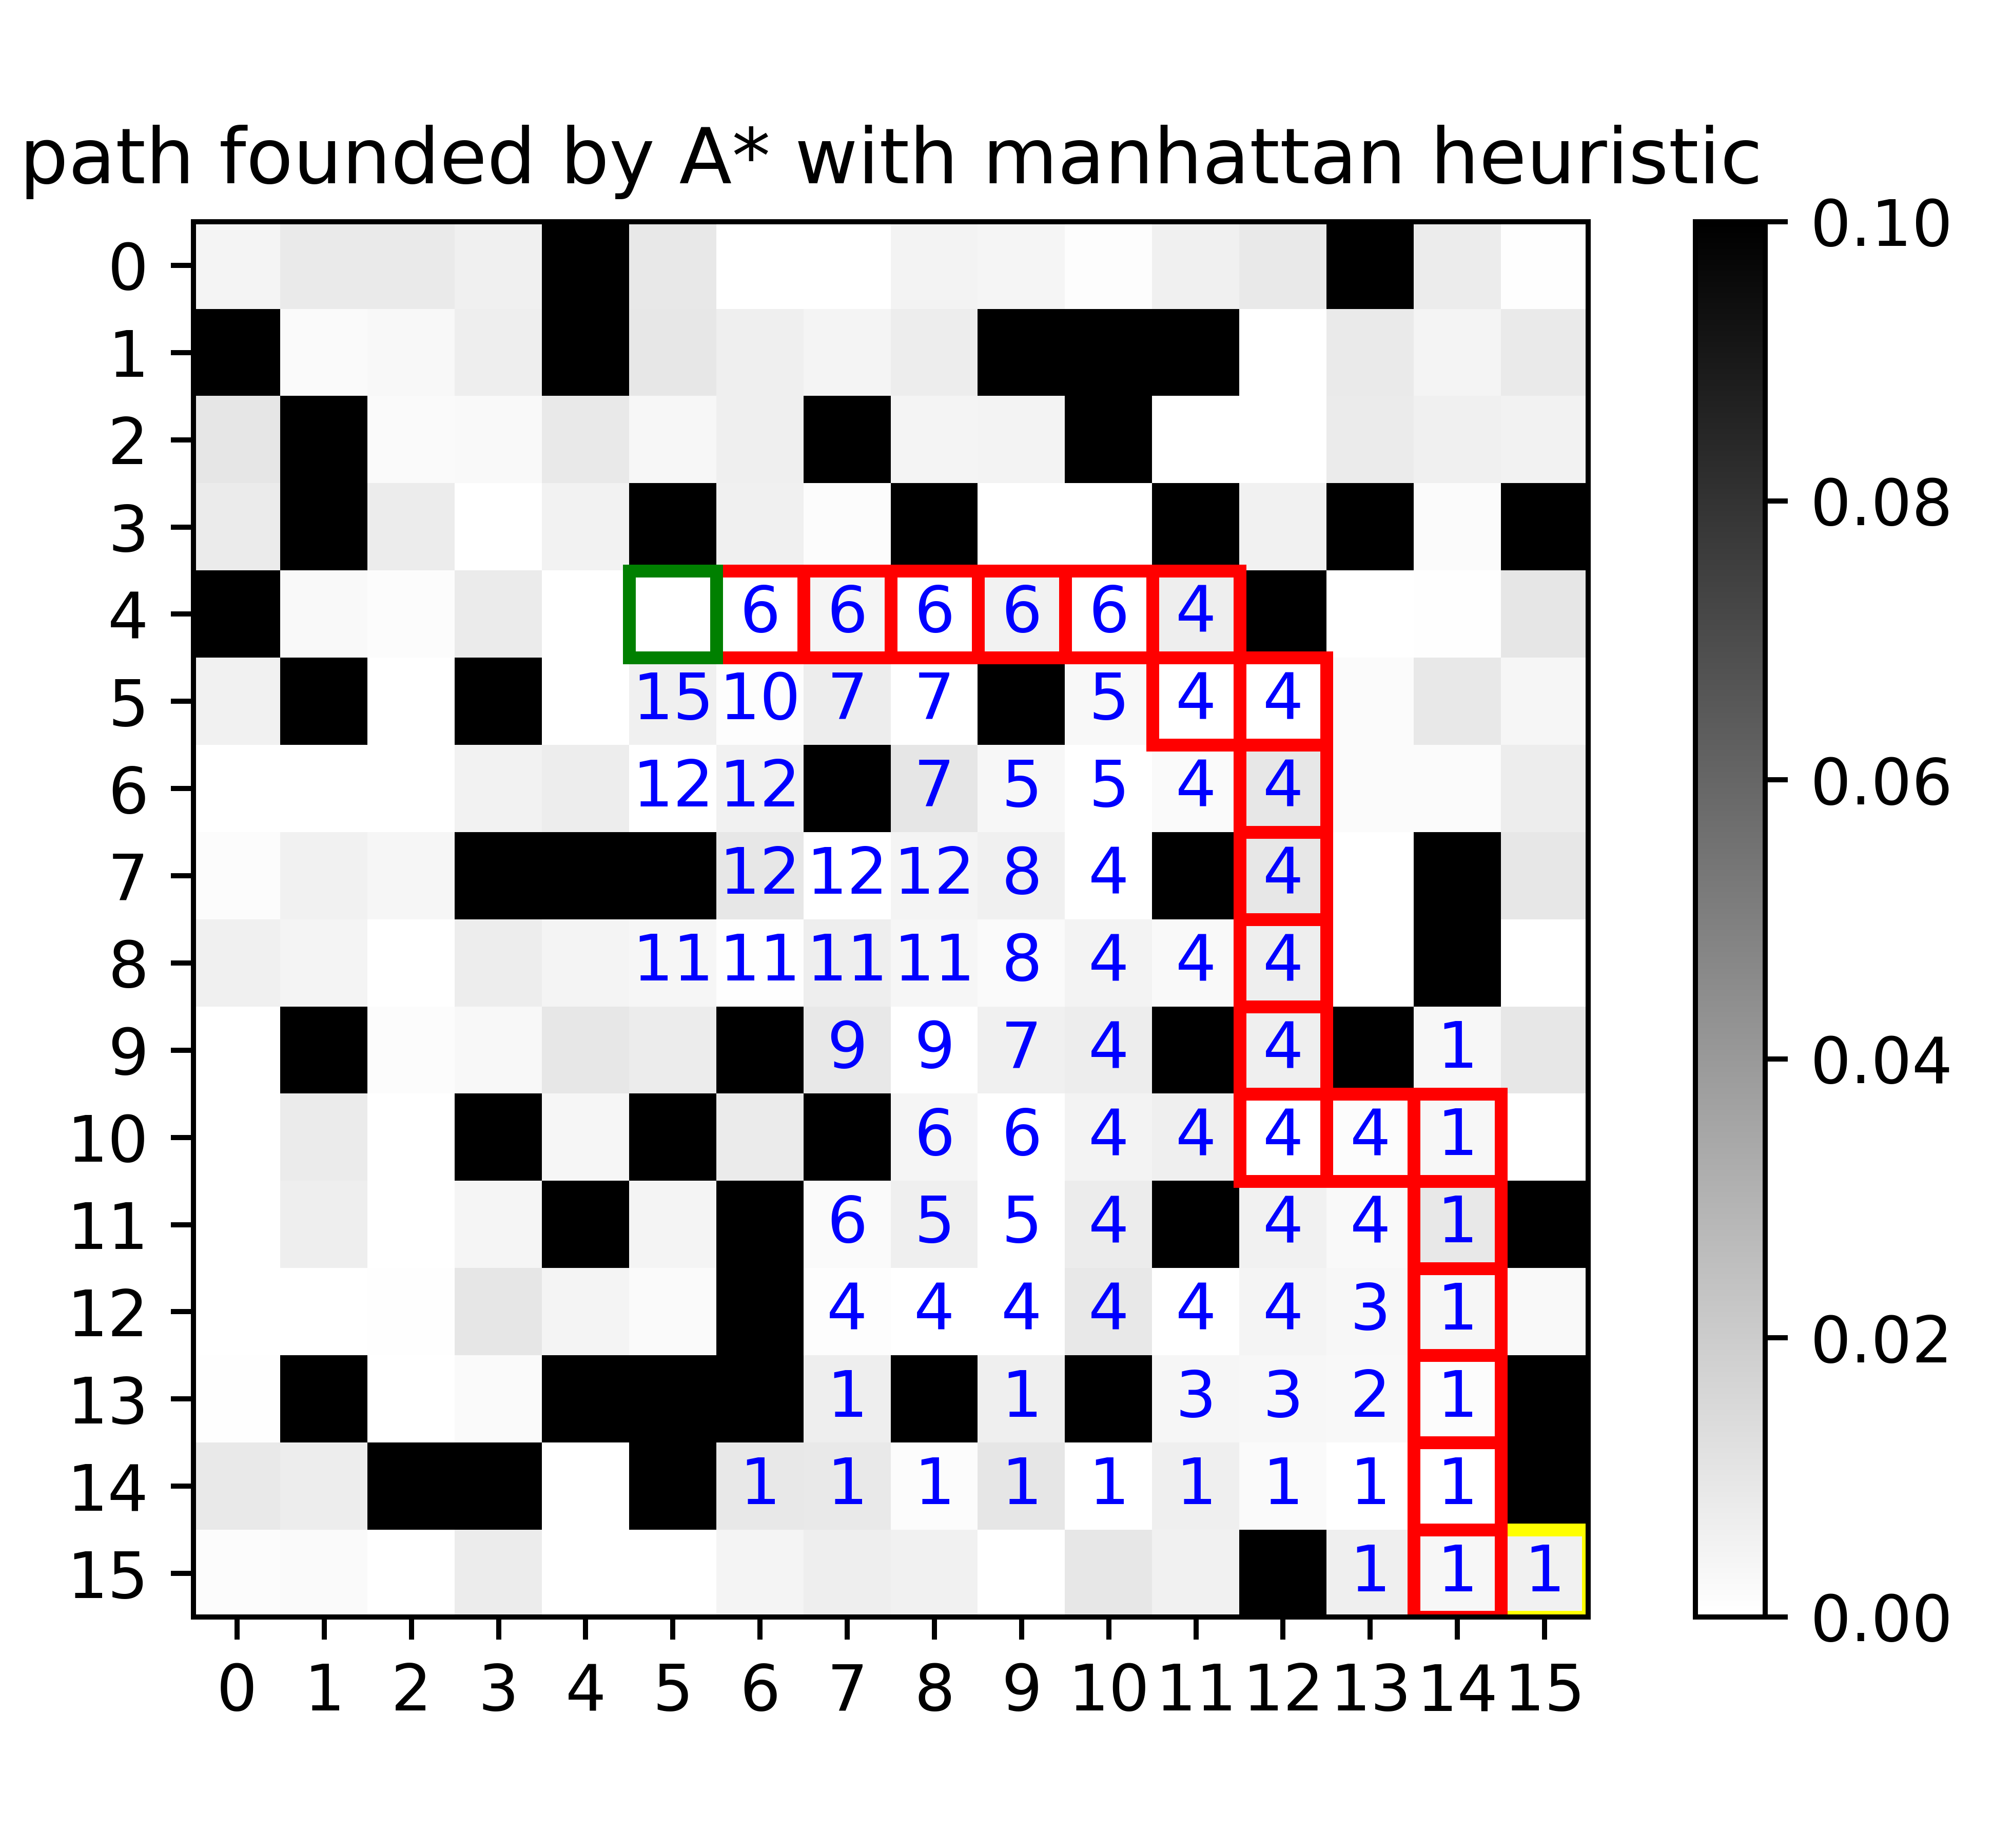
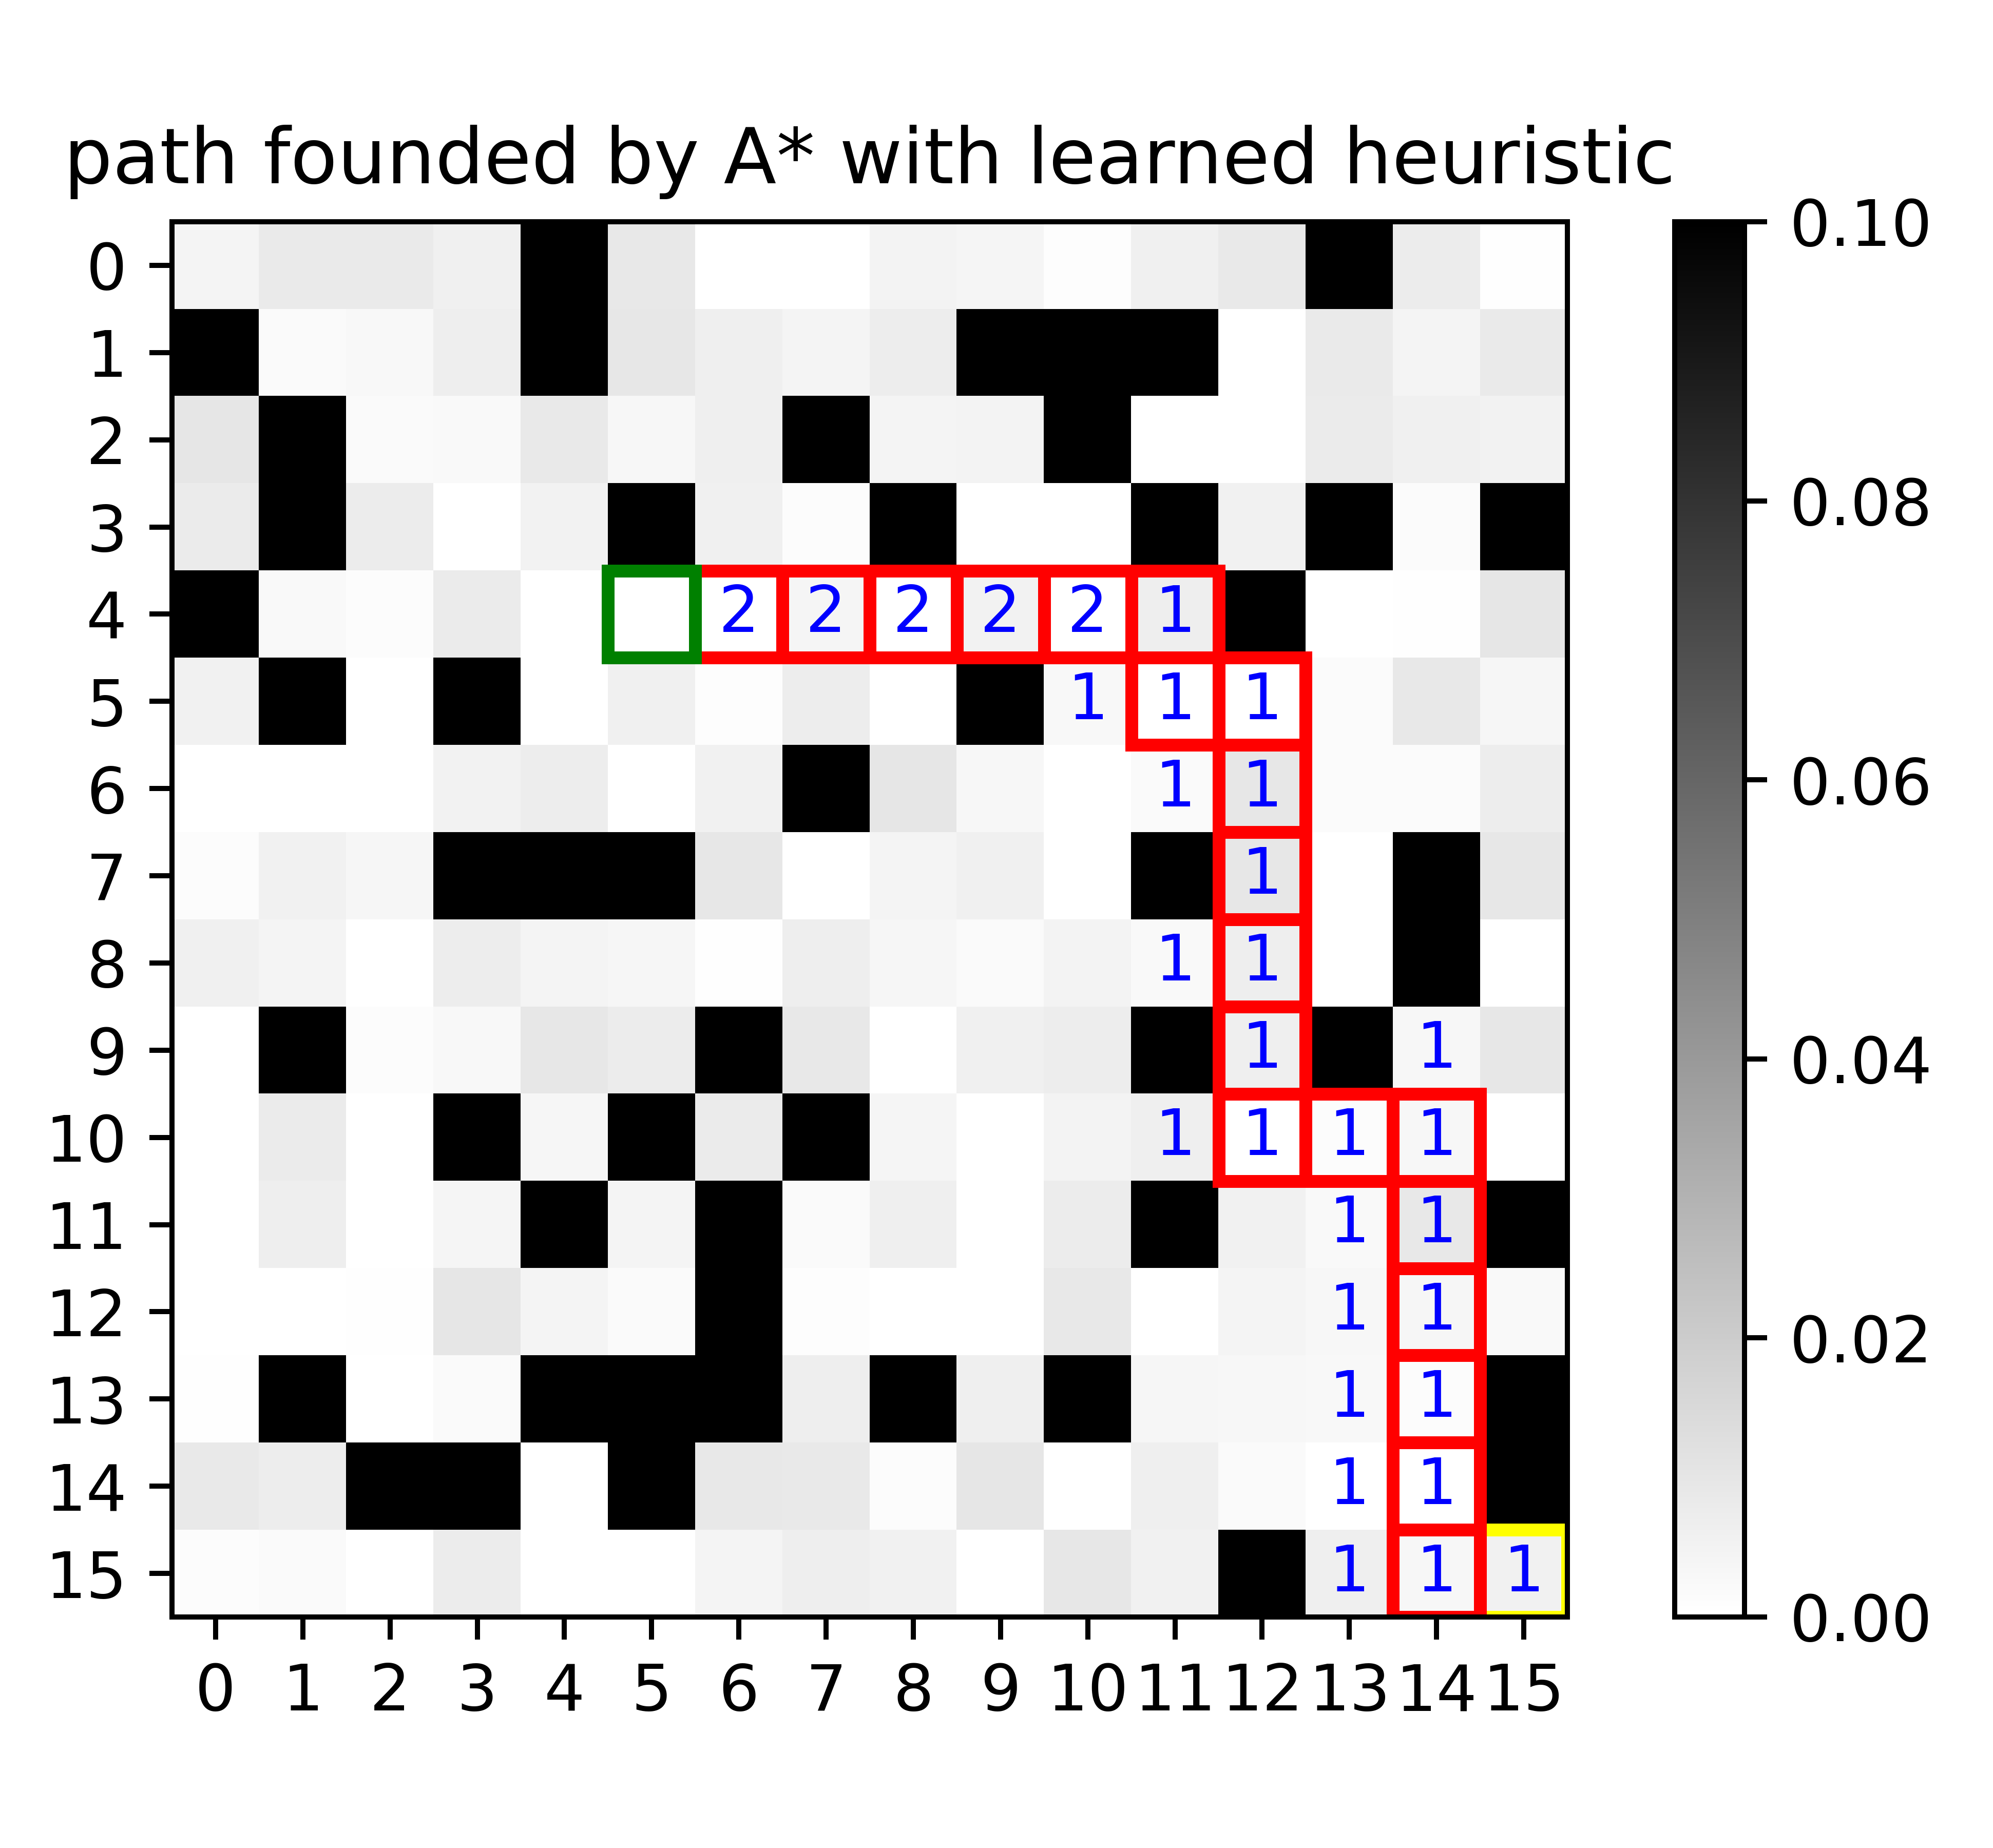
Experience Example(Random)
Notes:
Here is our reservation algorithm.
Until the agent reaches its destination.
It constructs a multi-resolution graph,
defines the initial block and the goal block,
runs MSA* to find the optimal path from the initial block to the goal block.
Then, it reserve the nodes in the front of the path.
After the reservation, the agent moves along the path to the next node and repeats the previous processes.

Slide 13
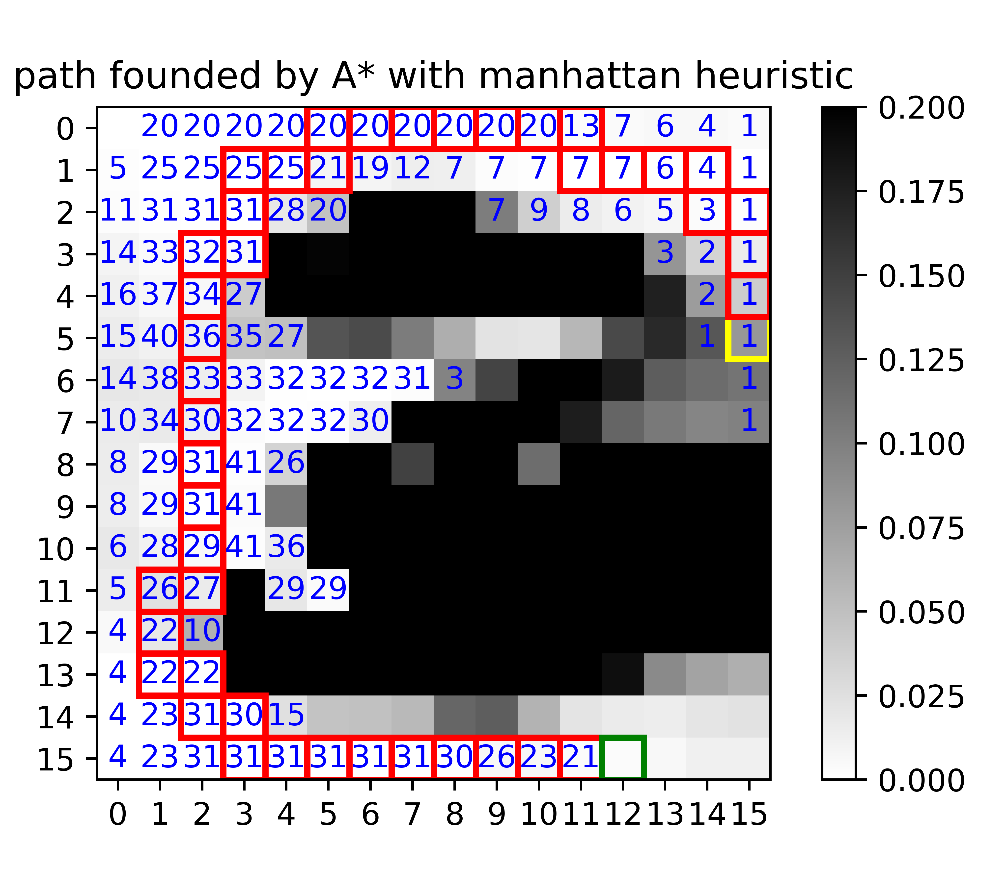
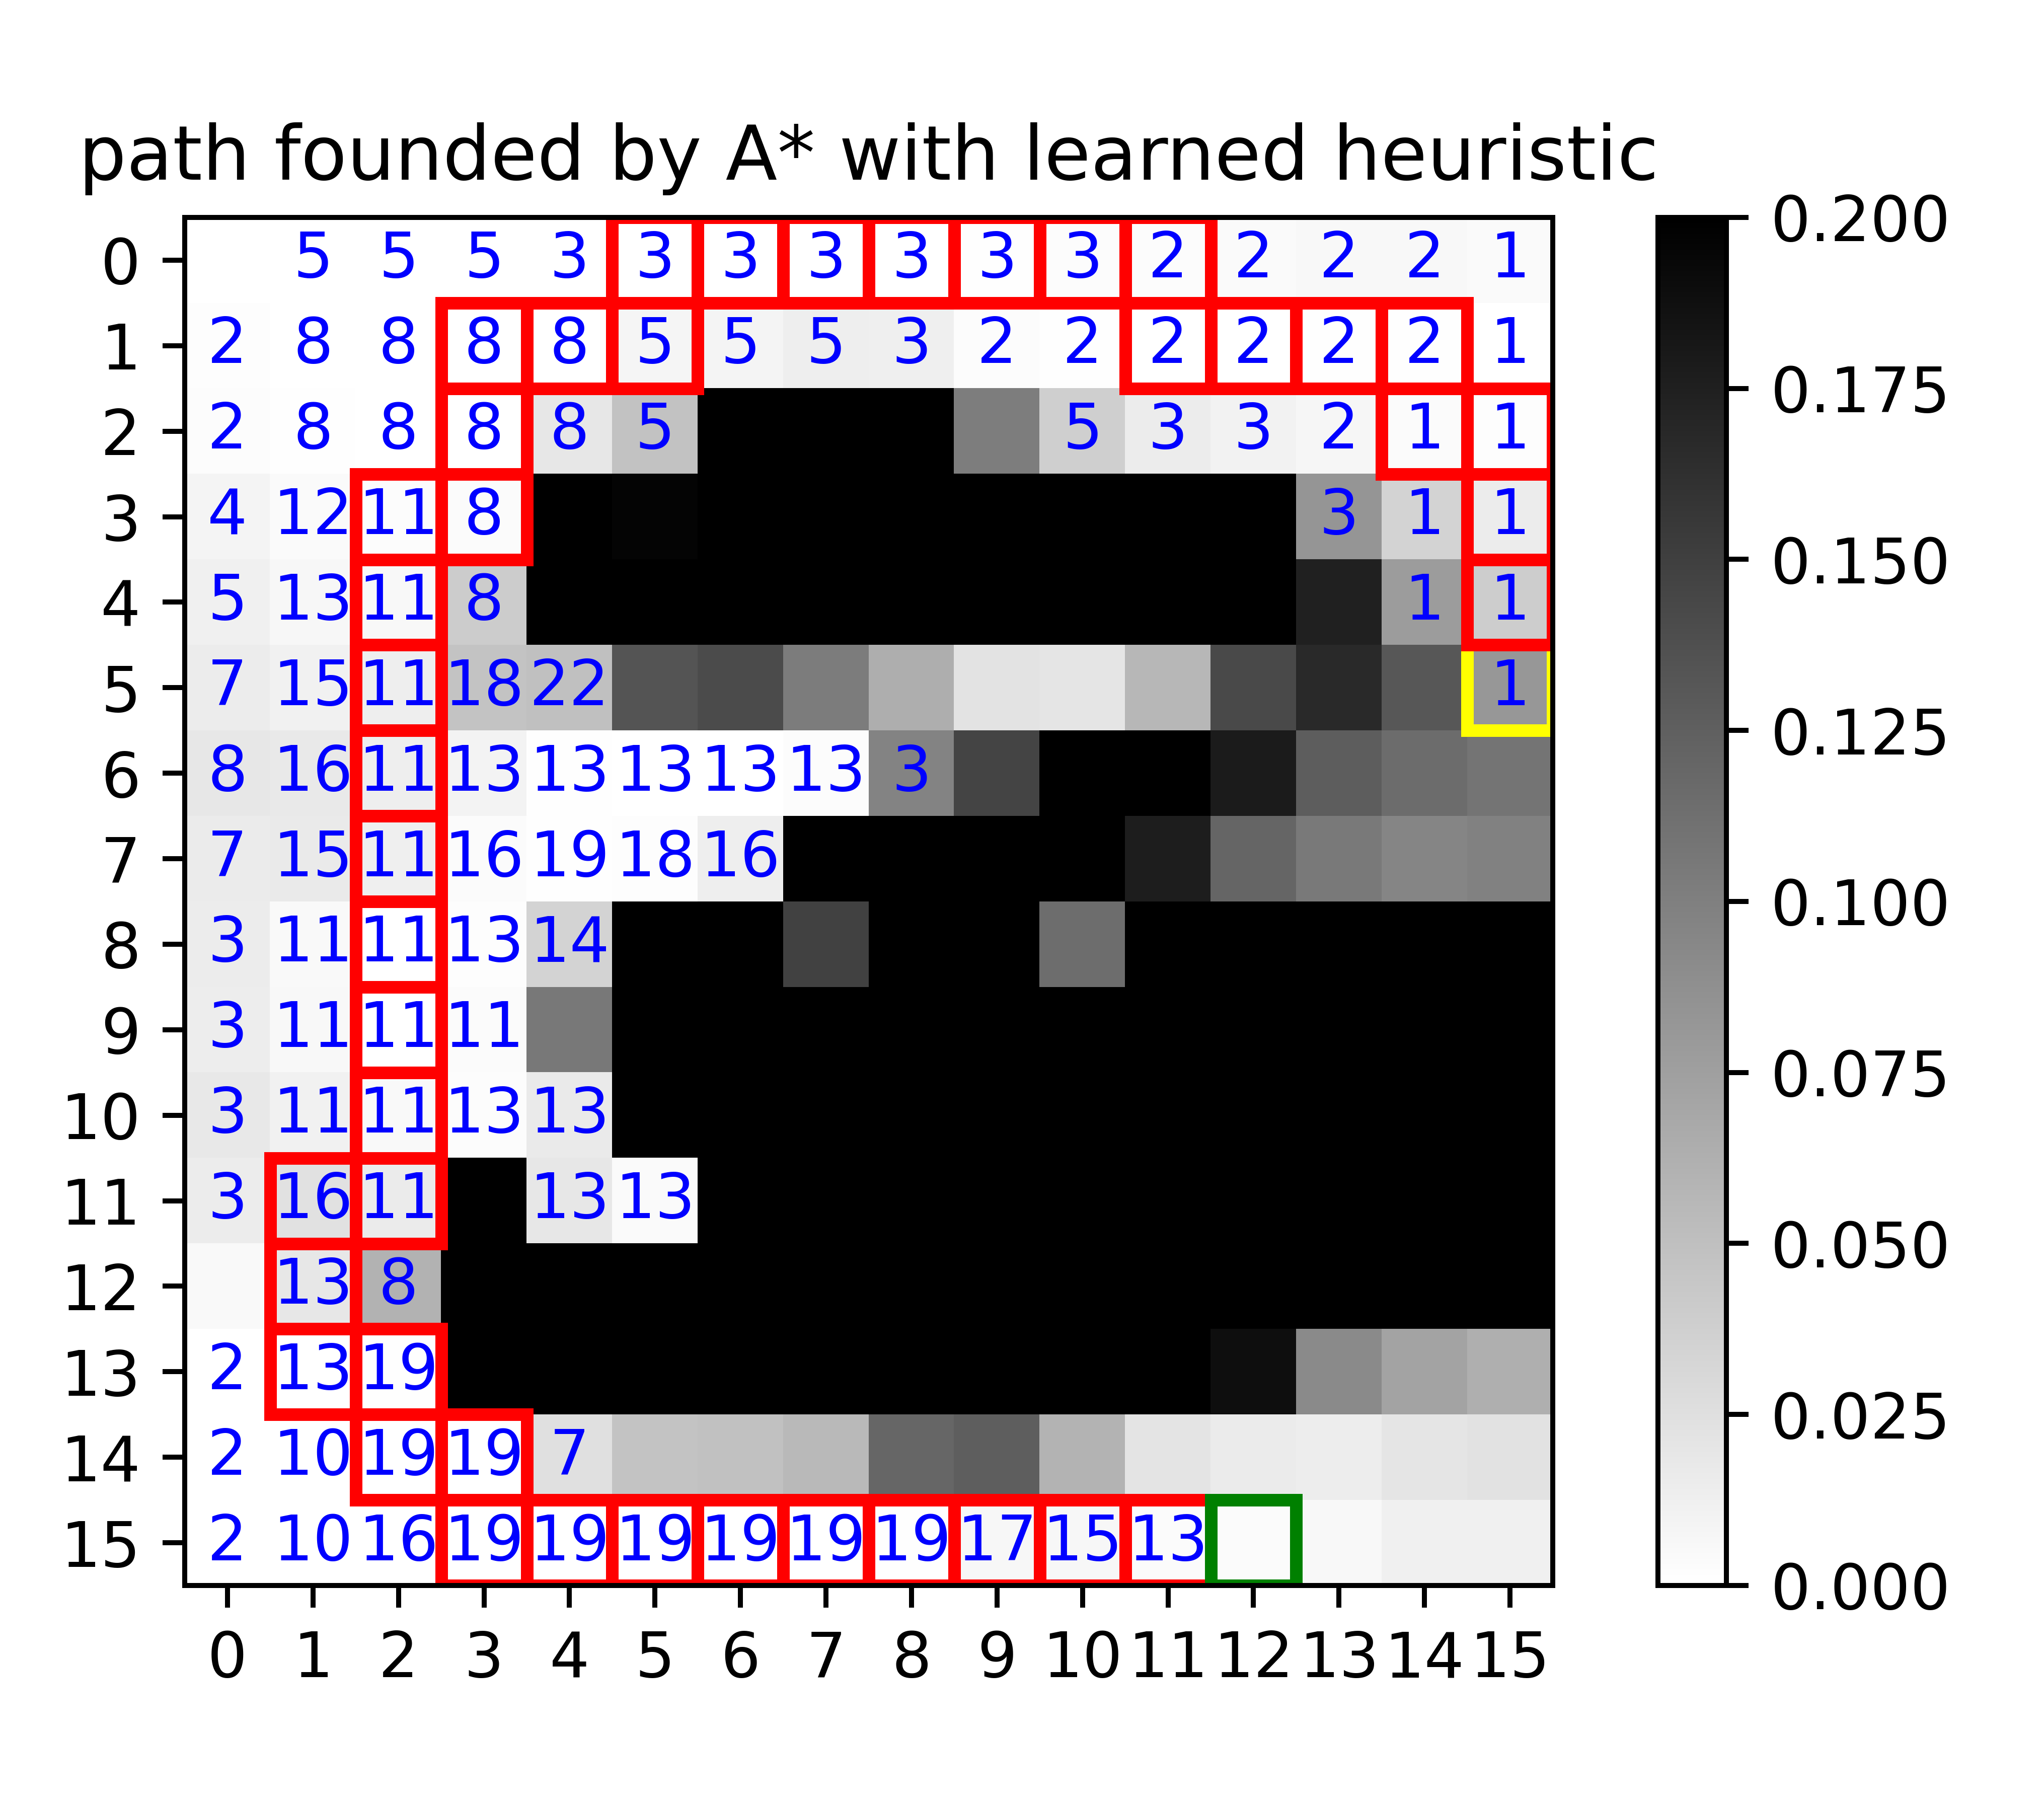
Experience Example(Wind Flow)
Notes:
Here is our reservation algorithm.
Until the agent reaches its destination.
It constructs a multi-resolution graph,
defines the initial block and the goal block,
runs MSA* to find the optimal path from the initial block to the goal block.
Then, it reserve the nodes in the front of the path.
After the reservation, the agent moves along the path to the next node and repeats the previous processes.

Slide 14
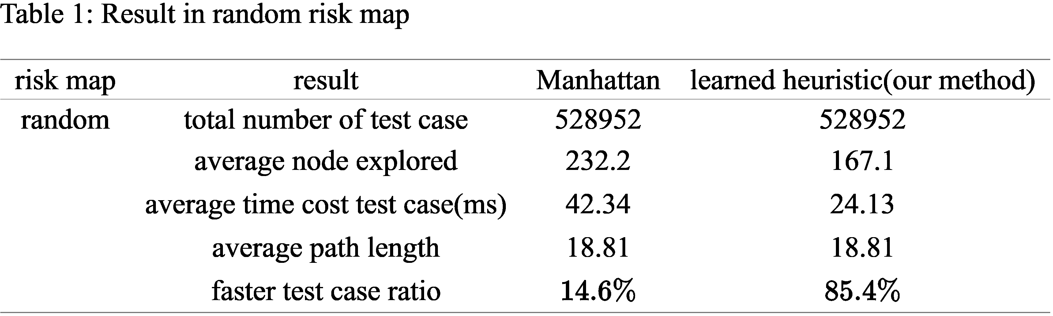
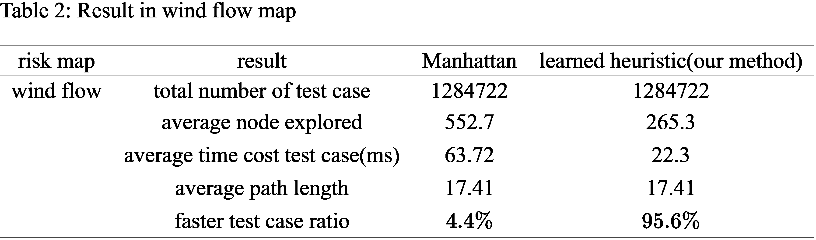
Results:
Notes:
We also test the MSA* in dynamic environment. The experiences show that the agent moving with MSA*, can reach the destination and avoid the moving obstacle.

Slide 15
Conclusion and Future Implementation
Conclusion:
drastically shortening the A* algorithm’s run time in 16 x 16 grid world
accelerate NP-hard problem solver
Future:
test in larger grid world
improving the neural network
Notes:
The proposed method can drastically shorten the A* algorithm’s run time and makes real-time path-planning and reservation possible
In the future, we would like to implement this method in a 3D real-time city with high density air traffic.

Slide 16
jxiang9143@sdsu.edu jxie4@sdsu.edu Jun.Chen@sdsu.edu

