Slide 1
Service-Oriented Architectures
COMP 30220: Distributed Systems
Lecturer: Rem Collier
Email: rem.collier@ucd.ie

Slide 2
Service-Oriented Architectures
An architectural design pattern in which a system is viewed as being composed of services that interact through some well-defined API.
“As a gross generalization, a service is a repeatable task within a business process. So, if you can identify your business processes, and within that the set of tasks that you perform within the process, then you can claim that the tasks are services and the business process is a composition of services” [IBM, 2007]
The pattern applies both for centralized applications (e.g. OSGi) and distributed applications (web services).

Slide 3
Service-Oriented Architectures
Based on the use of standards to integrate software modelled as services.
How to declare a service
How to deploy a service
How to use a service
Services become the building blocks on which the applications are built.
Developing an application becomes focused on service orchestration – what services are needed to realise the business need and how should they be linked together.
Services can be reused to deliver multiple applications – obvious example: single sign-on function of google, facebook, …

Slide 4
So, What is a Service?
A service is a reusable component that can be used as a building block to form larger, more complex business-application functionality.
It can be as simple as “get me some person data” or as complex as “process an insurance quote”.
It is a discrete business function that operates on data in a consistent and predicable way.
It is based on open standards – maximises compatibility of service implementation.
It is loosely coupled – the consumer provides only the stated data and expects only the specified results – the service handles everything else (including error handling).
It is stateless –services do not maintain data between invocations; everything necessary is given in the input.
It is location independent – we do not care where the service is or how it is implemented; the infrastructure takes care of this.

Slide 5
Service-Oriented Architectures
The goal of SOA is to provide a standardised way to allow services to interoperate effectively.
Services can be used to seamlessly integrate new business functions and legacy systems in a way that is simple to manage…

Slide 6
Case Study: OSGi

Slide 7
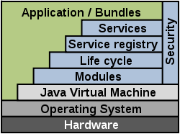
OSGi: Java-based SOA
OSGi: Open Services Gateway initiative.
Proposed by Ericsson, IBM, Motorola, and Sun Microsystems in 1999.
A service-oriented component-based infrastructure for Java applications.
It is the infrastructure that underpins the Eclipse IDE (plugin = module/bundle).

Slide 8
OSGi: Java-based SOA
OSGI is a modular approach to building software:
Modular programming is a software design technique that emphasizes separating the functionality of a program into independent, interchangeable modules.
Modules are often known as components.
In some cases one module may require functionality provided by another module this is known as a dependency.
Girl Power Module
Oldfellas Module
Broker
Module
Vetting
Module
Dodgy Drivers Module
GUI Module

Slide 9
OSGi: Java-based SOA
In OSGi:
Code is organised into modules, known as bundles.
Bundles can be dynamically installed, resolved, started, stopped, and uninstalled.
Each bundle has its own class loader.
Dependencies between bundles can be specified and are managed by the OSGi Runtime.
For OSGi a dependency = using a class / interface from one bundle in another bundle.
Bundles contain services that implement the core system functionality.
Services are typically implemented as an interface (service definition) + a class (service implementation).
Bundles contain an activator – a special class that starts up the required services.
Bundle configurations are written in a MANIFEST.MF file.

Slide 10
OSGi: Bundle Activator
package helloworld;
import org.osgi.framework.BundleActivator;
import org.osgi.framework.BundleContext;
public class Activator implements BundleActivator {
private BundleContext context;
@Override
publsic void start(BundleContext context) throws Exception {
System.out.println("Starting: Hello World");
this.context = context;
}
@Override
public void stop(BundleContext context) throws Exception {
System.out.println("Stopping: Goodbye Cruel World");
this.context = null;
}
}

Slide 11
OSGi: Bundle Manifest
MANIFEST.MF:
Bundle-Name: Hello World
Bundle-SymbolicName: helloworld
Bundle-Description: A Hello World bundle
Bundle-ManifestVersion: 2
Bundle-Version: 1.0.0
Bundle-Activator: helloworld.Activator
Export-Package: helloworld;version="1.0.0“
Import-Package: org.osgi.framework;version="1.3.0"

Slide 12
OSGi: Recommended Deployments
Recommended structure for OSGi Applications:
Core Bundle(s): These bundles contain all of the Java interfaces and classes that are used throughout the application.
Each bundle contains a related set of interfaces and classes.
Typically, there are no dependencies between core bundles.
Implementation Bundle(s): These bundles implement the services used by the application.
Each bundle contains the classes that implement the service and an activator to start / stop the services.
Typically, these bundles are dependant on the core bundles.
Application (Service User) Bundle(s): These bundles implement the business logic of the application.
They specify which services are to be used an in what order.
Typically, these bundles are dependant on the core bundles.
Application bundles should not have dependencies on Implementation bundles!

Slide 13
OSGi: Example Service
Calculator: A Simple OSGi Application
The key here is that the application bundle has no idea about the implementation bundle (even though it is using it).
The interaction is only possible because of the shared dependency on the core module, which includes the Calculator interface.
calculator.core
calculator.app
calculator.impl

Slide 14
OSGi: Example Service
Calculator: A Simple OSGi Application
calculator.core: This bundle contains the Calculator interface:
public interface Calculator {
public long add(long a, long b);
public long sub(long a, long b);
public long mul(long a, long b);
public long div(long a, long b);
}

Slide 15
OSGi: Example Service
Calculator: A Simple OSGi Application
calculator.impl: This bundle contains the implementation of the Calculator interface:
public class CalculatorImpl implements Calculator {
@Override
public long add(long a, long b) { return a + b; }
@Override
public long sub(long a, long b) { return a - b; }
@Override
public long mul(long a, long b) { return a * b; }
@Override
public long div(long a, long b) { return a / b; }
}

Slide 16
OSGi: Example Service
Calculator: A Simple OSGi Application
calculator.impl: It also registers the service:
public class Activator implements BundleActivator {
private BundleContext context;
@Override
public void start(BundleContext context) throws Exception {
context.registerService(
Calculator.class, new CalculatorImpl(), null);
this.context = context;
}
@Override
public void stop(BundleContext context) throws Exception {
System.out.println("Stopping: Goodbye Cruel World");
this.context = null;
}
}

Slide 17
OSGi: Example Service
Calculator: A Simple OSGi Application
calculator.app: This bundle implements the application:
public class Activator implements BundleActivator {
private BundleContext context;
private ServiceReference<Calculator> reference;
@Override
public void start(BundleContext context) throws Exception {
reference = context.
getServiceReference(Calculator.class);
Calculator service = context.getService(reference);
System.out.println(service.add(5l, 3l));
this.context = context;
}
@Override
public void stop(BundleContext context) throws Exception {
context.ungetService(reference);
this.context = null;
}
}

Slide 18
Why make life so difficult?
The practical benefits of OSGi are:
An OSGi bundle can contain a single service or many related services.
E.g. a quotation service, or a set of bank account services.
OSGi bundles are self-contained:
The implementation of the service is truly hidden from the application (you cannot even get a reference to the implementing class).
OGSi bundles can be installed, started, stopped and uninstalled at run-time.
You can install additional bundles (containing services) without stopping the application.
You can upgrade/replace your implementation of a (set of) service(s) without stopping the application.

Slide 19
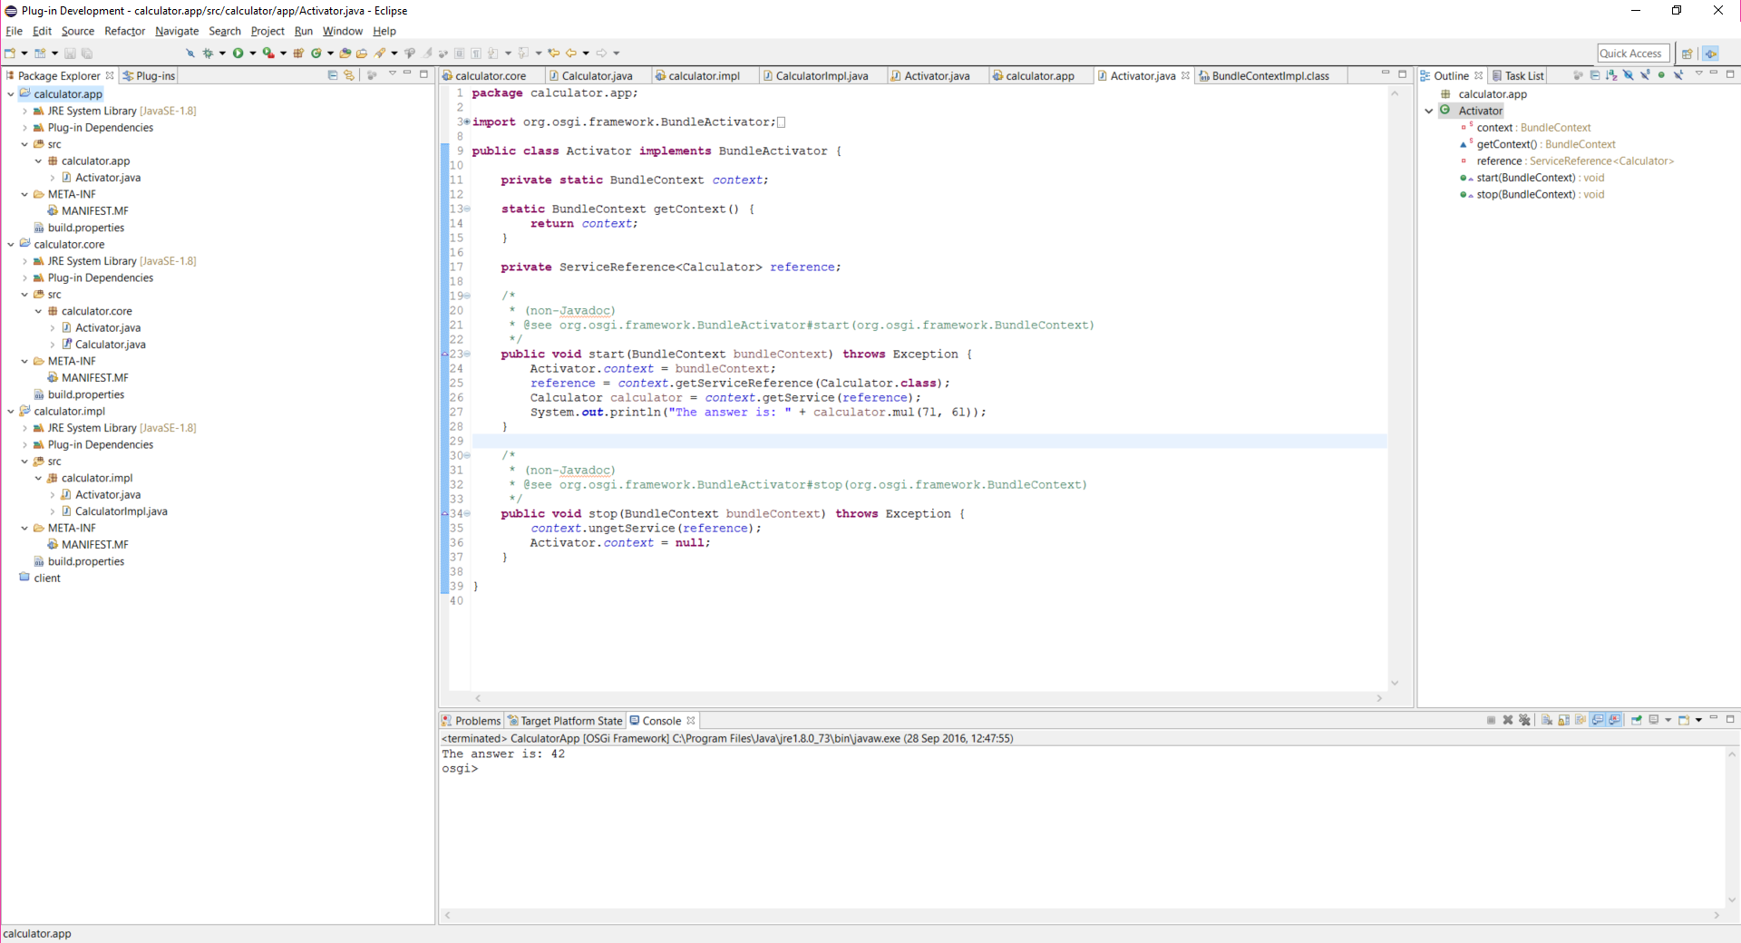
Deploying OSGi: Equinox
OSGi applications can be developed and run in Eclipse:
http://download.eclipse.org/equinox/

Slide 20
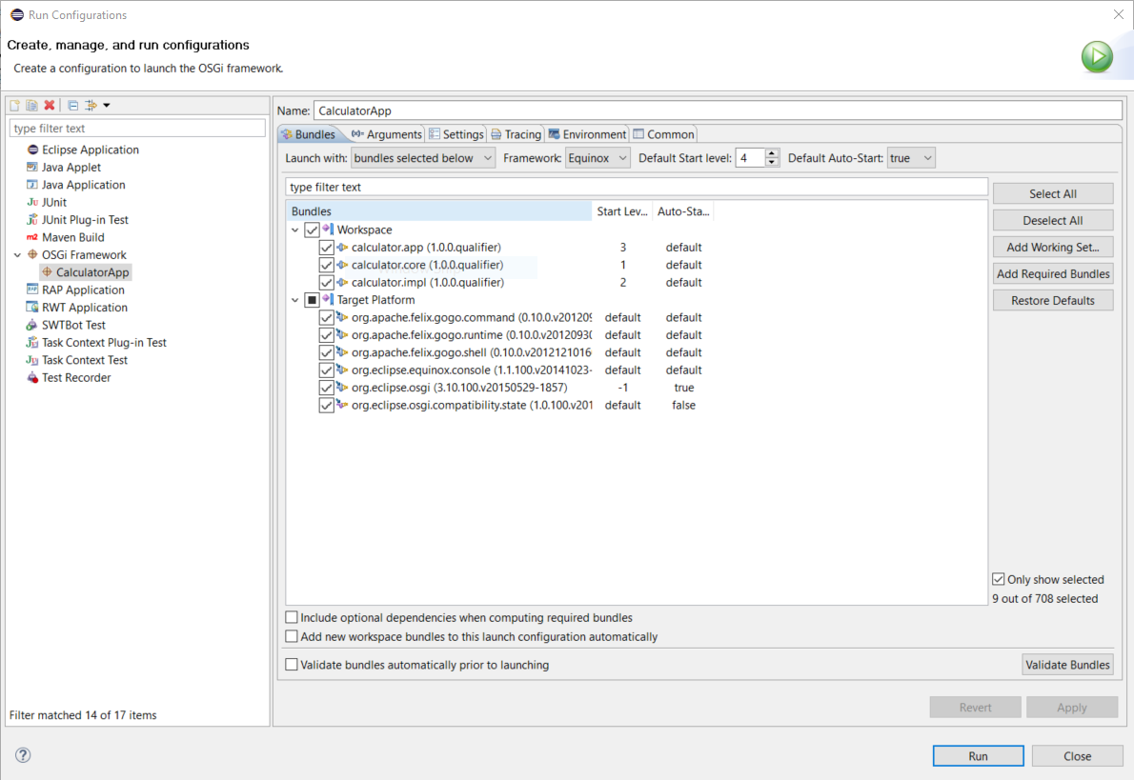
Deploying OSGi: Equinox
OSGi applications can be developed and run in Eclipse:
http://download.eclipse.org/equinox/
This is very important

Slide 21
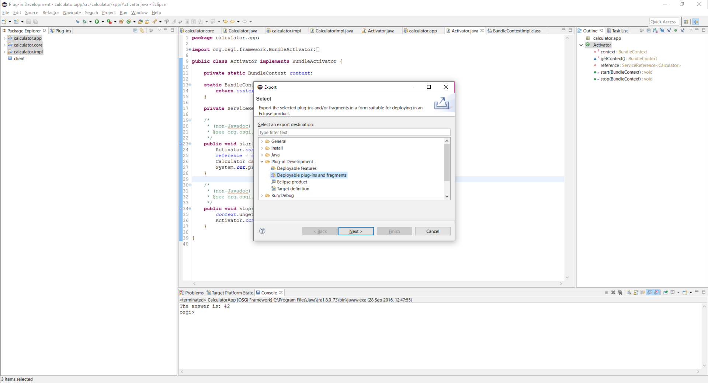
Deploying OSGi: Equinox
OSGi applications can be developed and run in Eclipse:
http://download.eclipse.org/equinox/

Slide 22
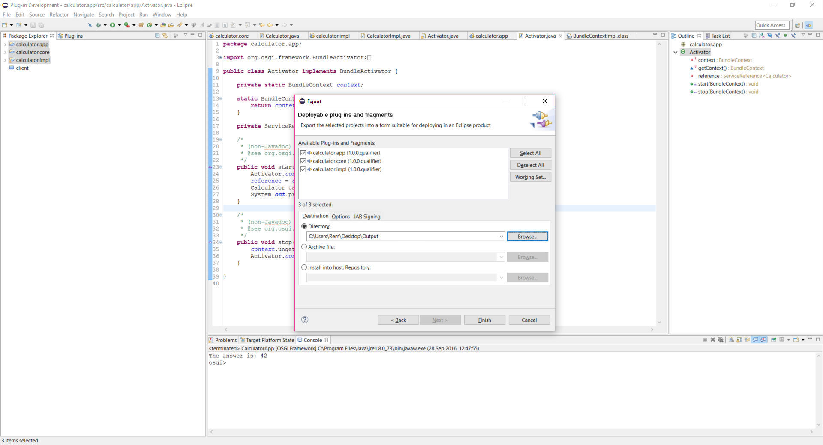
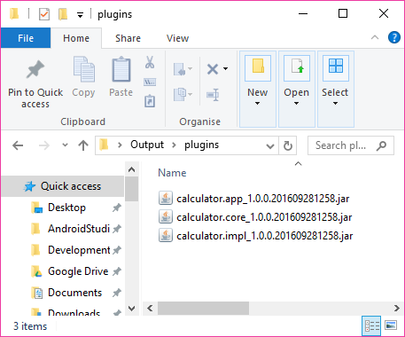
Deploying OSGi: Equinox
OSGi applications can be developed and run in Eclipse:
http://download.eclipse.org/equinox/

Slide 23
Deploying OSGi: Equinox
Standard OSGI Commands:
help List available commands
ss List installed bundles and their state
ss <name> List bundles with <name> in their names
start <id> Start the bundle with id <id>
stop <id> Stop the bundle with id <id>
install <url> Install bundle from <url>
uninstall <url> Uninstall bundle with id <url>

Slide 24
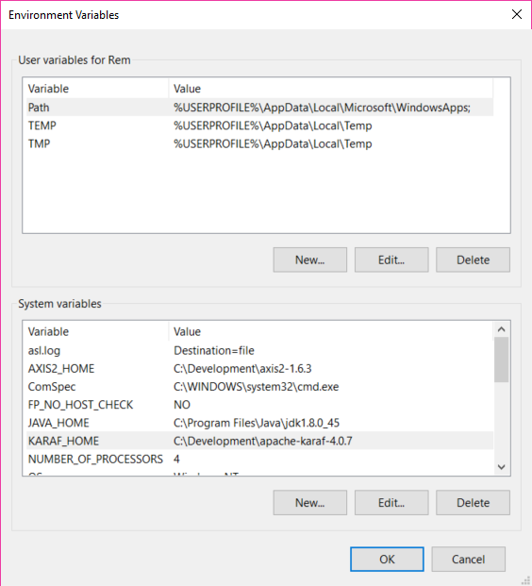
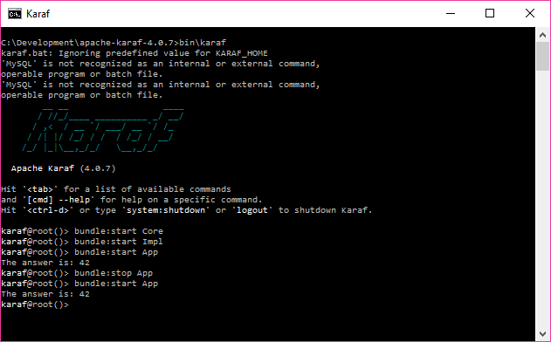
Deploying OSGi: Karaf
An alternative is Apache Karaf:
http://karaf.apache.org/
Download Version 4.0.x
Set KARAF_HOME
Install App:
Copy 3 bundles to KARAF_HOME\deploy
Manual:
http://karaf.apache.org/manual/latest/

Slide 25
Deploying OSGi: Karaf
Karaf is much more than an OSGi container:
Hot deployment: drop and deploy applications.
Complete Console: Unix-like console to manage apps.
Provisioning: Support for a large set of URLs where you can install your applications (Maven repository, HTTP, file, etc).
Management: Apache Karaf is an enterprise-ready container (including EJB, JDBC and more).
Remote: Apache Karaf embeds an SSHd server allowing you to use the console remotely.
Security: Apache Karaf provides a complete security framework (based on JAAS), and provides a RBAC (Role-Based Access Control) mechanism for console and JMX access.
Instances: multiple instances of Apache Karaf can be managed directly from a main instance (root).
Karaf Celler:
Clustered Containers (master-slave based replication)

Slide 26
Help / Resources
OSGi with Eclipse Equinox Tutorial
http://www.vogella.de/articles/OSGi/article.html
Equinox Quick start guide:
http://www.eclipse.org/equinox/documents/quickstart.php
Karaf:
http://karaf.apache.org/
http://karaf.apache.org/manual/latest/
OSGi Standards specifications:
http://www.osgi.org/Main/HomePage

