Slide 1
ELEN6886: Course Project ACOUSTIC SIGNAL CLASSIFICATION BASED ON SPARSE REPRESENTATION
Suyang Xu (UNI: sx2212), Xiaotong Qiu (UNI: xq2174)

Slide 2
Overview
Widely used
audio retrieval, documentation and scene analysis …
Main ingredients
Feature Selection
Classifier

Slide 3
System Design
Data preprocessing
Feature selection
Classification

Slide 4
Dataset Description
ESC-50 dataset ^{[1]}
2000 environmental audio recordings
5-second-long
50 semantical classes & 5 major categories
40 examples per class
[1]: K. J. Piczak. ESC: Dataset for Environmental Sound Classification. Proceedings of the 23rd Annual ACM Conference on Multimedia, Brisbane, Australia, 2015.

Slide 5
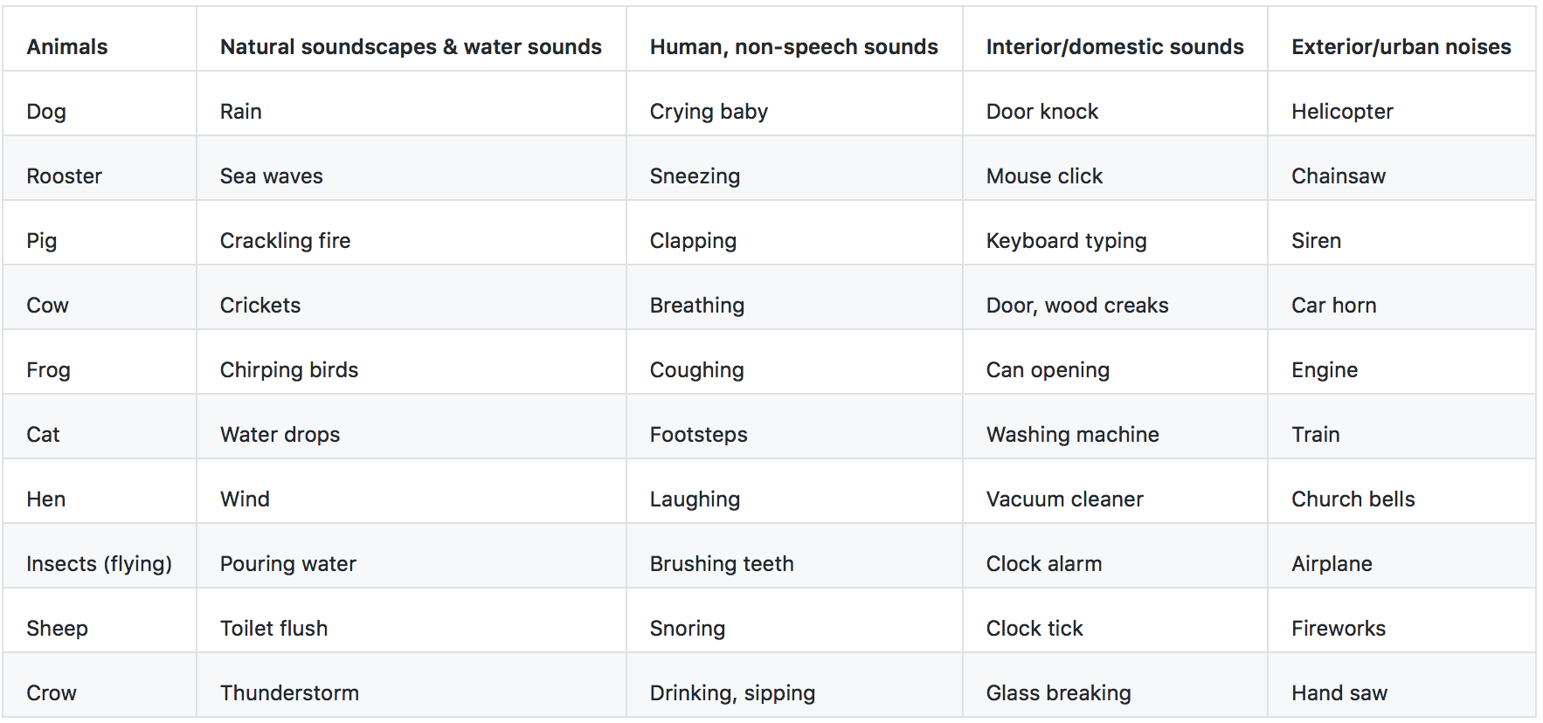
Dataset Description

Slide 6
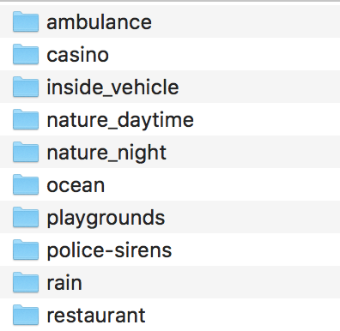
Dataset Description
10 classes
Download manually from Freesound.org ^{[2]}
Create according to the reference Robust features for environmental sound classification ^{[3]}
[2]: Link: https://freesound.org
[3] Sivasankaran, Sunit, and K. M. M. Prabhu. "Robust features for environmental sound classification." Electronics, Computing and Communication Technologies (CONECCT), 2013 IEEE International Conference on. IEEE, 2013.

Slide 7
Methodology
Dictionary learning based sparse feature extraction [4]
MFCC + Sparse features [3]
STFT (Short-time Fast Fourier Transform) + Computer Vision
Have not done yet
[4]: Zubair, Syed, Fei Yan, and Wenwu Wang. "Dictionary learning based sparse coefficients for audio classification with max and average pooling." Digital Signal Processing 23.3 (2013): 960-970.

Slide 8
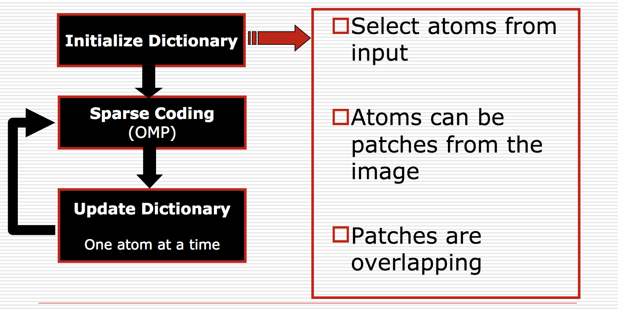
Dictionary learning based sparse feature extraction
Train Dictionaries for each class using K-SVD
K-SVD^{[5]}:
[5]: P. Chatterjee Image Denoising with K-SVD 2007

Slide 9
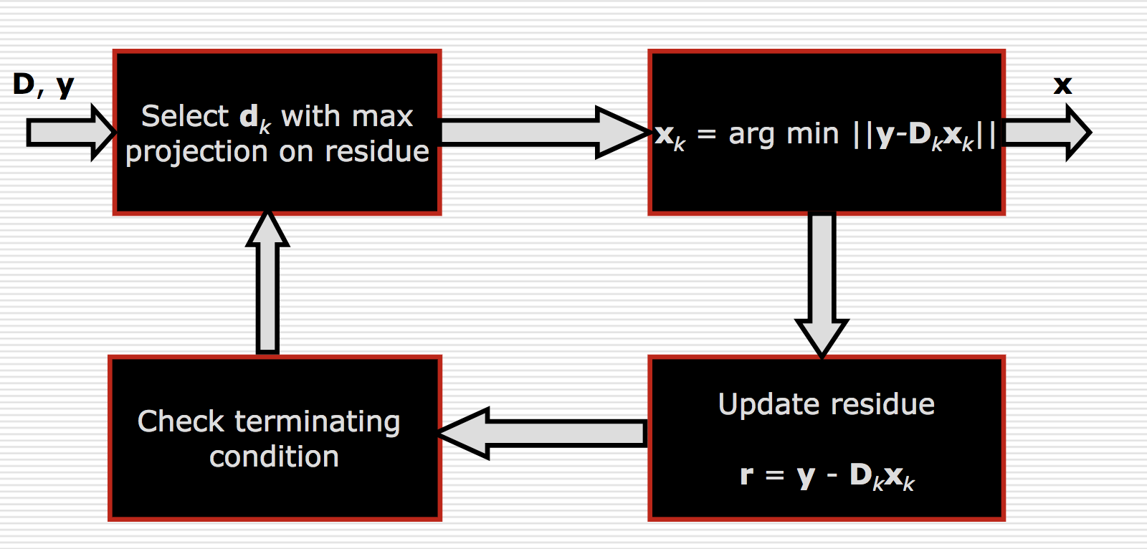
Dictionary learning based sparse feature extraction
Extract feature of sound using OMP
OMP^{[5]}:

Slide 10
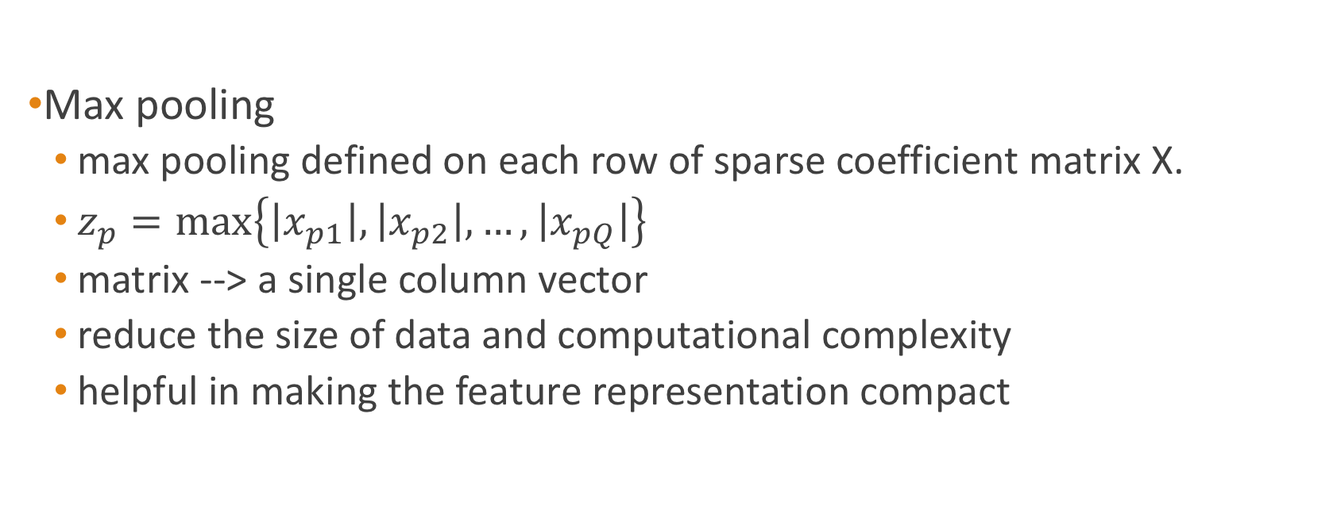
Dictionary learning based sparse feature extraction
Max pooling
max pooling defined on each row of sparse coefficient matrix X.
$z_{p}=\max\left\{\left|x_{p1}\right|,\left|x_{p2}\right|,…,\left|x_{pQ}\right|\right\}$
matrix --> a single column vector
reduce the size of data and computational complexity
helpful in making the feature representation compact

Slide 11
Preprocess
K-SVD
Class 1
DCT
OMP
Merge
OMP
Merge
Class 2
DCT
K-SVD

Slide 12
Max Pooling
Training data
Train-test Split
Test data
Classifier
(Random Forest, SVM, KNN)
Output

Slide 13
Preprocess
K-SVD
Merge
Class 1
DCT
OMP
Class 2
DCT
K-SVD
Merge
OMP
…
Class N
DCT
K-SVD
Merge
OMP

Slide 14
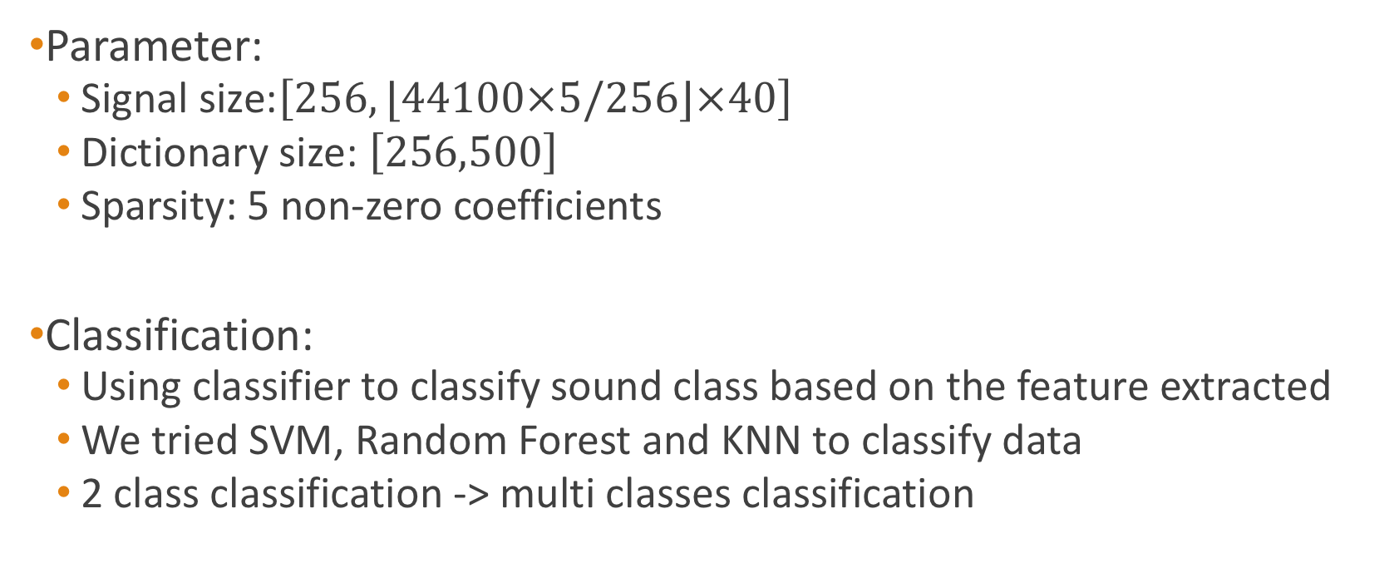
Experiment Result
Parameter:
Signal size:$\left[256,⌊44100×5/256⌋×40\right]$
Dictionary size: $\left[256,500\right]$
Sparsity: 5 non-zero coefficients
Classification:
Using classifier to classify sound class based on the feature extracted
We tried SVM, Random Forest and KNN to classify data
2 class classification -> multi classes classification

Slide 15
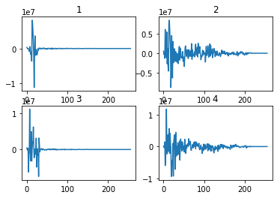
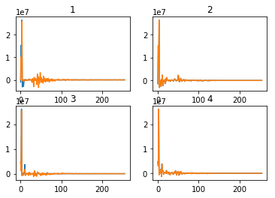
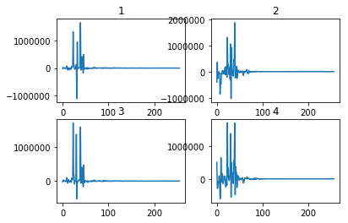
Experiment Result
Original & Reconstructed data (DCT processed)

Slide 16
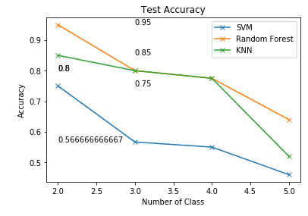
Experiment Result

Slide 17
Another method: MFCC + Sparse features
Using MFCC to extract features
Using OMP with Gabor dictionary to extract features of signal component with frequency higher than 1kHz (using filter)
Combine two features, doing classification

Slide 18
MFCC + Sparse features
10 Classes multi-classification using SVM on manually data
Accuracy around 99.05%
Accuracy without sparse features from OMP -- around 98%

Slide 19
MFCC only
5 Classes multi-classification using Random Forest on ESC-50
Accuracy around 92.5%

