Slide 1
RQ 3. How refactorings influence code metrics

Slide 2
Motivation
Refactoring is believed to enhance both code quality and maintainability
Previous study:
Are refactoring operations performed on classes having a low-level of maintainability as indicated by quality metrics?
e.g., If classes having high WMC value (measuring code complexity) are more subject to refactoring aiming at reducing code complexity like, for example, extract method.
Our research question:
How refactorings improve the code metrics
e.g., Does the Extract Method refactoring lead to a reduction in WMC values of classes?

Slide 3






Data Collection - Refactoring Extraction
& RefactoringMiner
Version Filtering
Refactoring Extraction
(detectAtDirectories)
Selected projects
Release tag lists
(major & minor versions)
Refactorings between releases

Slide 4
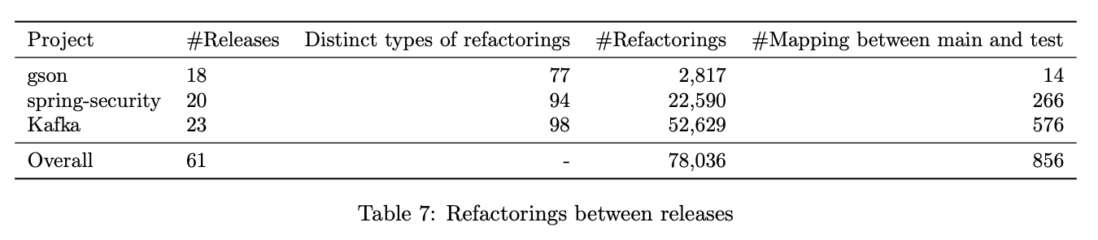
Data Collection - Refactoring Extraction

Slide 5
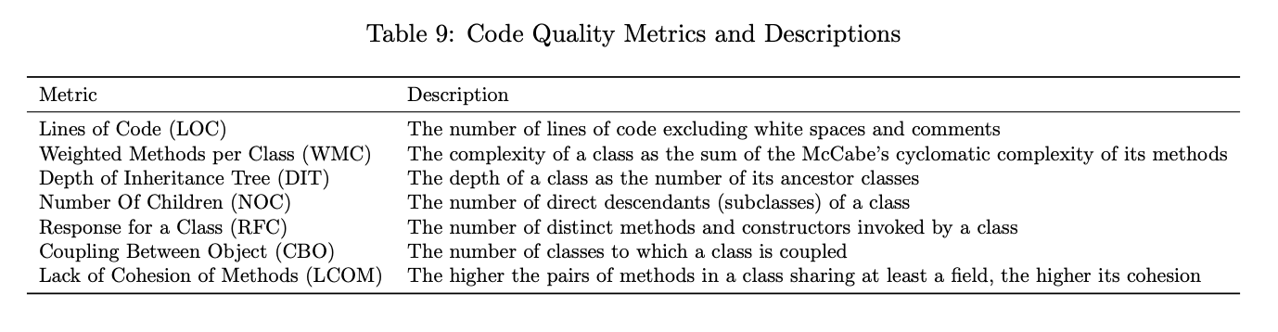


Data Collection - Metrics Extraction
Chidamber & Kemerer (CK) metrics

Slide 6
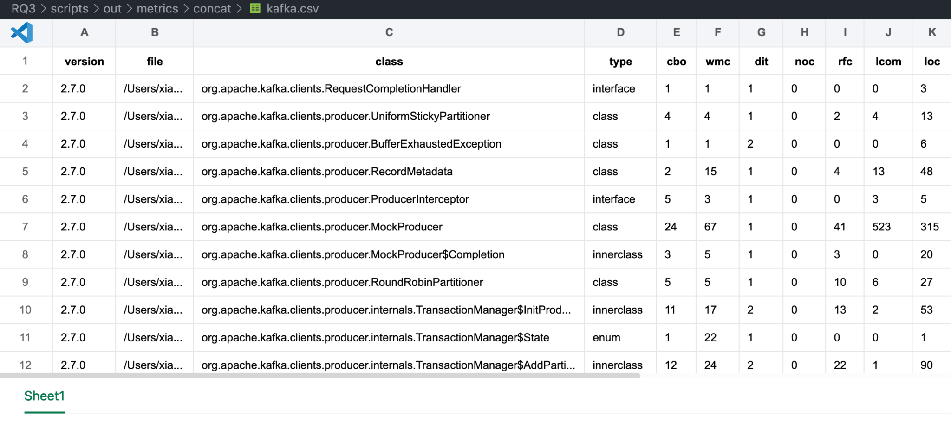
Data Collection - Metrics Extraction

Slide 7




Data Analysis
Refactoring Filter
(≥ 10 times)
Logistic Regression Model Builder
Metric Differences Calculator
Multi-Collinearity Detection
z-score
< refactoring type, cbo, …, loc >
Process Overview: Model construction for each refactoring type per project

Slide 8
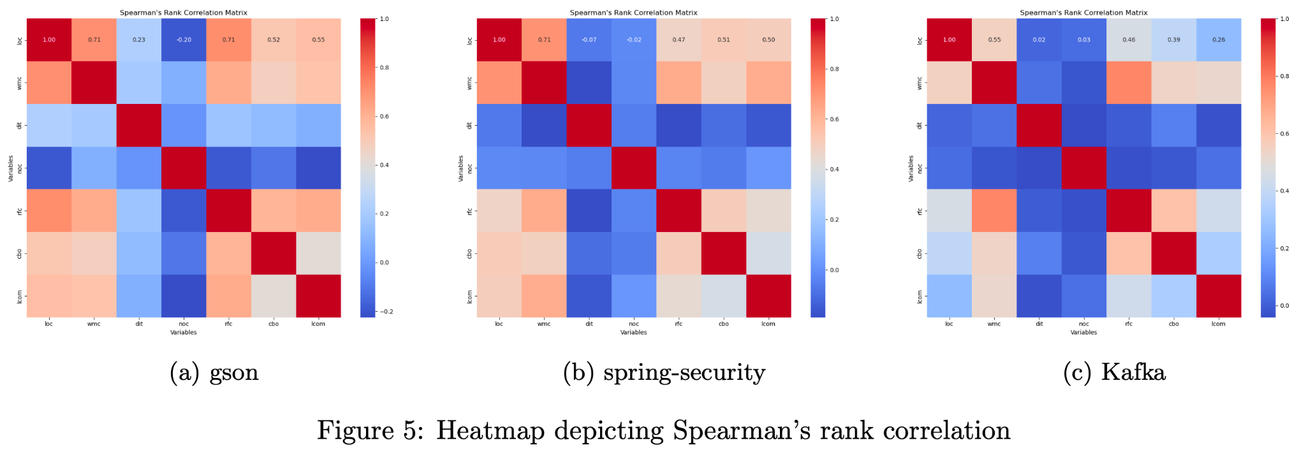
Multi-collinearity Detection ( >0.8 )
Notes:
feature selection

Slide 9
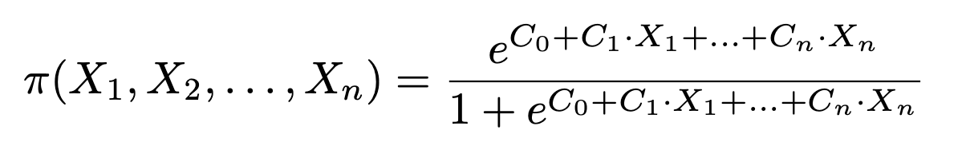

Data Analysis - Logistic Regression Models
Dependent variable: whether a refactoring type was performed
Independent variables: the changes in selected code metrics

Slide 10

Data Analysis - Odd Ratio (OR)
Quantify the strength and direction of the association between a binary outcome and an independent variable
OR > 1: positive correlation, larger OR → stronger correlation
OR < 1: negative correlation, smaller OR → stronger correlation
reducing metrics values → improving code quality

Slide 11
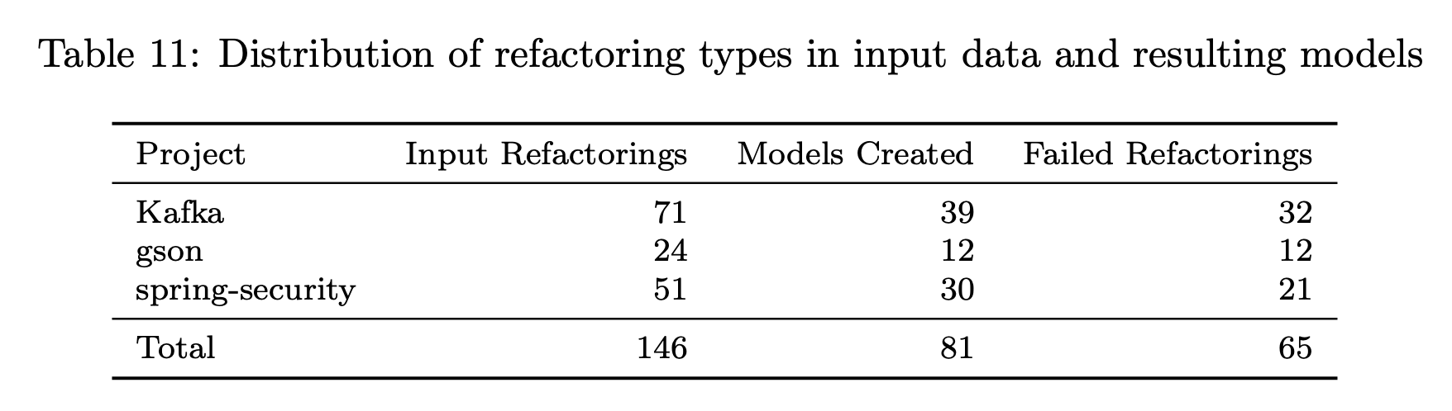
Preliminary Findings / Conclusions

Slide 12
Preliminary Findings / Conclusions
Refactorings with evidence of a negative correlation
statistically significant OR in at least one project
consistent results across other projects (even if no statistically significant)
Finding 1: Extract Variable may indirectly reduce WMC, RFC and LCOM

Slide 13
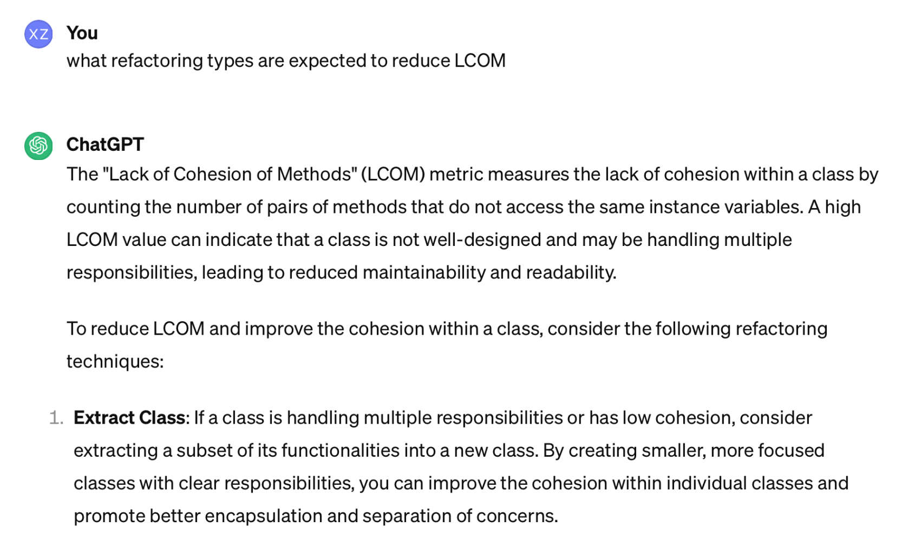
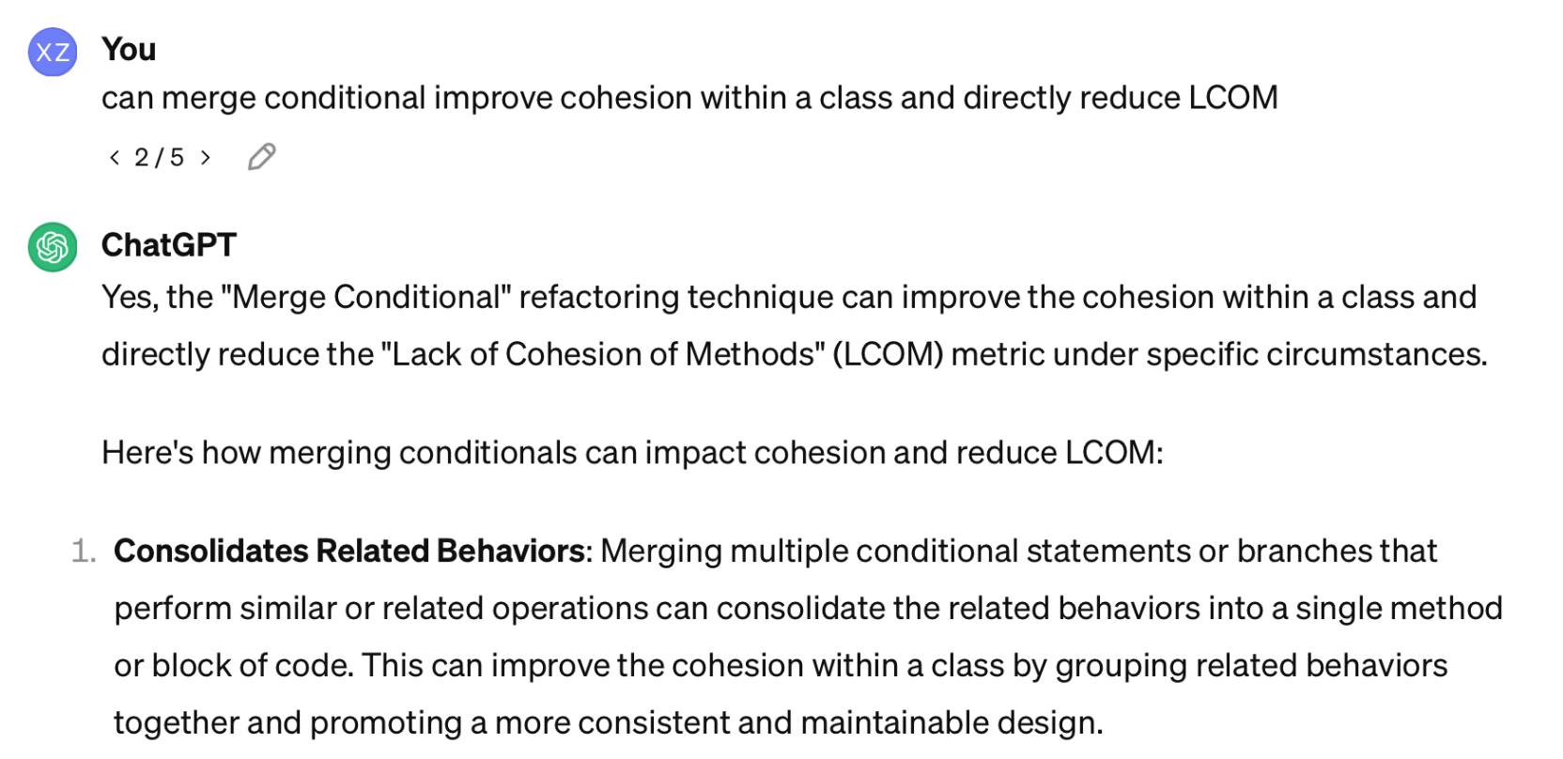
Preliminary Findings / Conclusions
2. Refactorings with expected negative correlations occurred in at least 2 projects

Slide 14
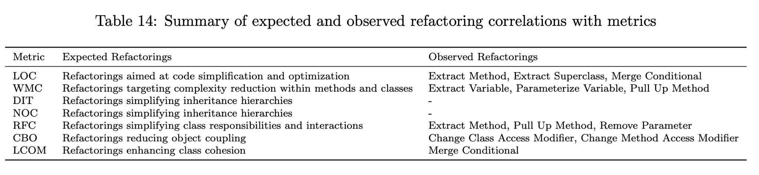
Preliminary Findings / Conclusions
2. Refactorings with expected negative correlations occurred in at least 2 projects
Notes:
Some refactoring types do improve code metrics as expected

