Slide 1

Project 2: Web Development Course
Northeastern University

Slide 2
Objective
Efficient Management: Enable collectors to digitally manage their collections with ease, replacing outdated physical logs and spreadsheets.
Enhanced Accessibility: Provide a platform that is accessible across various devices, allowing collectors to manage their collections anytime and anywhere.
User Engagement: Create an intuitive interface that caters to both novice and experienced collectors, making the platform easy to use and engaging.

Slide 3
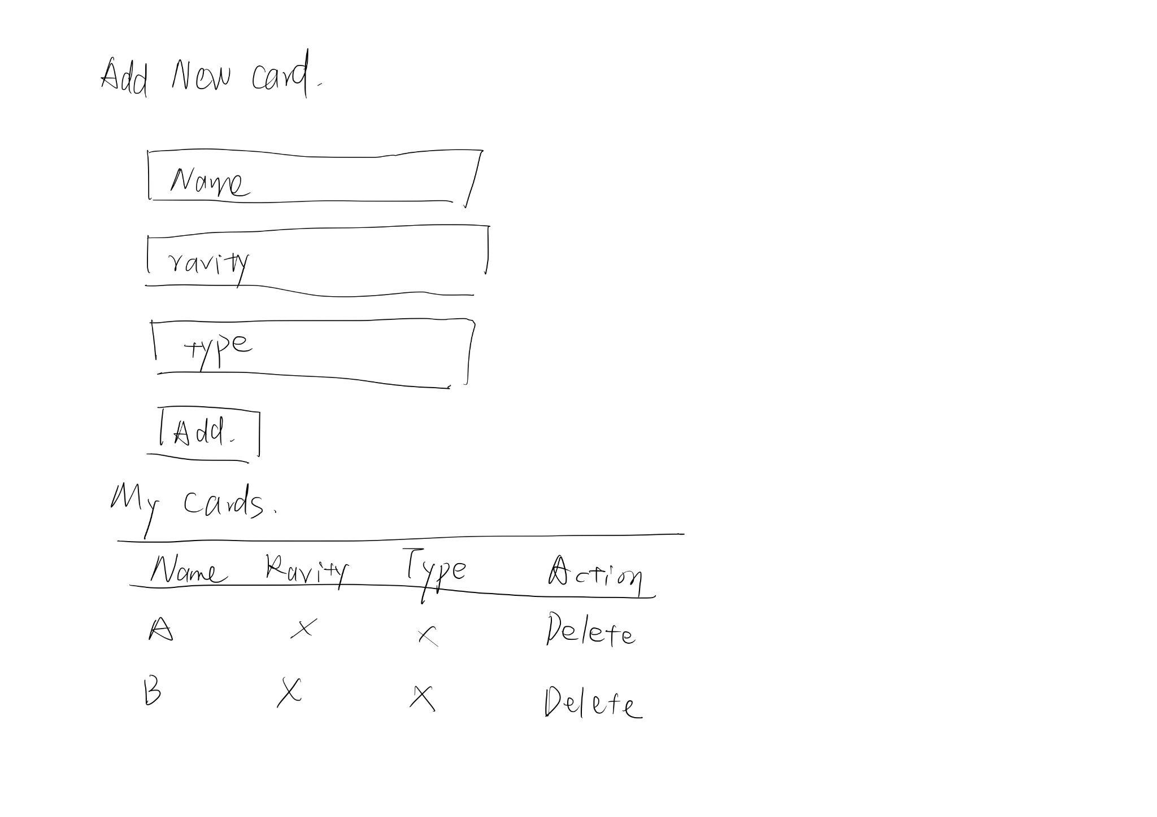
Design and Mockups

Slide 4
Technologies used
- **Node.js**: Server-side JavaScript runtime.
- **Express**: Web application framework for Node.js.
- **MongoDB**: NoSQL database used to store card data.
- **Mongoose**: MongoDB object modeling tool designed to work in an asynchronous environment.
- **dotenv**: Zero-dependency module that loads environment variables from a `.env` file into `process.env`

Slide 5
What I'm proud of
Efficient and Scalable Architecture: Developing a backend with Node.js and MongoDB that efficiently handles requests and scales well under load.
User-Friendly Design: Creating an intuitive and responsive user interface that makes it easy for users of all technical levels to navigate and manage their card collections.
Robust Data Management: Implementing a seamless system for adding, viewing, and deleting cards with immediate updates and strong data integrity.

Slide 6
What I struggled the most with
To make it more interaction and add more feature

