Slide 1

Semi-automation in systematic review on the domain of medical psychology--clinical trials
HS 651 Spring 2021 project
Xiaowen ji & Jaskirandeep Kaur
Advisor: Prof. Soodabeh Sarafrazi

Slide 2
Background
Limited NLP automation specified on medical psychology domain
Emerging of more powerful pre-trained NLP techniques like BERT and its variants on biomedical (BioBERT) and scientific(SciBERT) domain.
Fast growing of physiopyshcological clinical trials published each year.
Required extended human forces and experts’ knowledge to keep up with the emerging evidences from randomized clinical trails(RCTs).
NLP automation/semi-automation is warranted to retrieve and synthesize the surging findings from clinical trails on domain of medical psychology.

Slide 3
Objectives
Webscraping new academic findings through Pubmed API (use complementary and alternative medicine-CAM treatments for sleep and mood disturbances as test corpus).
To build an NLP text-classification model to differentiate the RCT abstract from non-RCT abstracts in the domain
To extracting key information from full-text of RCT abstracts by building question-answering models.
Use the answers to further screen studies to be included into the future meta-analyses.
Compared the performance of BERT, BioBERT, SciBERT for each tasks.

Slide 4
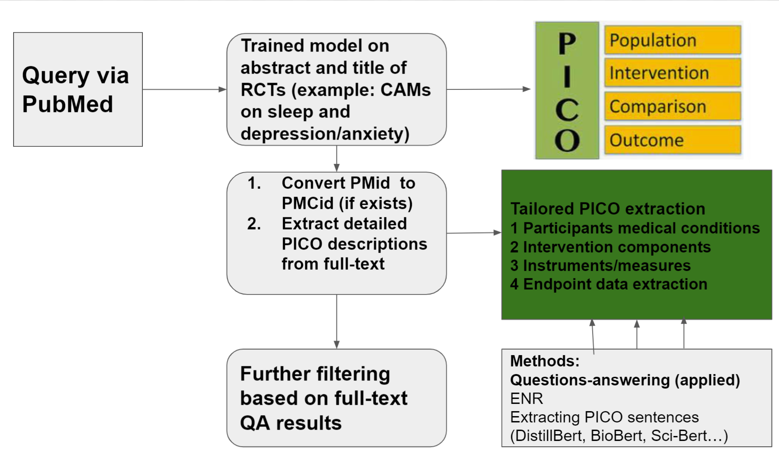
Pipeline

Slide 5

FLOWCHART
Web scrapping via bio.entrez (547 articles from pubmed 2000-2021 Feb.)
Machine filter title (exclude those contains review, qualitative..)
Manually label abstracts (abs+title: neg: 312; pos:235
Text-classification modeling
Full text QA (n=87; Full text labels- pos 42; neg:45
Notes:
Keywords:..

Slide 6
Main findings: text-classification on abstract and title
Similar AUC of 0.92 for distillbert, biobert and scibert
Best performance achieved with minimum train size = 100 (learning curve on distillBERT); valid size = 109
Train size | AUC | Label counts (1vs.0)
50 | 0.76 | 25 vs. 25
70 | 0.85 | 28 vs. 42
80 | 0.84 | 43 vs. 37
100 | 0.88-0.94 | 43 vs. 57
No efficient added-on for 100 above

Slide 7
Main findings: text-classification based on Q-A answers (Abs_Lable=1&PMCID!=nan)
DistillBERT: AUC 0.58
BioBERT: AUC 0.6
SciBERT: AUC 0.67

Slide 8
Main findings: Question-answering validation
sciBERT better?

Slide 9
Future directions
Validation of Q-A accuracy of three BERTs
Deep PICO extractions
Compare abstract filtered outcomes with manually screened outcomes
Compare other metrics: F1 ect.
Others after reading more papers in the area

