Slide 1
Seminar Hochwasser SS 2018
Thematische Vertiefung Georisiken –Analyse und Management
Lecture: Flood statistics
22.06.2018
Bruno Merz^{1,2}, Le Duy Nguyen¹, Eva Steirou¹
¹GFZ German Research Centre for Geosciences
Telegrafenberg, Potsdam
²Institute for Earth and Environmental Sciences
Professor for Engineering Hydrology and Management of Georisks
bmerz@gfz-potsdam.de
duy@gfz-potsdam.de
esteirou@gfz-potsdam.de
Notes:
Scope of lecture: To give an overview of the basics of extreme value theory.
Extreme value statistics play an important role in hazard assessment and risk analysis.
They allow to extrapolate measured data in the “extreme area” by means of a statistical model.

Slide 2




Some basic concepts…
Hydro-climatic variables (precipitation, temperature, discharge…) can be mathematically described using the concept of probability.
Random variable: a variable whose possible values are outcomes of a random phenomenon/experiment.
Cumulative distribution function (CDF):
Probability of exceedance:
Probability density function (PDF):
Return period:
Discrete
Probability mass function
Random variables
Continuous
Probability density function
$$F_{X}\left(x\right)=P(X≤x)$$
$$P_{E}=P\left(X>x\right)=1−F_{X}\left(x\right)$$
$$f_{X}\left(x\right)=\frac{dF_{X}(x)}{dx}$$
$$T=\frac{1}{{1−F}_{X}(x)}=\frac{1}{P_{E}}$$
2
Notes:
For the purpose of engineer design, forecasting of natural disasters… one needs often to translate certain event magnitudes into probability statements.
Question for distribution function: what is the probability that X will take a value less than or equal to x?
Common interpretations of return level - return period of T years:
- Waiting time: Average waiting time until next occurrence of event is T years.
Number of events: Average number of events occurring within a T-year time period is 1.

Slide 3
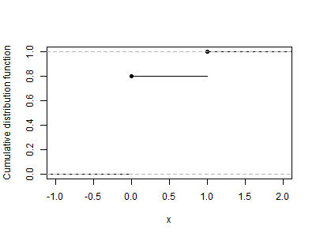
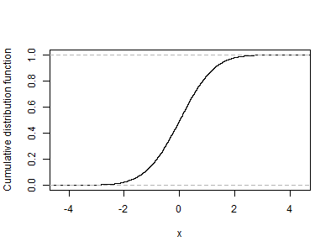
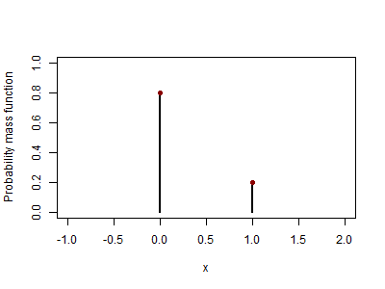
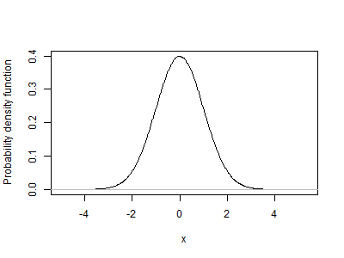
Some basic concepts (2)
Discrete variable
Continuous variable
3
Notes:
Depending on the problem we may use discrete or continuous variables:
e.g. discrete: annual number of events exceeding a threshold or will it rain tomorrow?
e.g. continuous: daily/monthly/seasonal rainfall (one can examine a certain phenomenon on different time scales)
x: variable under investigation (discharge, precipitation, wind speed etc.)
Probability distribution: a limit case of the relative frequency distribution when sample size tends to population size.

Slide 4
Extreme values
Extreme value theory takes into account only extreme values (“distribution tail”)
Probability density function (PDF)
of daily wind speed
Messdaten
0.07
Fit (ML)
0.06
0.05
probability density
0.04
0.03
0.02
0.01
0
0
5
10
15
20
25
30
35
Windgeschwindigkeit
Justification:
Fitting a parametric distribution to data may result in model that agrees well with data in high density regions, but poorly in areas of low density, e.g. extreme values.
Extreme values/behavior are poorly described.
4
Notes:
When all data are used to fit a statistical model, extreme values have only a small weight. The model describes better the middle values (high-density area of distribution).
In many applications, fitting the data in the tail is the main concern, e.g. insurance, design of protection measures.
Tail: not a precisely defined term. There is no specific point which separates the tail from the middle of the distribution. The tail refers to the part of the distribution that is far from the mean.

Slide 5
Extreme values
Extreme value theory takes into account only extreme values (“distribution tail”)
Probability density function (PDF)
of daily wind speed
Messdaten
0.07
Fit (ML)
0.06
0.05
Wahrscheinlichkeitsdichte
0.04
0.03
0.02
0.01
0
0
5
10
15
20
25
30
35
Windgeschwindigkeit
Fitting of extreme value
distributions to extreme values
Data selection
Block maxima
(usually annual)
all values > threshold
Distribution
Generalised Extreme
Value distribution
Generalised Pareto
distribution
5
Notes:
Two main approaches to derive extreme values: Block Maxima Method or Peak-Over-Threshold Method.
Traditionally, blocks on annual basis. Seasonal (e.g. winter maxima) or monthly basis is also possible. This might be important in cases when the behavior of the processes involved in the risk calculation varies strongly between seasons.

Slide 6
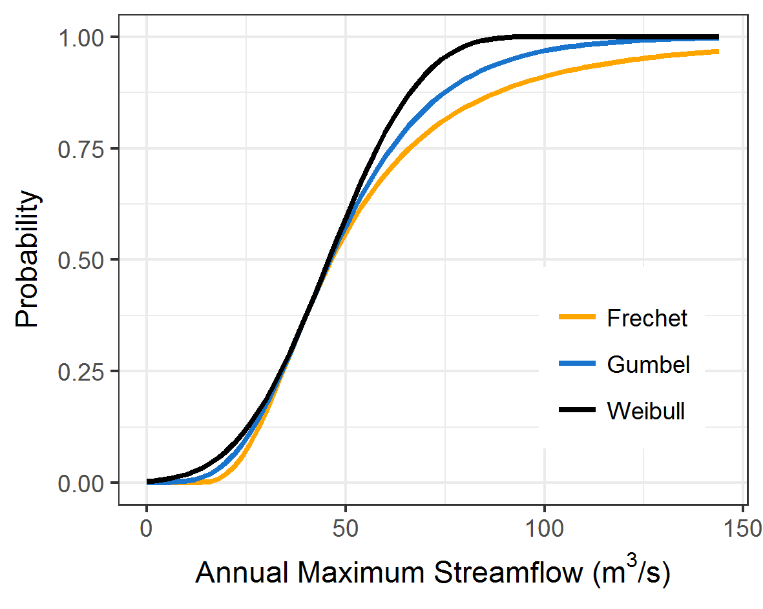
Block Maxima Method
Classical Extreme value theory (Fisher & Tippet, 1928)
Limit (asymptotic) distribution of block maxima: Generalized Extreme Value distribution (GEV)
Cumulative distribution function
Parameter:
ξ: Shape
µ: Location
σ: Scale
ξ = 0
Type I, Gumbel
exponential tail
ξ > 0
Type II, Fréchet
„fat tail“
ξ < 0
Type III,
Reversed Weibull
upper finite endpoint
Notes:
Limit behavior of extreme values: block maxima from any parent distribution converge to GEV (for number of values n→∞). In more detail:
There are 3 types of limit distributions (Gumbel, Fréchet and Weibull families) that can be combined into a single family of models (GEV).
The 3 types have distinct forms of behavior, corresponding to the different forms of tail behavior.
Heavy tail behavior implies a probability of extreme events higher than that of exponentially tailed distributions.

Slide 7
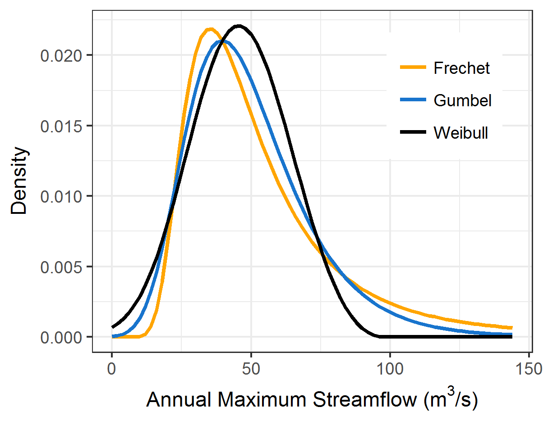
Generalized Extreme Value distribution (GEV)
Cumulative distribution function
Cumulative distribution function
Probability density function
Parameter:
ξ: Shape
µ: Location
σ: Scale
Heavy tail: higher probability of extreme events
7
Notes:
upper bound for reversed Weibull: μ-(σ/ξ)
Here: μ=39.66, σ=17.48, ξ=-0.3, upper bound for reversed Weibull: 98.63 m³/s

Slide 8
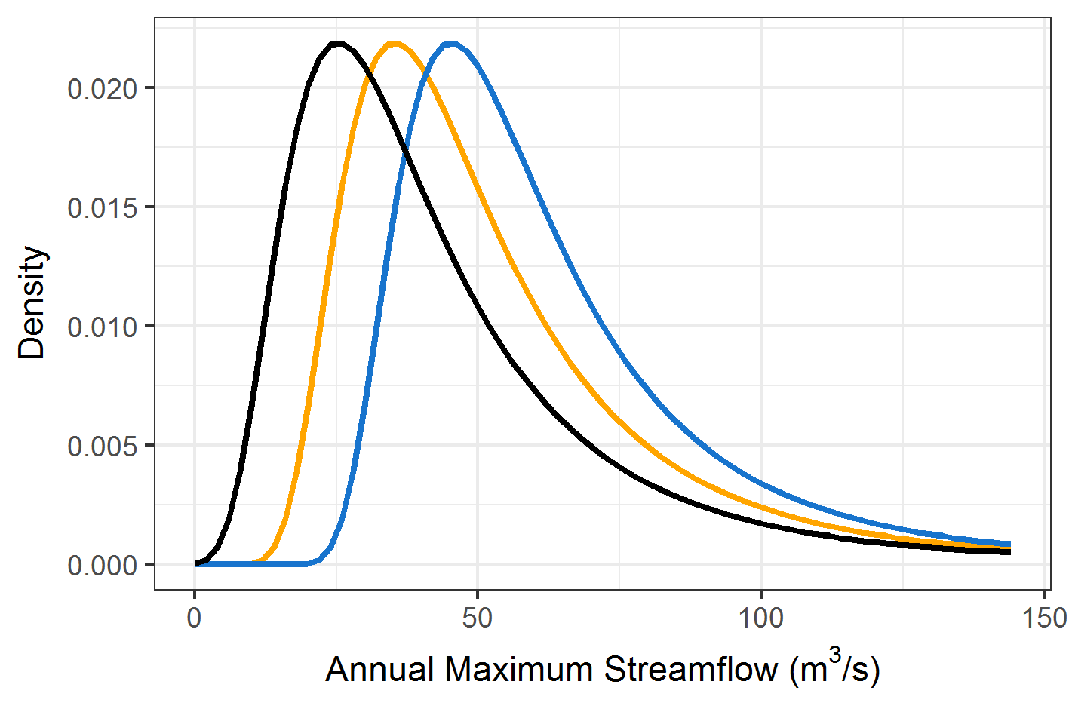
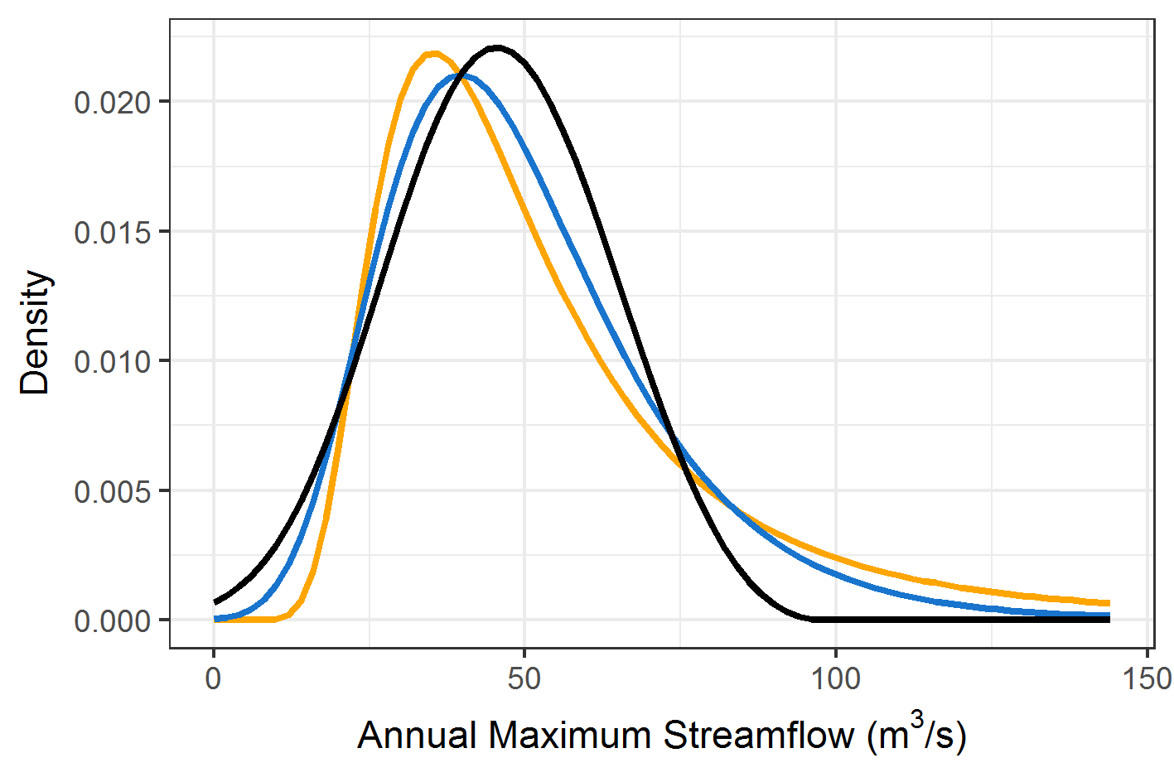
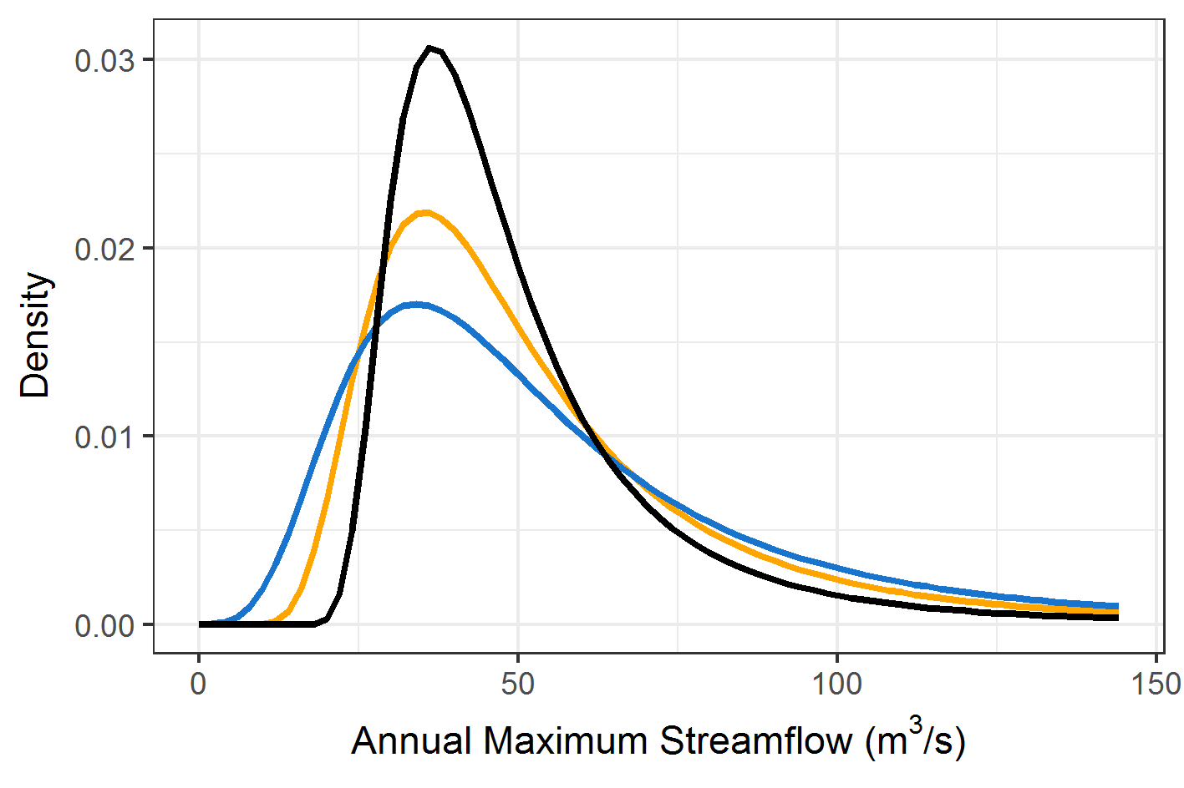
GEV parameter explanation
Location: Indicator of center of gravity of distribution
Scale: Indicator of dispersion / variability
Shape: Indicator of distribution (tail in particular)
Location
Shape
Scale
8

Slide 9
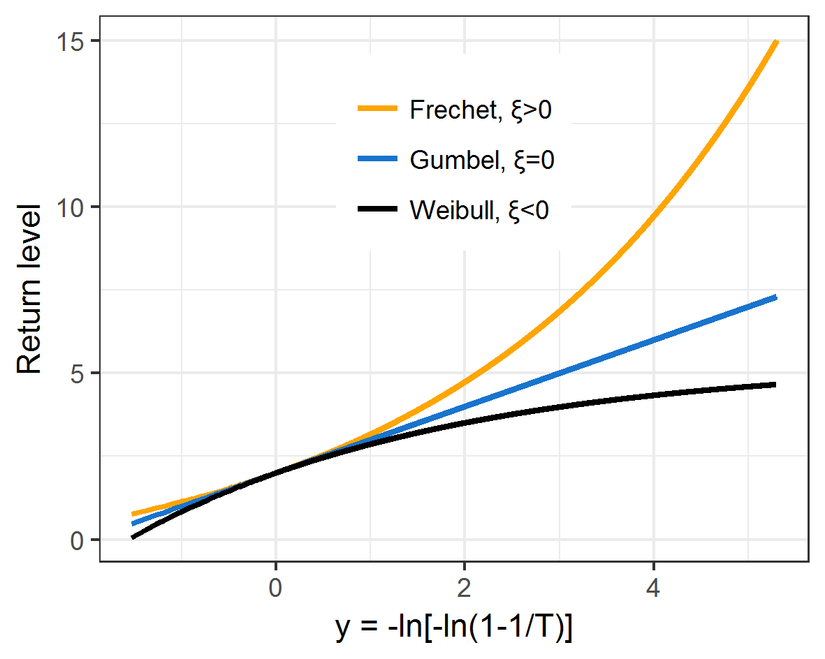
Return levels
Return levels are calculated using the quantile function: inverse of (cumulative) distribution function
Return level X_{T}: function of probability of exceedance P_{E} or return period T = 1/P_{E}
Cumulative distribution function
Parameter:
ξ: Shape
µ: Location
σ: Scale
Quantile function
Requirement:
Estimation of parameters ξ, µ, σ
9
Notes:
Return level plot:
- heavy tail distributions (ξ > 0) are concave,
- light tailed distributions (ξ = 0) are straight lines, and
- bounded upper-tailed distributions (ξ < 0) are convex, asymptotic at the upper bound μ-(σ/ξ)
Here: μ=2, σ=1, ξ=-0.3, upper bound for reversed Weibull: 5.33

Slide 10
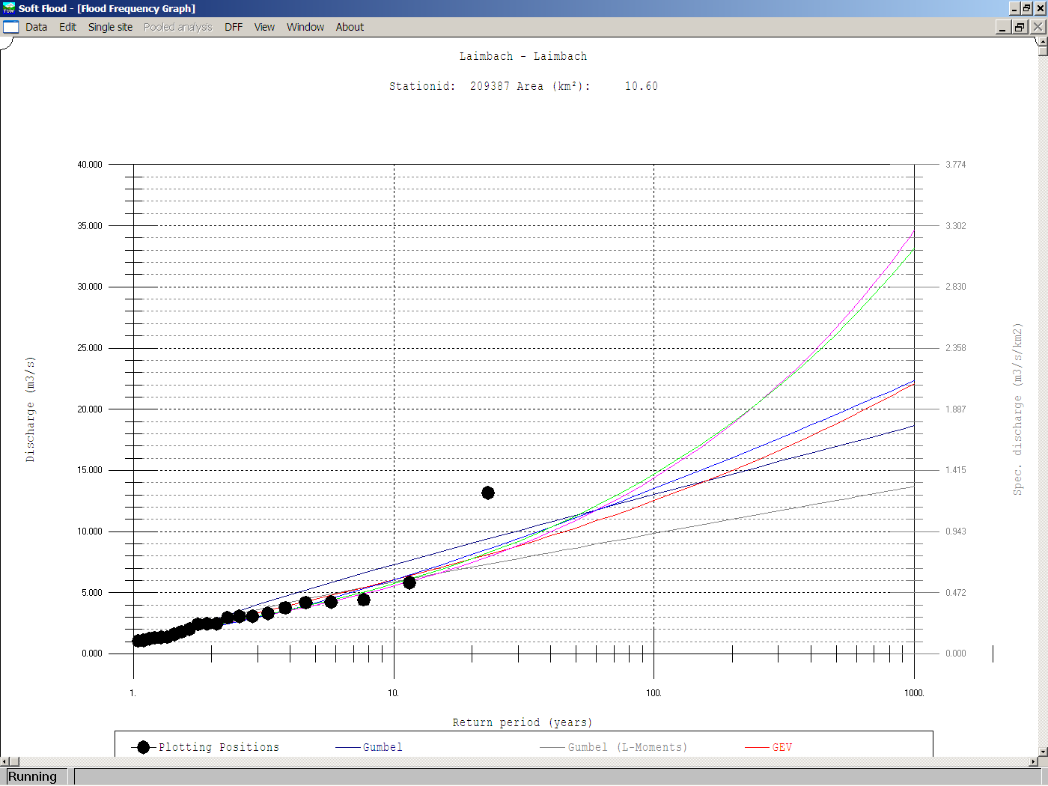
Uncertainty Quantification
40
35
30
25
Discharge / return level (m³/s)
Durchfluss (m³/s)
20
?
15
10
5
0
1
10
Return period
100
1000
Laimbach, 10km²
Confidence intervals
Different statistical models
10
Notes:
Confidence intervals:
Interval estimates can be contrasted with point estimates. A point estimate is a single value given as the estimate of a population parameter that is of interest, for example, the mean of some quantity or the return level for some return period. An interval estimate specifies instead a range within which the true, but unknown parameter is estimated to lie.
If confidence intervals are constructed using a given confidence level from an infinite number of independent sample statistics, the proportion of those intervals that contain the true value of the parameter will be equal to the confidence level.

Slide 11
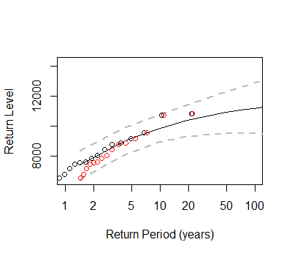


Empirical probabilities - Plotting positions
Empirical probabilities can be calculated based on the sorted data.
One first ranks the data, typically annual extremes or values over a threshold, in increasing order of magnitude from the smallest m=1 to the largest m=N.
A cumulative probability P is assigned to the ranked data, usually with a function of the form:
Weibull formula (Weibull, 1939):
$$P=\frac{m+α}{N+β}$$
$$P=\frac{m}{N+1}$$
Example with Weibull formula: Sample of 21 annual maxima
1st value: P = 1/(21+1) = 0.045
T = 1/(1-P) = 1.05
Last value: P = 21/22 = 0.955
T = 1/(1-P) = 22
Weibull formula
11
Notes:
Weibull formula:
What is the return period of the second highest value in the sample?
P = 20/22 = 0.91
T = 1/(1-P) = 11

Slide 12
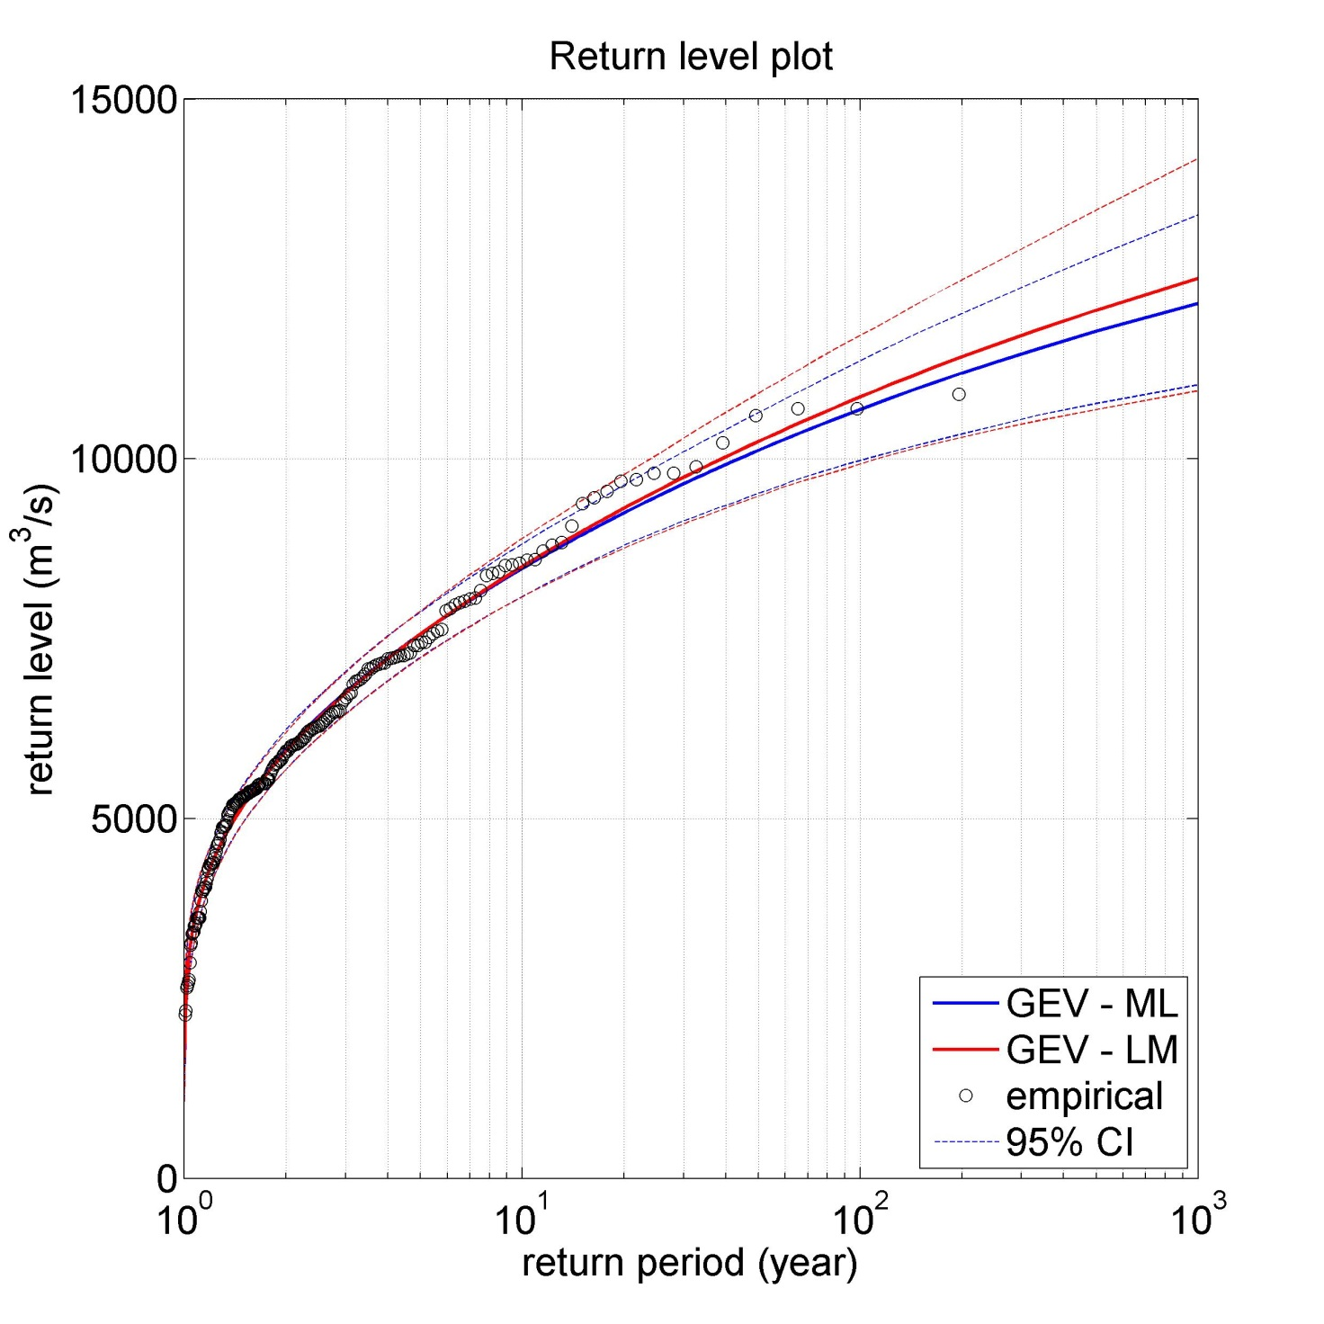
Example: Influence of parameter estimation method
Block maxima AMS
ML: Maximum Likelihood Method
LM: Method of L-Moments
 | µ | σ | ξ
GEV ML | 5.369 | 1.656 | -0,17
GEV LM | 5.350 | 1.635 | -0.15
12

Slide 13
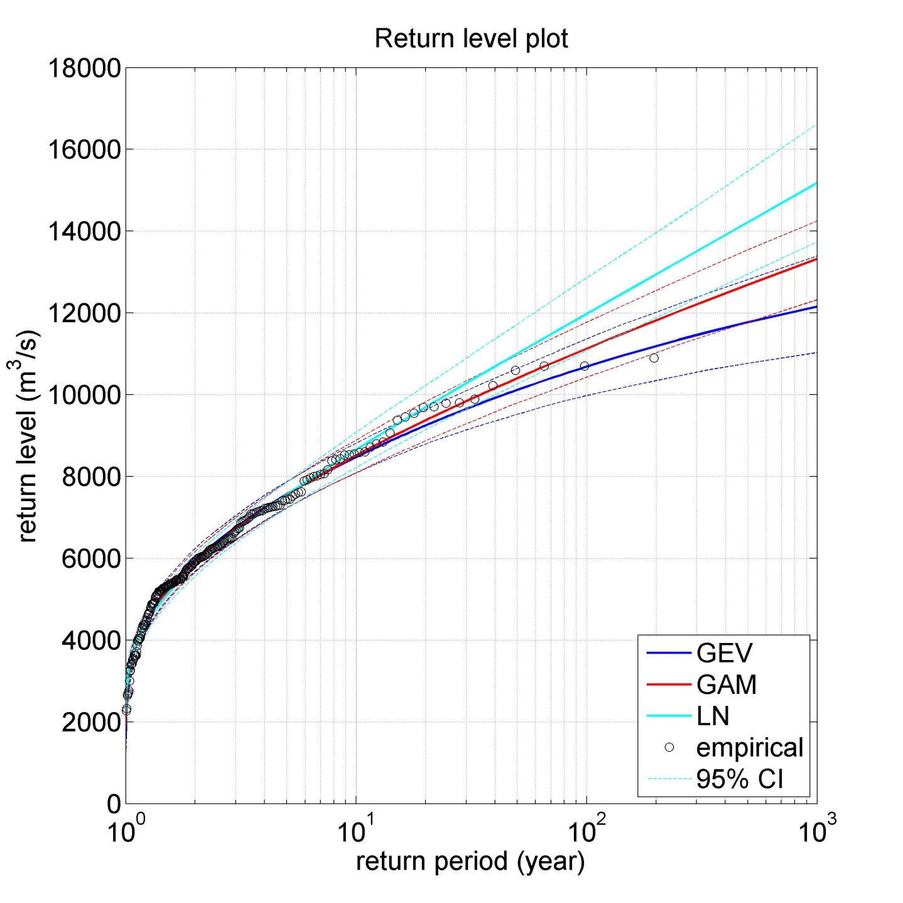
Example: Different statistical models
Block maxima AMS
GAM: Gamma distribution function
LN: LogNormal distribution function
 | HQ100 [m³/s] | HQ1000 [m³/s]
GEV | 10.687 | 12.157
GAM | 11.127 | 13.322
LN | 11.977 | 15.183
13
Notes:
Extreme values can also be modelled with other distributions, for example the Gamma distribution and the Lognormal distribution.

Slide 14
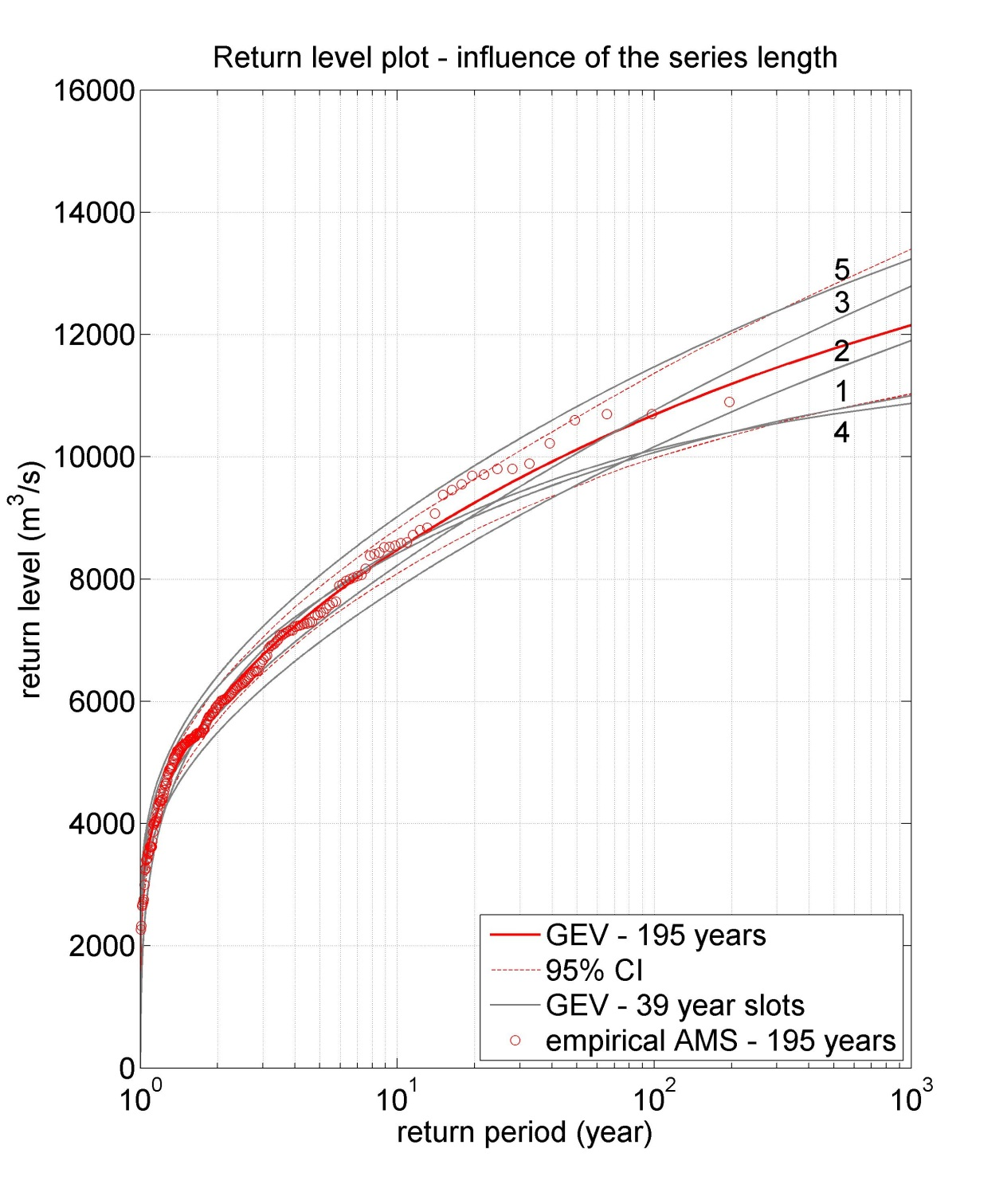
Example: Different time periods
 | 39-year period | HQ100 [m³/s] | HQ1000 [m³/s]
1 | 1817-1855 | 10.069 | 10.999
2 | 1856-1894 | 10.163 | 11.903
3 | 1895-1933 | 10.757 | 12.793
4 | 1934-1972 | 10.115 | 10.874
5 | 1973-2011 | 11.471 | 13.235
14

Slide 15
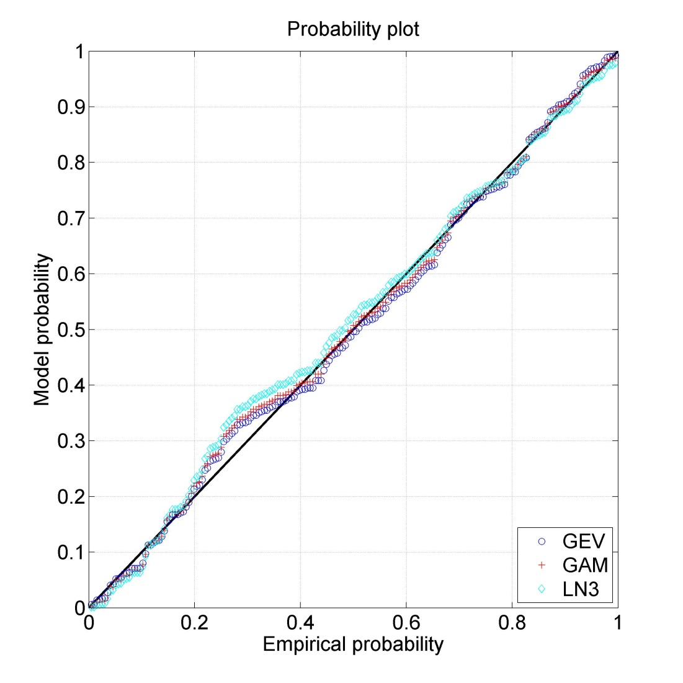
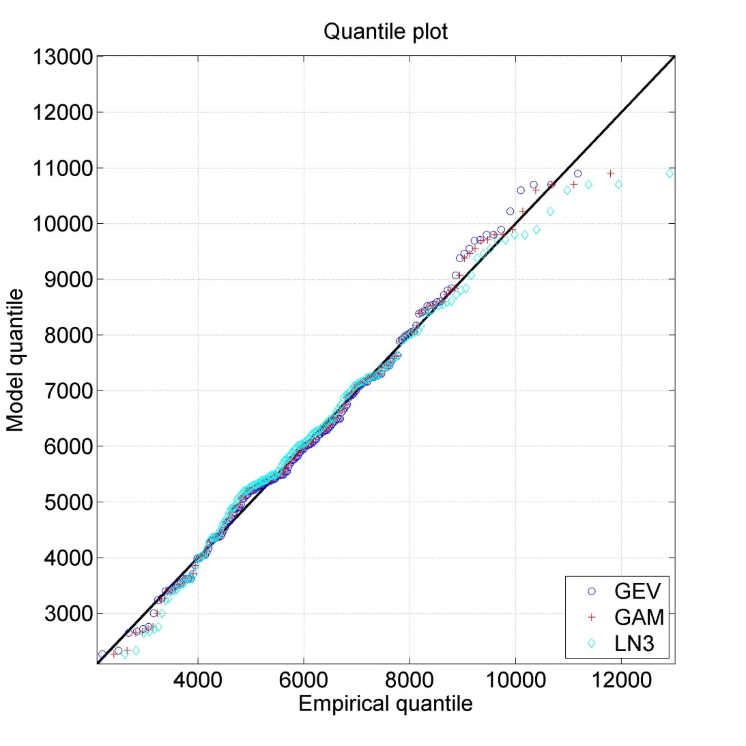
Example: Model diagnostics
Better resolution in the center of the distributions.
Better resolution at the tails.
15
Notes:
Quantile-Quantile (Q-Q) plots are a popular technique for checking the fit of extremal distributions, as they are particularly effective at highlighting apparent discrepancies in the extreme upper tail.

