Slide 1
Flood Risk Seminar
Exercise with R
Xiaoxiang Guanª, Bruno Merz^{a,b}
a. GFZ German Research Centre for Geosciences, Section Hydrology, Potsdam, Germany
b. Institute of Environmental Science and Geography, University of Potsdam, Potsdam, Germany

Slide 2
Overview
Introduction to R and R bsics
Exercise with R - Flood frequency analysis
Exercise with R - Time-varying flood risk analysis
Materials here:
https://github.com/XiaoxiangGuanGFZ/FloodRiskSeminar

Slide 3
Timetable
10.05.2023: R basics
17.06.2023: R basics and frequency analysis
24.06.2023: Flood risk analysis
12.07.2023: Time-varying flood risk exercise
19.07.2023: Time-varying flood risk exercise

Slide 4
Topic 1. Introduction to R
What’s R: Installation, IDE
Data types and structures in R
Getting data into R
Functions and Control structures
Data manipulation
Graphic tools

Slide 5
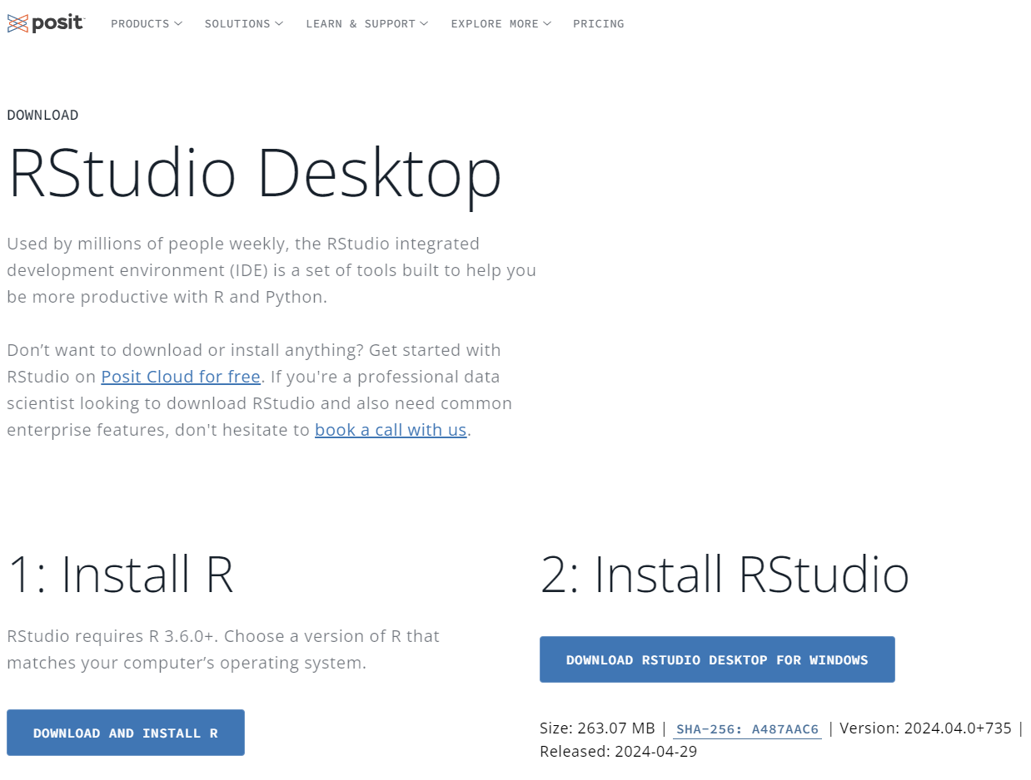
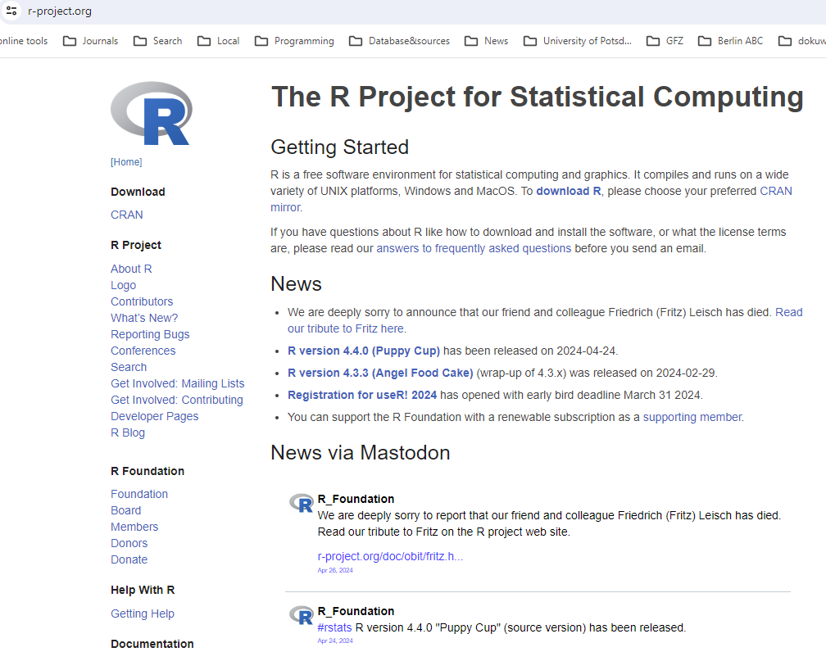
Topic 1. Introduction to R
1. What’s R
R project (download and installation): https://www.r-project.org/
IDE: RStudio (https://posit.co/download/rstudio-desktop/)
Packages: https://cran.r-project.org/web/packages/available_packages_by_name.html

Slide 6
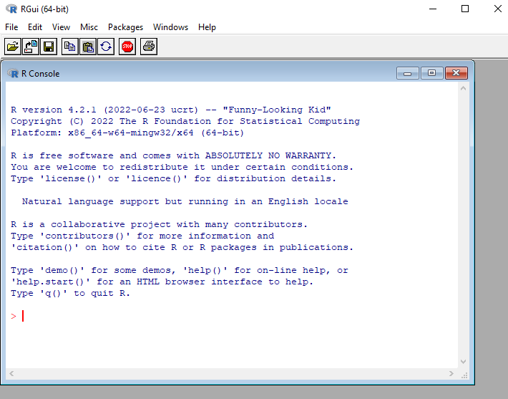
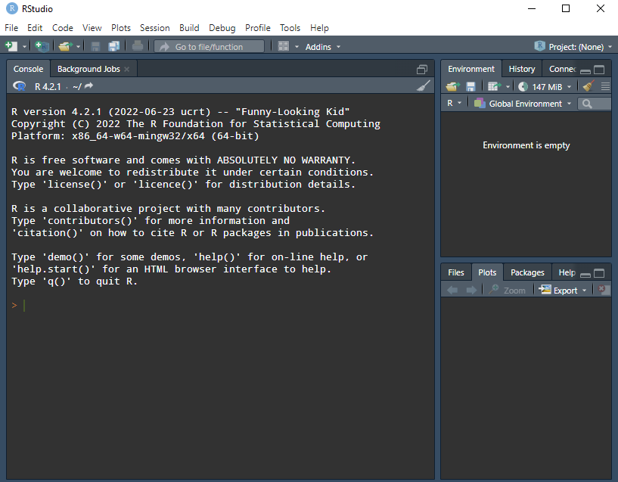
Topic 1. Introduction to R
1. What’s R
Key advantages of R:
Free of charge
Cross-platform
Open source
Statistical facilities
Graphics capabilities
Interactive programming

Slide 7
Topic 1. Introduction to R
What’s R: Installation, IDE
Data types and structures in R
Getting data into R
Functions and Control structures
Data manipulation
Graphic tools

Slide 8
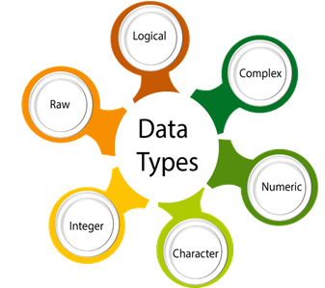
Topic 1. Introduction to R
2. Data types and structures
Data type | Example | Description
Real numbers | 0.0, 12.3, -32.25, 112, 5432.0 | Decimal value is called numeric in R, and it is the default computational data type.
Integer | 0, 3, 66, 2346L | Here, L can help tell R to store the value as an integer.
Logical (boolean) | True, False | It is a special data type for data with only two possible values which can be construed as true/false.
Character | 'a', 'good', "TRUE", '35.4' | In R programming, a character is used to represent string values. We convert objects into character values with the help of as.character() function.
numeric
categorical
TRUE --> 1
FALSE --> 0
non-zero --> TRUE 1
0 --> FALSE

Slide 9
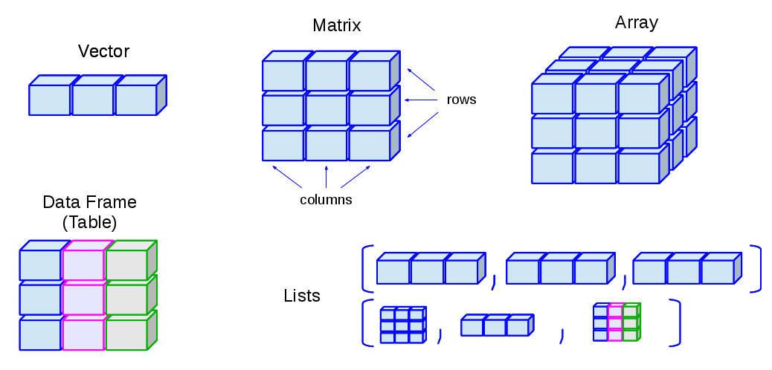
Topic 1. Introduction to R
2. Data types and structures
1) Vector
one-dimensional arrays used to store collection data of the same data type
Numeric Vectors (data type: numeric)
Logical Vectors (data type: logical)
Character Vector or text strings (data type: character)
2) Matrix
two-dimensional arrays to store collections of data of the same mode.
3) Array
similar to matrices but they can be multi-dimensional (more than 2D)
4) Data Frame
Also 2D; generalization of matrix where different columns can store different data types.
5) List
ordered collection of objects, where the elements can be of different data structures
Data structure
a way of organizing and storing data

Slide 10
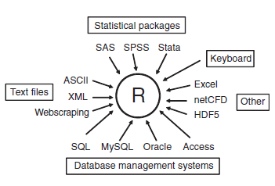

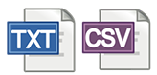
Topic 1. Introduction to R
3. Getting data into R
Export: write.table()
Import: read.table()

Slide 11
Topic 1. Introduction to R
4. Functions and Control structures
What’s function:
A function is a set of statements organized together to perform a specific task.
Funtion_name <- function(parameters) {
… function body (commands chunk)
… return ()
}
Function sources:
Built-in
Third-party packages
Self-defined
Notes:
A function is a set of statements organized together to perform a specific task. R has a large number of in-built functions and the user can create their own functions. In R, a function is an object so the R interpreter is able to pass control to the function, along with arguments that may be necessary for the function to accomplish the actions.

Slide 12
Topic 1. Introduction to R
Exercises:
getting data into R and find data file here: data/Example_data.csv, use read.table() function
Check the dimensions of the imported data
How many years this data set covers? Starting year? End year?
Derive the maximum, minimum, mean value, standard deviation of the discharge column
Derive the maximum, minimum, mean value, standard deviation of the first 365 elements in discharge column
Export the first 365 rows of df into text file with write.table() function

Slide 13
Topic 1. Introduction to R
4. Functions and Control structures
What’s function:
A function is a set of statements organized together to perform a specific task.
Funtion_name <- function(parameters) {
… function body (commands chunk)
… return ()
}
Function sources:
Built-in
Third-party packages
Self-defined
Notes:
A function is a set of statements organized together to perform a specific task. R has a large number of in-built functions and the user can create their own functions. In R, a function is an object so the R interpreter is able to pass control to the function, along with arguments that may be necessary for the function to accomplish the actions.

Slide 14
Topic 1. Introduction to R
4. Functions and Control structures
Control structures:
If-Else statements
Loops
Notes:
The if...else statement executes two different codes depending upon whether the test expression is true or false.

Slide 15
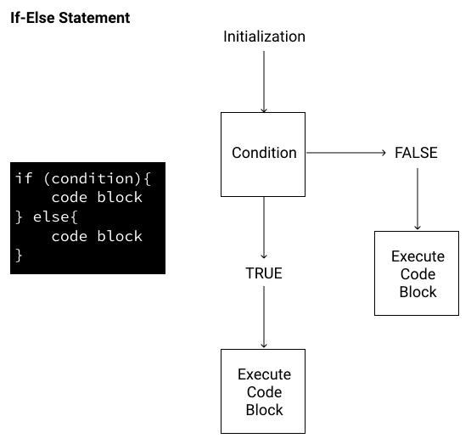
Topic 1. Introduction to R
4. Functions and Control structures
Control structures:
If-Else statements
Loops
Notes:
The if...else statement executes two different codes depending upon whether the test expression is true or false.

Slide 16
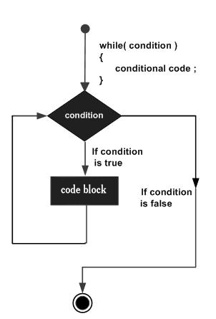
Topic 1. Introduction to R
4. Functions and Control structures
Control structures:
If-Else statements
Loops
While-type loop
keep looping as long as a specific logical condition is satisfied
Example:
i <- 0
while (i <= 4)
{
i <- i + 1
print(i)
}
## [1] 1
## [1] 2
## [1] 3
## [1] 4
## [1] 5
Notes:
While loop:
Keep execute some codes as long as the test expression is true.
Here the loop will only continue to pass values to the main body of the loop (the expression body) when i is less than or equal to 4 (specified using the <- operator in this example). Once i is greater than 4 the loop will stop.

Slide 17
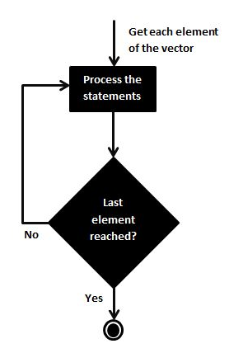
Topic 1. Introduction to R
4. Functions and Control structures
Control structures:
If-Else statements
Loops
For-type loop
repeat a task a defined number of times:
Example:
for (i in 1:5) {
print(i)
}
## [1] 1
## [1] 2
## [1] 3
## [1] 4
## [1] 5
i <- 1
print(i)
## [1] 1
i <- 2
print(i)
## [1] 2
i <- 3
print(i)
## [1] 3
i <- 4
print(i)
## [1] 4
i <- 5
print(i)
## [1] 5

Slide 18
Topic 1. Introduction to R
5. Data manipulation
Typical (successful) procedures for data science
Accessing the data (getting the data into the application from multiple sources)
Cleaning the data (coding missing data, fixing or deleting miscoded data, transforming variables into more useful formats)
Annotating the data (in order to remember what each piece represents)
Summarizing the data (getting descriptive statistics to help characterize the data)
Visualizing the data (a picture really is worth a thousand words)
Modeling the data (uncovering relationships and testing hypotheses)
Preparing the results (creating publication-quality tables and graphs)
Getting data in
Data manipulation
Visualization
Algorithm

Slide 19
Topic 1. Introduction to R
5. Data manipulation
Data frame variable name
Create
Rename
Alter
Add
Sort
Merge
Filter and subset
Aggregation
df
c1 c2 c3 c4
1 1 25 Type1 Poor
2 2 34 Type2 Improved
3 3 28 Type1 Excellent
4 4 52 Type1 Poor
5 5 35 Type1 Poor
6 6 40 Type2 Improved
Column names
row names
data

Slide 20
Topic 1. Introduction to R
5. Data manipulation
Create
Rename
Alter
Add
Sort
Merge
Filter and subset
Aggregation
colnames(df) <- c("patientID", "age", "diabetes", "status")
df
ID age diabetes status
1 1 25 Type1 Poor
2 2 34 Type2 Improved
3 3 28 Type1 Excellent
4 4 52 Type1 Poor
5 5 35 Type1 Poor
6 6 40 Type2 Improved

Slide 21
Topic 1. Introduction to R
5. Data manipulation
Create
Rename
Alter
Add
Sort
Merge
Filter and subset
Aggregation
df$age[1] <- 30
Df[1,3] <- “Type3”
df
ID age diabetes status
1 1 30 Type3 Poor
2 2 34 Type2 Improved
3 3 28 Type1 Excellent
4 4 52 Type1 Poor
5 5 35 Type1 Poor
6 6 40 Type2 Improved

Slide 22
Topic 1. Introduction to R
5. Data manipulation
Create
Rename
Alter
Add
Sort
Merge
Filter and subset
Aggregation
df
ID age diabetes status
1 1 25 Type1 Poor
2 2 34 Type2 Improved
3 3 28 Type1 Excellent
4 4 52 Type1 Poor
5 5 35 Type1 Poor
6 6 40 Type2 Improved
gender
M
F
F
M
M
F
7 30 Type2 Excellent

Slide 23
Topic 1. Introduction to R
5. Data manipulation
Create
Rename
Alter
Add
Sort
Merge
Filter and subset
Aggregation
df[order(df$age), ]
df[order(df$age, decreasing = TRUE), ]
df
ID age diabetes status
1 1 25 Type1 Poor
3 3 28 Type1 Excellent
2 2 34 Type2 Improved
5 5 35 Type1 Poor
6 6 40 Type2 Improved
4 4 52 Type1 Poor
df
ID age diabetes status
4 4 52 Type1 Poor
6 6 40 Type2 Improved
5 5 35 Type1 Poor
2 2 34 Type2 Improved
3 3 28 Type1 Excellent
1 1 25 Type1 Poor

Slide 24
Topic 1. Introduction to R
5. Data manipulation
df
ID age diabetes status
1 1 25 Type1 Poor
2 2 34 Type2 Improved
3 3 28 Type1 Excellent
4 4 52 Type1 Poor
5 5 35 Type1 Poor
6 6 40 Type2 Improved
df2
ID gender
1 2 M
2 3 F
3 5 F
Create
Rename
Alter
Add
Sort
Merge
Filter and subset
Aggregation
+
ID age diabetes status gender
1 1 25 Type1 Poor <NA>
2 2 34 Type2 Improved M
3 3 28 Type1 Excellent F
4 4 52 Type1 Poor <NA>
5 5 35 Type1 Poor F
6 6 40 Type2 Improved <NA>
merge(
df, df2,
by.x = "ID", by.y = "ID",
all.x = TRUE
)
=

Slide 25
Topic 1. Introduction to R
5. Data manipulation
df[, 1] or df$diabetes or df[, “diabetes”]
Create
Rename
Alter
Add
Sort
Merge
Filter and subset
Aggregation
df
ID age diabetes status
1 1 25 Type1 Poor
2 2 34 Type2 Improved
3 3 28 Type1 Excellent
4 4 52 Type1 Poor
5 5 35 Type1 Poor
6 6 40 Type2 Improved
df[1:4, 1:2]
df[df$status == “Excellent”, ]
df[1, ]

Slide 26
Topic 1. Introduction to R
5. Data manipulation
Create
Rename
Alter
Add
Sort
Merge
Filter and subset
Aggregation
data aggregation
compile typically amounts of information and organize it into a more comprehensive medium.
Summarize information
Make conclusion
Shrink data
Group statistics

Slide 27
Topic 1. Introduction to R
aggregate(rainfall~y, data = df, FUN = sum)
y rainfall
1982 1797.59
1983 1650.93
1984 1373.37
1985 1390.72
1986 1282.76
1987 1660.45
1988 1693.15
1989 1586.80
Year month day rainfall evaporation discharge
1982 1 1 0 1.3 38.3
1982 1 2 0 0.6 37.8
1982 1 3 1.59 0.6 38
1983 1 1 0 0.4 41.5
1983 1 2 0.01 0.8 39.8
1983 1 3 0 1 38.3
1984 1 1 0 0.7 16.8
1984 1 2 0 1 16.3
1984 1 3 0 0.9 15.8
1985 1 1 0.22 0 20
1985 1 2 2.83 0.3 22.4
1985 1 3 0.04 0.4 24.9
1986 1 1 0 1.9 38
1986 1 2 0 1.7 27.8
1986 1 3 0.06 0.3 25.7
1987 1 1 0 1.7 9.6
1987 1 2 0 2.5 9.4
1987 1 3 0.22 1.4 9.2
1988 1 1 0 1.7 35.5
1988 1 2 0 0.9 34.2
1988 1 3 0 0.2 33.1
1989 1 1 0.12 1.6 52.6
1989 1 2 0.01 91 33.7
1989 1 3 0.42 0.6 30
…
Apply function sum()
…
…
…
…
…
…
…

Slide 28
Topic 2. Exercise with R - Flood frequency analysis
Exercises:
get data into R: ./data/Example_data.csv, use read.table() function
How many days are there with discharge exceeding (>=) 8000?
Which month has the most discharge days exceeding 8000?
Derive the annual maximum discharge series
Figure out in which day (date) the discharge reaches the maxima for each year

Slide 29
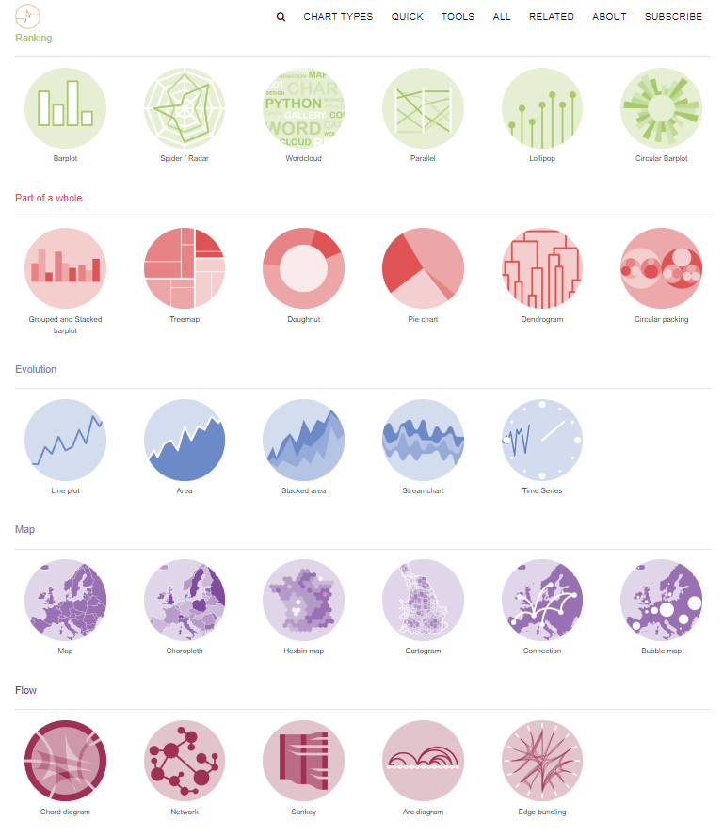
Topic 1. Introduction to R
6. Graphing tool
Built-in
ggplot2: https://ggplot2-book.org/
https://r-graph-gallery.com/

Slide 30
Topic 1. Introduction to R
legend
title
6. Graphing tool
Plot panel
y-axis label
Plot area
data
y-axis
tick
x-axis
tick label
x-axis label

Slide 31
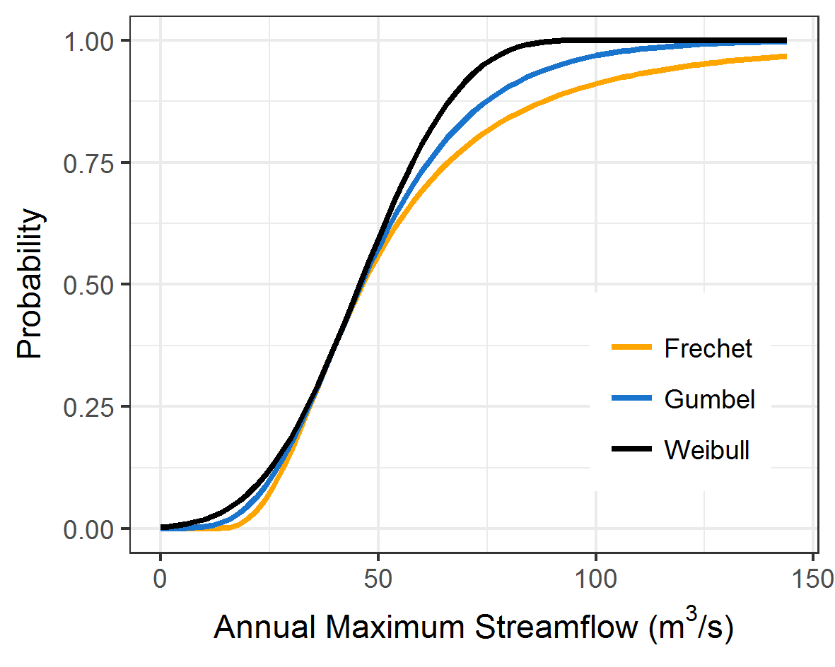
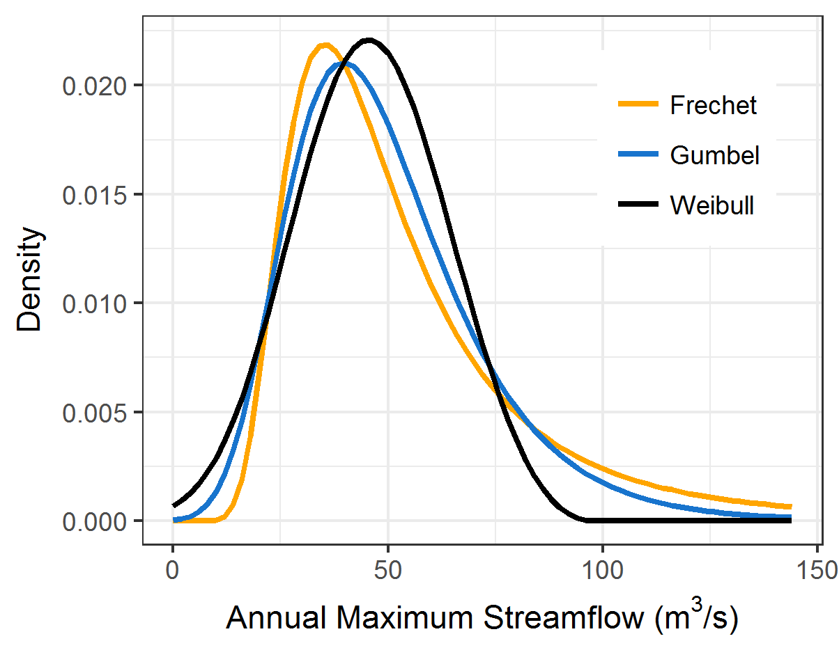
Topic 2. Exercise with R - Flood frequency analysis
Cumulative distribution function
Probability density function
Cumulative distribution function
Parameter:
ξ: Shape
µ: Location
σ: Scale

Slide 32
Topic 2. Exercise with R - Flood frequency analysis
Exercises:
get data into R: ./data/Example_data.csv, use read.table() function
Derive the annual maximum discharge series
Estimate the GEV parameters for annual maximum discharge
Generate 100 random numbers based on the estimated GEV parameters

Slide 33
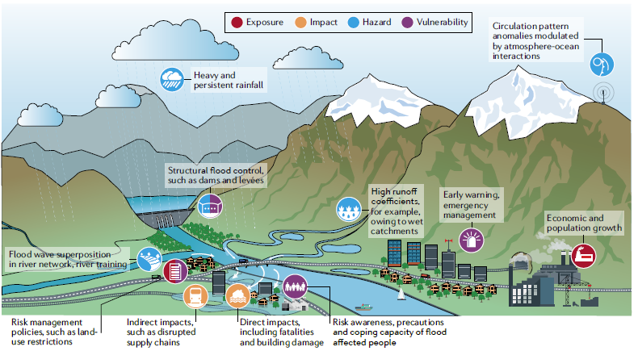
Topic 2. Exercise with R - Flood frequency analysis
Flood risk analysis
Components:
Hazard
Exposure
Vulnerability

Slide 34
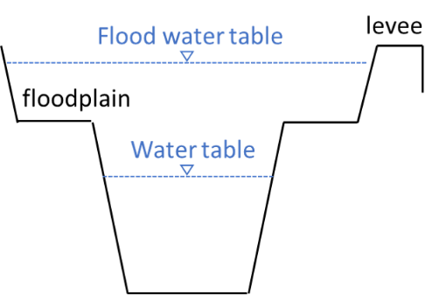
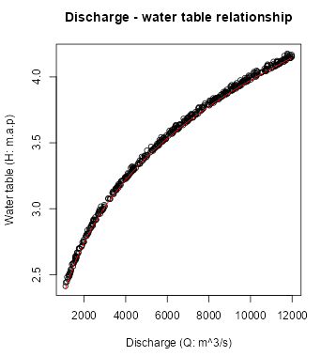
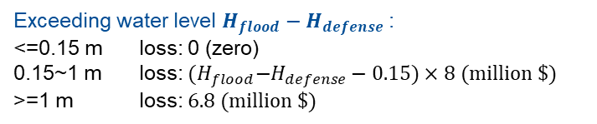
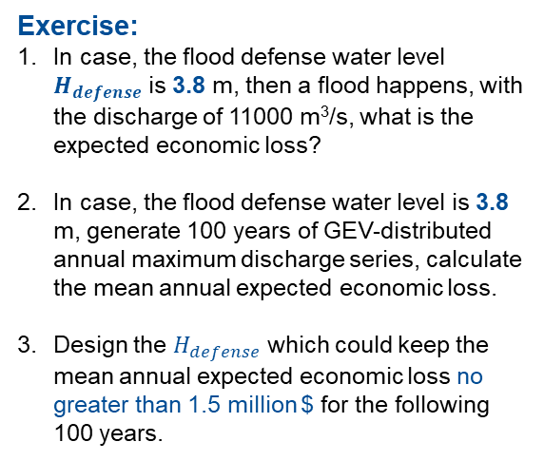

Topic 2. Exercise with R - Flood frequency analysis
Exercise:
In case, the flood defense water level $H_{defense}$ is 3.8 m, then a flood happens, with the discharge of 11000 m³/s, what is the expected economic loss?
In case, the flood defense water level is 3.8 m, generate 100 years of GEV-distributed annual maximum discharge series, calculate the mean annual expected economic loss.
Design the $H_{defense}$ which could keep the mean annual expected economic loss no greater than 1.5 million $ for the following 100 years.
$$H=0.478Q^{0.23}$$
H: water level (m)
Q: discharge (m3/s)
Exceeding water level $H_{flood}−H_{defense}$:
<=0.15 m loss: 0 (zero)
0.15~1 m loss: ${(H}_{flood}−H_{defense}−0.15)×8 (million \$)$
>=1 m loss: $6.8 (million \$)$
Notes:
For instance, there is a city located beside the river and protected by embankments.
Within the river channel, the water level can be estimated from discharge.
Therefore, based on the water level – discharge relation, when a big discharge comes, we can derive the expected water level and quantify whether the water level will exceed the design defense level (flooding threshold) and the flood overtops or breaches the embankments and causes damages.
And further, the damages resulted from flood inundation is assumed to the function of exceeding water level.

Slide 35
Topic 4. Exercise with R - Time-varying flood risk analysis

