Slide 1
Social Statistical Interpretation of Trending YouTube Video
Xiaoxiao Chen
10/28/2020

Slide 2
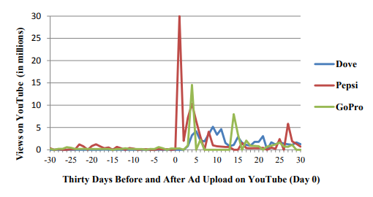
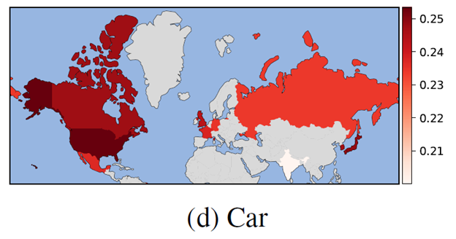
Background
Virality studies
Modeling techniques
Visualization approaches
Data types
Geographic
Time series
Topics
Entertainment
Informativeness
Customization
Popularity pattern
Advertisements
Broadcasting behavior
Sentiment analysis
SVM
Graph model
Correlation analysis
Statistical tests
Classification modeling
DNNs
Recommender algorithms
(Leinhardt 2016)
(Zhang et al 2020)

Slide 3
Project aims
Statistically learn the trending of YouTube videos:
The correlation of various factors on the popularity of trending YouTube videos
Cultural discrepancy on trending topics
Trending topic prediction, such as how long will it take for a recent uploaded video for trending
Categorizing large-scale YouTube video dataset
Visualization using various approaches

Slide 4
Project Plan
Task | Start Date | End Date | Deliverables | Toolkit
Brain storm on topics | 09/03/20 | 09/04/20 | Collect topics | /
Literature review | 09/12/20 | 09/19/20 | Review summary | /
Proposal | 09/19/20 | 09/24/20 | Proposal draft for review | MS office
Presentation & video | 10/24/20 | 10/28/20 | Presentation & video | /
Data collection | 10/30/20 | 11/10/20 | Share dataset with team | Python, SQLite
Cleaning & preparation | 11/11/20 | 11/15/20 | Cleaned dataset | Python, R, OpenRefine
Data mining | 11/16/20 | 11/20/20 | Data mining script & charts | Python, R
Statistical modeling | 11/21/20 | 11/26/20 | Models & script & results | Python, R
Visualization | 11/26/20 | 11/28/20 | Script & html & plots | /
Report | 11/29/20 | 11/30/20 | Report & poster & video | /

