Slide 1





GOLEM Knowledge Graph
Study Metadata and Characters with SPARQL
Graphs and Ontologies for Literary Evolution Models
A 5-year (2023-2027) research project funded by the European Commission (ERC StG)
Xiaoyan Yang

Slide 2
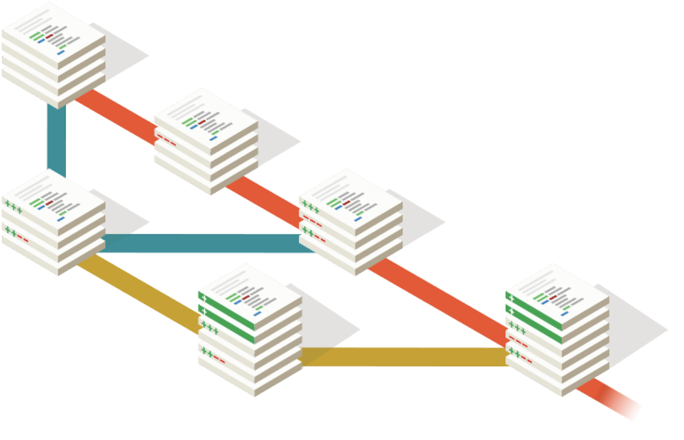
GOLEM project’s research goals
RQ1: How do story traits spread, become successful, disappear?
RQ2: Which narrative strategies have a stronger impact on readers?
Data: Fanfic communities of readers and writers who reinterpret stories and further transmit modifications of them

Slide 3
Desiderata for a formal ontology for fiction and narrative
Character module should (minimally) express:
Characters are entities that appear in multiple contexts (e.g. a novel, its film adaptation, a wiki entry)
Characters have some recognizable features (e.g. appearance)
Characters engage in social relationships (e.g. become friends)
Characters do things and participate in events (e.g. fight a dragon)
Characters fulfill some roles in the plot development (e.g. villain)
All the above aspects are either explicitly stated in the fiction (e.g. “Harry is brave”) or inferred from it (e.g. “Harry jumps into the fire to rescue Ron”)
The provenance of each statement about characters should be clear.

Slide 4
GOLEM KG and named subgraphs
regular endpoint: https://graph.golemlab.eu:8890/sparql
BUT today:
development endpoint: http://graph-dev.golemlab.eu:8890/sparql

Slide 5
RDF and Knowledge Graphs
Knowledge Graphs store information as networks of entities, using Subject-Predicate-Object triplets.
‘Shakespeare wrote Hamlet’ →
s(Shakespeare), p(wrote), o(Hamlet) .
Each entity is identified by a ‘resource identifier’ (IRI or URI):
wd:Q692, wdt:P800, wd:Q41567 .

Slide 6
Querying Knowledge Graphs with SPARQL
SPARQL is the query language for RDF graphs.
A SPARQL query includes SELECT and WHERE clauses.
SELECT defines variables to retrieve (e.g., ?subject), and WHERE describes triple patterns to match.
Prefixes simplify long URIs:
PREFIX schema: <https://schema.org/>
SELECT ?work ?title
WHERE {
?work schema:title ?title .
}

Slide 7
GOLEM KG
GOLEM reuses CIDOC-CRM, DOLCE, LRMoo, Schema:
PREFIX dlp: <http://www.ontologydesignpatterns.org/ont/dlp/>
PREFIX schema: <https://schema.org/>
PREFIX crm: <http://www.cidoc-crm.org/cidoc-crm/>
PREFIX lrm: <http://iflastandards.info/ns/lrm/lrmoo/>
PREFIX gc: <https://ontology.golemlab.eu/>
PREFIX gd: <https://data.golemlab.eu/entity/>
PREFIX gt: <https://data.golemlab.eu/entity/type/>

Slide 8
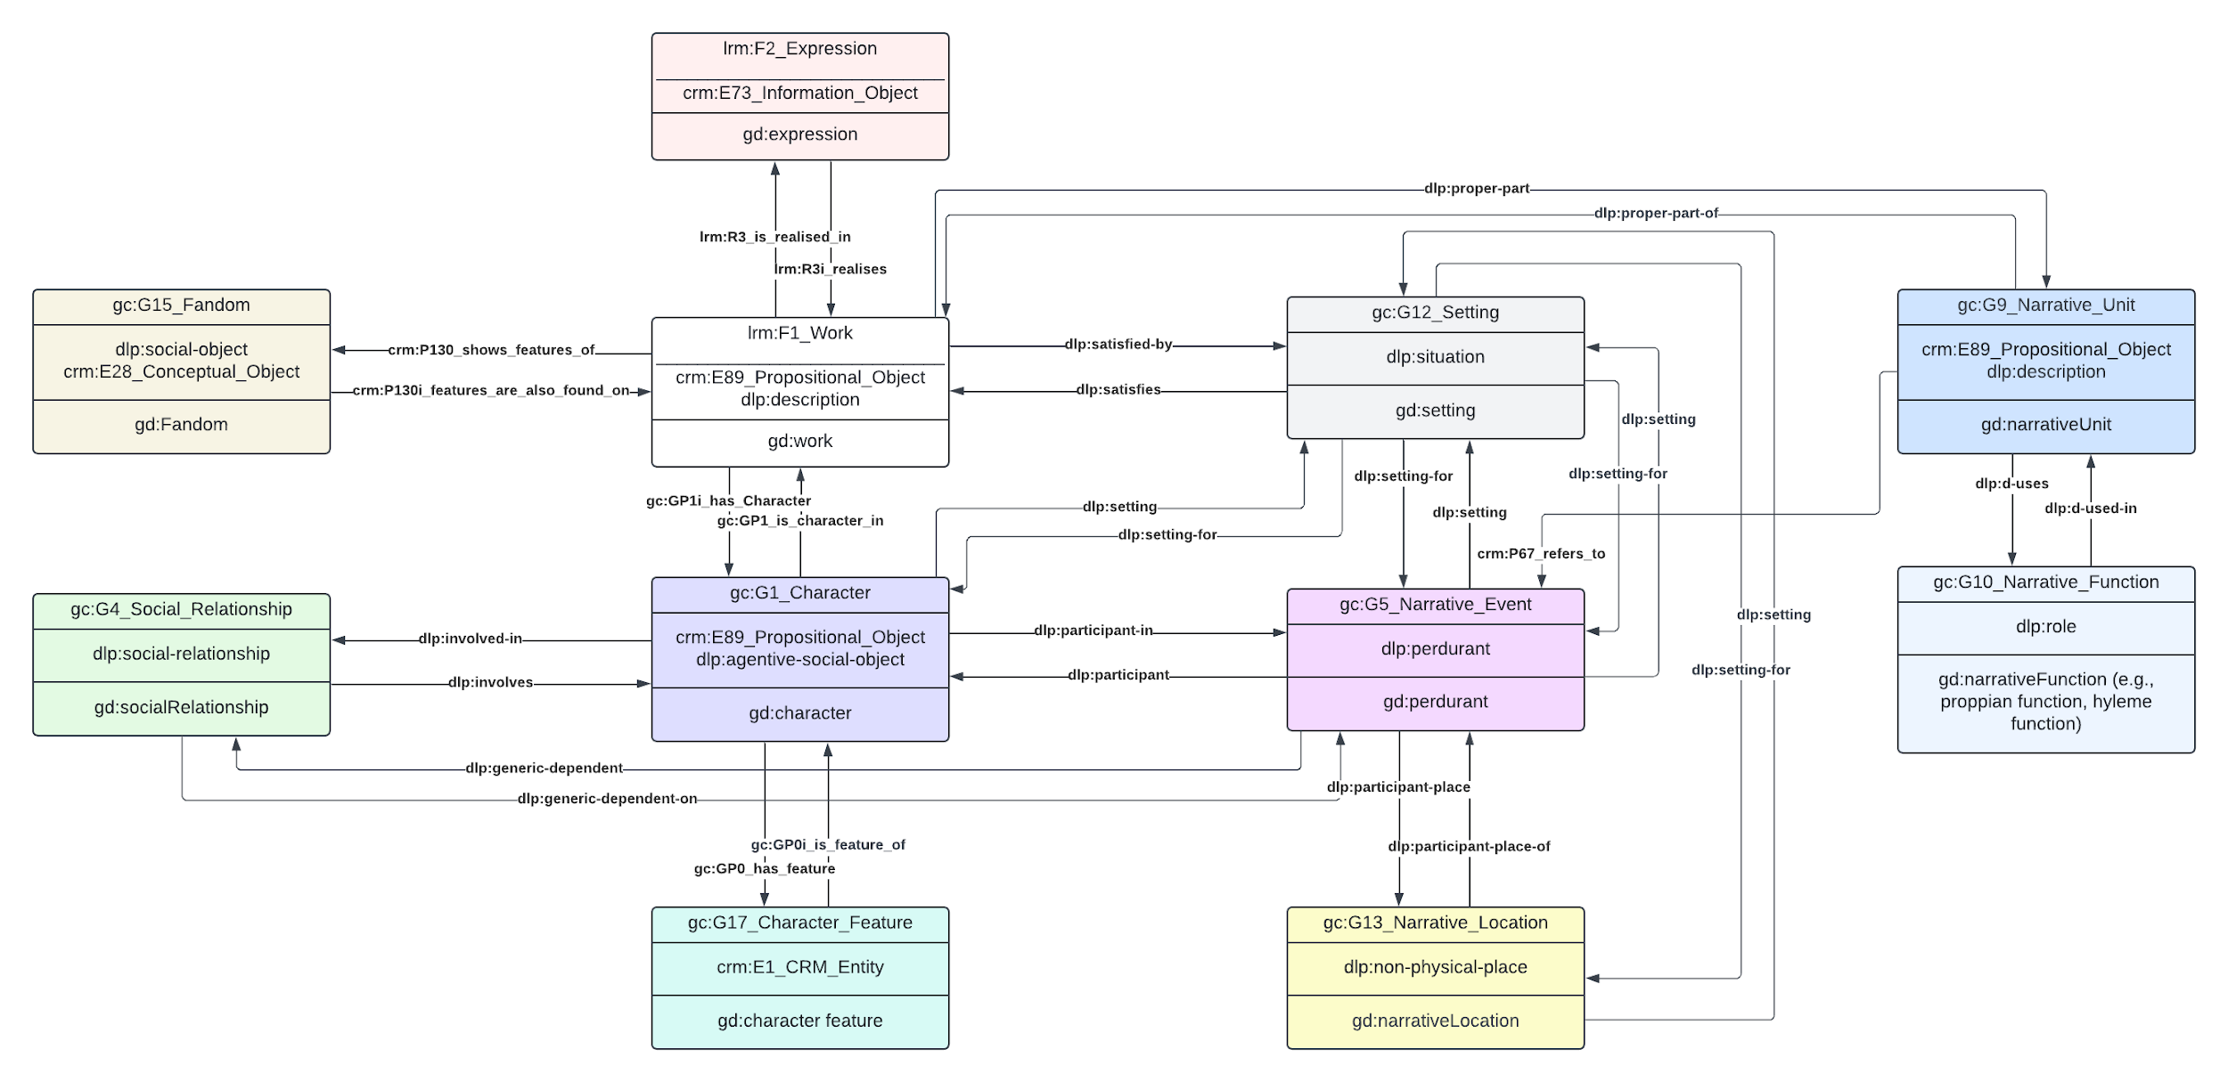

Canon Work
Fan Work
Fandom
Character

Slide 9
SPARQL: GOLEM metadata example
[first define prefixes for schema, CRM, LRMoo, and GOLEM]
SELECT DISTINCT ?work ?title ?creator
WHERE {
GRAPH <https://golemlab.eu/graph/dh2025Greek10Metadata> {
?work a lrm:F1_Work ;
schema:title ?title ;
lrm:R3i_realises ?expression .
?expression schema:creator ?creator .
?work crm:P2_has_type gt:T000000014 . }
}
LIMIT 10

Slide 10
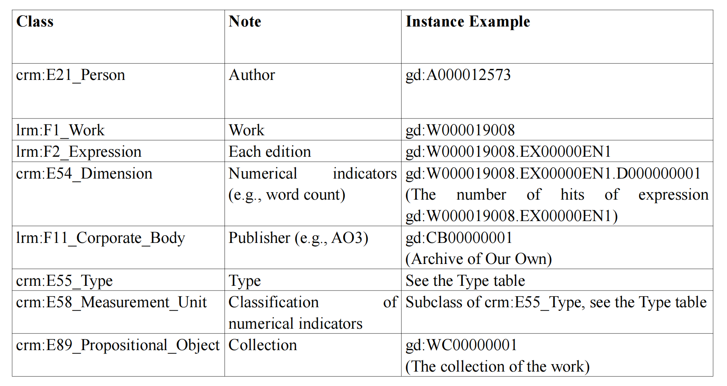
Core Classes of the Fanfiction Metadata
https://github.com/GOLEM-lab/golem-ontology/wiki/8.-IRI-Naming-Conventions-for-Instances-in-Knowledge-Graph

Slide 11
Type Instances of the Fanfiction Metadata
Type Instance | Class | Note
gt:T000000028 | crm:E58_Measurement_Unit | numberOfHits
gt:T000000029 | crm:E58_Measurement_Unit | numberOfKudos
gt:T000000030 | crm:E58_Measurement_Unit | numberOfComments
gt:T000000031 | crm:E58_Measurement_Unit | numberOfBookmarks
gt:T000000032 | crm:E58_Measurement_Unit | wordCount
gt:T000000033 | crm:E58_Measurement_Unit | numberOfChapters
gt:T000000034 | crm:E55_Type | AO3 Tag
gt:T000000035 | crm:E55_Type | Content Warning
gt:T000000036 | crm:E55_Type | Romantic Category
gt:T000000037 | crm:E55_Type | AO3 Tag： Graphic Depictions Of Violence
gt:T000000038 | crm:E55_Type | AO3 Tag： Major Character Death
gt:T000000039 | crm:E55_Type | Romantic Categor：F/M

Slide 12
Object and Data Properties
Object Properties connect instances of different classes, represent relationships between entities:
Structure: Instance → Property → Another Instance
Example:
?work → lrm:R3i_realises → ?expression
?expression → schema:creator → ?creator
Data Properties assign literal values to instances:
Structure: Instance → Property → Literal Value
Example from your query:
?work → schema:title → "Title Text" (where "Title Text" is a string)

Slide 13
Example: RQ → ontology
RQ: what are the most common narrative locations for Italian sci-fi novels published in the 21st century?
locations → gc:G13_Narrative_Location
Italian → schema:inLanguage
sci-fi → schema:genre
21st century → schema:datePublished
novel → ?

Slide 14
Example: RQ → ontology
RQ: what are the most common narrative locations for Italian sci-fi novels published in the 21st century?
locations → gc:G13_Narrative_Location
Italian → schema:inLanguage
sci-fi → schema:genre
21st century → schema:datePublished
novel → maybe, crm:E55_Type

Slide 15
Object Properties of AO3 Metadata
Domain | Predicate (inverse predicate) | Range | Note
lrm:F1_Work | lrm:R3i_realises (lrm:R3_is_realised_in) | lrm:F2_Expression | Links work with edition
lrm:F2_Expression | crm:P43_has_dimension | crm:E54_Dimension | Links edition with numeric metrics
lrm:F2_Expression | schema:creator | crm:E21_Person | Links edition with author
lrm:F2_Expression | schema:keywords | crm:E55_Type | Links edition with tags
lrm:F2_Expression | schema:publisher | lrm:F11_Corporate_Body | Links edition with publisher
crm:E54_Dimension | crm:P2_has_type | crm:E58_Measurement_Unit | Links edition’s numeric metrics with corresponding classification
lrm:F1_Work | schema:collection | crm:E89_Propositional_Object | Links work with collection
crm:E55_Type | crm:P127i_has_narrower_term | crm:E55_Type | Type hierarchy

Slide 16
Data Properties of AO3 Metadata
Domain | Predicate | Range | Note
(any type of resource ) | skos:prefLabel | xsd:string | Entity label @en, @it…
lrm:F2_Expression | schema:abstract | xsd:string | Links work with edition
lrm:F2_Expression | schema:contentRating | xsd:string | Links edition with relevant metrics
lrm:F2_Expression | schema:creativeWorkStatus | xsd:string | Status of the creative work (e.g., Completed, InProgress, Draft)
lrm:F2_Expression | schema:inLanguage | xsd:string | Language of the edition (e.g., "en", "es"). Prefer 2-character ISO code.
lrm:F2_Expression | schema:abstract | xsd:string | Summary or abstract of the edition; links to the intellectual content of a work
lrm:F2_Expression | schema:datePublished | xsd:date | First publication date of the edition
lrm:F2_Expression | schema:dateModified | xsd:date | Last modification date of the edition
lrm:F2_Expression | schema:endTime | xsd:date | Date when the edition (e.g., a fanfiction) was finished or ended
crm:E89_Propositional_Object | schema:url | URL | Links to the full content or external page (e.g., AO3 story URL)
crm:E54_Dimension | crm:P90_has_value | xsd:decimal | Numerical value for a measurable metric (e.g., word count, kudos)

Slide 17
Representing Characters in the GOLEM KG
The GOLEM ontology models characters as evolving narrative entities whose identities, traits, and relationships transform across canonical and fan-generated texts.
Two-level character modeling strategy:
- G1_Character: Individual character instantiations
- G0_Character-Stoff: Broader conceptual entities linking various instances of characters appearing in single works

Slide 18
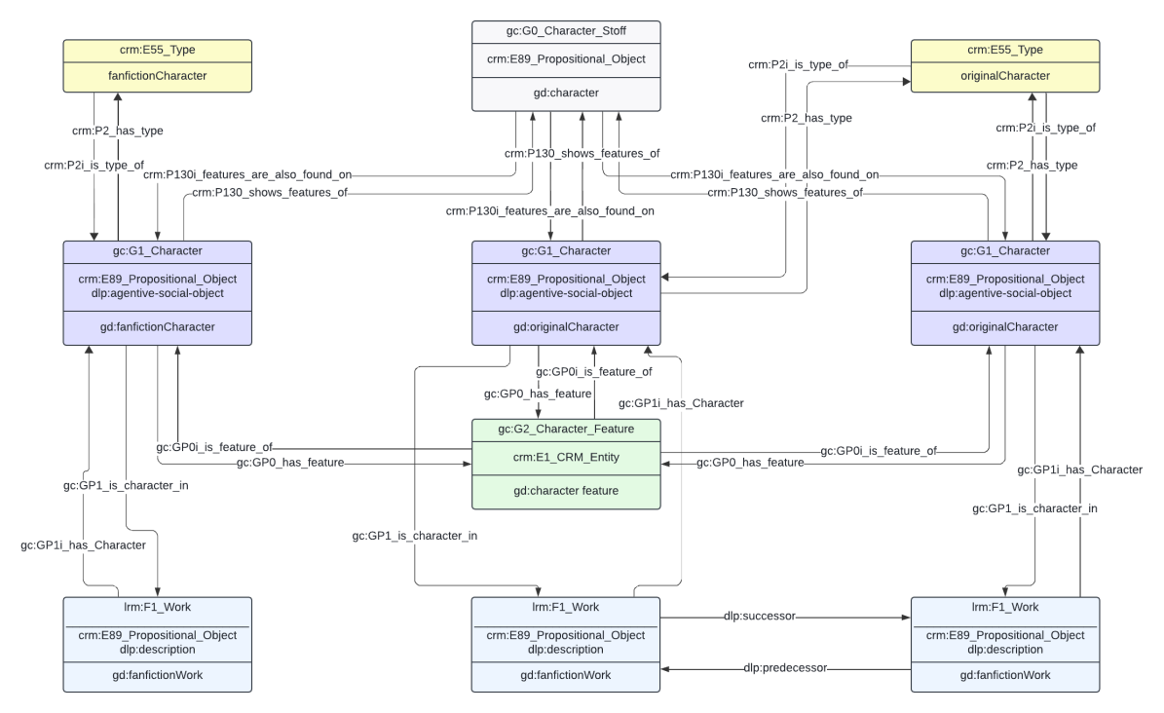
Characters in works

Slide 19
Character-Stoff

Slide 20
Character traits

Slide 21
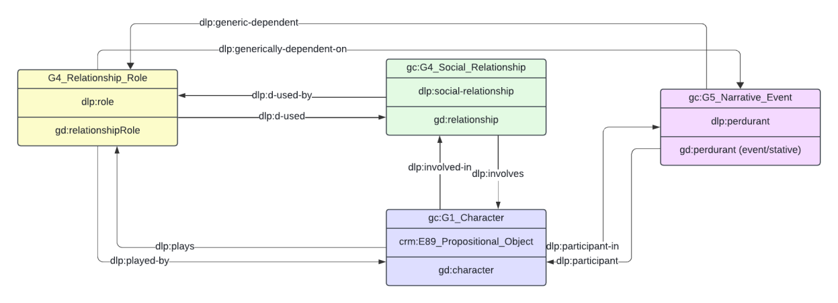
Relationships Between Characters
Relationships (gc:G4_Social_Relationship) include "romantic/erotic relationship", "familial relationship", "antagonistic relationship" and "social relationship".
Relationship roles (gc:G6_Relationship_Role) define the specific nature of a connection between characters within a relationship, such as "wife" "lover" "enemy" "father".

Slide 22
Character Agency: Narrative Roles
Narrative Roles (gc:G11_Narrative_Role) describe a character's function within narrative events (gc:G5_Narrative_Event) or sequences (gc:G7_Narrative_Sequence), clarifying who performs or is affected by an action (e.g., "victim" or "perpetrator"), linked via the dlp:plays property.

Slide 23
Core Classes of the Character Module
Class | Note | Example
gc:G0_Character-Stoff | Abstract character idea connecting several instances of characters | gd:C000000254 "Orpheus (Ancient Greek Religion & Lore)"
gc:G1_Character | Character appearing in a work | gd:W000019008.C000000254, Orpheus in work W000019008
gc:G17_Character_Feature | Character traits/attributes | gd:W000019008.CF00000001, “male”
gc:G4_Social_Relationship | Relationships between characters | gd:W000019008.SR00000001, “Orpheus husband of Eurydice”
gc:G6_Relationship_Role | Character roles in relationships | gd:RR00000001, “husband”
gc:G11_Narrative_Role | Character roles in narratives | gd:NR00000001, “victim”; gd:NR00000001, “perpetrator”
gc:G5_Narrative_Event | Story events involving characters | gd:W000019008.NE00000001, "Eurydice died from a snakebite and descended to the underworld."
gc:G7_Narrative_Sequence | Sequences of narrative events | gd:W000019008.NS00000001, "Eurydice's death and descent"

Slide 24
Object Properties of the Character
Domain | Predicate | Range | Note
gc:G1_Character | gc:GP1_is_character_in | lrm:F1_Work | Links character to work
gc:G1_Character | crm:P130_shows_features_of | gc:G0_Character-Stoff | Links instance to abstract idea of the character
gc:G1_Character | dlp:plays | gc:G11_Narrative_Role | Links character to narrative role, e.g. “victim”
gc:G1_Character | dlp:participant-in | gc:G5_Narrative_Event | Character’s participation in events
gc:G1_Character | gc:GP0_has_feature | gc:G17_Character_Feature | Character traits
gc:G4_Social_Relationship | dlp:involves | gc:G1_Character | Relationships in which the characters is involved

Slide 25
Object Properties of the Character
Type Instance | Class | Note
gt:T000000004 | crm:E55_Type | Biographical features (Gender, etc.)
gt:T000000005 | crm:E55_Type | Physical features
gt:T000000006 | crm:E55_Type | Psychological features

Slide 26
Practical Session!
SPARQL queries for Metadata and Characters
Any Question?

