Slide 1



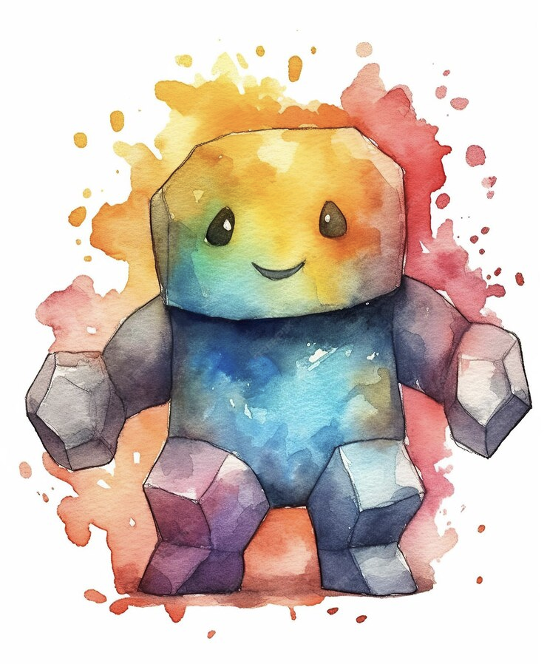

GOLEM Knowledge Graph
What Happens When Fans Rewrite Characters?
Graphs and Ontologies for Literary Evolution Models
A 5-year (2023–2027) ERC Starting Grant project
Xiaoyan Yang
Notes:
第1页 | GOLEM Knowledge Graph
讲授时间：00:00–01:00，本页1分钟
开场：今天讨论粉丝如何改写熟悉的人物，以及怎样把这些改写转成可查询的数据。介绍自己与GOLEM项目。说明前70分钟建立研究和建模思路，后30分钟一起运行notebook。
Source: DHBenelux2026-GOLEM (1).pptx, original slide 1.

Slide 2
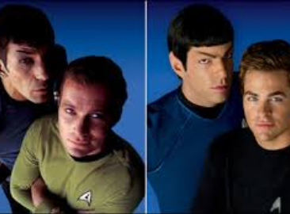
Comparative Literature Study
AI Storytelling Quality Benchmark
Why Interesting?

Slide 3
Workshop Overview
Fanfiction and East Asian Cultural Research
GOLEM Research Questions and Data
Ontology and Knowledge Graph Basics
Character Modelling Across Works
Guided Notebook Practice: 30 Minutes
Notes:
第2页 | Workshop Overview
讲授时间：01:00–02:00，本页1分钟
先交代路线：文化现象、研究数据、知识图谱、人物建模、实际查询。今天不要求背诵本体编号，也不要求从零写程序。
Source: D-SEA Pre 2024-07.pptx, original slide 2.
Background references retained from the source deck (original slide 26): Jenkins; Pugh; Coppa; additional references as listed in that source.

Slide 4
Fandom and Fanfiction
A fandom is a community of fans who discuss, reinterpret, and share cultural works.
Fanfiction uses characters or settings from existing works to tell new stories (Jenkins, 2013).
Modern media fandom has important roots in Star Trek fanzines of the 1960s and 1970s.
Online platforms such as Archive of Our Own (AO3) support large communities of readers and writers.
Fanfiction offers material for studying the reception of East Asian cultural products.
Notes:
第3页 | Fandom and Fanfiction
讲授时间：02:00–04:00，本页2分钟
问学生熟悉哪些作品、改编或粉丝创作，请Lau老师转述两三个回答。区分围绕作品形成的社群与粉丝创作的故事。粉丝创作并非仅仅复制原作，而会改变人物、关系和情节。不要将同人创作的全部历史简化为始于Star Trek。
Source: D-SEA Pre 2024-07.pptx, original slide 4.
Background references retained from the source deck (original slide 26): Jenkins; Pugh; Coppa; additional references as listed in that source.

Slide 5
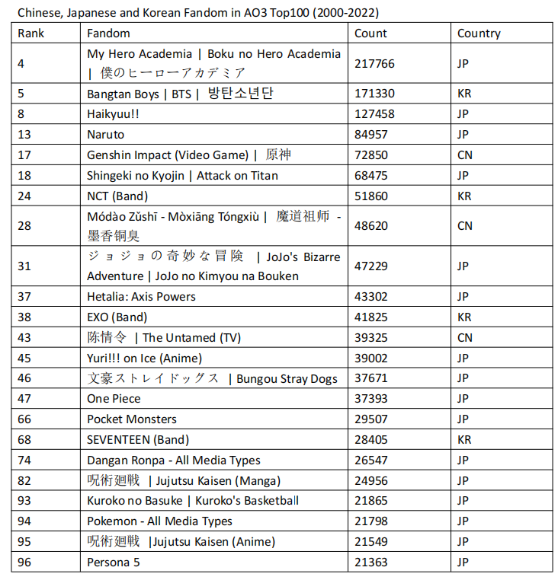
AO3 Fandoms (2024)
In the 2024 presentation, 23 of the 100 largest AO3 fandoms originated in China, Japan, or South Korea.
Japanese examples include anime and games.
Korean examples include K-pop.
Chinese examples include web literature and games.
Notes:
第4页 | East Asian Fandoms on AO3
讲授时间：04:00–06:00，本页2分钟
此页是2024年D-SEA报告中的历史统计，不是2026年实时排名。重点看动漫、游戏、K-pop与中国网络文学如何共同进入跨语言粉丝空间，不要求学生记23这个数字。
Source: D-SEA Pre 2024-07.pptx, original slide 6.
Background references retained from the source deck (original slide 26): Jenkins; Pugh; Coppa; additional references as listed in that source.

Slide 6
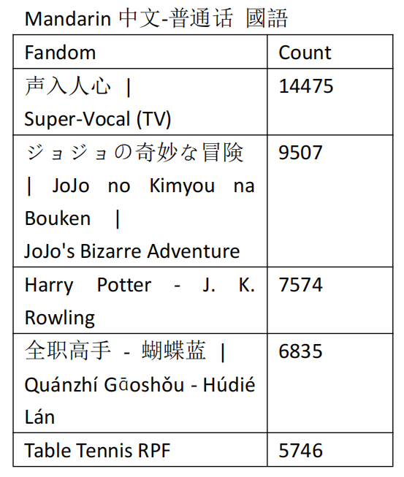

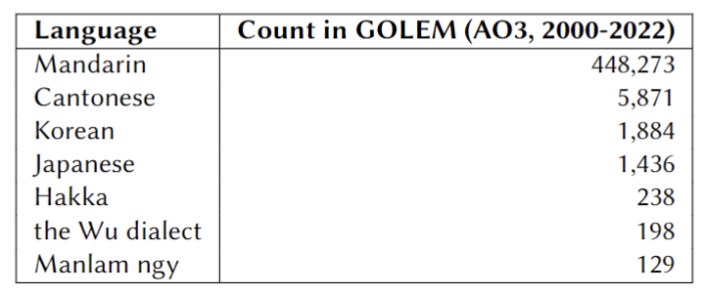
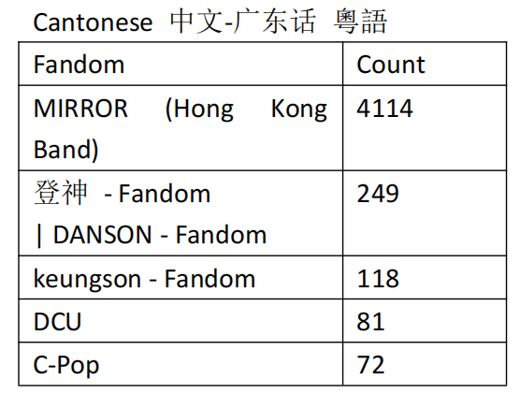
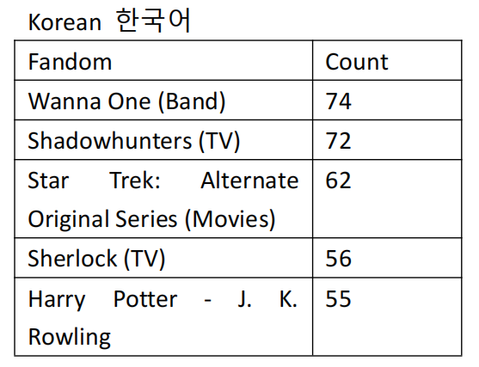
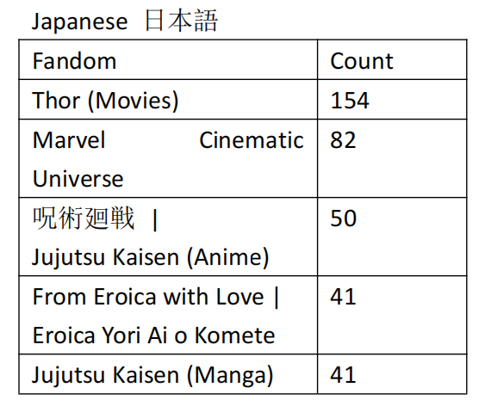
AO3 Languages (2024)
Notes:
第5页 | East Asian Languages on AO3
讲授时间：06:00–07:30，本页1.5分钟
这也是原报告中的历史数据。强调作品文化来源、作者写作语言与读者所在地不是同一个维度。不要从语言直接推断国籍。
Source: D-SEA Pre 2024-07.pptx, original slide 5.
Background references retained from the source deck (original slide 26): Jenkins; Pugh; Coppa; additional references as listed in that source.

Slide 7
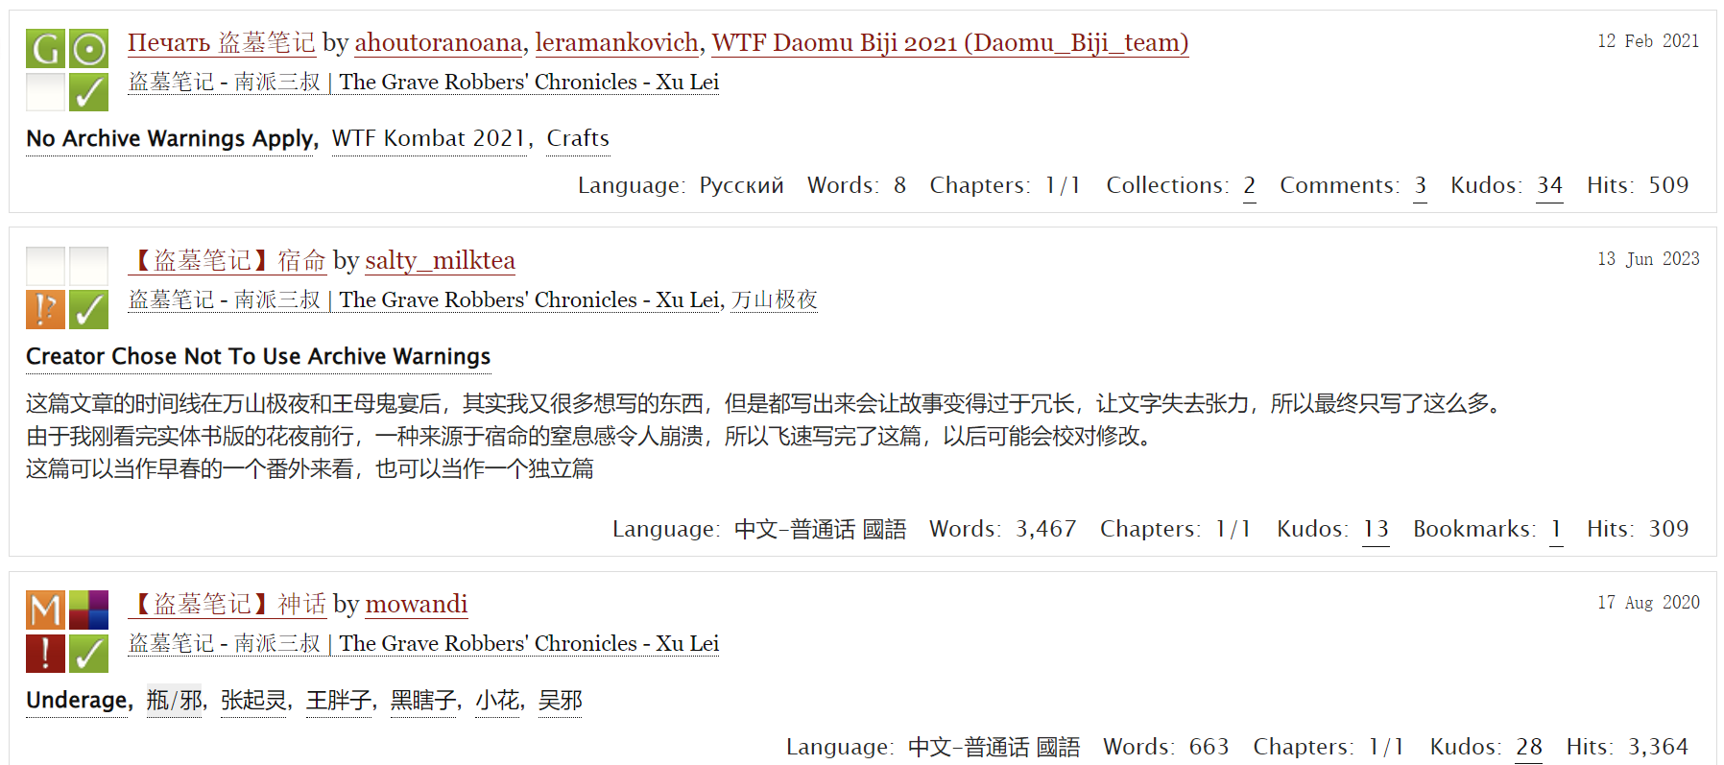
Fanfiction Data on AO3
https://archiveofourown.org/works/search?work_search%5Bquery%5D=%E7%9B%97%E5%A2%93%E7%AC%94%E8%AE%B0
Notes:
第6页 | Fanfiction Data on AO3
讲授时间：07:30–09:30，本页2分钟
用原稿盗墓笔记截图带学生观察标题、作者、日期、标签、字数和互动指标。问：仅靠这些信息，可以提出什么问题？截图是原材料示例，不要求现场访问AO3。
Source: D-SEA Pre 2024-07.pptx, original slide 11.
Background references retained from the source deck (original slide 26): Jenkins; Pugh; Coppa; additional references as listed in that source.

Slide 8

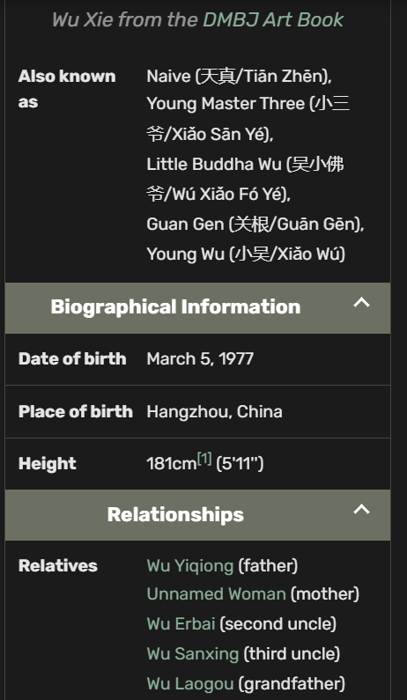
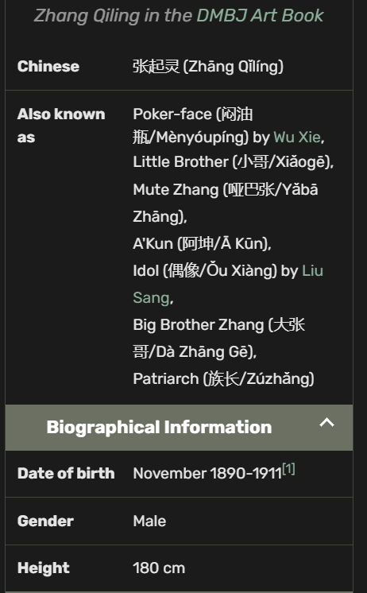
Fan Wiki Character Data
https://daomu-biji.fandom.com/wiki/Wu_Xie
https://daomu-biji.fandom.com/wiki/Zhang_Qiling
Notes:
第7页 | Character Information in Fan Wikis
讲授时间：09:30–11:30，本页2分钟
让学生观察吴邪与张起灵的wiki页。平台元数据告诉我们作品如何发布，人物wiki帮助我们组织人物背景和关系。wiki是特定社群整理的知识，需要考虑来源与版本。
Source: D-SEA Pre 2024-07.pptx, original slide 12.
Background references retained from the source deck (original slide 26): Jenkins; Pugh; Coppa; additional references as listed in that source.

Slide 9
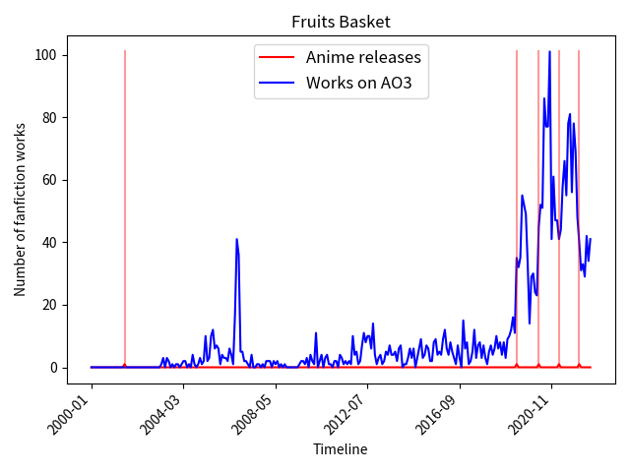
Anime Releases and Fanfiction Creation
2024 case study: AO3 fandoms in the Anime & Manga category
534 fandoms matched with anime releases in JVMG
Question: how does fanfiction activity vary around anime releases?
Temporal patterns invite further analysis; they do not establish causation.
Notes:
第8页 | Anime Releases and Fanfiction Creation
讲授时间：11:30–13:30，本页2分钟
用Fruits Basket图引出问题：新动画上映前后，同人创作如何变化？红线与蓝线提供时间比较的入口，但仅凭重合不能认定因果。534是原2024年项目案例中的匹配数。
Source: D-SEA Pre 2024-07.pptx, original slide 19.
Background references retained from the source deck (original slide 26): Jenkins; Pugh; Coppa; additional references as listed in that source.

Slide 10
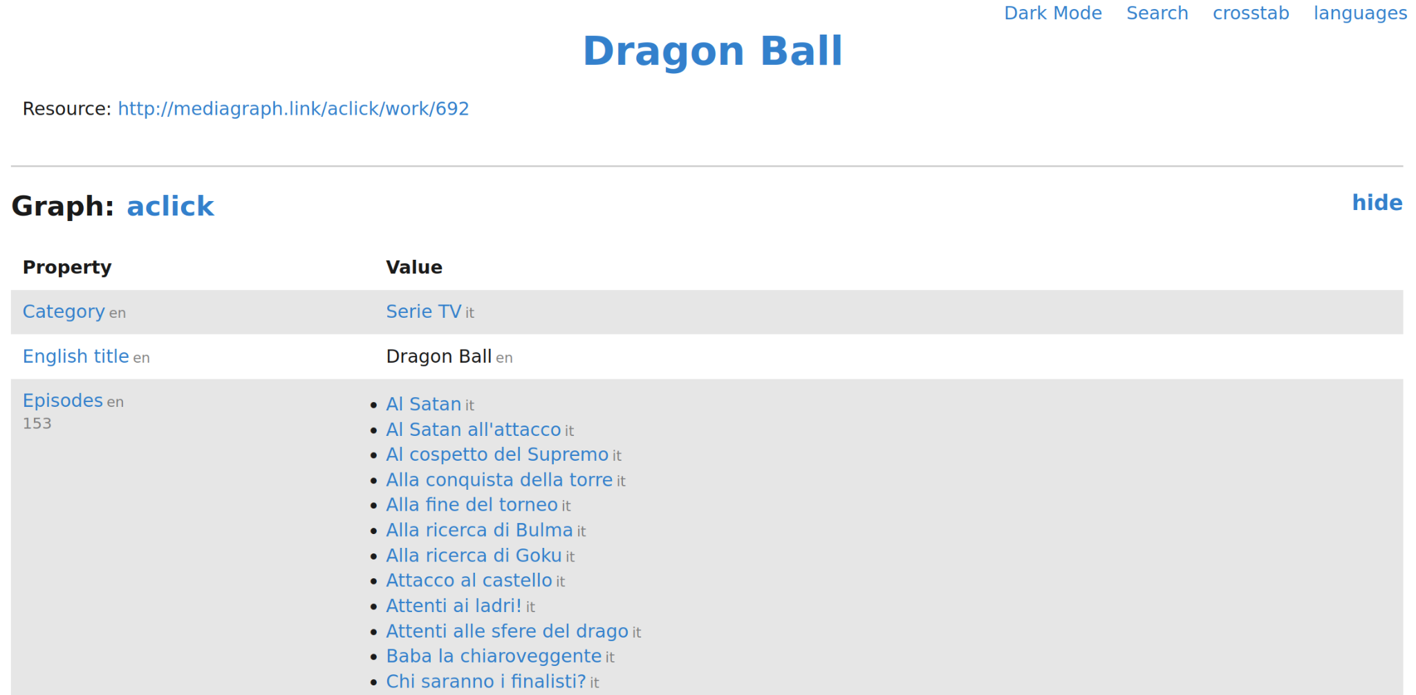
Connecting Anime and Fanfiction Data
Notes:
第9页 | Connecting Anime and Fanfiction Data
讲授时间：13:30–15:00，本页1.5分钟
这里用Dragon Ball页面演示另一类数据来源，不把它说成上一页Fruits Basket的对应记录。动画数据库提供标题与发行信息，AO3提供粉丝创作信息，先确认两边指的是同一作品或系列，才能连接比较。
Source: D-SEA Pre 2024-07.pptx, original slide 18.
Background references retained from the source deck (original slide 26): Jenkins; Pugh; Coppa; additional references as listed in that source.

Slide 11
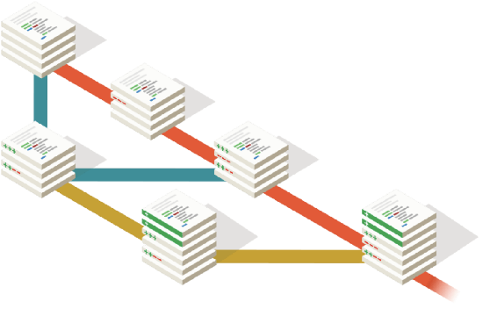

The GOLEM Project
Principal Investigator: Federico Pianzola
ERC Starting Grant project, 2023–2027
Research focus: the transmission of story traits across languages
Computational literary studies and cultural evolution
Fanfiction provides connected examples of stories and their transformations.
golemlab.eu/news/why_golem/
Notes:
第10页 | The GOLEM Project
讲授时间：15:00–16:30，本页1.5分钟
介绍项目PI Federico Pianzola与ERC资助背景，重点是跨文化文学研究与故事特征传播。团队成员名单属于旧报告，避免将其作为当前完整名单展示。
Source: D-SEA Pre 2024-07.pptx, original slide 8.
Background references retained from the source deck (original slide 26): Jenkins; Pugh; Coppa; additional references as listed in that source.

Slide 12
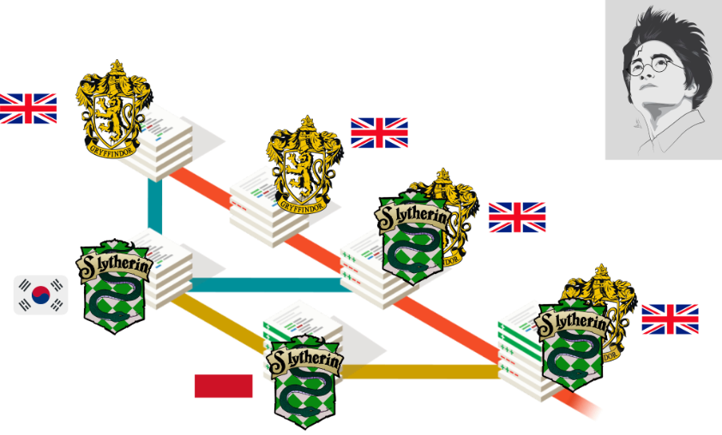
GOLEM Research Questions
RQ1: How do story traits spread, become successful, disappear?
RQ2: Which narrative strategies have a stronger impact on readers?
Data: Fanfic communities of readers and writers who reinterpret stories and further transmit modifications of them
Notes:
第11页 | GOLEM Research Questions
讲授时间：16:30–18:30，本页2分钟
把兴趣问题提升到研究目标：故事特征如何传播、哪些叙事策略与读者反应有关？解释研究项目的问题比今天的小型演示更广，课堂查询只展示其中一部分。
Source: DHBenelux2026-GOLEM (1).pptx, original slide 2.

Slide 13
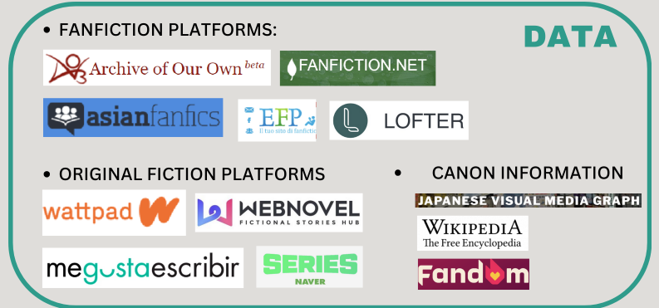
Sources of GOLEM Data
Notes:
第12页 | Sources of GOLEM Data
讲授时间：18:30–20:00，本页1.5分钟
按图片分组介绍同人平台、原创小说平台与原作信息来源。说明数据来源有不同的覆盖范围和结构，不能把所有平台当作同一总体。
Source: D-SEA Pre 2024-07.pptx, original slide 10.
Background references retained from the source deck (original slide 26): Jenkins; Pugh; Coppa; additional references as listed in that source.

Slide 14
Fanfiction Metadata
Works: titles and identifiers
Creators and publication dates
Tags and language information
Metrics: hits, kudos, comments, and word count
Question: what can these fields tell us about readers and stories?
Notes:
第13页 | Fanfiction Metadata
讲授时间：20:00–21:30，本页1.5分钟
以AO3页面回扣：标题、作者、发布时间属于描述信息，hits和kudos是平台互动指标。问学生：kudos较多是否等于文学质量较高？强调这些指标是读者互动的有限观察。
Source: DHBenelux2026-GOLEM (1).pptx, original slide 12.

Slide 15
Characters and Narrative Content
Which characters appear in a story?
How does the story describe them?
What relationships connect them?
Which events do they participate in?
These questions require representations of narrative content.
Notes:
第14页 | Characters and Narrative Content
讲授时间：21:30–23:00，本页1.5分钟
对照上一页，元数据一般不能直接回答人物的性格或具体事件。人物研究需要将作品内容转为明确的标注或结构化陈述；标签与正文中的叙事事实也应区别。
Source: DHBenelux2026-GOLEM (1).pptx, original slide 17.

Slide 16
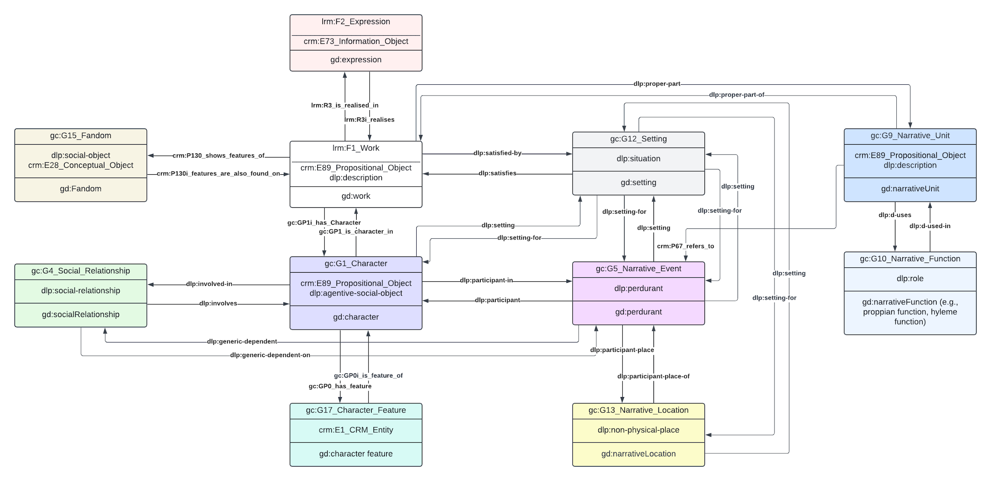

Canon Work
Fan Work
Fandom
Character
Notes:
第15页 | Fandom, Work, and Character
讲授时间：23:00–25:00，本页2分钟
此页图较密，只指认fandom、原作、同人作品与人物四处区域，不逐条读关系编号。告诉学生后面会逐层放大人物部分。
Source: DHBenelux2026-GOLEM (1).pptx, original slide 8.

Slide 17
Data Modelling in GOLEM
Notes:
第16页 | Data Modelling in GOLEM
讲授时间：25:00–26:00，本页1分钟
用原分节页做过渡：刚才我们知道想问什么，下面要决定如何把问题中的对象表达清楚。请学生想一想同名人物是否必然是同一个实体。
Source: D-SEA Pre 2024-07.pptx, original slide 13.
Background references retained from the source deck (original slide 26): Jenkins; Pugh; Coppa; additional references as listed in that source.

Slide 18
Top-down VS Bottom-up approaches
Top-down approach:
  Compatibility with major ontologies and literary theories
  Easier interfacing with other projects that use one of those ontologies
  Larger initial effort required for developing the data model and preparing the data
  Example: CIDOC-CRM, LRMoo, NIF, schema.org, etc.,
Bottom-up approach:
  Working from the structure of the domain
  Intuitive understanding of the data model for researchers working on the domain
  Prioritizing making the data available for research as soon as possible
GOLEM Ontology: A mixed top-down and bottom-up approach
  Building mainly on CIDOC-CRM and LRMoo
Notes:
第17页 | Top-down and Bottom-up Approaches
讲授时间：26:00–28:30，本页2.5分钟
解释自上而下复用既有标准，自下而上理解实际平台与粉丝社群的数据。两者结合使模型既能交流，又能表达研究对象。这里只解释思路，不展开所有标准。
Source: D-SEA Pre 2024-07.pptx, original slide 14.
Background references retained from the source deck (original slide 26): Jenkins; Pugh; Coppa; additional references as listed in that source.

Slide 19
RDF and Knowledge Graphs
Knowledge graphs represent entities and their connections.
An RDF triple contains a subject, a predicate, and an object.
Example: Shakespeare wrote Hamlet.
Subject: Shakespeare
Predicate: wrote
Object: Hamlet
Notes:
第18页 | RDF and Knowledge Graphs
讲授时间：28:30–30:30，本页2分钟
用Shakespeare wrote Hamlet拆解主语、谓语、宾语。让学生口头将一条人物与作品的关系拆成三个部分。此页先讲结构，下一页再讲标识符。
Source: DHBenelux2026-GOLEM (1).pptx, original slide 5.

Slide 20
Entity Identifiers
Names can be ambiguous. Identifiers distinguish entities.
An IRI identifies a resource in the knowledge graph.
A label provides a readable name for that resource.
Example: wd:Q692 identifies William Shakespeare.
Example: wd:Q41567 identifies Hamlet.
Notes:
第19页 | Entity Identifiers
讲授时间：30:30–32:00，本页1.5分钟
名字会重复，也可能有别名，因此实体需要稳定标识符。IRI指认实体，label帮助人阅读；不要把示意性的wrote与Wikidata P800完全等同。
Source: DHBenelux2026-GOLEM (1).pptx, original slide 5.

Slide 21
Object Properties
Object properties connect entities.
A work connects to an expression.
An expression connects to its creator.
Example query patterns:
?work lrm:R3i_realises ?expression .
?expression schema:creator ?creator .
Notes:
第20页 | Object Properties
讲授时间：32:00–34:00，本页2分钟
对象属性连接两个实体。指认作品、表达与作者之间的查询路径，只解释模型需要经过哪些对象，不深挖书目学。保留原稿IRI写法，具体执行以课堂notebook为准。
Source: DHBenelux2026-GOLEM (1).pptx, original slide 12.

Slide 22
Data Properties
Data properties connect entities to literal values.
A literal may be text, a date, or a number.
Example: a work has a title.
?work schema:title "Example title" .
Example: a metric has a numerical value.
?dimension crm:P90_has_value 300 .
Notes:
第21页 | Data Properties
讲授时间：34:00–35:30，本页1.5分钟
数据属性把实体与文字、日期、数字这样的字面值连接起来。让学生判断作者实体与标题字符串分别属于哪一类。
Source: DHBenelux2026-GOLEM (1).pptx, original slide 12.

Slide 23
Research Questions and Ontology Terms
RQ: what are the most common narrative locations for Chinese sci-fi novels published in the 21st century?
locations → gc:G13_Narrative_Location
Chinese→ schema:inLanguage
sci-fi → schema:genre
21st century → schema:datePublished
novel → ?
Notes:
第22页 | Research Questions and Ontology Terms
讲授时间：35:30–37:30，本页2分钟
先展示原稿问题。问：查询需要找到哪些对象与条件？停顿让学生指出地点、语言、类型、年份。此处表示意大利语作品，不等于意大利国籍作者。
Source: DHBenelux2026-GOLEM (1).pptx, original slide 13.

Slide 24
A Worked Modelling Example
RQ: what are the most common narrative locations for Chinese sci-fi novels published in the 21st century?
locations → gc:G13_Narrative_Location
Chinese → schema:inLanguage
sci-fi → schema:genre
21st century → schema:datePublished
novel → maybe, crm:E55_Type
Notes:
第23页 | A Worked Modelling Example
讲授时间：37:30–40:00，本页2.5分钟
沿用上一页映射结果，解释自然语言中的每个限制都要有数据字段或模型依据。novel的映射是一个待确定的建模选择，不宣称schema:genre等字段在今天演示数据中一定齐全。
Source: DHBenelux2026-GOLEM (1).pptx, original slide 14.

Slide 25
Requirements for Character Modelling
Character module should (minimally) express:
Characters are entities that appear in multiple contexts (e.g. a novel, its film adaptation, a wiki entry)
Characters have some recognizable features (e.g. appearance)
Characters engage in social relationships (e.g. become friends)
Characters do things and participate in events (e.g. fight a dragon)
Characters fulfill some roles in the plot development (e.g. villain)
All the above aspects are either explicitly stated in the fiction (e.g. “Harry is brave”) or inferred from it (e.g. “Harry jumps into the fire to rescue Ron”)
The provenance of each statement about characters should be clear.
Notes:
第24页 | Requirements for Character Modelling
讲授时间：40:00–42:00，本页2分钟
不逐条念清单。围绕人物在不同作品中出现、具有特征、建立关系、参与事件及陈述来源这几项展开。明确文本明说与研究者推断不同，模型应保留语境与证据。
Source: DHBenelux2026-GOLEM (1).pptx, original slide 3.

Slide 26
Representing Characters in the GOLEM KG
The GOLEM ontology models characters as evolving narrative entities whose identities, traits, and relationships transform across canonical and fan-generated texts.
Two-level character modeling strategy:
- G1_Character: Individual character instantiations
- G0_Character-Stoff: Broader conceptual entities linking various instances of characters appearing in single works
Notes:
第25页 | Representing Characters in GOLEM
讲授时间：42:00–44:00，本页2分钟
给出人物实例与Character-Stoff的两层思路。今天核心是既能连接同一人物的不同版本，又不会把不同作品中的信息直接混在一起。
Source: DHBenelux2026-GOLEM (1).pptx, original slide 17.

Slide 27
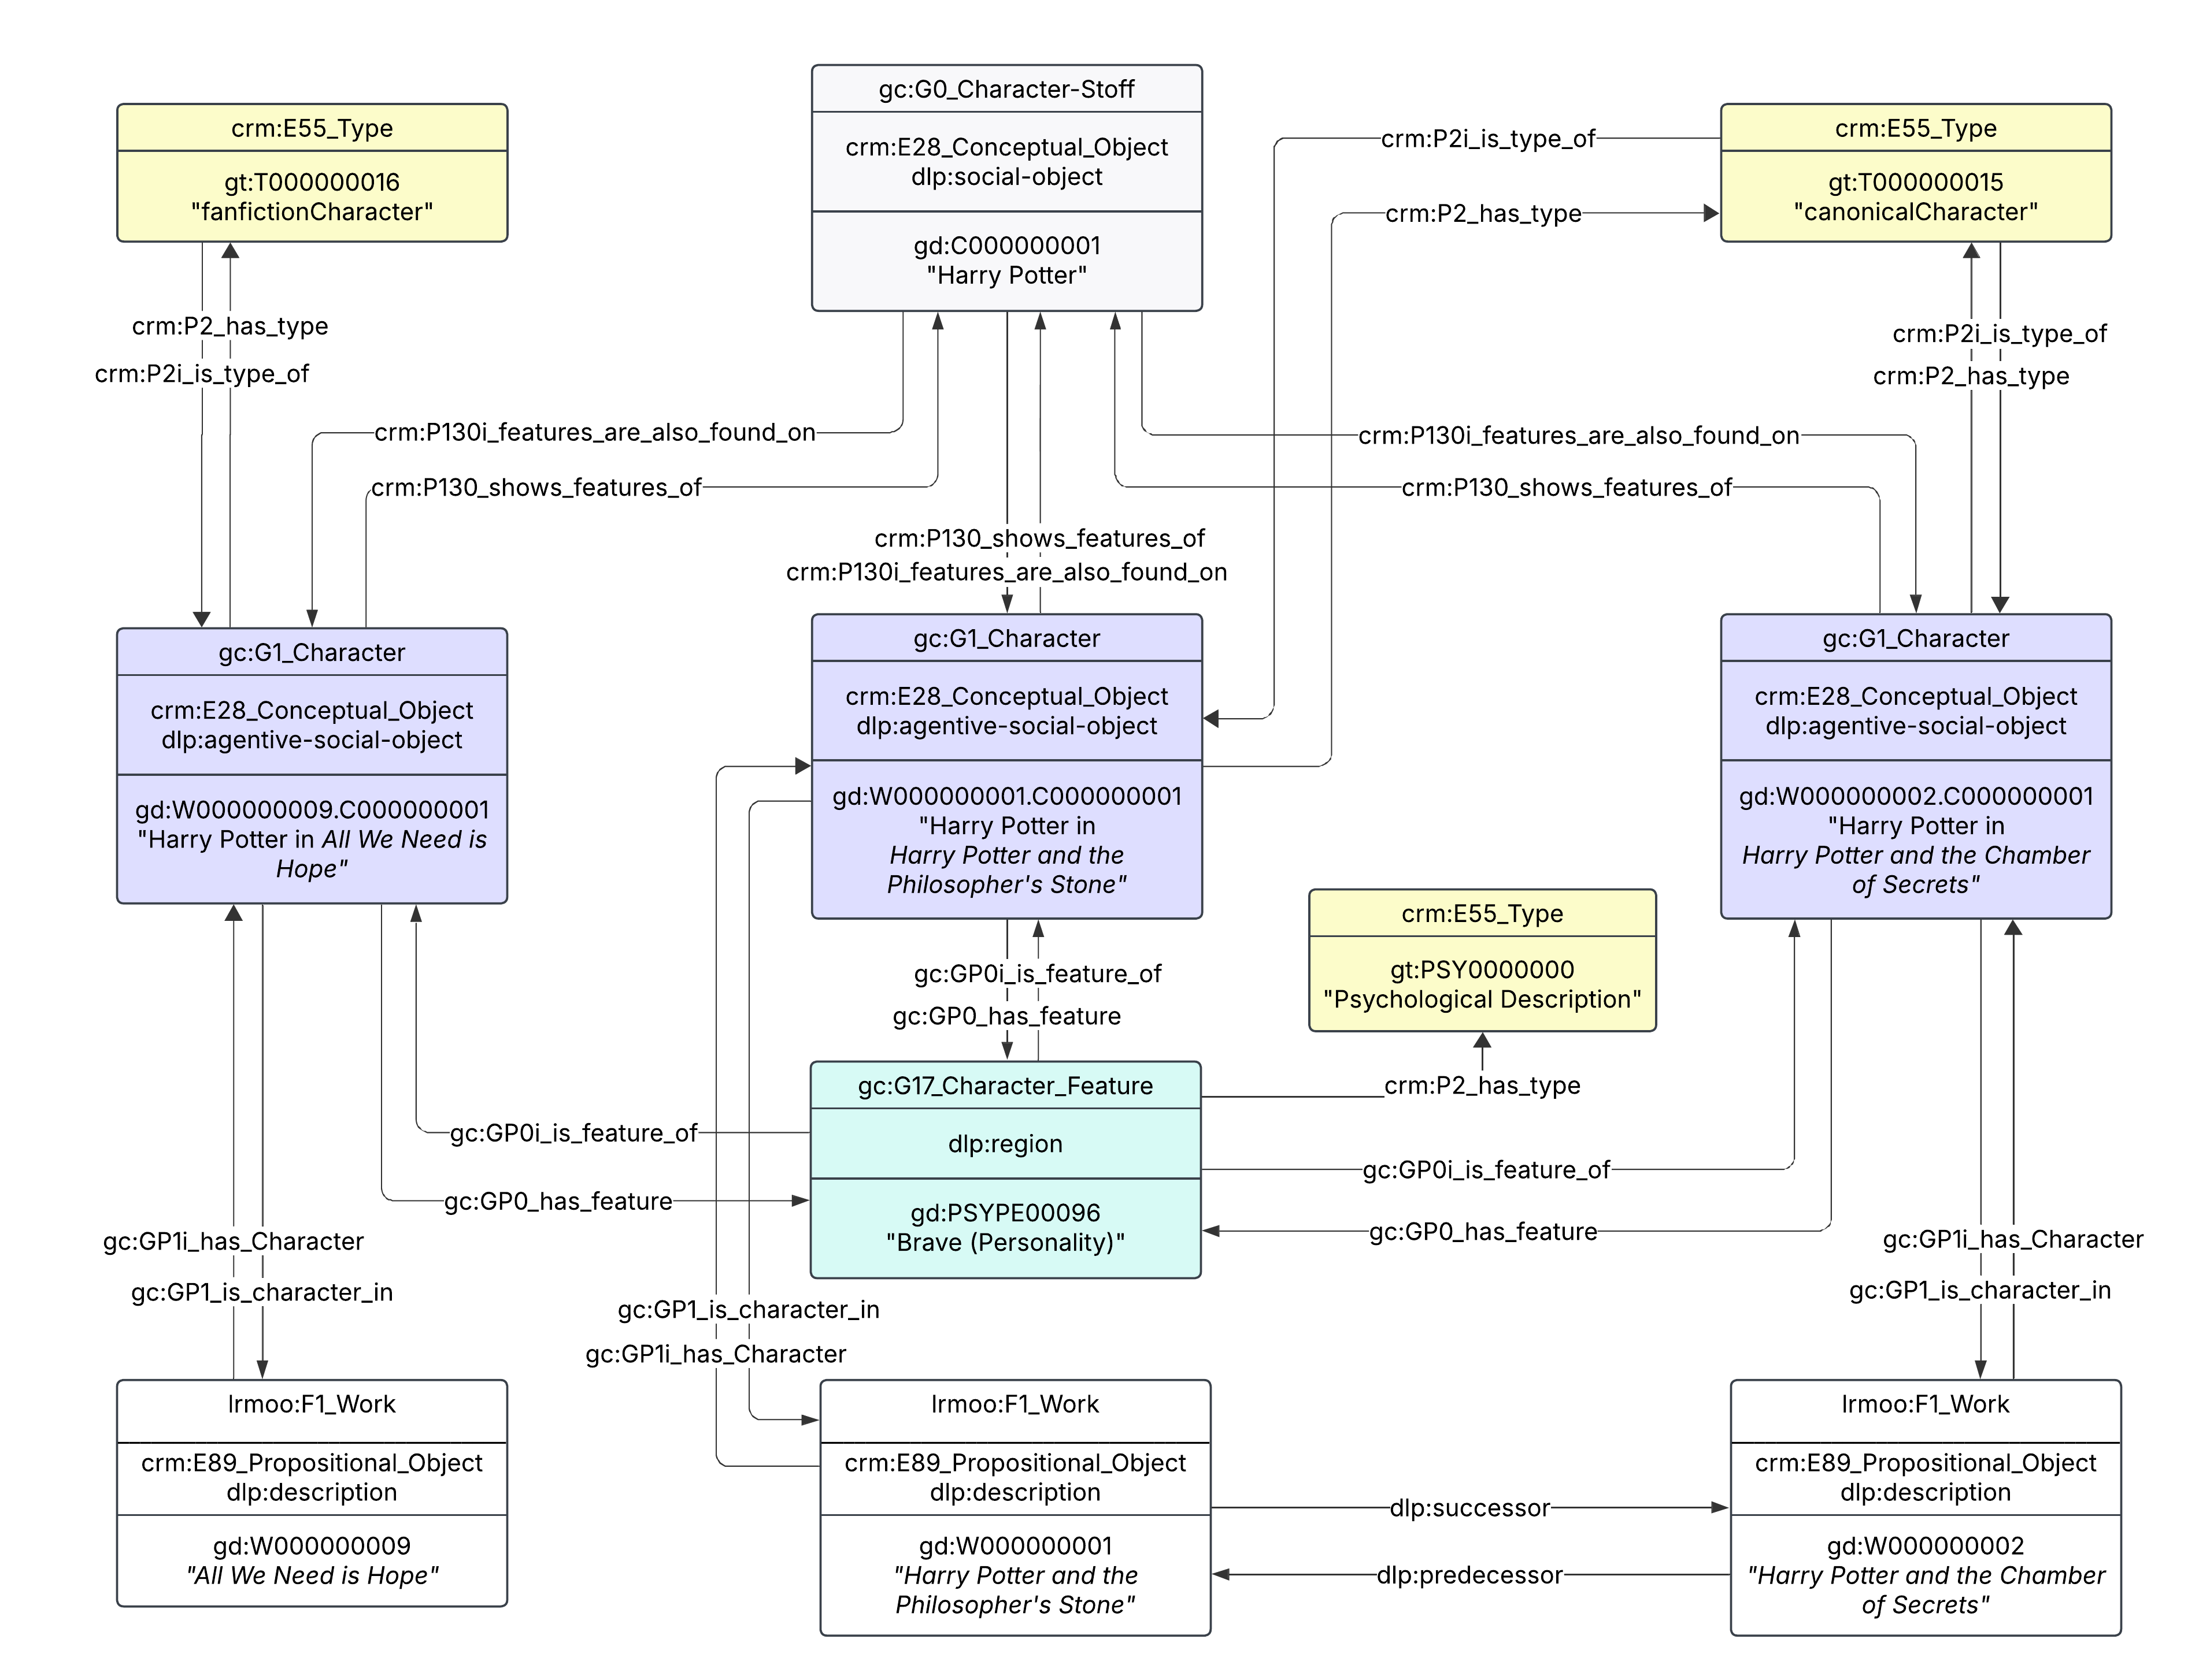
Characters
in works
Notes:
第26页 | Characters in Individual Works
讲授时间：44:00–46:00，本页2分钟
用红框定位具体作品中的人物实例。一个人物在两篇作品中出现，可以有不同的作品内实例。原图属于早期模型示意，G2等旧编号不作为当前notebook的代码参考。
Source: DHBenelux2026-GOLEM (1).pptx, original slide 18.
Version note: original conceptual diagrams use some historical identifiers. The tutorial uses gc:G17_Character_Feature and gc:G6_Relationship_Role; use the notebook for executable identifiers.

Slide 28
Character
-Stoff
Notes:
第27页 | Character-Stoff
讲授时间：46:00–48:00，本页2分钟
用红框定位跨作品的概念层，再指向作品中的人物实例。强调这是组织跨文本比较的建模方式，不是在解决所有人物身份的哲学争论。原图为原材料中的概念示意。
Source: DHBenelux2026-GOLEM (1).pptx, original slide 19.
Version note: original conceptual diagrams use some historical identifiers. The tutorial uses gc:G17_Character_Feature and gc:G6_Relationship_Role; use the notebook for executable identifiers.

Slide 29
Character Identity Across Works
Teaching example: Orpheus in two different stories
Story A places Orpheus in a mythological setting.
Story B places Orpheus in a modern setting.
Separate character instances preserve each story’s details.
Character-Stoff connects the instances for comparison.
Notes:
第28页 | Character Identity Across Works
讲授时间：48:00–50:00，本页2分钟
用课堂假设说明：两篇同人作品都写Orpheus，一篇保留原故事背景，另一篇改成现代背景。可以连接人物概念，但作品内的职业、性格与事件需要分别保存。这是教学假设，不是查询结果。
Source: DHBenelux2026-GOLEM (1).pptx, original slide 17.

Slide 30
Character
Features
(G17 in
Notebook)
Notes:
第29页 | Character Features
讲授时间：50:00–52:00，本页2分钟
特征属于具体人物实例，因此能讨论不同作品中的相似与差异。此原图内G2_Character_Feature为旧版标签，本次notebook使用gc:G17_Character_Feature；课堂强调概念关系，不让学生抄图中旧编号。
Source: DHBenelux2026-GOLEM (1).pptx, original slide 20.
Version note: original conceptual diagrams use some historical identifiers. The tutorial uses gc:G17_Character_Feature and gc:G6_Relationship_Role; use the notebook for executable identifiers.

Slide 31
Types of Character Features
Type Instance | Class | Note
gt:BIO0000000 | crm:E55_Type | Biographical features (Gender, etc.)
gt:PHY0000000 | crm:E55_Type | Physical features
gt:PSY0000000 | crm:E55_Type | Psychological features
Notes:
第30页 | Types of Character Features
讲授时间：52:00–53:00，本页1分钟
此页只读三类：生平、外貌、心理。类型表使用notebook中的BIO、PHY、PSY标识，不要求学生记忆。
Source: DHBenelux2026-GOLEM (1).pptx, original slide 25.

Slide 32
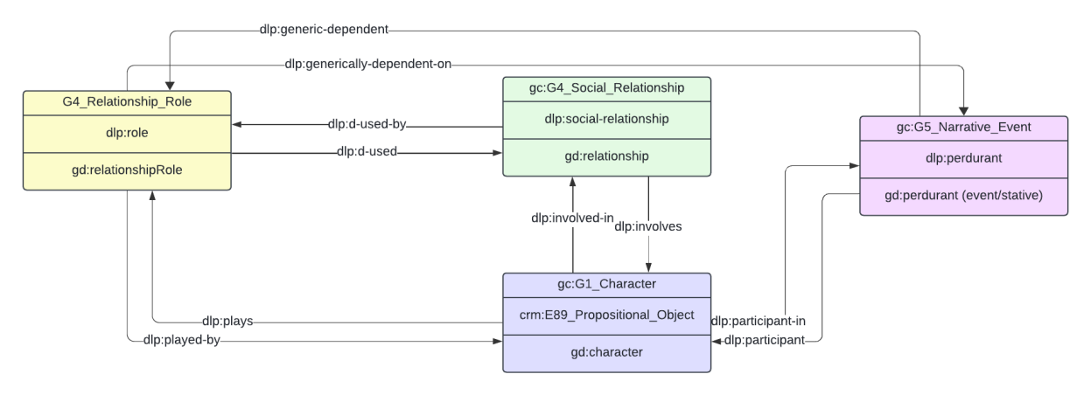
Relationships Between Characters
Social relationships connect characters.
Examples include familial and antagonistic relationships.
gc:G4_Social_Relationship represents a relationship.
The model links the relationship to its participants.
Notes:
第31页 | Relationships Between Characters
讲授时间：53:00–54:30，本页1.5分钟
先解释relationship本身：例如家庭关系或对立关系。用原图指认人物与关系对象相连。下一页再解释人物在关系中的具体角色。
Source: DHBenelux2026-GOLEM (1).pptx, original slide 21.
Version note: original conceptual diagrams use some historical identifiers. The tutorial uses gc:G17_Character_Feature and gc:G6_Relationship_Role; use the notebook for executable identifiers.

Slide 33
Relationship Roles
Relationship roles describe a participant’s position in a relationship.
Examples: father, child, wife, lover, or enemy.
gc:G6_Relationship_Role represents a relationship role.
A relationship type and a participant’s role describe different information.
Notes:
第32页 | Relationship Roles
讲授时间：54:30–56:00，本页1.5分钟
同一个关系里，各个人物承担的角色可以不同，例如父亲与孩子。角色描述人物在关系中的位置，不能与下一页事件角色混同。
Source: DHBenelux2026-GOLEM (1).pptx, original slide 21.
Version note: original conceptual diagrams use some historical identifiers. The tutorial uses gc:G17_Character_Feature and gc:G6_Relationship_Role; use the notebook for executable identifiers.

Slide 34
Narrative Events and Roles
Narrative Roles (gc:G11_Narrative_Role) describe a character's function within narrative events (gc:G5_Narrative_Event) or sequences (gc:G7_Narrative_Sequence), clarifying who performs or is affected by an action (e.g., "victim" or "perpetrator"), linked via the dlp:plays property.
Notes:
第33页 | Narrative Events and Roles
讲授时间：56:00–58:00，本页2分钟
用事件解释victim和perpetrator。人物参与事件与人物扮演某角色是相关但不同的信息。复杂查询需要确认角色、事件和作品范围，不能只看到victim标签便推断所有死亡细节。
Source: DHBenelux2026-GOLEM (1).pptx, original slide 22.

Slide 35
A Character Modelling Example
Teaching example: Eurydice in a retelling
Character instance: Eurydice in this particular work
Feature: a description attached to that instance
Social relationship: a connection with another character
Narrative event: an occurrence involving the character
Narrative role: the character’s function in that event
Notes:
第34页 | A Character Modelling Example
讲授时间：58:00–60:00，本页2分钟
以Eurydice为教学示意：人物实例属于某部作品，特征描述她在该作品中的呈现，关系连接她与其他人物，事件记录发生了什么，角色描述她在事件中的位置。问学生：妻子、勇敢、受害者分别是什么？此页不是实时数据结果。
Source: DHBenelux2026-GOLEM (1).pptx, original slide 17.

Slide 36
Querying Knowledge Graphs with SPARQL
SPARQL is the query language for RDF graphs.
A SPARQL query includes SELECT and WHERE clauses.
SELECT defines variables to retrieve (e.g., ?subject), and WHERE describes triple patterns to match.
Prefixes simplify long URIs:
  PREFIX schema: <https://schema.org/>
  SELECT ?work ?title
  WHERE {
  ?work schema:title ?title .
  }
Notes:
第35页 | Querying Knowledge Graphs with SPARQL
讲授时间：60:00–61:30，本页1.5分钟
解释SPARQL的用途：表达想找的图模式。此处完整示例只用于理解结构，不逐字讲语法，稍后会直接运行准备好的代码。
Source: DHBenelux2026-GOLEM (1).pptx, original slide 6.

Slide 37
SELECT, WHERE, and Variables
SELECT chooses the variables to return.
WHERE describes the patterns to match.
Variables begin with a question mark, such as ?work.
LIMIT restricts the number of result rows.
SELECT ?work ?title
WHERE { ?work schema:title ?title . }
LIMIT 5
Notes:
第36页 | SELECT, WHERE, and Variables
讲授时间：61:30–63:30，本页2分钟
指出SELECT决定结果列，WHERE指定需要满足的图模式，问号开头的是变量。LIMIT控制返回行数，修改它是稍后第一个小任务。
Source: DHBenelux2026-GOLEM (1).pptx, original slide 6.

Slide 38
Prefixes in GOLEM Queries
GOLEM reuses CIDOC-CRM, DOLCE, LRMoo, Schema:
  PREFIX dlp: <http://www.ontologydesignpatterns.org/ont/dlp/>
  PREFIX schema: <https://schema.org/>
  PREFIX crm: <http://www.cidoc-crm.org/cidoc-crm/>
  PREFIX lrm: <http://iflastandards.info/ns/lrm/lrmoo/>
  PREFIX gc: <https://ontology.golemlab.eu/>
  PREFIX gd: <https://data.golemlab.eu/entity/>
  PREFIX gt: <https://data.golemlab.eu/entity/type/>
Notes:
第37页 | Prefixes in GOLEM Queries
讲授时间：63:30–64:30，本页1分钟
前缀把长IRI缩短。只指认schema、lrm、crm、gc，说明学生可以复制使用，不需要背诵全部前缀。
Source: DHBenelux2026-GOLEM (1).pptx, original slide 7.

Slide 39
Querying Titles and Creators
[first define prefixes for schema, CRM, LRMoo, and GOLEM]
SELECT DISTINCT ?work ?title ?creator
WHERE {
GRAPH <https://golemlab.eu/graph/dh2025Greek10Metadata> {
?work a lrm:F1_Work ;
schema:title ?title ;
lrm:R3i_realises ?expression .
?expression schema:creator ?creator .
?work crm:P2_has_type gt:T000000014 . }
}
LIMIT 10
Notes:
第38页 | Querying Titles and Creators
讲授时间：64:30–67:00，本页2.5分钟
按研究问题、输出列、匹配路径、数据范围、LIMIT顺序读查询。让学生预测会出现哪几列。这就是实践的第一题。
Source: DHBenelux2026-GOLEM (1).pptx, original slide 9.

Slide 40
Named Graphs and Query Results
A named graph identifies the dataset queried.
Metadata: dh2025Greek10Metadata
Characters: Greek10_Character_Module_Demo
A result row is a match to the query pattern.
Results describe this teaching dataset, not all of AO3.
The class notebook contains the endpoint setting.
Notes:
第39页 | Named Graphs and Query Results
讲授时间：67:00–69:00，本页2分钟
解释元数据与人物模块练习使用两个教学图，结果只反映图中数据。避免把图名里的10当成AO3总体规模。端点以课堂notebook中经核对的设置为准，PPT不宣称已验证旧开发地址。
Source: DHBenelux2026-GOLEM (1).pptx, original slide 4.

Slide 41
Guided Notebook Practice
1.1 Titles and creators
1.2 Work metrics
2.1 Characters in works
Optional: 2.2 Victim roles
Questions welcome
Notes:
第40页 | Guided Notebook Practice
讲授时间：69:00–70:00，本页1分钟
现在停止PPT，切换Colab。请学生跟随共享屏幕运行1.1、1.2、2.1。若进度顺利再运行2.2。请Lau老师协助收集问题。30分钟内包括连接、操作、讨论与总结。
Source: DHBenelux2026-GOLEM (1).pptx, original slide 26.

