Slide 1
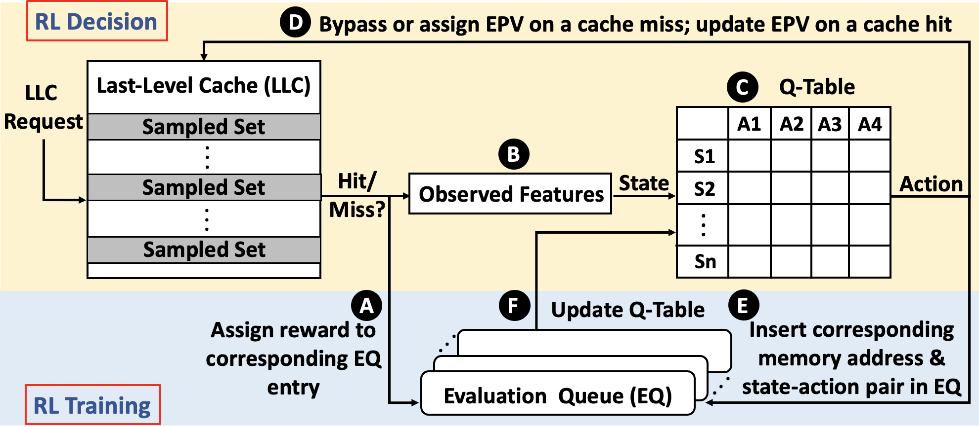
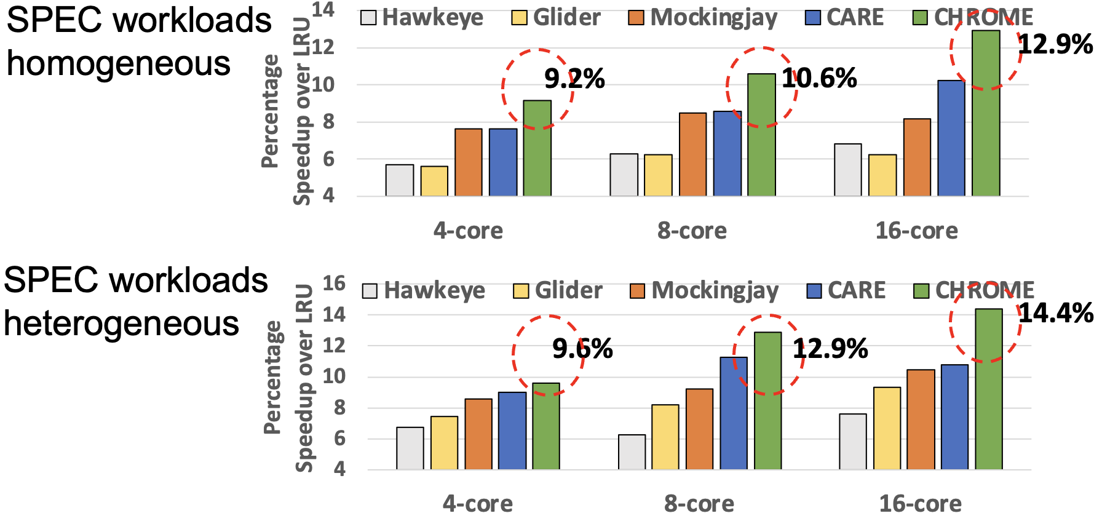
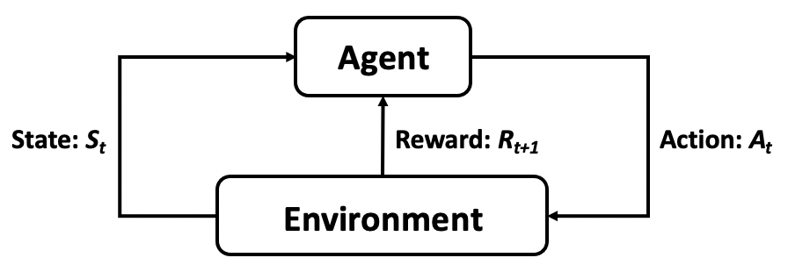

CHROME: Concurrency-Aware Holistic Cache Management Framework with Online Reinforcement Learning
Xiaoyang Lu¹, Hamed Najafi², Jason Liu², Xian-He Sun¹
¹Illinois Institute of Technology, ²Florida International University
Cache Management
Essential for bridging the performance gap between fast CPU and slower main memory
Formulating Cache Management as an RL Problem
State: A vector of features for each access
S = (PC, page number)
Using PC signature to distinguish between demand accesses and prefetch accesses
Action: Using EPV to reflect the eviction priorities of the cache block
Cache miss (4 optional actions):
Bypass LLC
Insert the corresponding block in LLC with an EPV of low, moderate, or high
Cache hit (3 optional actions):
Update the EPV of the corresponding block to low, moderate, or high
Reward: Considering
Accuracy of each action
Distinguish between actions triggered by demand or prefetching
Concurrency-Aware System Feedback
Cache Replacement: Determines which cache blocks to evict when new data needs to be loaded
Cache Bypassing: Decides whether incoming data should be stored in the cache
Prefetching: Predictively loads data into the cache before it is actually requested by the CPU
Limitations of Current Cache Management Schemes
We observe there are two common limitations faced by traditional cache management techniques:
Lack of Holistic View: Current schemes often examine cache replacement, bypassing, and prefetching in isolation, overlooking the potential benefits that could arise from a joint optimization strategy
Lack of Adaptability: Current schemes often rely on fixed heuristics that don't account for the changing access patterns of modern applications and system configurations
CHROME Overview
Our Solution: CHROME
A holistic cache management framework that dynamically adapts to various workloads and system configurations
Holistic Integration: Integrate cache bypassing and replacement with pattern-based prefetching
Dynamic Online Learning: Utilizes online reinforcement learning to adapt cache management to varying workloads and system configurations
Multiple Program Features: Employs multiple program features to achieve a thorough understanding of memory access patterns
Concurrency-Aware Rewards: Implements a reward system that is aware of concurrent accesses, factoring in system-level feedback for decision-evaluation
Efficient Design: Achieves a minimal hardware overhead
Results
The holistic view provides a performance guarantee
Online RL provides good adaptability and scalability
CHROME can accurately provide cache management for different workloads
CHROME outperforms all other schemes across all system configurations
Performance advantage of CHROME over others increases with more cores
Reinforcement Learning (RL)

