Slide 1
STAT628-Group 10
Body Fat Calculator Project
10-18-2023
Osama Kheshaifaty
Chuyi Lin
Xiaoyang Dong

Slide 2
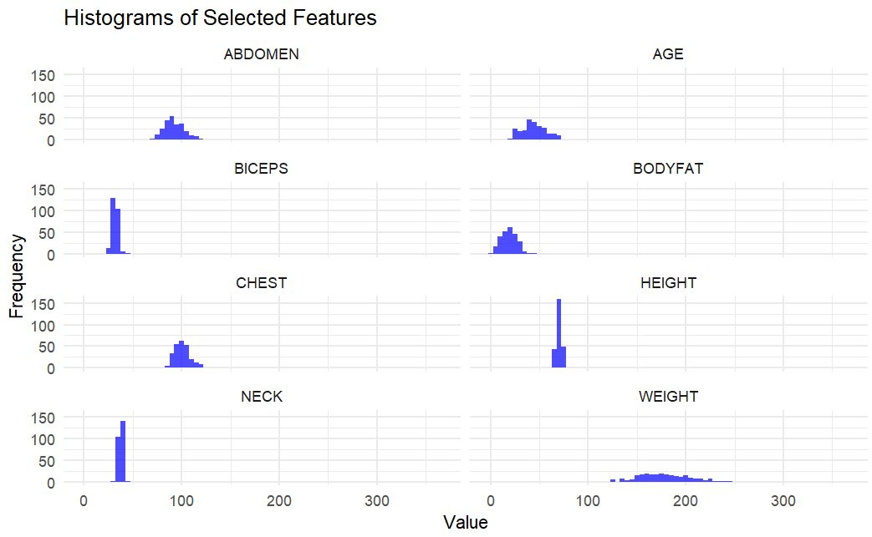
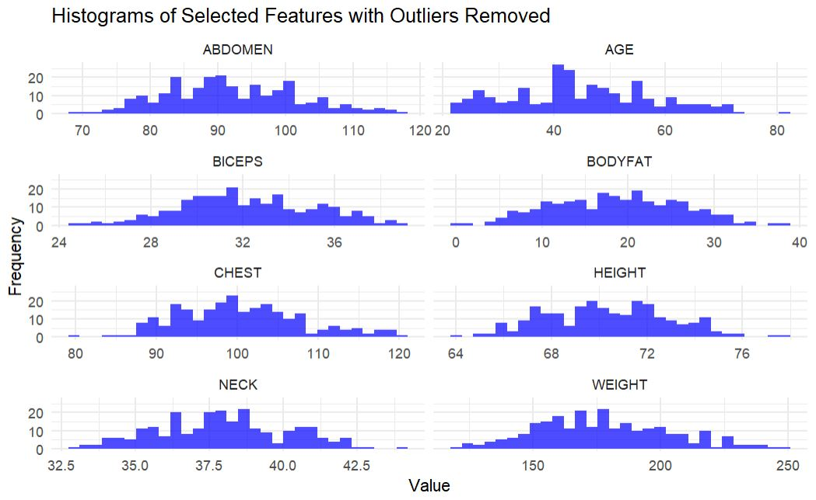
Summary of Data Cleaning
Removed height and weight outliers
For the remaining predictors, we used the IQR ranges
Original dataset size: 252 observations
Cleaned dataset size: 245 observations

Slide 3
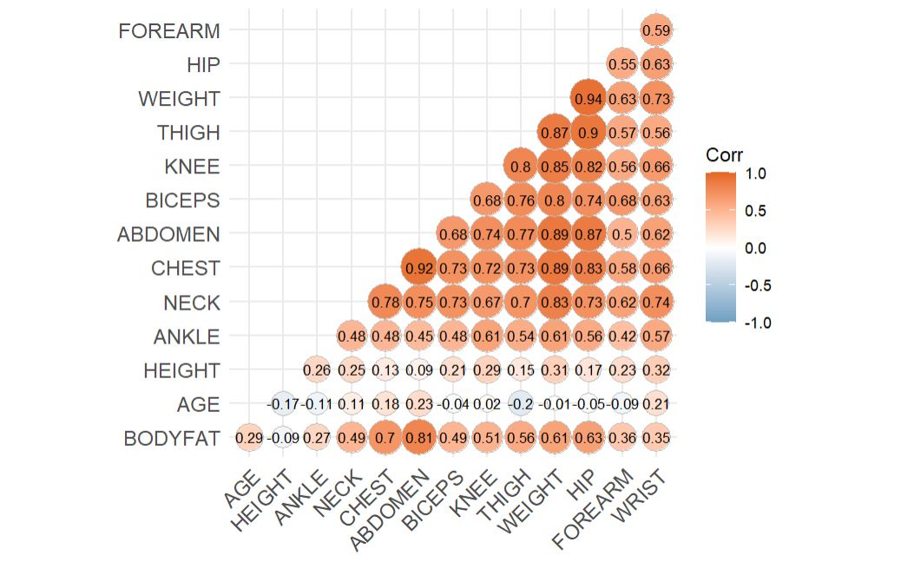
Finding the Best Model for Body Fat
Feature Selection:
Eliminated density - defeats the purpose of creating a “simple” body fat calculator.
Based on available literature:
Selected the 5 features (Age, Height, Weight, Neck and Abdomen)
Investigated (Chest and Biceps) due to strong correlation
Correlation Check: Using correlation matrix

Slide 4
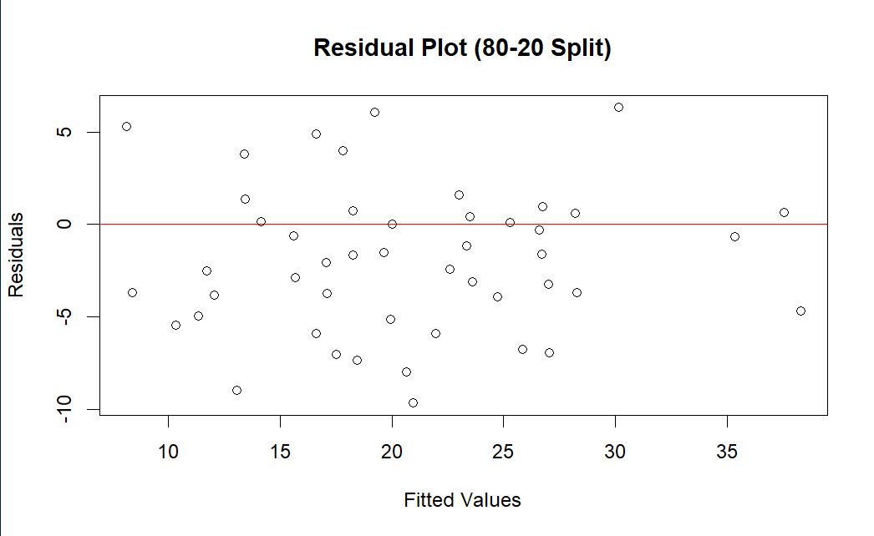
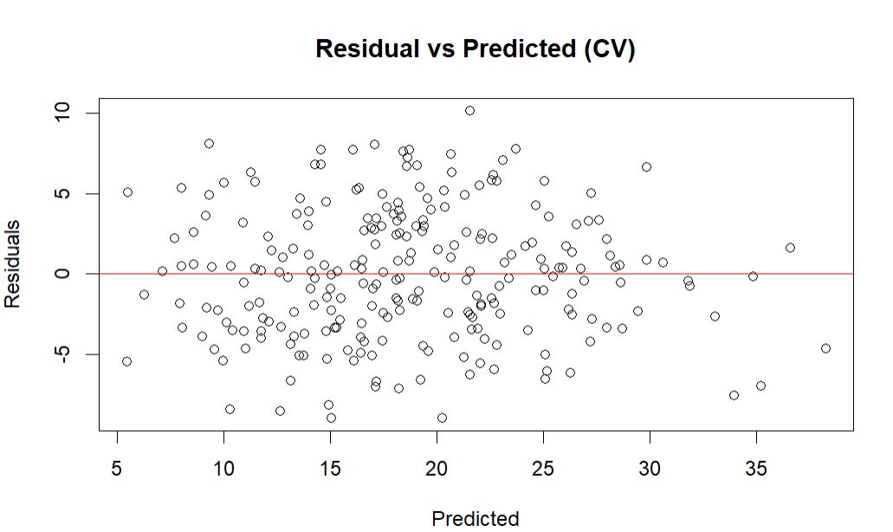
Model Hyper-tuning
Linear Regression Model
Mode Parameters Hyper-tuning:
80-20 train-test split vs. 10-fold cross-validation
Assumption Evaluation:
Linearity
Normality
Homoscedasticity

Slide 5
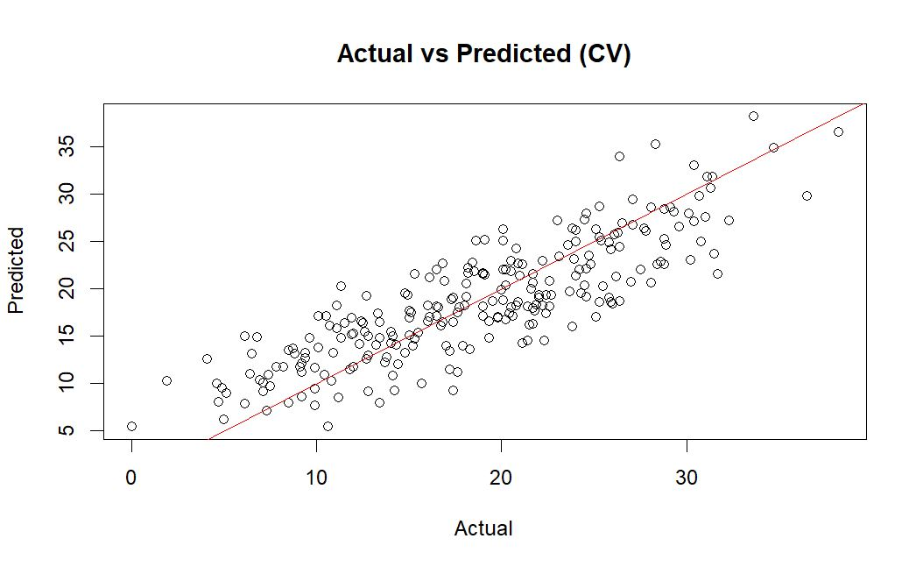
Model Hyper-tuning
Linear Regression Model
Mode Parameters Hyper-tuning:
80-20 train-test split vs. 10-fold cross-validation
Assumption Evaluation:
Linearity
Normality
Homoscedasticity

Slide 6
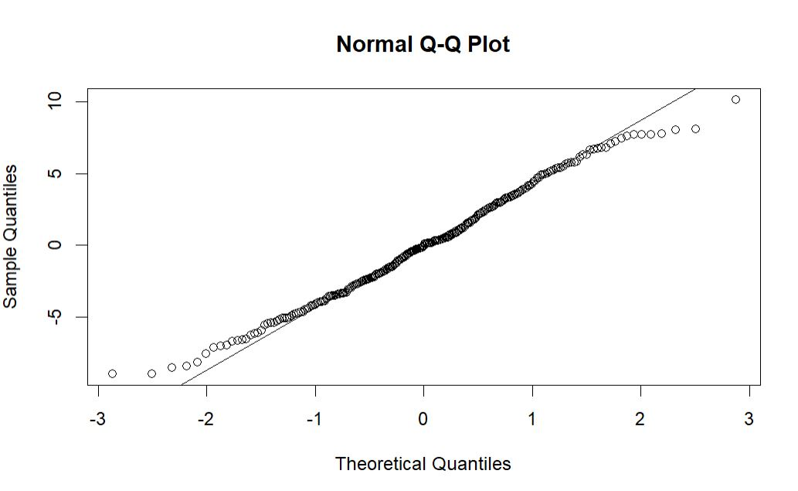
Model Hyper-tuning
Linear Regression Model
Mode Parameters Hyper-tuning:
80-20 train-test split vs. 10-fold cross-validation
Assumption Evaluation:
Linearity
Normality
Homoscedasticity

Slide 7
Model Results
Model | R2 | RMSE | Adj_R2
fit_cv_A | 0.71 | 3.98 | 0.71
fit_cv_B | 0.71 | 3.97 | 0.71
fit_cv_C | 0.71 | 3.97 | 0.71
fit_cv_D | 0.72 | 3.95 | 0.71
Tested 4 different models:
(A) Age, weight, height, neck, and waist
(B) Adding Chest
(C) Adding Biceps
(D) Adding Chest and Biceps

Slide 8
Final Model
Model Coefficients:
BODYFAT = -21.29 - 0.0073 * AGE - 0.0902 * WEIGHT - 0.1847 * HEIGHT - 0.3180 * NECK + 0.8876 * ABDOMEN.
Goodness of Fit:
Multiple R-squared of 0.713
The model can explain 71.3% of variation in body fat
Significance:
F-statistic = 95.9
p-value << 0.05
Example Usage:
40-year-old
weight = 80 kg
height = 170 cm
neck circumference = 35 cm
abs measurement = 90 cm Estimated body fat: ~15.25%.​
The 95% interval for this estimate is 14.5%-16%.

Slide 9
Strengths and Weaknesses
Strengths:
Robust cross-validation methodology
Model simplicity ​
Comprehensive Feature Engineering
Weaknesses:
May perform poorly on population outside the dataset
The model could not account for other potential confounders such as exercise
Sensitive to outliers

Slide 10
Conclusion
The model provides a reasonably accurate, robust, and interpretable method for predicting body fat percentage based on easily obtainable measurements.
While the model is useful, it is important to consider its limitations and the influence of unmeasured factors.

Slide 11

Demo
https://xdong88.shinyapps.io/BodyfatApp/

