Slide 1
Mobility Pattern Analysis during COVID-19
Xiaoyi Wu
2022/02/04
Notes:
2-min introduction
Problem-current way vs method- results

Slide 2
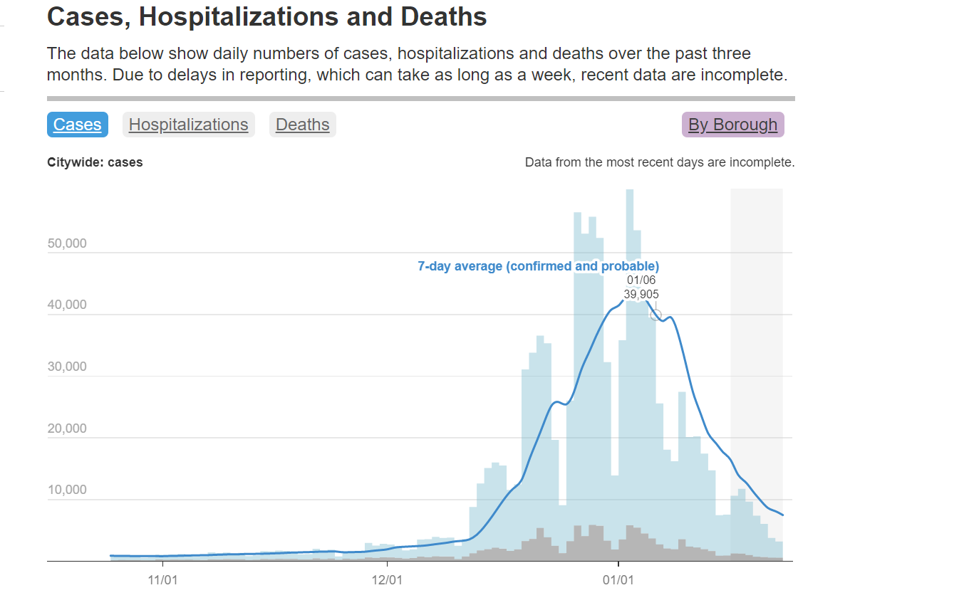
Motivation
Before/During COVID-19
What are the places people usually visit?
How long they stay?
Where are they from? Where are they to?
Spatio-termporal changes of customer preference?
Travel behaviors and necessary needs/services satisfaction in different contexts?
Political implications?
COVID-19 develop trend in NY
Data from NYC Health https://www1.nyc.gov/site/doh/covid/covid-19-data.page#daily
Notes:
Overview of master program
In-class projects
Choose one which is deepest
Starting with the research problem, how to do, results

Slide 3
Data
Data | Source
Mobility pattern/core places | SafeGraph
NYC Demographic Data | ACS
COVID-19 cases | NYC Health
Notes:
Overview of master program
In-class projects
Choose one which is deepest
Starting with the research problem, how to do, results

Slide 4
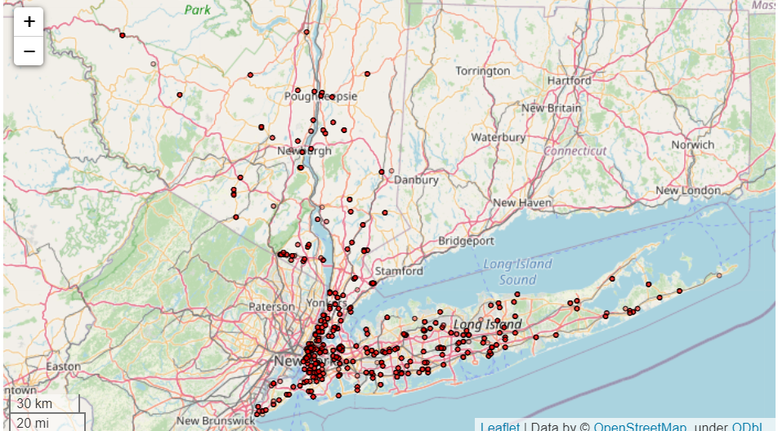
Explanatory analysis
What are POIs / Where is the study area?
Notes:
Overview of master program
In-class projects
Choose one which is deepest
Starting with the research problem, how to do, results

Slide 5
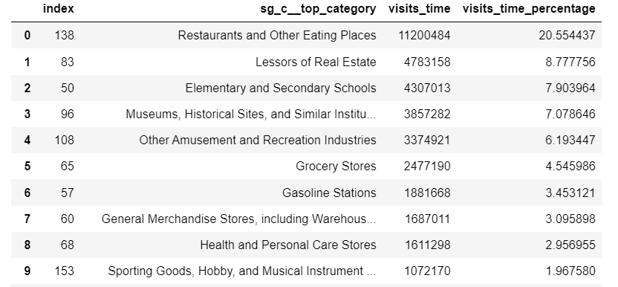
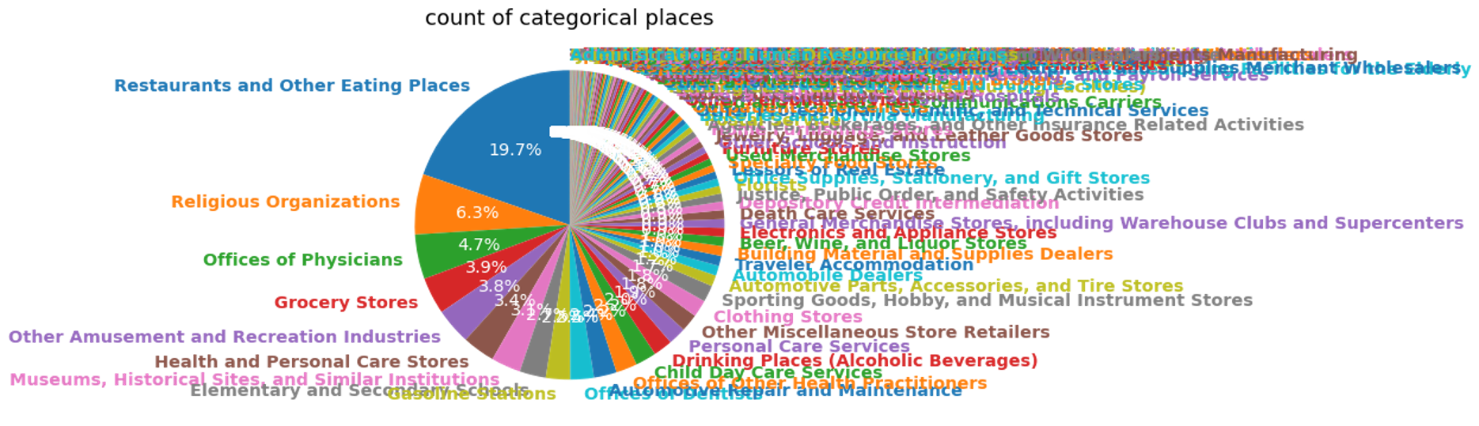
Explanatory analysis
The category percentage of POIs
Notes:
Overview of master program
In-class projects
Choose one which is deepest
Starting with the research problem, how to do, results

Slide 6
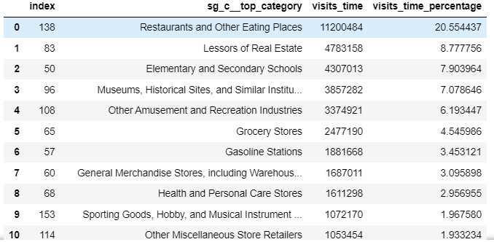
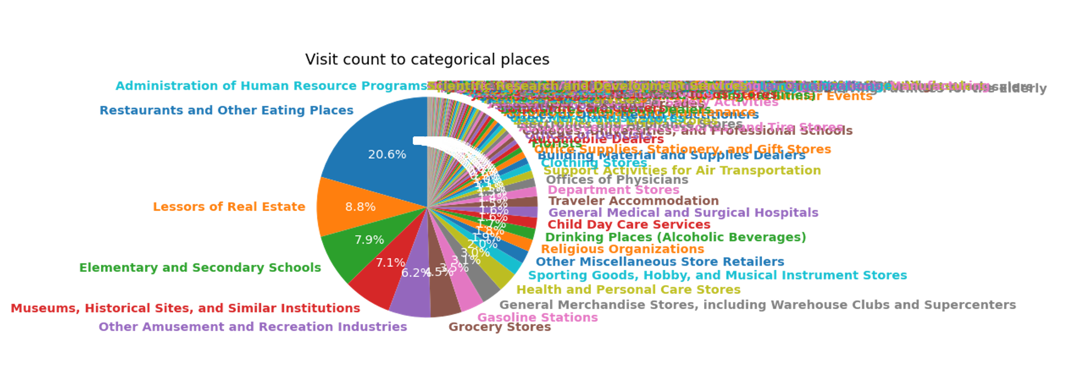
Explanatory analysis
What are the places people usually visit?
Question: Does this cause bias in dataset?
Notes:
Overview of master program
In-class projects
Choose one which is deepest
Starting with the research problem, how to do, results

Slide 7
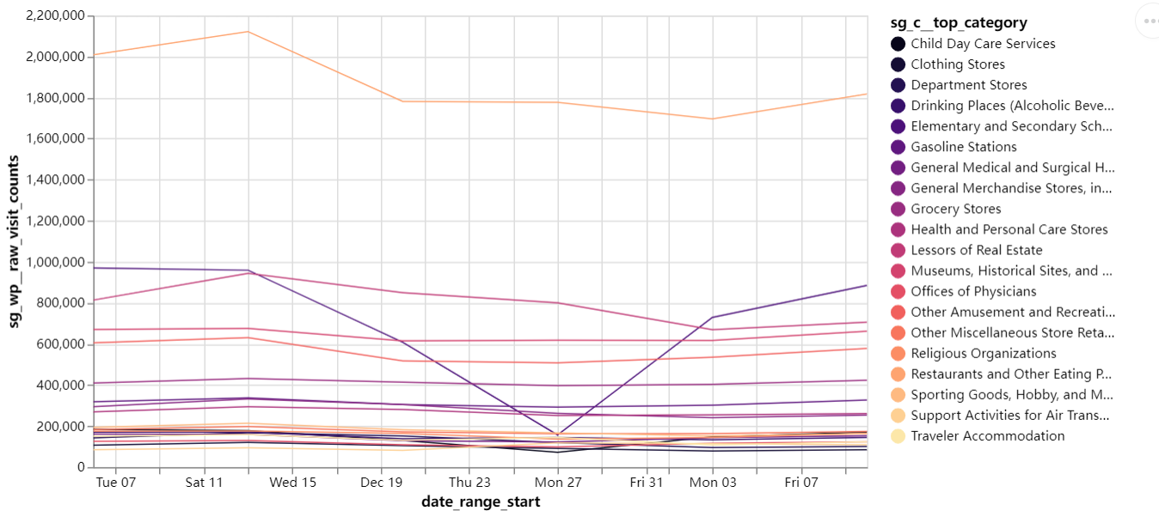
Explanatory analysis
Temporal changes of the most popular 20 spots
Notes:
Overview of master program
In-class projects
Choose one which is deepest
Starting with the research problem, how to do, results

Slide 8
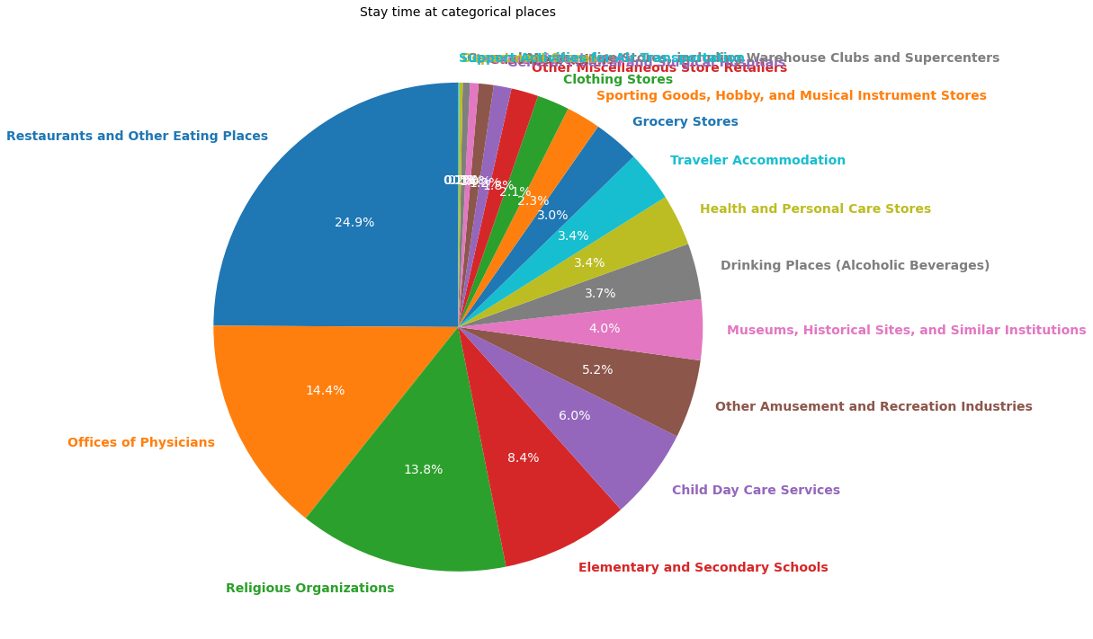
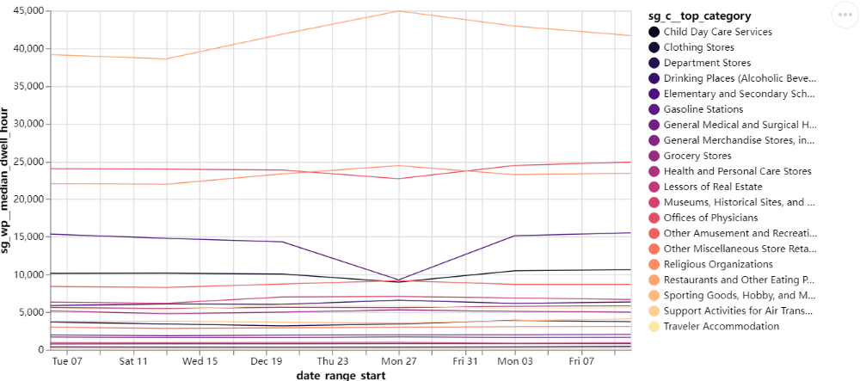
Explanatory analysis
How long do they stay?
Notes:
Overview of master program
In-class projects
Choose one which is deepest
Starting with the research problem, how to do, results

Slide 9
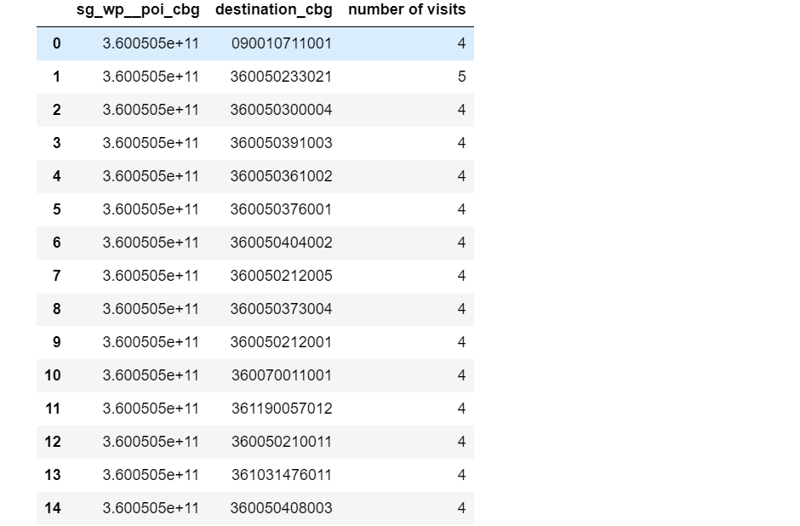
Explanatory analysis
Where are they from and where are they to
Aggravate data on census level to visualize
flow pattern
Notes:
Overview of master program
In-class projects
Choose one which is deepest
Starting with the research problem, how to do, results

Slide 10
Future work
Focus study area in NYC
Combine with demographic data/ census data
Analyze visits in different contexts
Correlation with Include COVID-19 data
Mobility index
Build predict model
Compare other datasets such StreetLight
Next week
Notes:
Overview of master program
In-class projects
Choose one which is deepest
Starting with the research problem, how to do, results

