Slide 1

















$$E_{L}$$
$$F_{L}$$
$$E_{M}$$
$$F_{M}$$
$$F$$
$$E_{T}$$
$$F_{T}$$

Slide 2















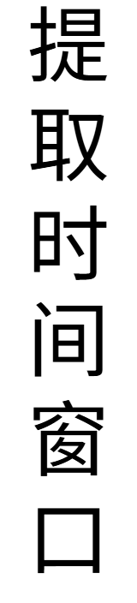



















Slide 3

































































$$f_{m,k}=\left\lceil \frac{\left\lfloor \frac{T}{2^{m}}\right\rfloor }{p_{k}}\right\rceil$$
$$s_{0}^{1}$$
$$f_{0,1}$$
$$p_{1}$$
$$z_{0}^{1}$$
$$t_{0}^{1}$$
$$z_{0}^{1}$$
$$C$$
$$d$$
$$f_{0,2}$$
$$p_{2}$$
$$z_{0}^{2}$$
$$s_{0}^{2}$$
$$z_{0}^{2}$$
$$\left\lfloor \frac{T}{2^{0}}\right\rfloor$$
$$\left\lfloor \frac{T}{2^{0}}\right\rfloor$$
$$x_{0}$$
$$x_{0}$$
$$x_{0}$$
$$t_{0}^{2}$$
$$C$$
$$s_{1}^{1}$$
$$d$$
$$f_{1,1}$$
$$C$$
$$T$$
$$\left\lfloor \frac{T}{2^{1}}\right\rfloor$$
$$x_{1}$$
$$\left\lfloor \frac{T}{2^{1}}\right\rfloor$$
$$x_{1}$$
$$p_{1}$$
$$z_{1}^{1}$$
$$t_{1}^{1}$$
$$z_{1}^{1}$$
$$f_{1,2}$$
$$p_{2}$$
$$z_{1}^{2}$$
$$s_{1}^{2}$$
$$z_{1}^{2}$$
$$x_{1}$$
$$\left\lfloor \frac{T}{2^{m}}\right\rfloor$$
$$C$$
$$\left\lfloor \frac{T}{2^{m}}\right\rfloor$$
$$d$$
$$t_{1}^{2}$$
$$x_{m}$$
$$x_{m}$$
$$s_{m}^{1}$$
$$f_{m,1}$$
$$p_{1}$$
$$z_{m}^{1}$$
$$t_{m}^{1}$$
$$z_{m}^{1}$$
$$A=\{A_{f_{1}},…,A_{f_{K}}\}$$
$$\{f_{1},…,f_{K}\}$$
$$f_{m,2}$$
$$\{p_{1},…,p_{K}\}$$
$$p_{2}$$
$$z_{m}^{2}$$
$$s_{m}^{2}$$
$$z_{m}^{2}$$
$$x_{m}$$
$$t_{m}^{2}$$

Slide 4
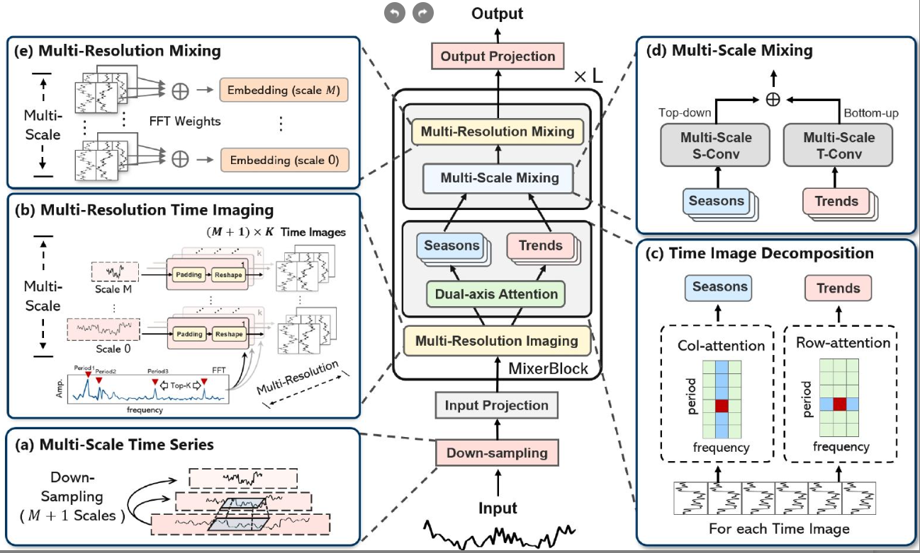

Slide 6

$$f_{m,k}=\left\lceil \frac{\left\lfloor \frac{T}{2^{m}}\right\rfloor }{p_{k}}\right\rceil$$
$$s_{0}^{1}$$
$$f_{0,1}$$
$$p_{1}$$
$$z_{0}^{1}$$
$$t_{0}^{1}$$
$$z_{0}^{1}$$
$$C$$
$$d$$
$$f_{0,2}$$
$$p_{2}$$
$$z_{0}^{2}$$
$$s_{0}^{2}$$
$$z_{0}^{2}$$
$$\left\lfloor \frac{T}{2^{0}}\right\rfloor$$
$$\left\lfloor \frac{T}{2^{0}}\right\rfloor$$
$$x_{0}$$
$$x_{0}$$
$$x_{0}$$
$$t_{0}^{2}$$
$$C$$
$$s_{1}^{1}$$
$$d$$
$$f_{1,1}$$
$$C$$
$$T$$
$$\left\lfloor \frac{T}{2^{1}}\right\rfloor$$
$$x_{1}$$
$$\left\lfloor \frac{T}{2^{1}}\right\rfloor$$
$$x_{1}$$
$$p_{1}$$
$$z_{1}^{1}$$
$$t_{1}^{1}$$
$$z_{1}^{1}$$
$$f_{1,2}$$
$$p_{2}$$
$$z_{1}^{2}$$
$$s_{1}^{2}$$
$$z_{1}^{2}$$
$$x_{1}$$
$$\left\lfloor \frac{T}{2^{m}}\right\rfloor$$
$$C$$
$$\left\lfloor \frac{T}{2^{m}}\right\rfloor$$
$$d$$
$$t_{1}^{2}$$
$$x_{m}$$
$$x_{m}$$
$$s_{m}^{1}$$
$$f_{m,1}$$
$$p_{1}$$
$$z_{m}^{1}$$
$$t_{m}^{1}$$
$$z_{m}^{1}$$
$$A=\{A_{f_{1}},…,A_{f_{K}}\}$$
$$\{f_{1},…,f_{K}\}$$
$$f_{m,2}$$
$$\{p_{1},…,p_{K}\}$$
$$p_{2}$$
$$z_{m}^{2}$$
$$s_{m}^{2}$$
$$z_{m}^{2}$$
$$x_{m}$$
$$t_{m}^{2}$$

Slide 7













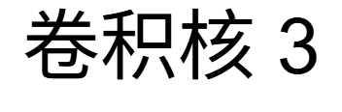





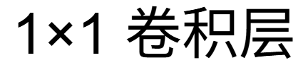











Slide 8








Slide 9
















Slide 11
V2.0

Slide 12









Slide 13








Slide 14




Slide 16
V3.0

Slide 17
MLP分类器

Slide 18
















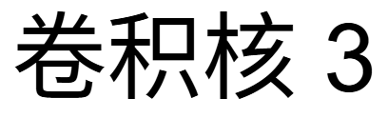


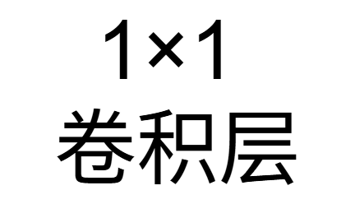







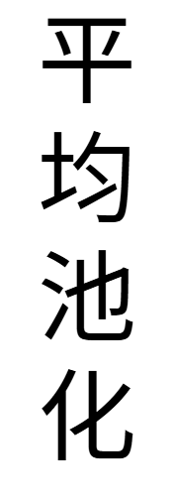






Slide 19
















