Slide 1
Austin Real Estate Data Scrappy, Analysis and Interactive Visualization
Computational Optimization
Advisor: Dr. Ned Dimitrov
Xiaoyu Qian (UT ORIE)
Daqi Xu (UT ME)
Chunqi Wang (UT ME)
November 17 2015

Slide 2
Outline
Data Acquisition
(scrapy, pandana)
Analysis and Prediction
(sklearn, xgboost)
Interactive Visualization
(Bokeh)

Slide 3
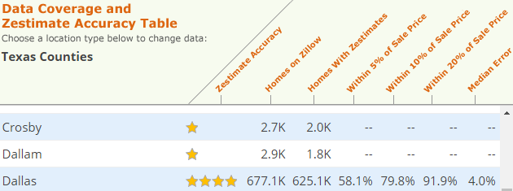
Data Acquisition
Zestimate® home value
Elements influence price
Geography
Size
http://www.zillow.com/howto/DataCoverageZestimateAccuracyTX.htm

Slide 4
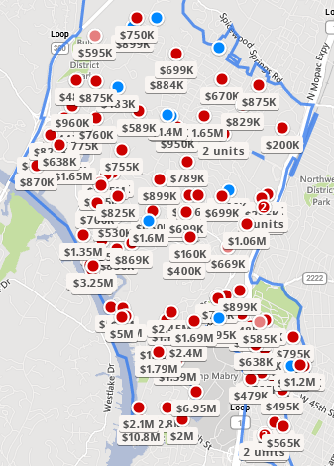
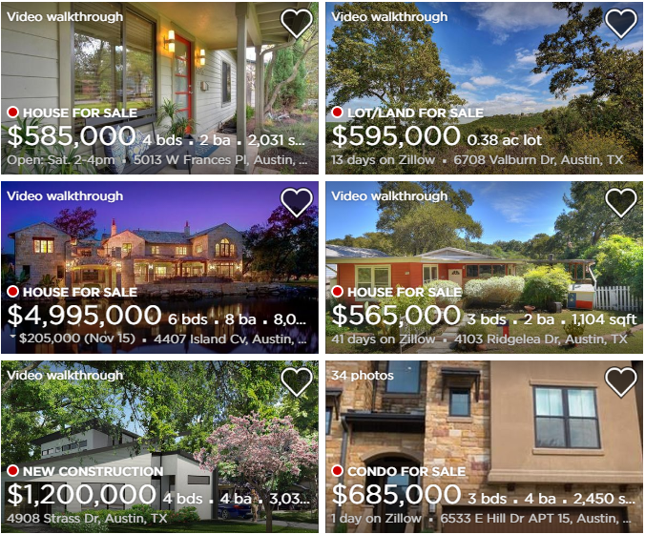
Data Acquisition
Zillow.com (Scrapy)
Geography
Latitude
Longitude
Zip Code
Address
House
Area
Bathroom
Bedroom
Price
http://www.zillow.com/homes/for_sale/Austin-TX-78731_rb/

Slide 5
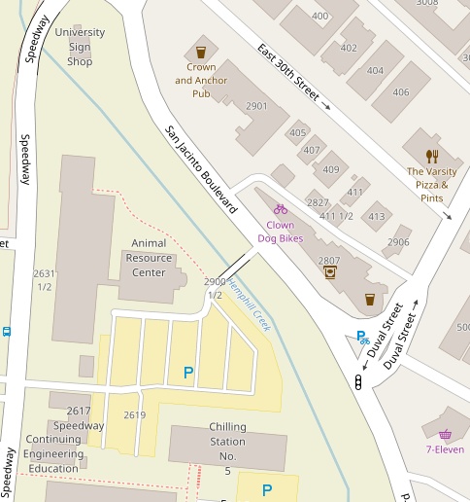
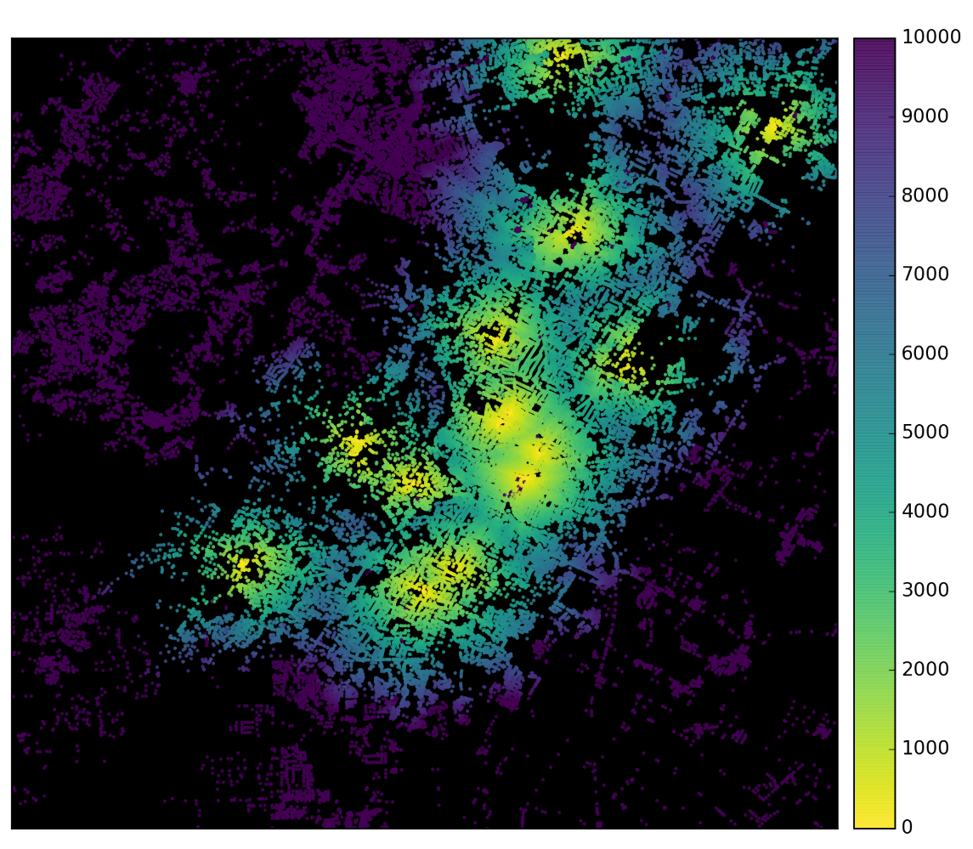
Data Acquisition
OpenStreetMap API (Pandana)
★supermarket ★ restaurant
★hospital ★ bar ★ school
Distance to The Closest Hospital Near Austin (m)

Slide 6
Analysis and Prediction
Preprocessing
Format
data.bedrooms =“stuido” -> 1 ;
data.price = “132K” -> 132000;
Data.price = 495000+ -> 495000;
Missing Value
Clustering:
Location
Size
Amanities

Slide 7
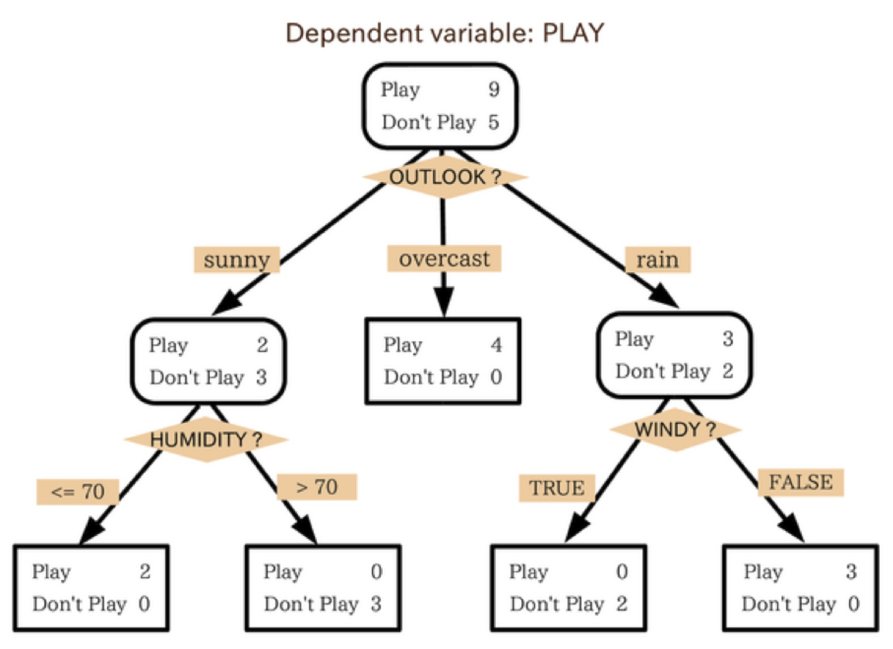
Analysis and Prediction
Model
Linear Regression
Random Forest Tree
Xgboost

Slide 8
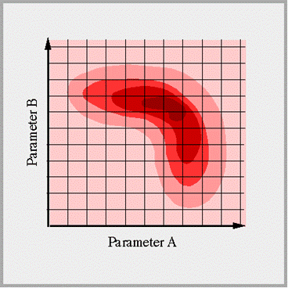
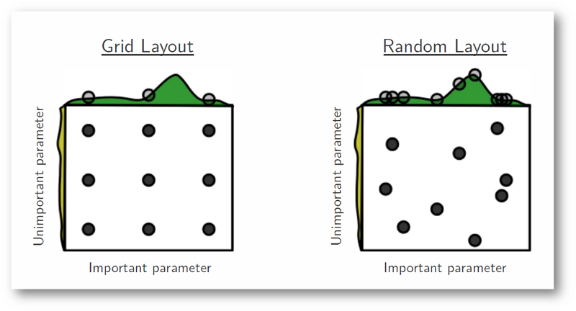
Analysis and Prediction
Tuning Parameters
GridSearch

Slide 9
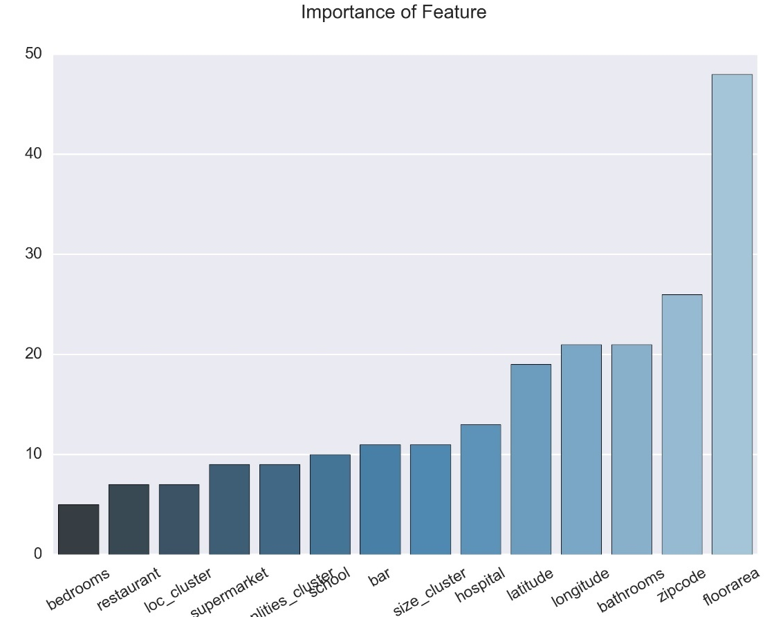
Analysis and Prediction
Result
Important Feature
Prediction Result
Error Analysis

Slide 10
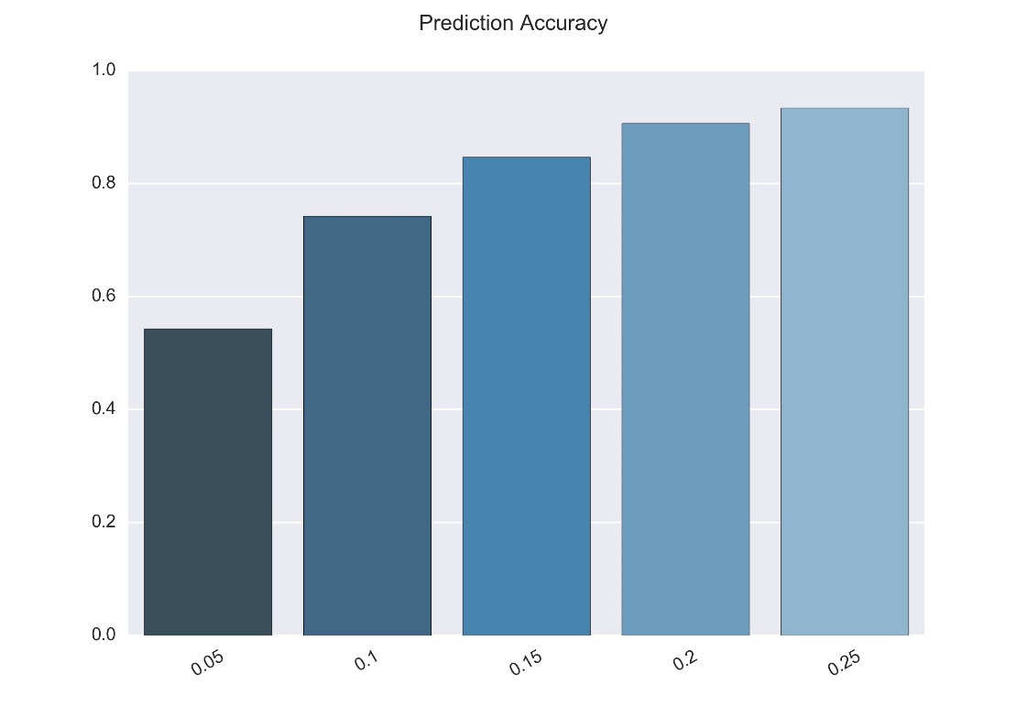
Analysis and Prediction
Result
Important Feature
Prediction Result
Error Analysis

Slide 11

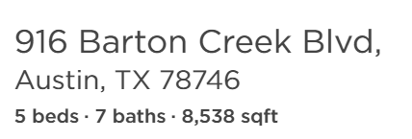

Analysis and Prediction
Result
Important Feature
Prediction Result
Error Analysis

Slide 12
Visualization
Key for a good data report:
Effective
Attractive
Comprehensive
Interactive report
Interesting
One-for-All

Slide 13
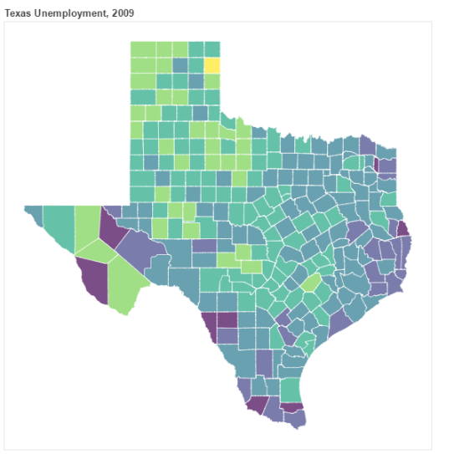
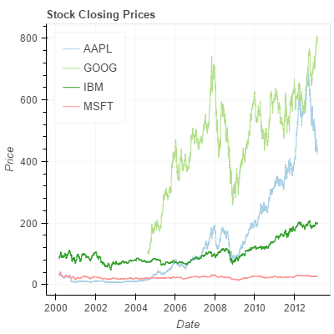
Visualization
Bokeh: plotting, ColumnDataSource,Circle
Examples:

Slide 14
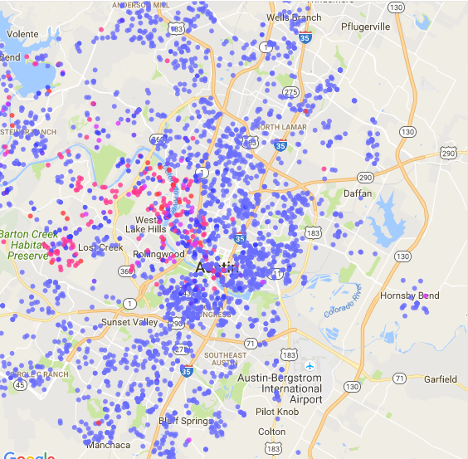
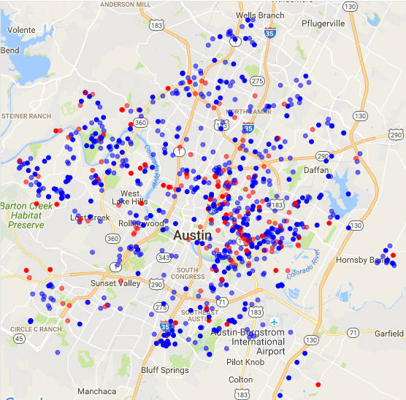
Visualization
Austin Houses for Sale:
Austin Predictions:

Slide 15
Future Work
Scrapping more information (year built) from other website (redfin.com)
Collecting more data from other Texas counties
D3 interactive analysis

Slide 16


Q&A

