Slide 1

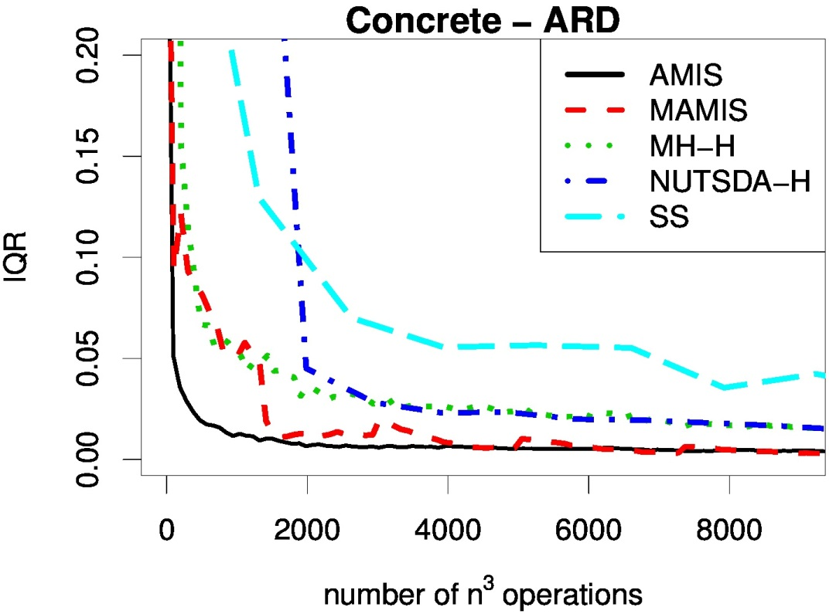
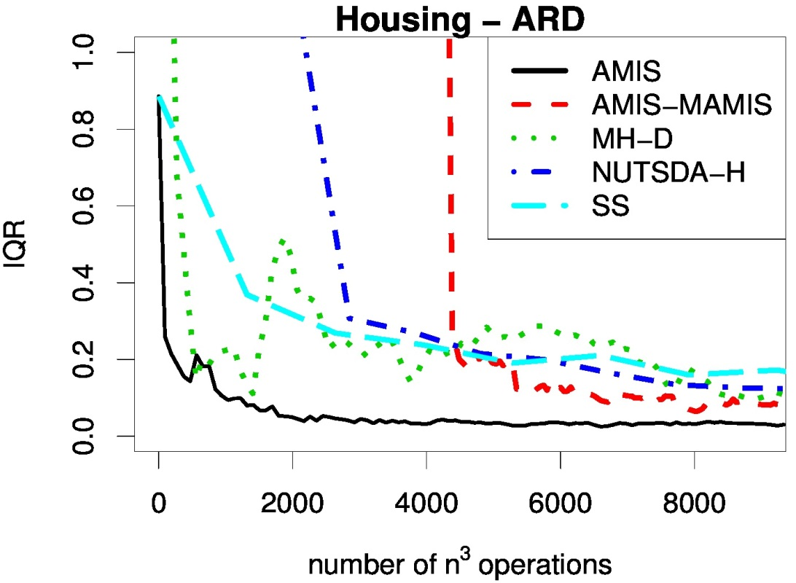
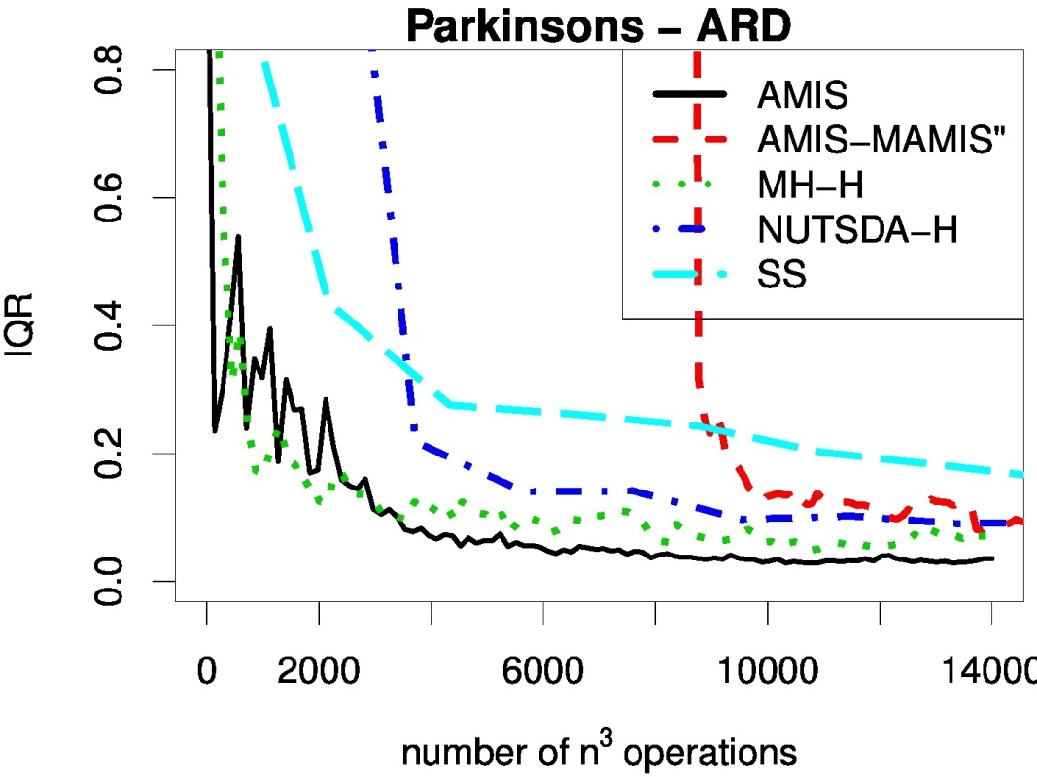
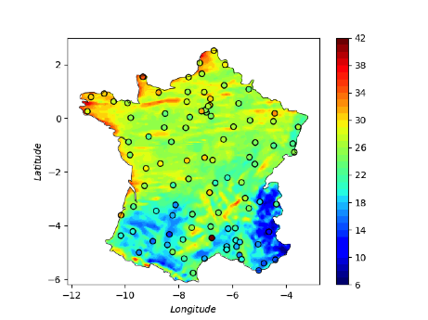
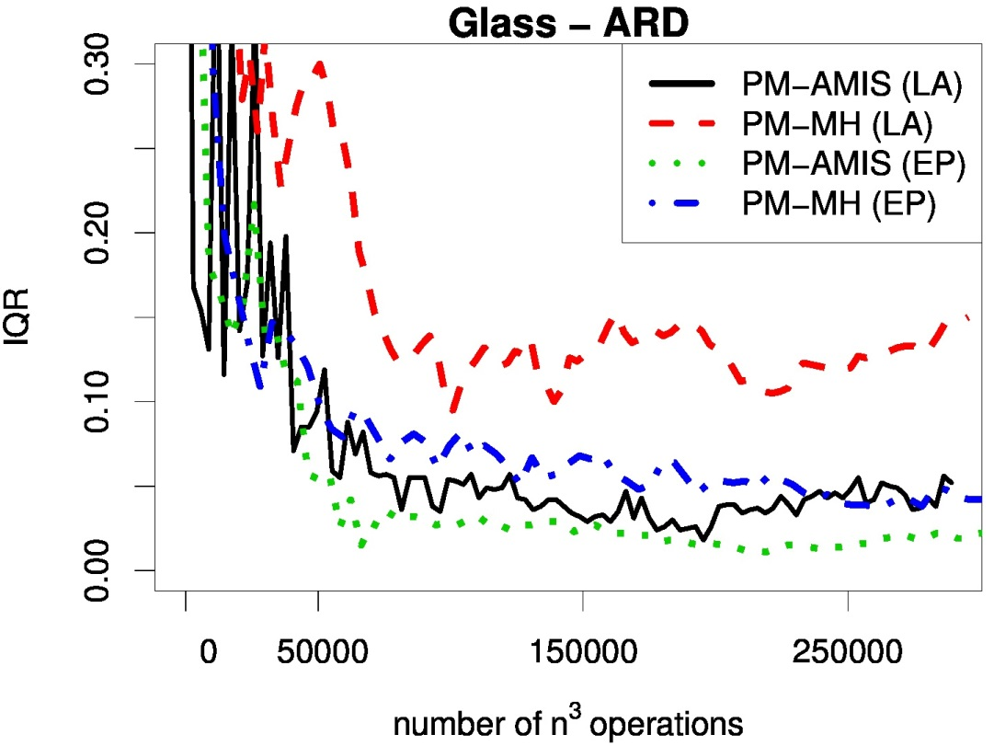
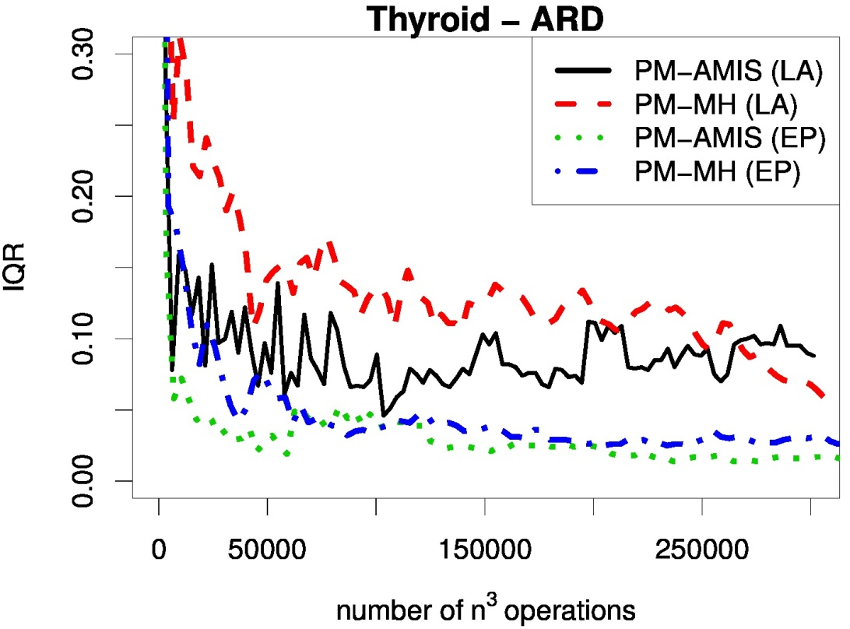
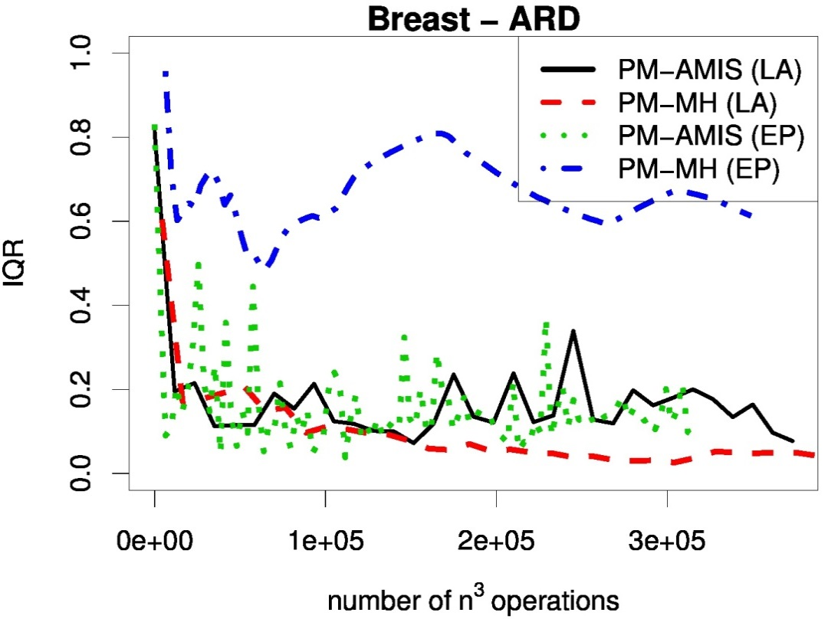
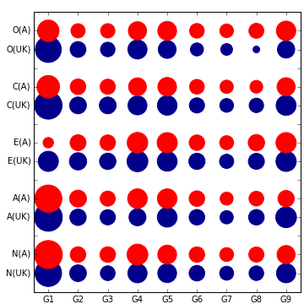
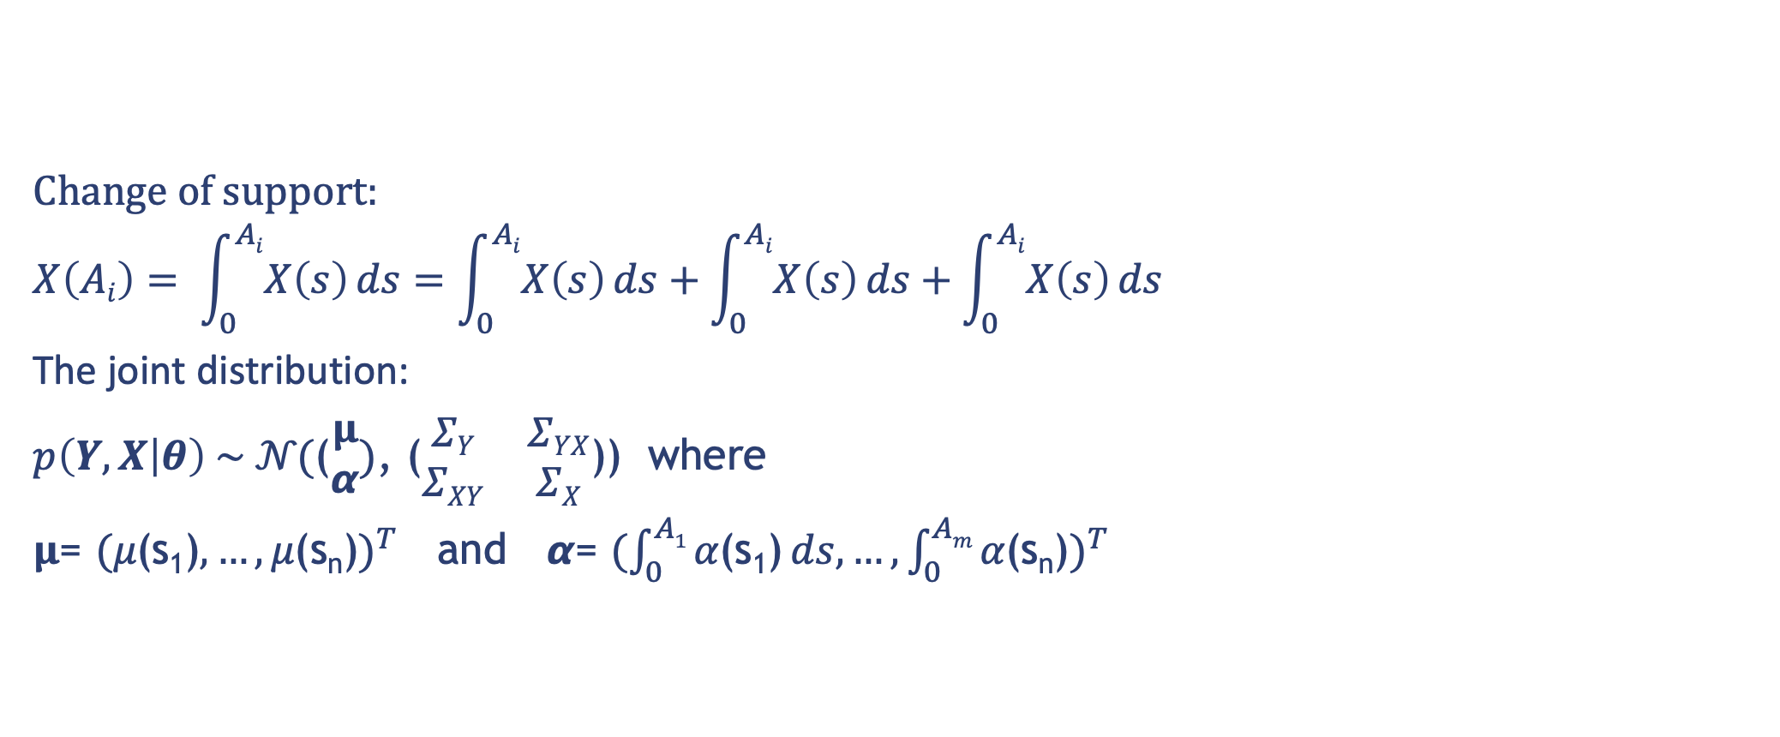
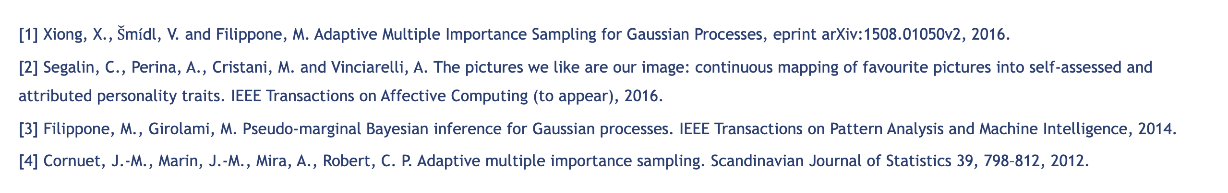
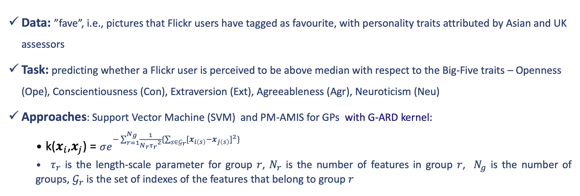
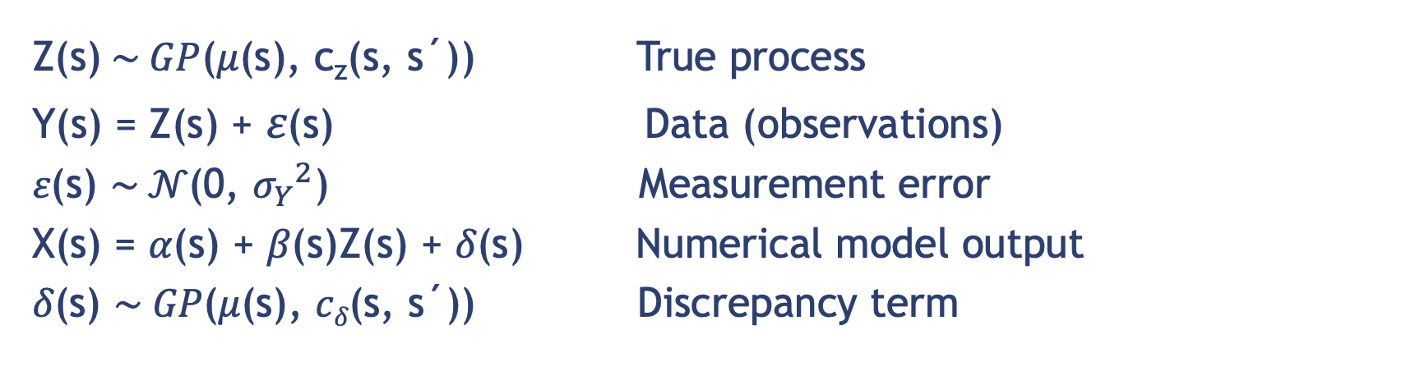
Data fusion with Gaussian processes for estimation of windstorm events
Xiaoyu Xiong, Benjamin D. Youngman, Theodoros Economou
University of Exeter email: x.xiong@exeter.ac.uk, b.youngman@exeter.ac.uk
t.economou@exeter.ac.uk
Motivation
Experiments
The hazard footprints are conventionally estimated using measurements from observing stations and/or gridded analyses produced by numerical climate simulation models
ground monitoring stations lack spatial coverage but can be thought to measure true wind speed fairly accurately
Structured model outputs tend to have complete spatial coverage but can only represent true values at the model's predetermined resolution and not at smaller scales
IQR: Interquartile Range of the expectation of the norm of the parameters
Convergence analysis: IQR against computational costs (number of n^3 operations)
GP regression - AMIS vs MH, Best of HMC family, slice sampling (SS)
GP classification - PM-AMIS vs PM-MH
Knowledge of small scale detail in windstorm footprints is important because of the large spatial heterogeneity in vulnerability,
Interpolation at small scale based solely on sparse observational data is often not accurate, hence integrating additional data sources for improved spatial interpolation is necessary but entails several challenges:
Application of PM-AMIS for GPs: Personality inference from Flickr images
All data sources should be thought of as imperfect representations of the truth. Biases can be both systematic and random.
The data sources can have different spatial support.
It is important to accurately quantify uncertainty from the different data sources and propagate this to predictions.
Data: ”fave”, i.e., pictures that Flickr users have tagged as favourite, with personality traits attributed by Asian and UK assessors
Task: predicting whether a Flickr user is perceived to be above median with respect to the Big-Five traits – Openness (Ope), Conscientiousness (Con), Extraversion (Ext), Agreeableness (Agr), Neuroticism (Neu)
Approaches: Support Vector Machine (SVM) and PM-AMIS for GPs with G-ARD kernel:
k($x_{i}$,$x_{j}$) = $σe^{−\sum_{r=1}^{N_{g}}{\frac{1}{{N_{r}τ_{r}}^{2}}}\{\sum_{s∈𝒢_{r}}{{{[x}_{i\left(s\right)}−x_{j\left(s\right)}]}^{2}\}}}$
${ τ}_{r}$ is the length-scale parameter for group $r$, $N_{r}$ is the number of features in group $r$, $N_{g}$ is the number of groups, $𝒢_{r}$ is the set of indexes of the features that belong to group $r$
we present a general modelling framework that is able to tackle these challenges and provide footprint estimates (predictions) that reliably integrate information across all available data sources
Data Fusion with Gaussian processes
Z(s)$\sim GP$(𝜇(s), c_{z}(s, s´)) True process
Y(s) = Z(s) + 𝜀(s) Data (observations)
𝜀(s) $\sim 𝒩\text{(}\text{0}\text{,} {σ_{Y}}^{2}\text{)}$ Measurement error
X(s) = 𝛼(s) + 𝛽(s)Z(s) + 𝛿(s) Numerical model output
𝛿(s) $\sim GP\text{(}\text{μ}\text{(}\text{s}\text{), }cδ\text{(}\text{s}\text{, }\text{s}\text{´))}$ Discrepancy term
Table 1: Groups of features (number in brackets denotes the number of features for each group )
G1 | G2 | G3 | G4 | G5 | G6 | G7 | G8 | G9
Faces (1) | Colour Properties(3) | Colour Distribution(1) | Homogeneous Regions (4) | Composition (2) | Texture Wavelets (12) | GIST filters (24) | GLCM (24) | Texture Statistics (4)
Main novelty of the model:
while 𝛼(s) , 𝛽(s) will capture consistent under- or over-estimation of wind speeds, the GP nonparametric formulation of 𝛿(s) can allow for any possible form of spatially structured discrepancy.
Results:
PM-AMIS for GPs achieves comparable accuracies with SVM (see Table 2)
G-ARD is able to identify the groups of features (G1, G5, G9, G4) that mostly influence personality impression
Weights difference (Figure 1) across Asian and UK personality assessors suggests cultural difference on personality perception
Change of support:
$$X\left(Ai\right)= \int_{0}^{Ai}{X\left(s\right)}ds=\int_{0}^{Ai}{X\left(s\right)}ds+\int_{0}^{Ai}{X\left(s\right)}ds+\int_{0}^{Ai}{X\left(s\right)}ds$$
The joint distribution:
$p\left(Y,X | θ\right) \sim 𝒩\text{(}\text{(}\begin{matrix}μ \\ α\end{matrix}\text{)}\text{,}\text{ (}\begin{matrix}ΣY & ΣYX \\ ΣXY & ΣX\end{matrix}$)) where
$μ$= ${(\text{μ}\text{(}\text{s}\text{1}\text{)}, …,\text{μ}\text{(}\text{sn}\text{)})}^{T}$ and $α$= ${(\int_{0}^{A1}{\text{α}\text{(}\text{s}\text{1}\text{)}}ds, …,\int_{0}^{Am}{\text{α}\text{(}\text{s}\text{n}\text{)}})}^{T}$
Figure 1: Coefficients of the G-ARD for the five traits (O, C, E, A, N) and two cultures Asian (A) and UK
Table 2: Prediction Accuracy
Simulation study – simulated data and predictions
 | Ope | Con | Ext | Agr | Neu
PM-AMIS for GPs (UK) | 65% | 58% | 71% | 73% | 79%
SVM(UK) | 59% | 62% | 71% | 74% | 77%
PM-AMIS for GPs (Asia) | 68% | 52% | 74% | 68% | 69%
SVM(Asia) | 68% | 47% | 68% | 69% | 70%
Figure (c) indicates that the model has captured the true process Z(s) reasonably well
Conclusions
AMIS achieves faster convergence than MCMC for GPs while being easy to tune and implement and facilitating massive parallelization
AMIS for GPs offers an efficient probabilistic framework for SSP
References
[1] Xiong, X.,$\check{S}$m$\acute{i}$dl, V. and Filippone, M. Adaptive Multiple Importance Sampling for Gaussian Processes, eprint arXiv:1508.01050v2, 2016.
[2] Segalin, C., Perina, A., Cristani, M. and Vinciarelli, A. The pictures we like are our image: continuous mapping of favourite pictures into self-assessed and attributed personality traits. IEEE Transactions on Affective Computing (to appear), 2016.
[3] Filippone, M., Girolami, M. Pseudo-marginal Bayesian inference for Gaussian processes. IEEE Transactions on Pattern Analysis and Machine Intelligence, 2014.
[4] Cornuet, J.-M., Marin, J.-M., Mira, A., Robert, C. P. Adaptive multiple importance sampling. Scandinavian Journal of Statistics 39, 798–812, 2012.

