Slide 1

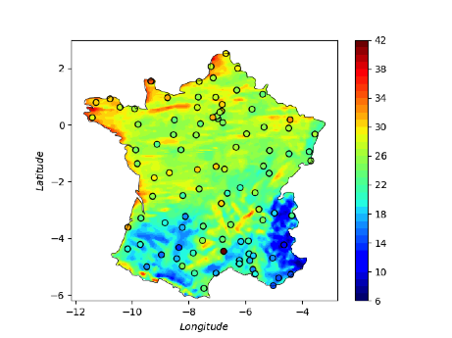
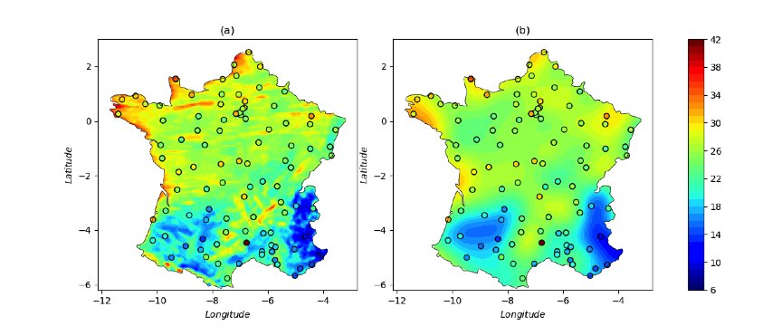
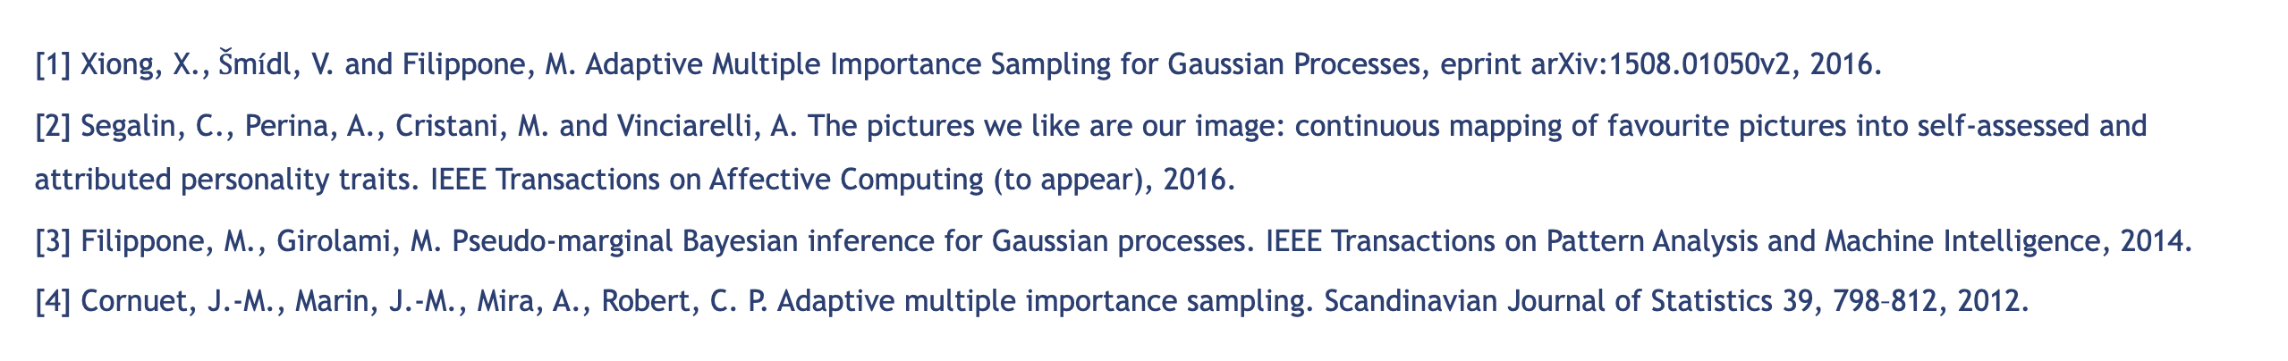
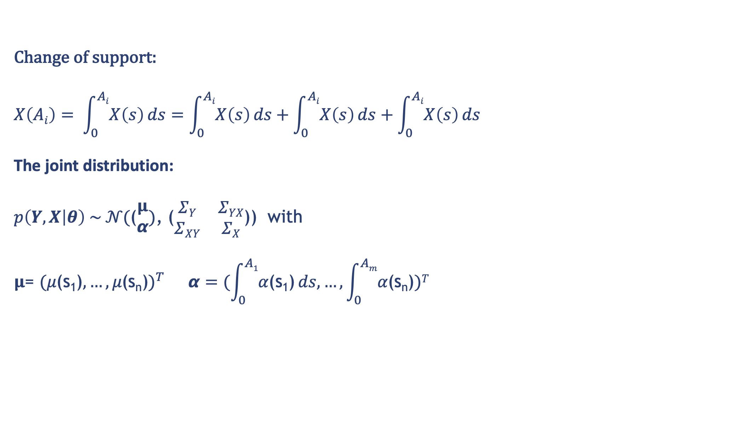
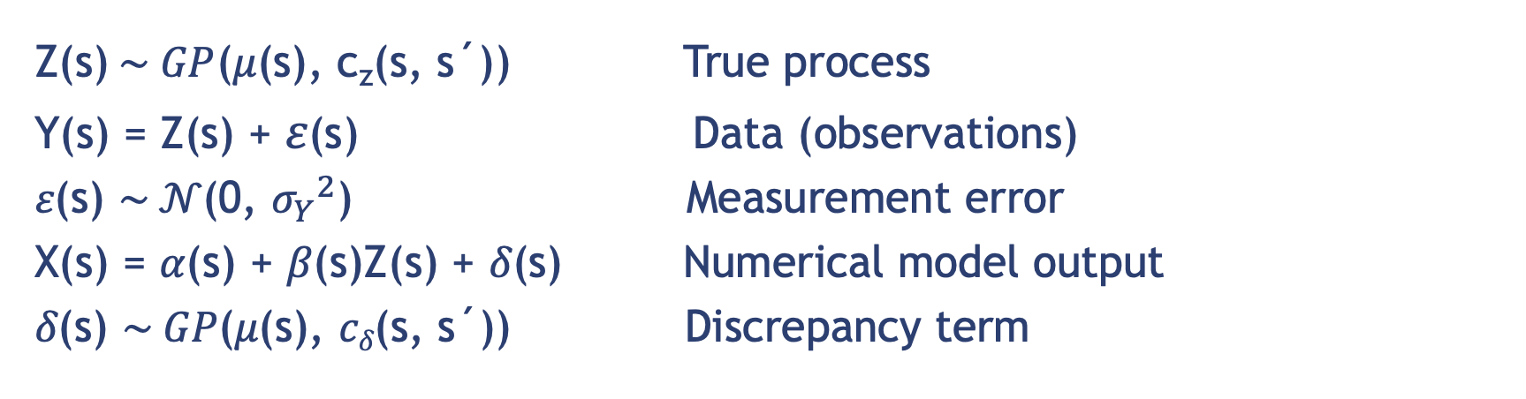
Data fusion with Gaussian processes for estimation of windstorm events
Xiaoyu Xiong, Benjamin D. Youngman, Theodoros Economou
University of Exeter email: x.xiong@exeter.ac.uk, b.youngman@exeter.ac.uk
t.economou@exeter.ac.uk
Motivation
Experiments
Windstorms are normally quantified by the windstorm footprint, a spatial area describing potential damage
Windstorm footprints are conventionally estimated using measurements from observing stations and/or gridded analyses produced by numerical climate simulation models
Ground monitoring stations lack spatial coverage but can be thought to measure true wind speed fairly accurately
Structured model outputs tend to have complete spatial coverage but can only represent true values at the model's predetermined resolution and not at smaller scales
The out-of-sample RMSE, average width of 95% confidence interval and coverage probability
over 100 simulations for Kriging and the DF approach
Knowledge of small scale detail in windstorm footprints is important because of the large spatial heterogeneity in vulnerability,
Interpolation at small scale based solely on sparse observational data is often not accurate, hence integrating additional data sources for improved spatial interpolation is necessary but entails several challenges:
Application of Imogen Windstorm data
All data sources should be thought of as imperfect representations of the truth. Biases can be both systematic and random
The data sources can have different spatial support
It is important to accurately quantify uncertainty from the different data sources and propagate this to predictions
We present a general modelling framework that is able to tackle these challenges and provide footprint estimates (predictions) that reliably integrate information across all available data sources
Improved spatial interpolation at small scale
Could work as a way of validating numerical simulator outputs
Data Fusion with Gaussian processes
Z(s)$\sim GP$(𝜇(s), c_{z}(s, s´)) True process
Y(s) = Z(s) + 𝜀(s) Data (observations)
𝜀(s) $\sim 𝒩\text{(}\text{0}\text{,} {σ_{Y}}^{2}\text{)}$ Measurement error
X(s) = 𝛼(s) + 𝛽(s)Z(s) + 𝛿(s) Numerical model output
𝛿(s) $\sim GP\text{(}\text{μ}\text{(}\text{s}\text{), }cδ\text{(}\text{s}\text{, }\text{s}\text{´))}$ Discrepancy term
Main novelty of the model:
while 𝛼(s) , 𝛽(s) will capture consistent under- or over-estimation of wind speeds, the GP nonparametric formulation of 𝛿(s) can allow for any possible form of spatially structured discrepancy.
Change of support:
$$X\left(Ai\right)= \int_{0}^{Ai}{X\left(s\right)}ds=\int_{0}^{Ai}{X\left(s\right)}ds+\int_{0}^{Ai}{X\left(s\right)}ds+\int_{0}^{Ai}{X\left(s\right)}ds$$
The joint distribution:
$p\left(Y,X | θ\right) \sim 𝒩\text{(}\text{(}\begin{matrix}μ \\ α\end{matrix}\text{)}\text{,}\text{ (}\begin{matrix}ΣY & ΣYX \\ ΣXY & ΣX\end{matrix}$)) with
$$μ\text{= }{(\text{μ}\text{(}\text{s}\text{1}\text{)}, …,\text{μ}\text{(}\text{sn}\text{)})}^{T} α=(\int_{0}^{A1}{\text{α}\text{(}\text{s}\text{1}\text{)}}ds, …,\int_{0}^{Am}{\text{α}\text{(}\text{sn}\text{)}})T$$
Results:
High prediction accuracy
Two abnormal ones situates at the boundary where higher uncertainty expected
Simulation study – simulated data and predictions
Conclusions
AMIS achieves faster convergence than MCMC for GPs while being easy to tune and implement and facilitating massive parallelization
AMIS for GPs offers an efficient probabilistic framework for SSP
Simulated Z(s) over a 1000 $×$ 1000 grid (b) Simulated $X(Ai)$over a 25 $×$ 25 block
(c) Predicted Z(s) (d) Simulated Z(s) versus Y(s) and $X(Ai)$
References
Figure (d) shows averaging Z(s) to get X(A_{i}) has clearly induced bias
Figure (c) indicates that the model has captured the true process Z(s) reasonably well
[1] Xiong, X.,$\check{S}$m$\acute{i}$dl, V. and Filippone, M. Adaptive Multiple Importance Sampling for Gaussian Processes, eprint arXiv:1508.01050v2, 2016.
[2] Segalin, C., Perina, A., Cristani, M. and Vinciarelli, A. The pictures we like are our image: continuous mapping of favourite pictures into self-assessed and attributed personality traits. IEEE Transactions on Affective Computing (to appear), 2016.
[3] Filippone, M., Girolami, M. Pseudo-marginal Bayesian inference for Gaussian processes. IEEE Transactions on Pattern Analysis and Machine Intelligence, 2014.
[4] Cornuet, J.-M., Marin, J.-M., Mira, A., Robert, C. P. Adaptive multiple importance sampling. Scandinavian Journal of Statistics 39, 798–812, 2012.

