Slide 1
Edge-exchangeable random graph models
Xiaoyu Ouyang
2021/03/10

Slide 2
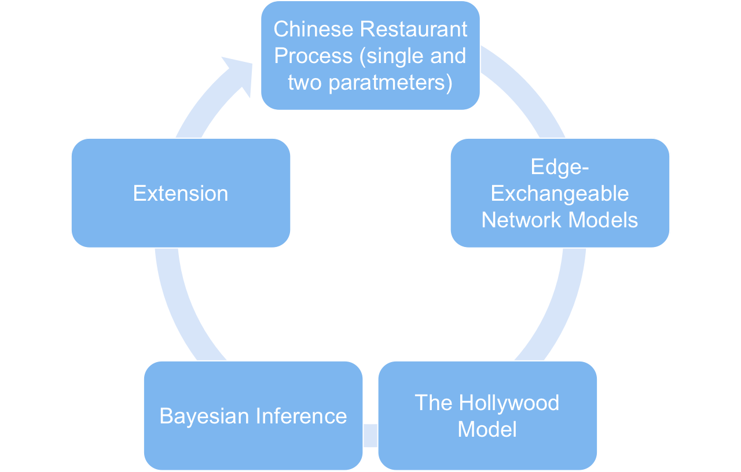
Outline

Slide 3
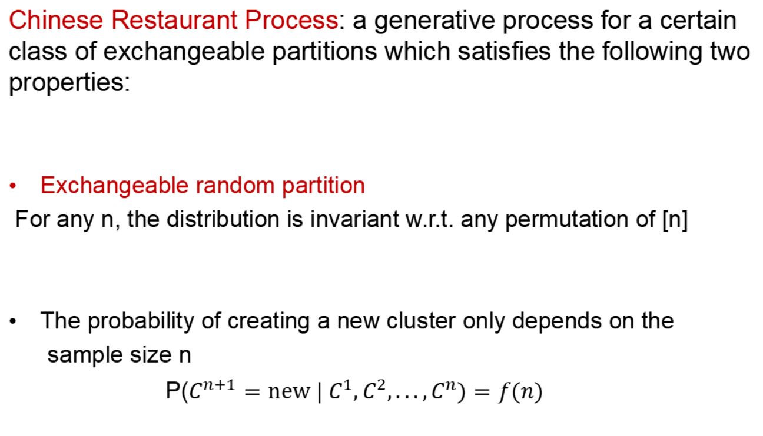
Chinese Restaurant Process

Slide 4
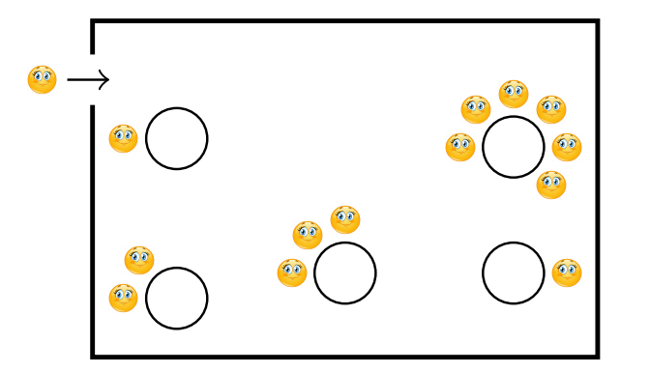
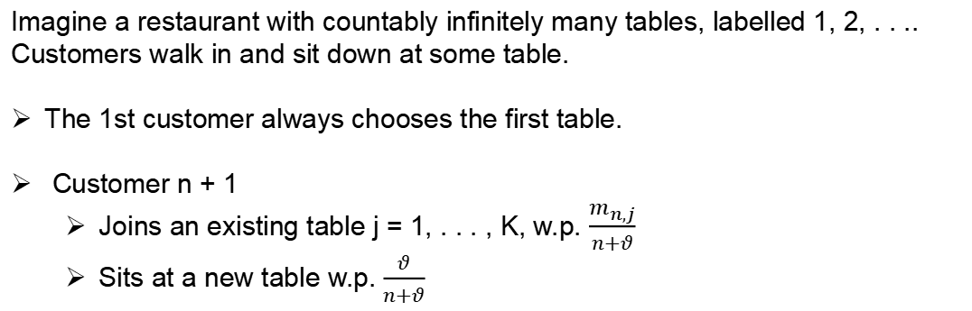
One-Parameter Chinese Restaurant Process

Slide 5
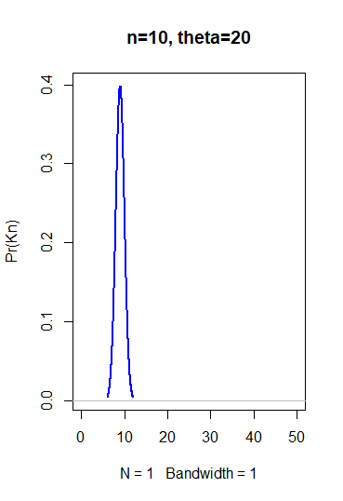
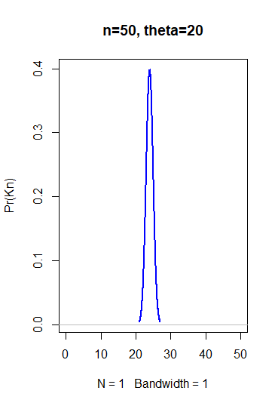
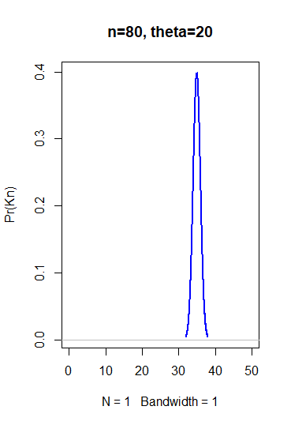
One-Parameter Chinese Restaurant Process

Slide 6
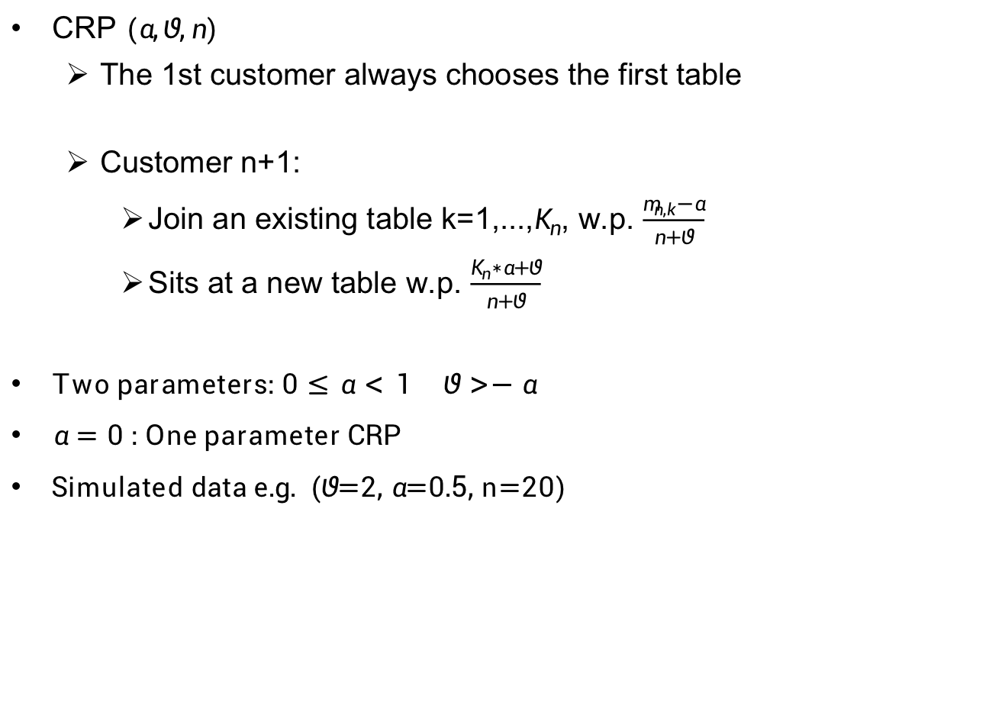
Two-Parameter Chinese Restaurant Process

Slide 7
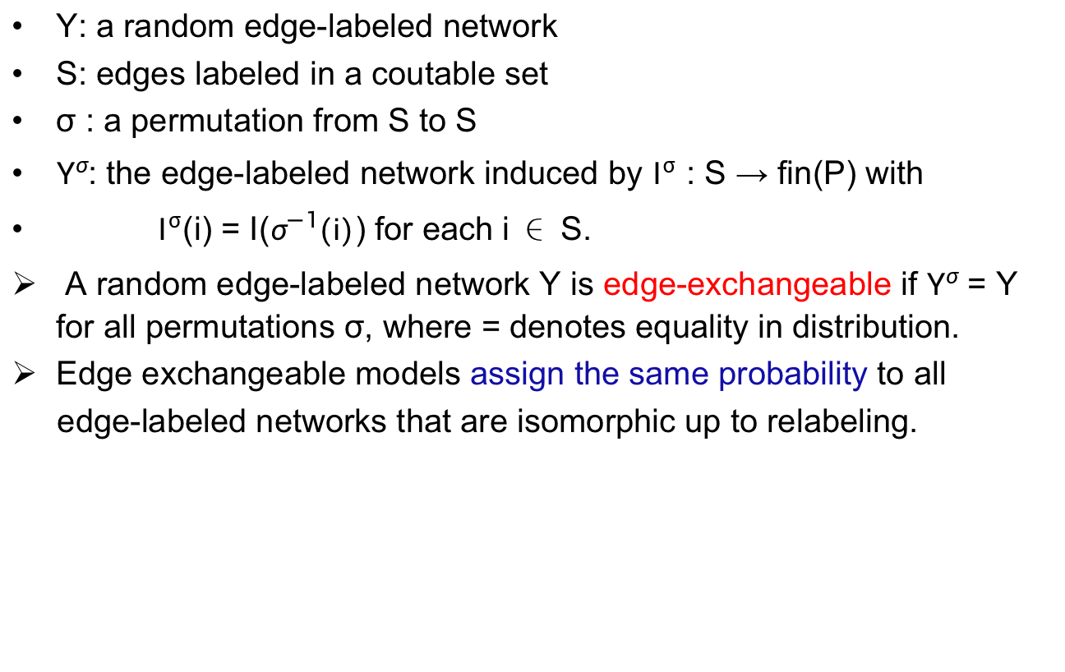
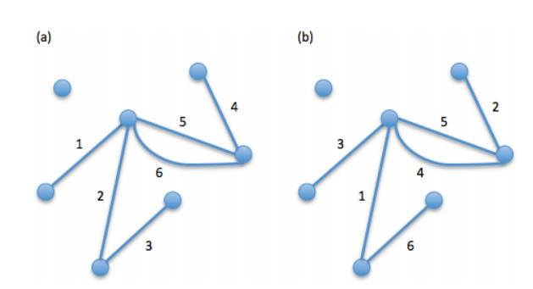
Edge-exchangeable Network Models

Slide 8
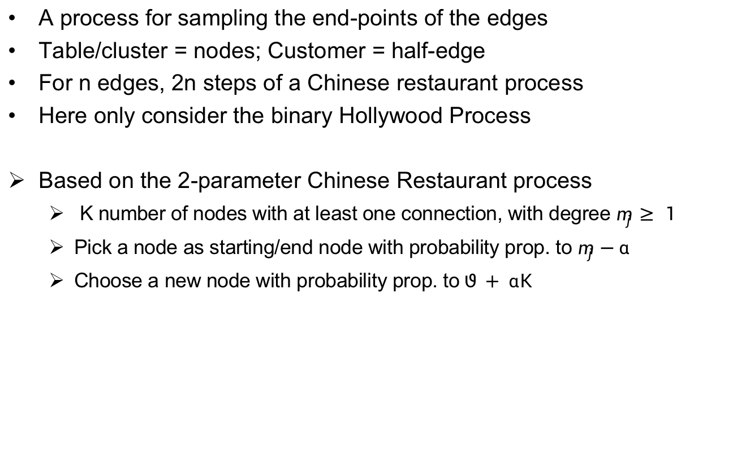
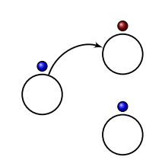
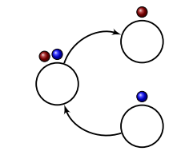
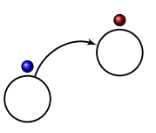


The Hollywood Model

Slide 9
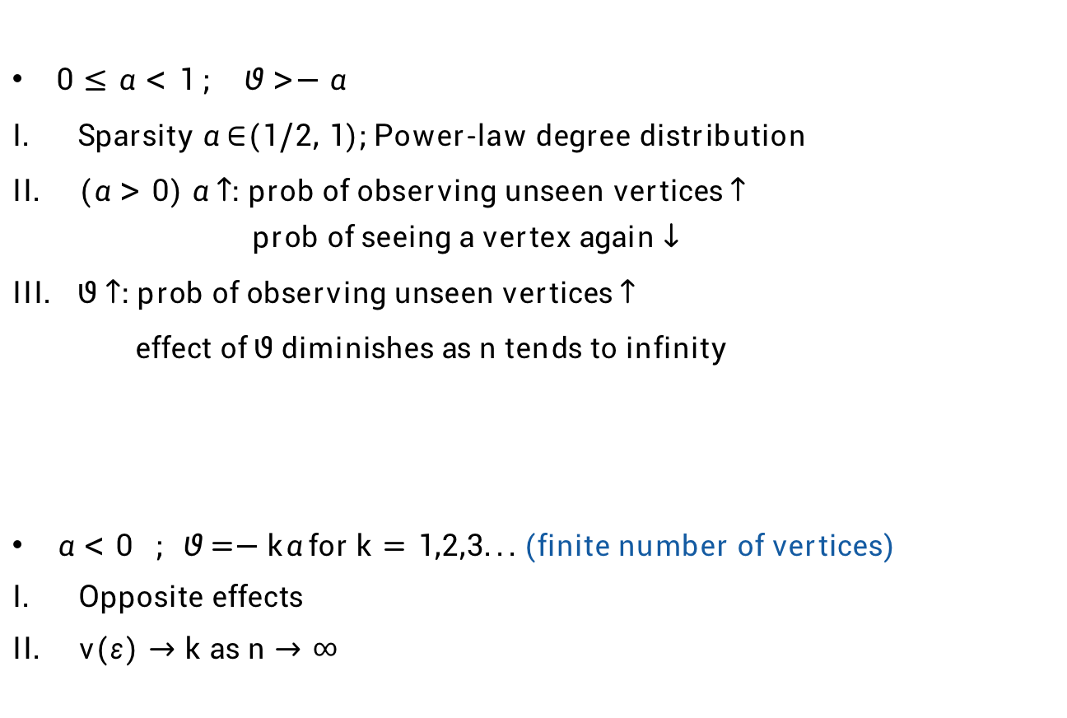
Interpretation of parameters

Slide 10
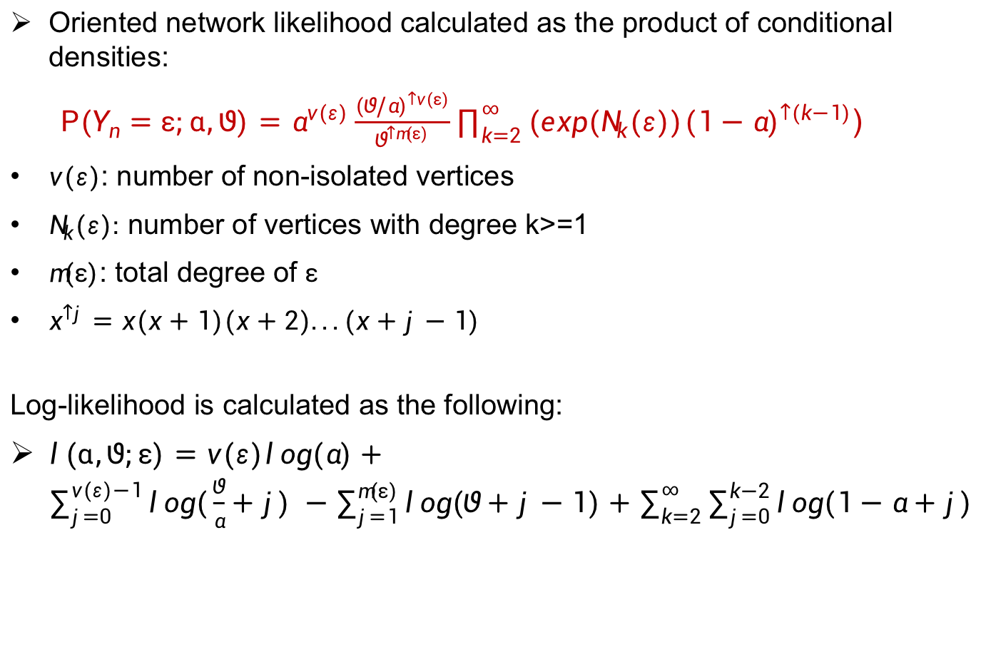

Inference

Slide 11
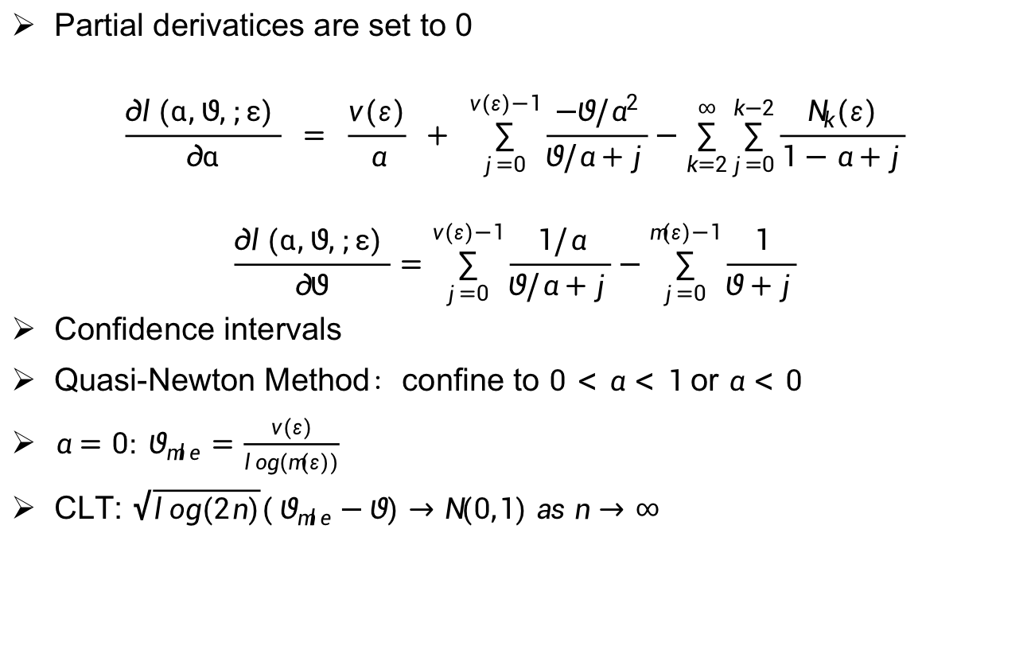
Maximum Likelihood Estimate

Slide 12
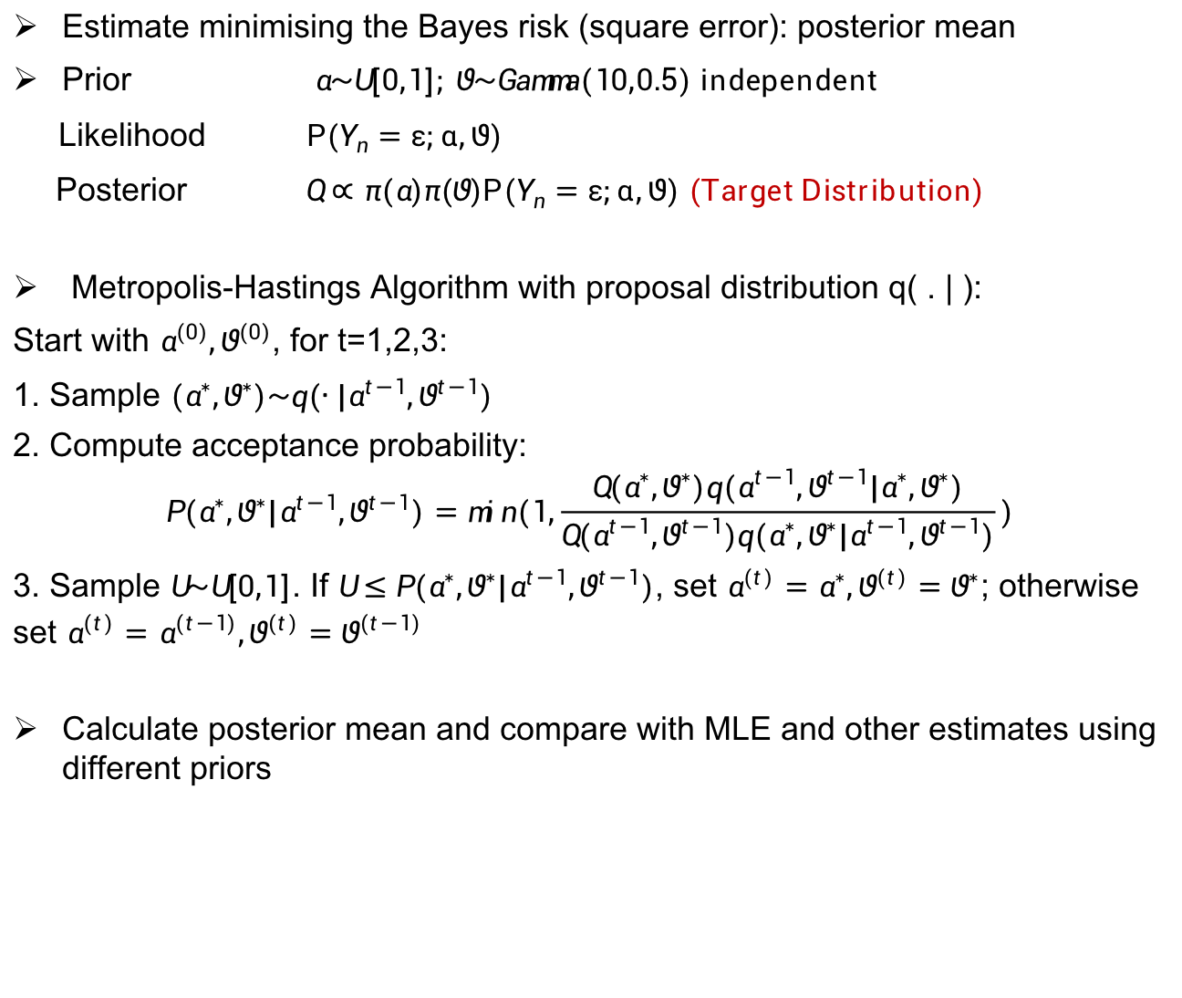
Comparison With Other Estimates

Slide 13
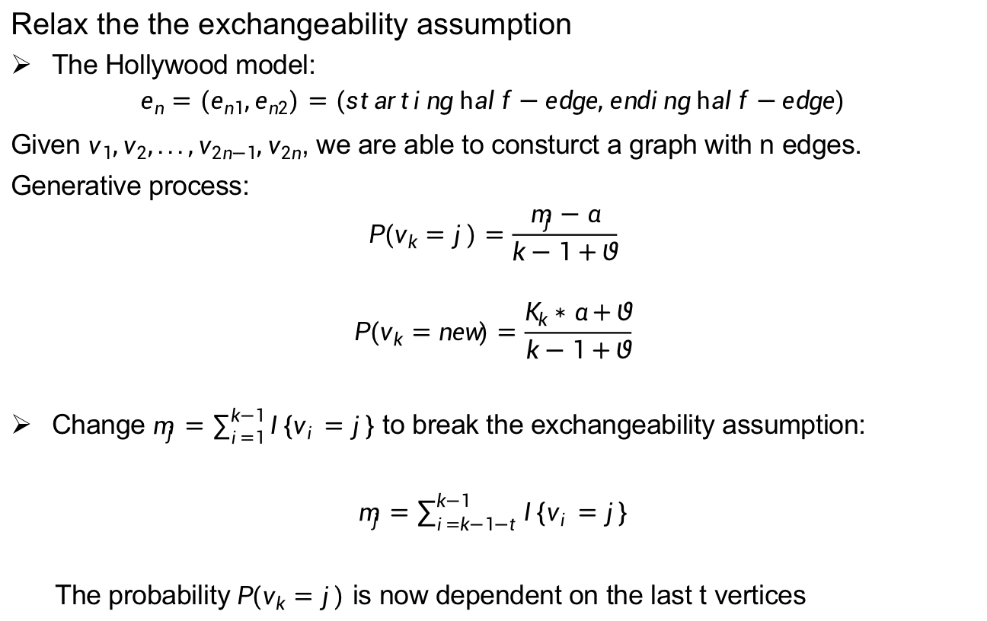
More Structured Models (Extension)

Slide 14
Inference of the extended model
Log-likelihoods, Maximum Likelihood Estimates, Confidence Intervals
Other properties

Slide 15
Conclusion
The Hollywood model
computationally tractable
performs well in many real-data examples
nice properties such as sparsity and power-law degree distribution
The extended model
better fit to real-life data?
nice properties?

Slide 16
Thanks for listening!

