Slide 1

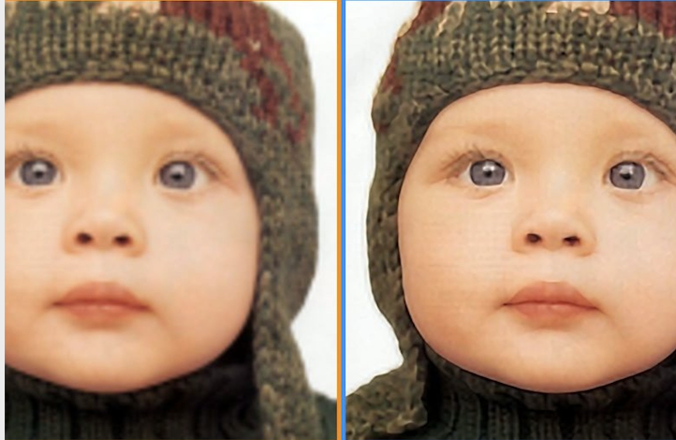
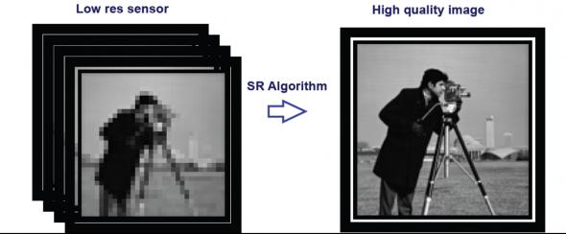
Super
Resolution
Group: pilipili
Jianhua Hu
Xiaoyu Zhou
Shuo Zhuang
Notes:
This is csc420 project presentation. Our group name is pilipili and my name is Jianhua Hu.
Our project topic is about super resolution, which is a process to recovering a high resolution image from a given low resolution image. The crucial problem is that this process is not easy to achieve. There are many traditional ways like weighted average neighborhoods or bilinear/bicubic interpolation methods don’t perform very well.
In recent years, a variety of deep learning methods have been applied to SR tasks. In 2014, Chao Dong and some of other researchers proposed a deep learning method for single image super-resolution(SR) using deep convolutional networks(SRCNN). Our solution for SR is mainly based on this algorithm with some changes and improvements.

Slide 2
What we have done so far:
Construct the framework of SRCNN.
Formalize the input images.
Create SRCNN function.
Find appropriate Loss Function
Notes:
The first and the most essential thing that we have done is construct the framework of SRCNN which includes three parts, which are prepare data, SRCNN algorithm and error analysis. Then we formalized our training data to fit the model. Also, we create a function to implement SRCNN. Finally, we found a better loss function which is used to analyze the error and improve our algorithm.

Slide 3
Pre-process Data
Use high resolution images to produce low resolution images
Idea is down-scaling the image first, then up-scaling
Using OpenCV interpolation methods (bicubic)
Convert image to YCbCr format for SRCNN model
SRCNN only use the Y charnel
Notes:
For SRCNN model, we need to do some pre-process before we use the raw image. In this project, we are trying to create our own training dataset, so we need some low resolution images and for each of it, we need a high resolution for evaluation. The solution that we came up is that downloading some high resolution images from google, and resizing them twice to produce some low resolution images. For the resizing, first down-scaling the image by a factor like 3 or 4, then up-scaling it by the same factor. Then, we will get a new low resolution image, which has same size of the high resolution image. Also, for up-scaling and down-scaling process, we are using the OpenCV interpolation methods. There are many choices like linear interpolation, bicubic interpolation, and what we chose for this project is the linear interpolation, which provides a lower resolution image.
Also, for the input image of SRCNN model, we need to convert the image format into YCbCr format, since the SRCNN model are training and predicting on the Y charnel. In addition, after the SRCNN model predict the value, we need to convert the result back to RGB format for visualization.

Slide 4
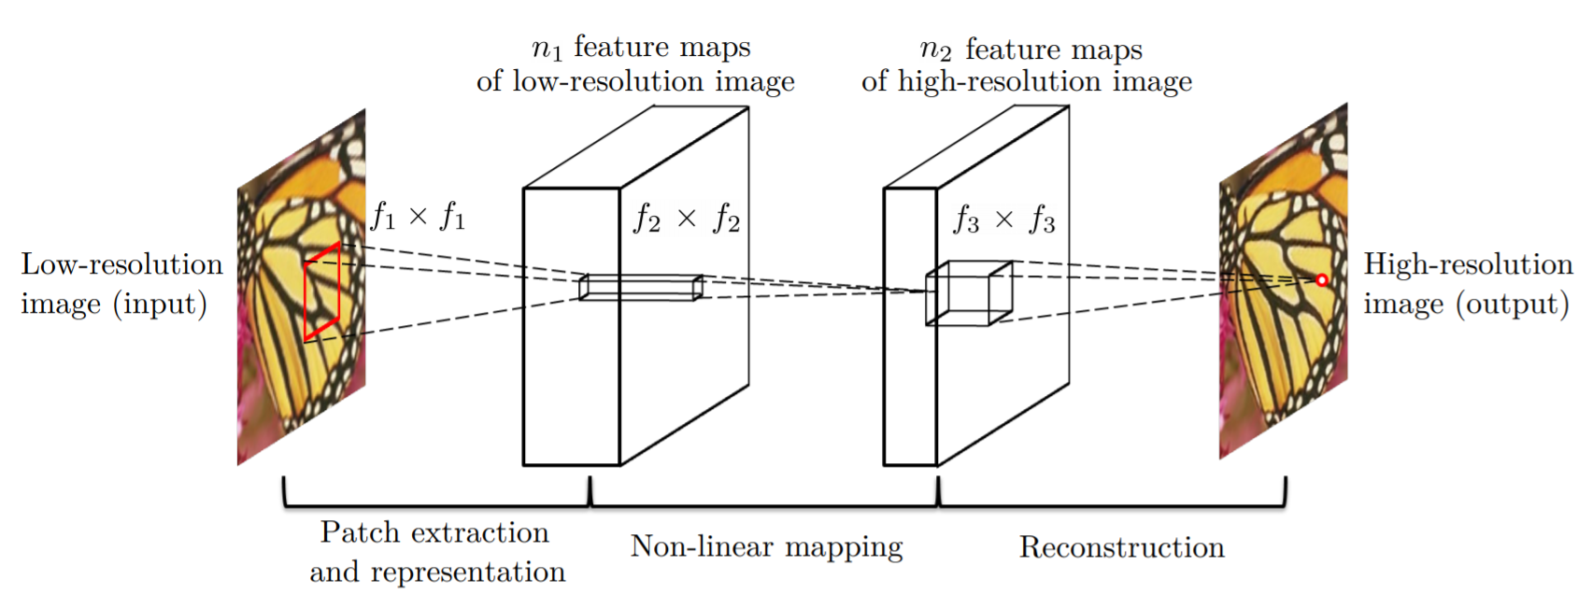
SRCNN Algorithm
Central idea: three layers of covolution.
Notes:
The central idea of SRCNN algorithm is the three-layer convolution. The first layer is patch extraction and representation. This layer extracts patches from the low-resolution image. This can be done by convolving the image by n1 filters. After this step, we can have n1 feature maps of low-resolution image. The second layer transforms the n1-dimensional vectors into n2-dimensional vectors through a nonlinear operation. Finally, the last step convolves the n2 feature maps of high-resolution image into the final full image.
Compared to the other interpolations, SRCNN uses deep learning to fill in the missing details in the upscaled image, which is more reasonable and also can receive a better result.
Until so far, we have simply implemented those three convolutions in the SRCNN by using the sequential model in Keras. In the future, we need to find better parameters such as filter numbers in the first two layers. The more filters we use in the convolution, the better results will be. However, too many filters will dramatically influence the speed of the algorithm, Thus, we will try different n1 and n2 to find better filter numbers. Moreover, different layers have different weights and biases for convolution, we also need to do experiments on finding them and find the best.

Slide 5

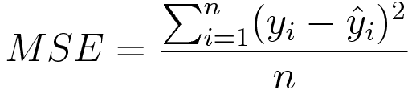
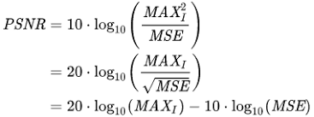
SRCNN:
SRGAN:
Notes:
We need to find a method to evaluate how well our algorithm performs.
We usually use a loss function to do that. There are two loss functions are used in SRCNN: Peak signal-to-noise ratio (PSNR) and mean square error (MSE).
PSNR is the ratio of maximum signal with the MSE
The goal is to Minimize this MSE while increase PSNR.
However using those pixelwise loss function may reduce the high frequency content and blur the edges in the image.
Some researchers try to solve this problem, like SRGAN algorithm. uses a weighted combination of three different loss functions, mean square error, perceptual and adversarial loss to enhance more details in the images.
However this approach involves a lot of computation which makes the process slower. It may cause less peak signal to noise ratio (PSNR).

Slide 6
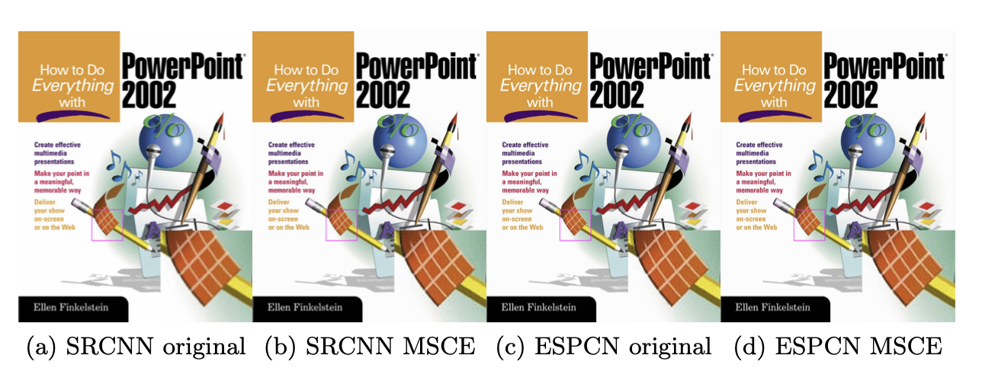
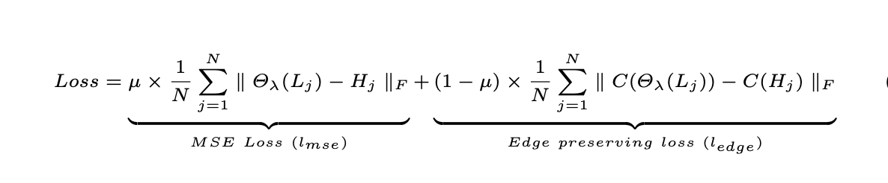
Our Solution:
Mean Sqaure canny error(MSCE)
Notes:
Our project aim to increase the PSNR value based on SRCNN.
At the same, we want to preserve the edge information.
We plan to define a loss function that is a combination of MSE and edge preserve loss function called mean square canny error.
The Canny operator provides the reliable edges. Minimizing this loss function should help to preserve the edges by giving more weightage to the edges. The PSNR values obtained should be better too. In addition we don’t add much additional computation compared to SRGAN.
We are going implement this algorithm and do some experiments to find the suitable weightage miu!

Slide 7
Thank you for listening~

