Slide 1
Comparing the results from Matlab & Stata
Xiaoyun Qiu
Aug. 3, 2015

Slide 2
Case 1: tau =0.2
Stata
Fail
Error:
tempXd missing values

Slide 3
Case 2: tau =0.25

Slide 4
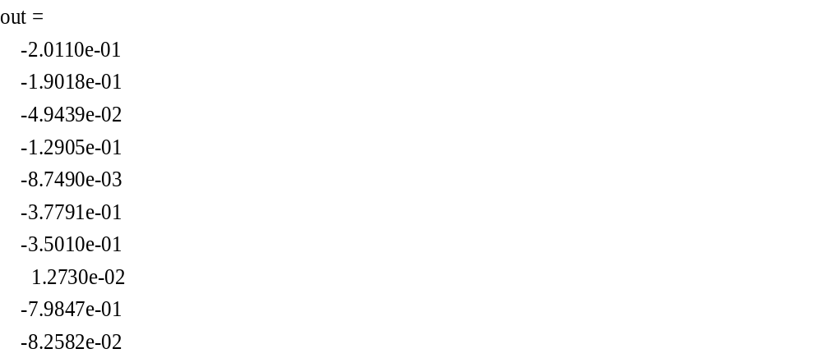
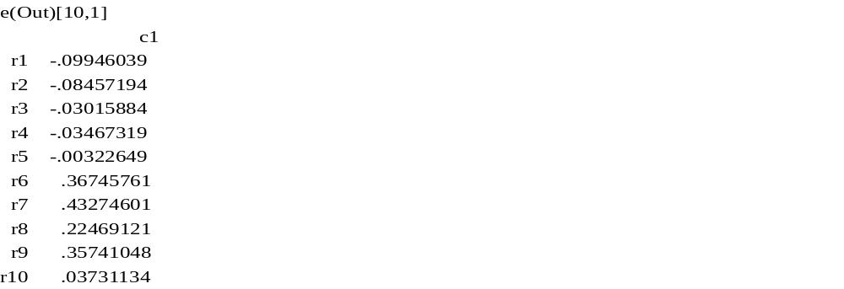
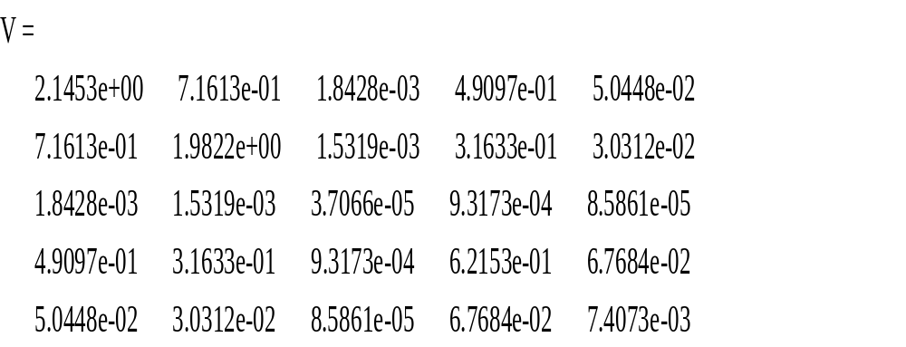
Case 3: tau = 0.3
Stata
Matlab
Nb1 = 8.050617444546775e+00
Dis = 9.697413550202844e+03
Nb1 = .
Dis = .
Missing
symmetric e(Var)[5,5]
c1 c2 c3 c4 c5
r1 .00365348
r2 .00195466 .00390847
r3 -.00005896 -.00004389 1.405e-06
r4 .00147597 .00106849 -.00003388 .00092119
r5 .0001558 .00007281 -3.617e-06 .00009833 .00001233

Slide 5
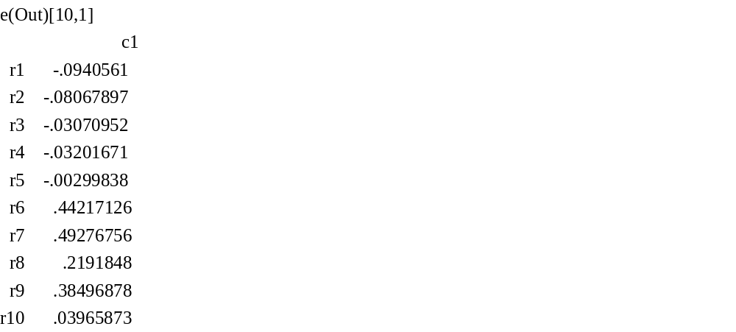
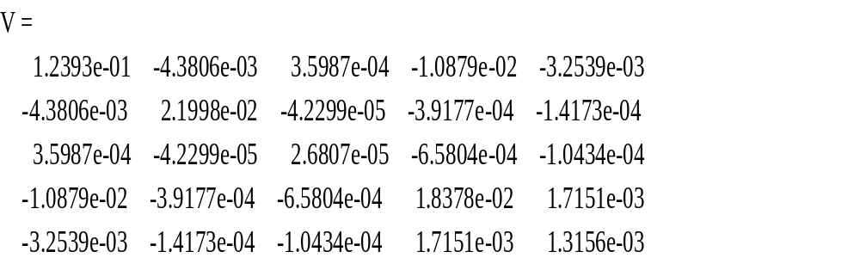
Case 3: tau = 0.35
Stata
Matlab
Nb1 = 7.8831e+00
Dis = 3.1416e+05
Nb1 = .
Dis = 9431496.490384117
out =
-1.2937e-01
-1.0241e-01
-3.7821e-02
1.3111e-01
2.3988e-02
-4.4843e-01
-5.8340e-01
-1.1227e-01
-2.0982e+00
-2.6877e-01
symmetric e(Var)[5,5]
c1 c2 c3 c4 c5
r1 .0034668
r2 .00215797 .00213478
r3 -.00006678 -.00005473 1.749e-06
r4 .00090015 .00043933 -.00001212 .00047935
r5 .000074 .00004062 -1.085e-06 .00004533 4.998e-06
Notes:
e(Out)[10,1]
c1
r1 -.10331619
r2 -.08853776
r3 -.0297908
r4 -.03770761
r5 -.00306394
r6 .36844971
r7 .41274116
r8 .22754467
r9 .34089858
r10 .03920419

Slide 6
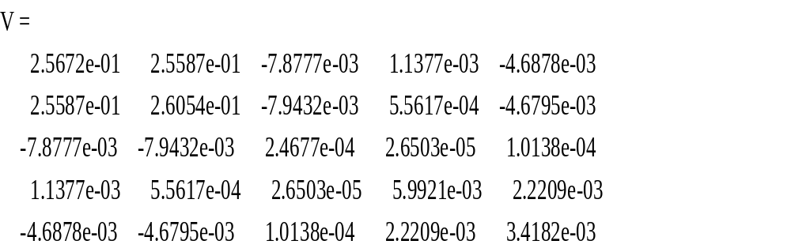
Case 4: tau = 0.4
Stata
Matlab
Nb1 = 11.54430741662729
Dis = 4344826.578941829
Nb1 = 9.0905e+00
Dis = 1.0065e+06
e(Out)[10,1]
c1
r1 -.10331619
r2 -.08853776
r3 -.0297908
r4 -.03770761
r5 -.00306394
r6 .36844971
r7 .41274116
r8 .22754467
r9 .34089858
r10 .03920419
out =
-1.0922e-01
-1.0850e-01
-2.7184e-02
5.1998e-03
9.8619e-03
-5.9918e-01
-5.1930e-01
-2.1822e-01
-8.7175e-01
-1.3747e-01
symmetric e(Var)[5,5]
c1 c2 c3 c4 c5
r1 .00532175
r2 .00329091 .00711359
r3 -.00010631 -.00009609 3.262e-06
r4 .00166176 .00142202 -.00004921 .00110868
r5 .0001192 .00012368 -4.915e-06 .00010673 .00002298

Slide 7
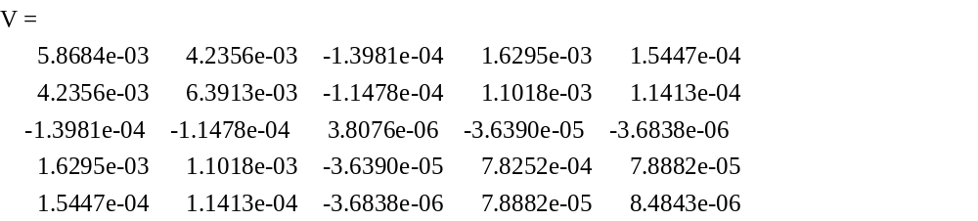
Case 5: tau = 0.6
Stata
Matlab
Nb1 = 12.00719285796652
Dis = 761852.614114482
Nb1 = 1.4139e+01
Dis = 7.8149e+05
out =
-1.0378e-01
-8.7912e-02
-2.9993e-02
-3.6371e-02
-2.8812e-03
-3.6562e-01
-4.1660e-01
-2.2629e-01
-3.4915e-01
-4.0332e-02
e(Out)[10,1]
c1
r1 -.1901248
r2 -.18491487
r3 -.04786225
r4 -.10750409
r5 -.00566711
r6 -.09461098
r7 -.1359381
r8 .04089748
r9 -.09470181
r10 .00430718
symmetric e(Var)[5,5]
c1 c2 c3 c4 c5
r1 1.2466907
r2 .46314295 1.2102341
r3 .00081103 .00068985 .00001014
r4 .27191674 .18484894 .00038031 .46320747
r5 .0252136 .01521742 .00003437 .05005373 .00545033

