Slide 1

666 Wealth Management
Team 666
Wu Xiao Yun
akoonhwee
angkoonhian
kuanwenxuan

Slide 2



Problem Statement
Advise Clients on the benefit of well-balanced portfolio
Investment Tracking Dashboard
Portfolio Rebalancing
Crypto data showcase

Slide 3
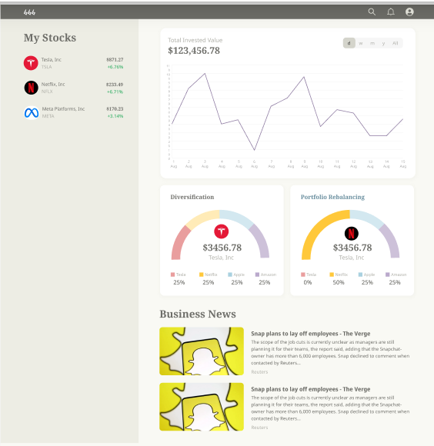
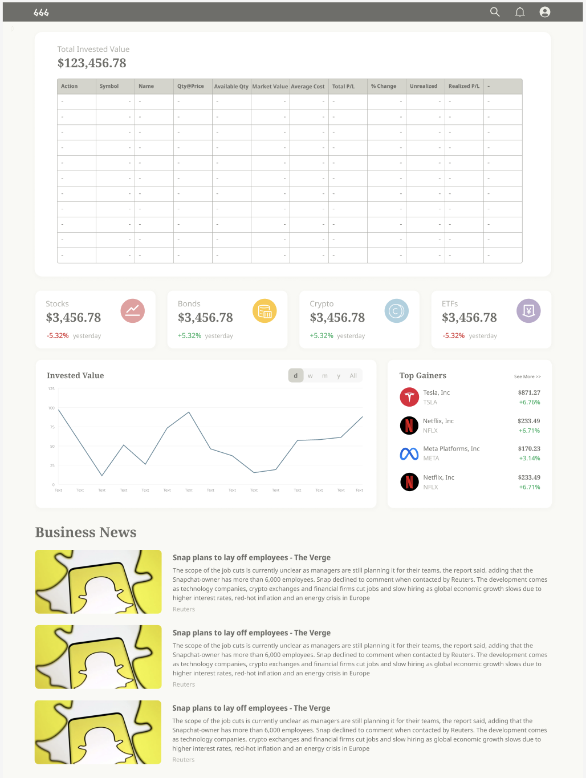
Dashboard
Stock View
Investment performance
Finance related articles
+Live notifications and alerts
+30%time savings
+More time on Valuable
activities

Slide 4
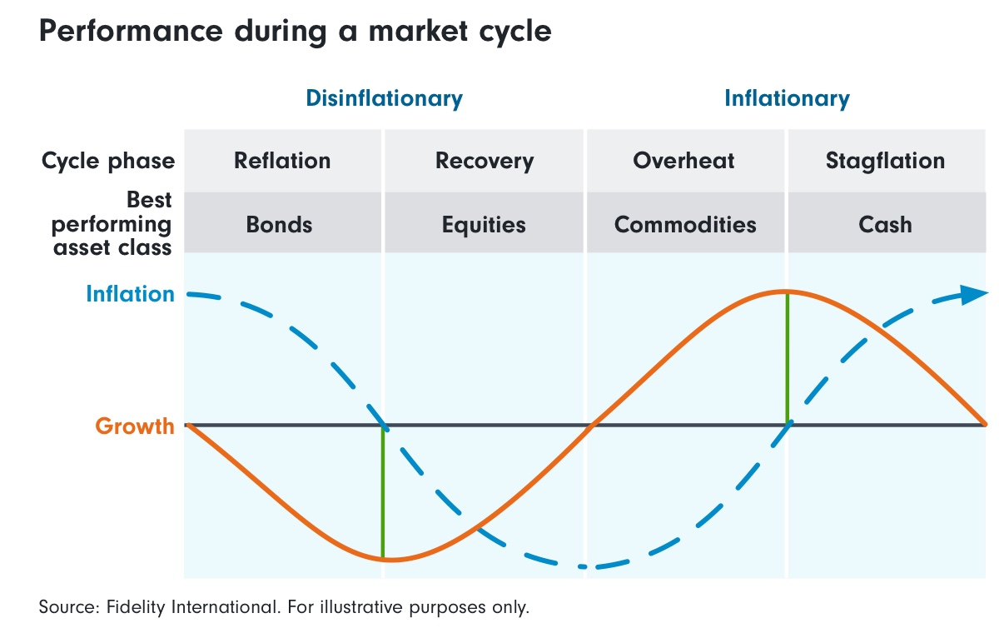
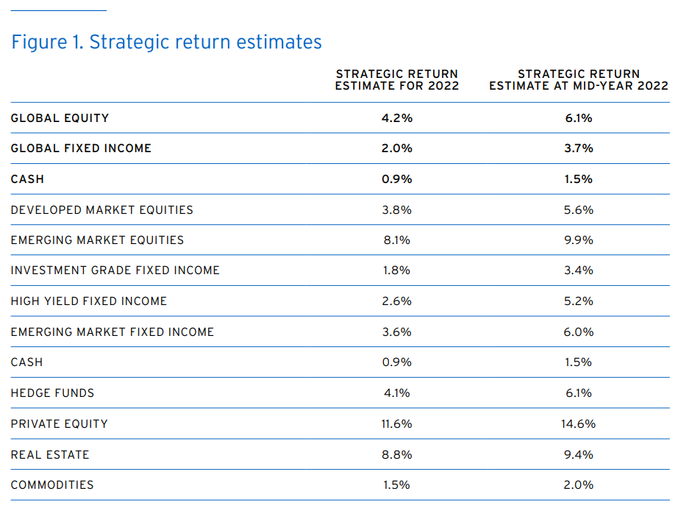
Complicated and unplanned variation throughout investment
Build Quality and Resilient Portfolios
https://www.fidelity.com.sg/beginners/what-is-volatility/balanced-portfolio
https://www.privatebank.citibank.com/outlook
Notes:
Showcase through analysis done by fidelity and citibank that differing types of investment will experience different growth in markets.

Slide 5
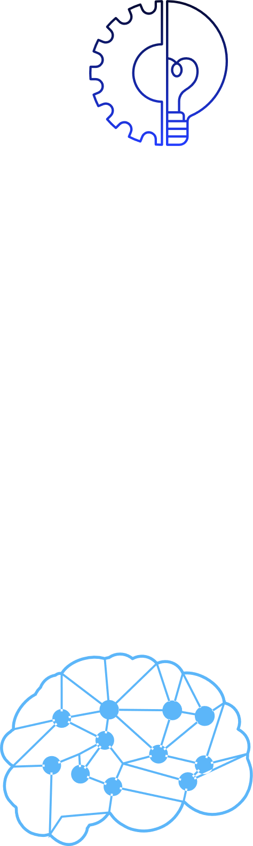
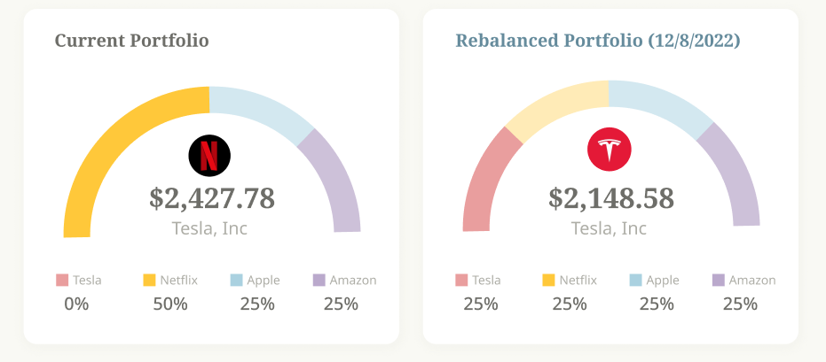
Portfolio Rebalancing & Smart Suggestion
Suggests an optimised portfolio through market analysis
Potential for portfolio improvement

Slide 6
Tech Stack
Frontend: ReactJS, Redux
Backend:Nestjs, REST API, SQL database: PostgreSQL
Portfolio Opt: Python (PyPortfolioOpt)
Notes:
React: most popular Javascript library to simplify frontend UI development. It speeds up frontend rendering with its virtual DOM implementation and rendering optimisations
Redux: state management

Slide 7
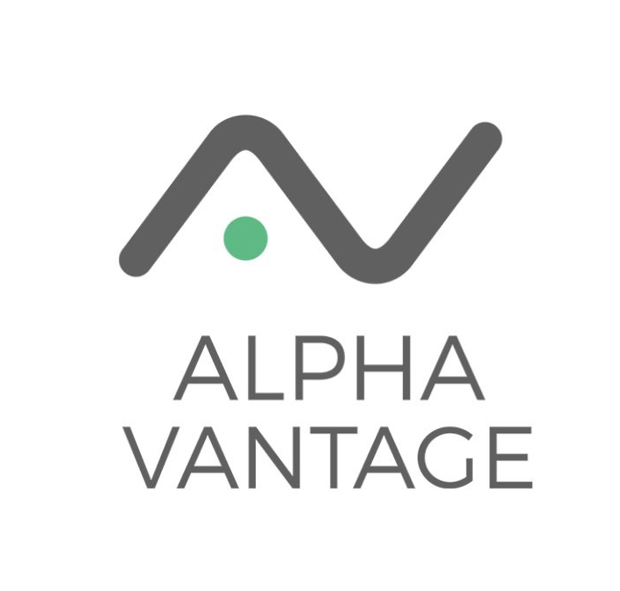
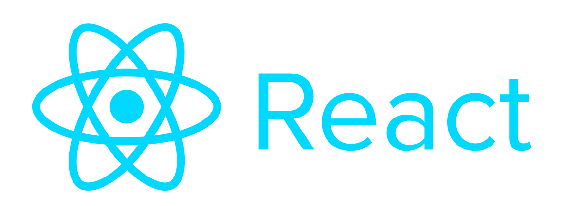

Tech Stack
Frontend: ReactJS, News API, Alpha Vantage, recharts, Yahoo Finance
Backend: Nestjs, mongoDB atlas
Portfolio Opt: Python (PyPortfolioOpt)
Frontend
Notes:
Chose to develop web application

Slide 8
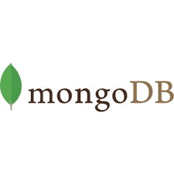
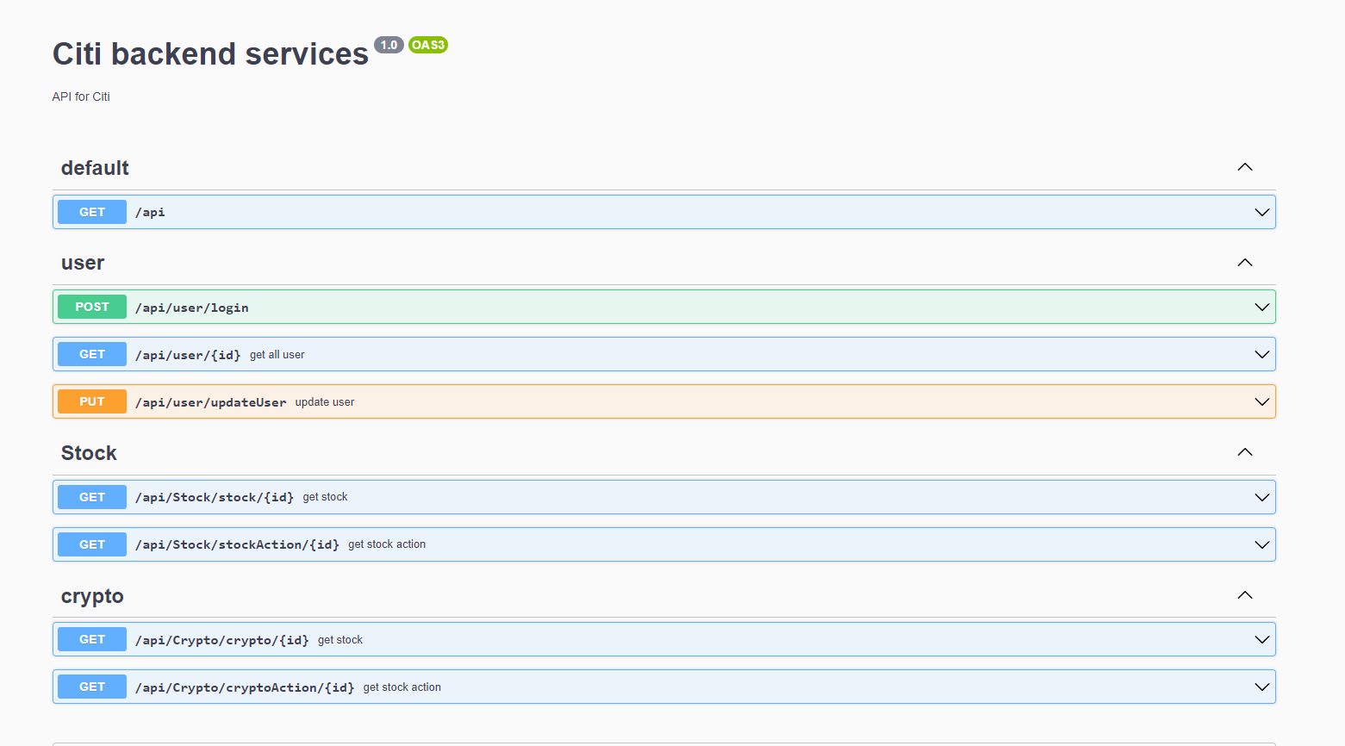

Tech Stack
Frontend: ReactJS
Backend: nestjs, mongoDB atlas
Portfolio Opt: Python (PyPortfolioOpt)
Backend

Slide 9
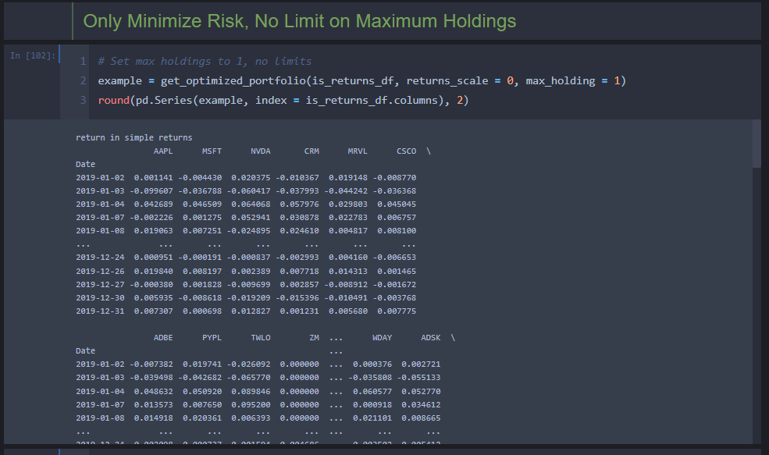
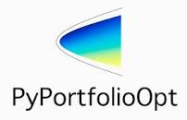
Tech Stack
Frontend: ReactJS
Backend: nestjs, mongoDB atlas
Portfolio Opt: Python (PyPortfolioOpt)
Portfolio Opt

Slide 10
Q & A
Q & A
Advise Clients on the benefit of well-balanced portfolio
Investment Tracking Dashboard
Portfolio Rebalancing
Crypto data showcase

Slide 11
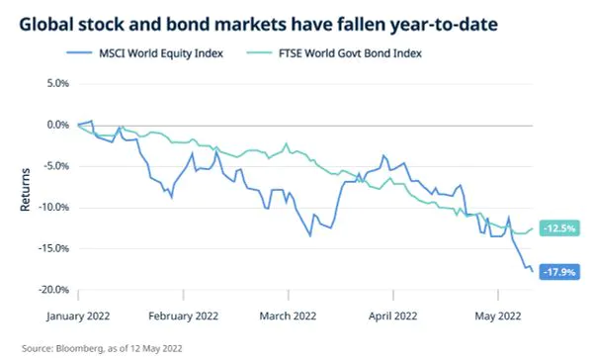
Q & A
Q & A
https://www.stashaway.sg/r/big-picture-look-2022-market-volatility

