Slide 1

Crop Yield Prediction Using Machine Learning
Under the Guidance of :-
Dr . Bajrang Bansal
Presented by :-
Shubham Soni - 9916102118
Naman Sahni - 9916102170
Swapnil Srivastav - 9916102200

Slide 2
OUR AIM
Wheat is one of the key cereal crops grown worldwide, providing the primary caloric and nutritional source for millions of people around the world.
In order to ensure food security and sound, actionable mitigation strategies and policies for management of food shortages, timely and accurate estimates of global crop production are essential.
Machine learning techniques can be used to improve prediction of crop yield under different climatic scenarios.
We aim to use machine learning techniques to predict crop yields (wheat) by using important features for the development of crop such as temperature, rainfall and other attributes which are important for prediction.

Slide 3
MACHINE LEARNING
Machine Learning is a core sub-area of Artificial Intelligence (AI) that uses statistical techniques to give computer system the ability to “learn” with data, without being explicitly programmed.
The process of learning begins with observations or data, such as examples, direct experience, or instruction, in order to look for patterns in data and make better decisions in the future based on the examples that we provide. The primary aim is to allow the computers learn automatically without human intervention or assistance and adjust actions accordingly.
3

Slide 4

PLATFORM USED
The Jupyter Notebook is an open-source web application that allows you to create and share documents that contain live code, equations, visualizations and explanatory text. It is used for data cleaning and transformation, numerical simulation, statistical modelling, machine learning and much more.

Slide 5
CROP YIELD PREDICTION
INTRODUCTION
Crop yield forecasting or prediction is an art of predicting crop yield and production before the harvest actually takes place, typically a couple of months in advance.
Crop yield forecasting relies on computer programs that describe the plant-environment interactions in quantitative terms^{[1]}.
Predicting crop yield well in advance prior to its harvest can help the farmer and government to make appropriate planning like storing, selling, fixing minimum support price, importing/exporting etc.
5

Slide 6
FLOWCHART
START
APPLY SUPERVISED LEARNING ALGORITHMS (Regression)
UNDERSTAND AND ANALYSE THE DATASET
SHOW THE ACCURACY
OF PREDICTIONS
DATA PREPROCESSING
(DATA CLEANING AND DATA EXPLORATION)
COMPARE THE MODELS BASED ON THE ACCURACIES
OBTAINED
CREATE TRAINING SET AND TESTING SET
STOP
CHECKING DATASET FOR MULTIPLE
MACHINE LEARNING ALGORITHMS
6

Slide 7
DATA PREPOCESSING
Data pre-processing is a data mining technique that involves transforming raw data into an understandable format.
In real world, data is generally:-
Incomplete : lacking attribute values, lacking certain attributes of interest, or containing only aggregate data.
Noisy : containing errors.
Inconsistent : containing discrepancies in codes or names.
Data pre-processing is a proven method of resolving such issues^{[3]}.

Slide 8
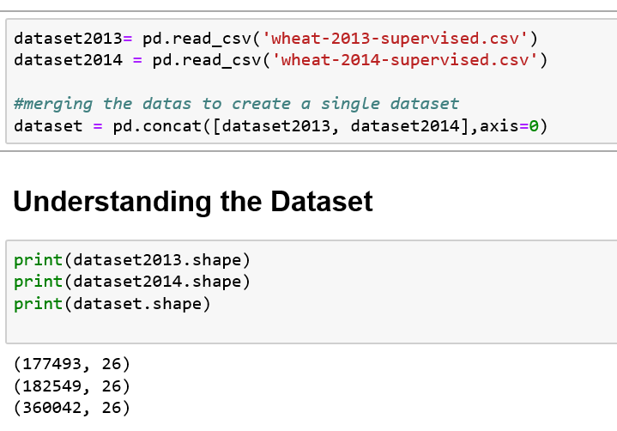
Understanding the dataset
We obtained data of wheat crop for 2 years, 2013 and 2014, of major American districts ^{[2]}.
We merged the two datasets into a single dataset, to get a larger number of data for better prediction.

Slide 9
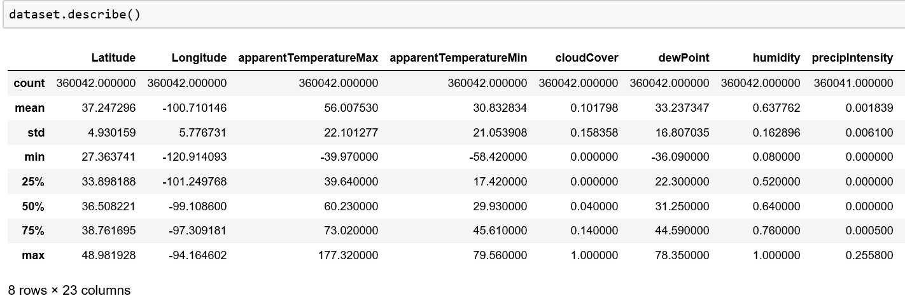
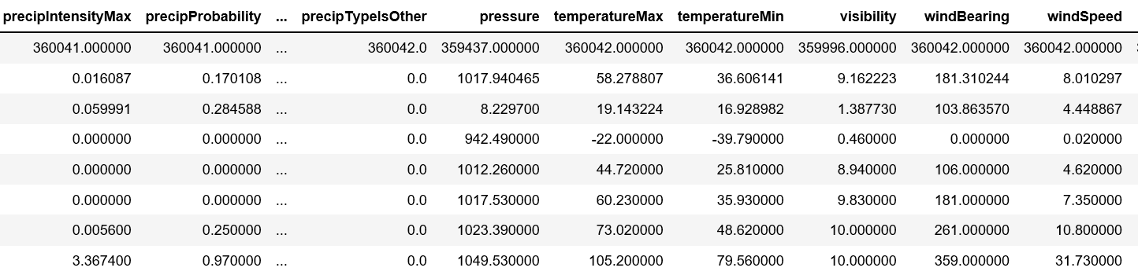
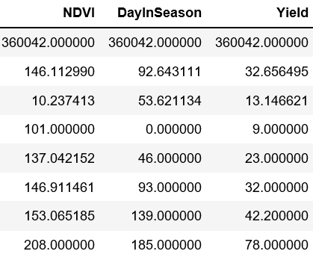
Describing the Dataset

Slide 10
Steps in Data Pre-processing
Step 1 : Import the necessary libraries.
Step 2 : Import the data-sets.
Step 3 : Remove unnecessary columns that do not contribute to the prediction.
Step 4: Check out the missing values and drop the rows having missing values.
Step 5 : Split the data into train set and test set.
Step 6 : Feature Scaling (Normalization of data)
Step 7 : Converting the features to float value for processing.

Slide 11



REGRESSION TECHNIQUES USED
Polynomial Regression
Polynomial regression is a form of regression analysis in which the relationship between the independent variable x and the dependent variable y is modelled as an nth degree polynomial in x.
$$Y=θ_{0}+θ_{1}\text{x}+θ_{2}x^{2}+…$$
where;
Y = dependent variable
$θ_{n}$= slope coefficients
*x_{n} = independent variable
$θ_{0}$= slope constant
11

Slide 12
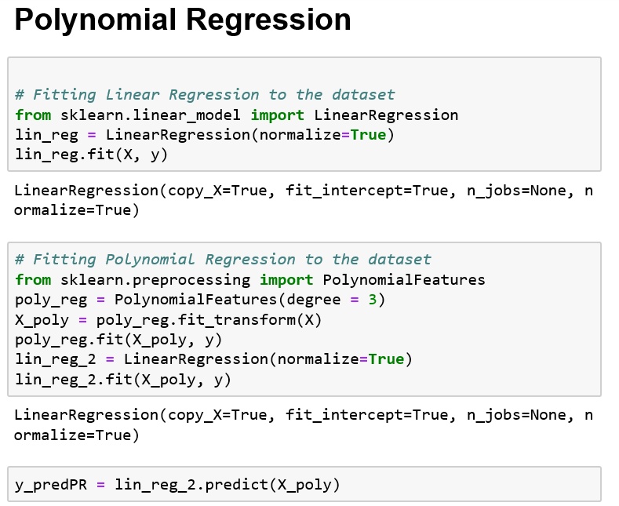
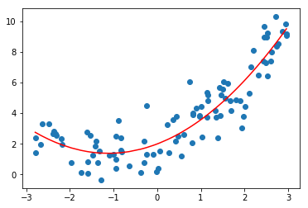
Dependent variable
independent variables.
Fig. 1 Polynomial Regression plot^{[3]}
Polynomial Regression Implementation

Slide 13
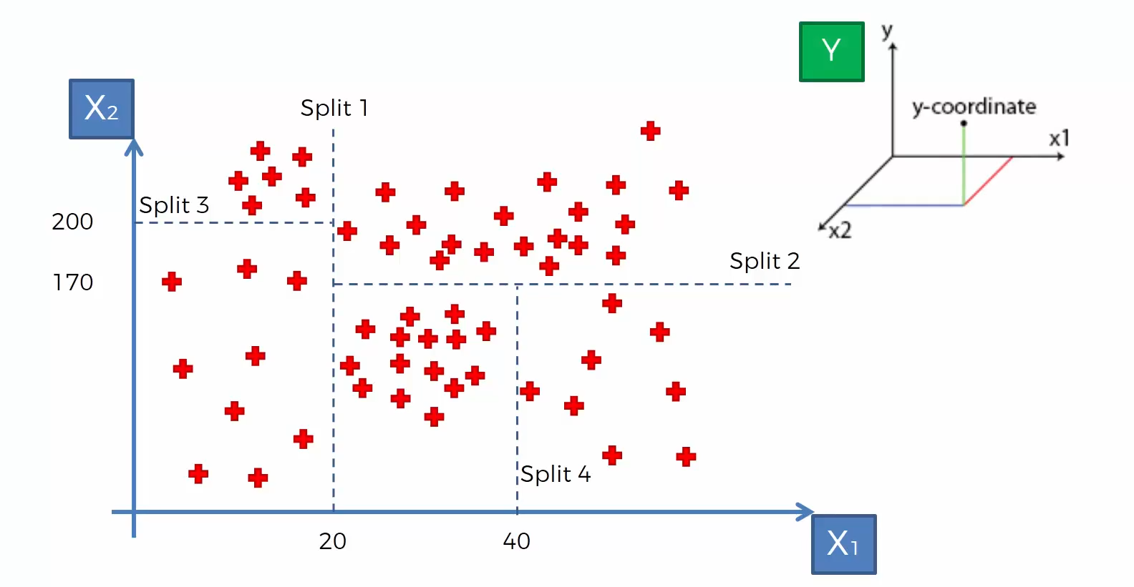
Decision Tree Regression
A decision tree is a decision support tool that uses a tree-like graph or model of decisions and their possible consequences, including chance event outcomes, resource costs, and utility. It is one way to display an algorithm that only contains conditional control statements.
Unlike linear models, they map non-linear relationships quite well.
Fig. 2 Graph representing a Decision Tree^{[4]}

Slide 14
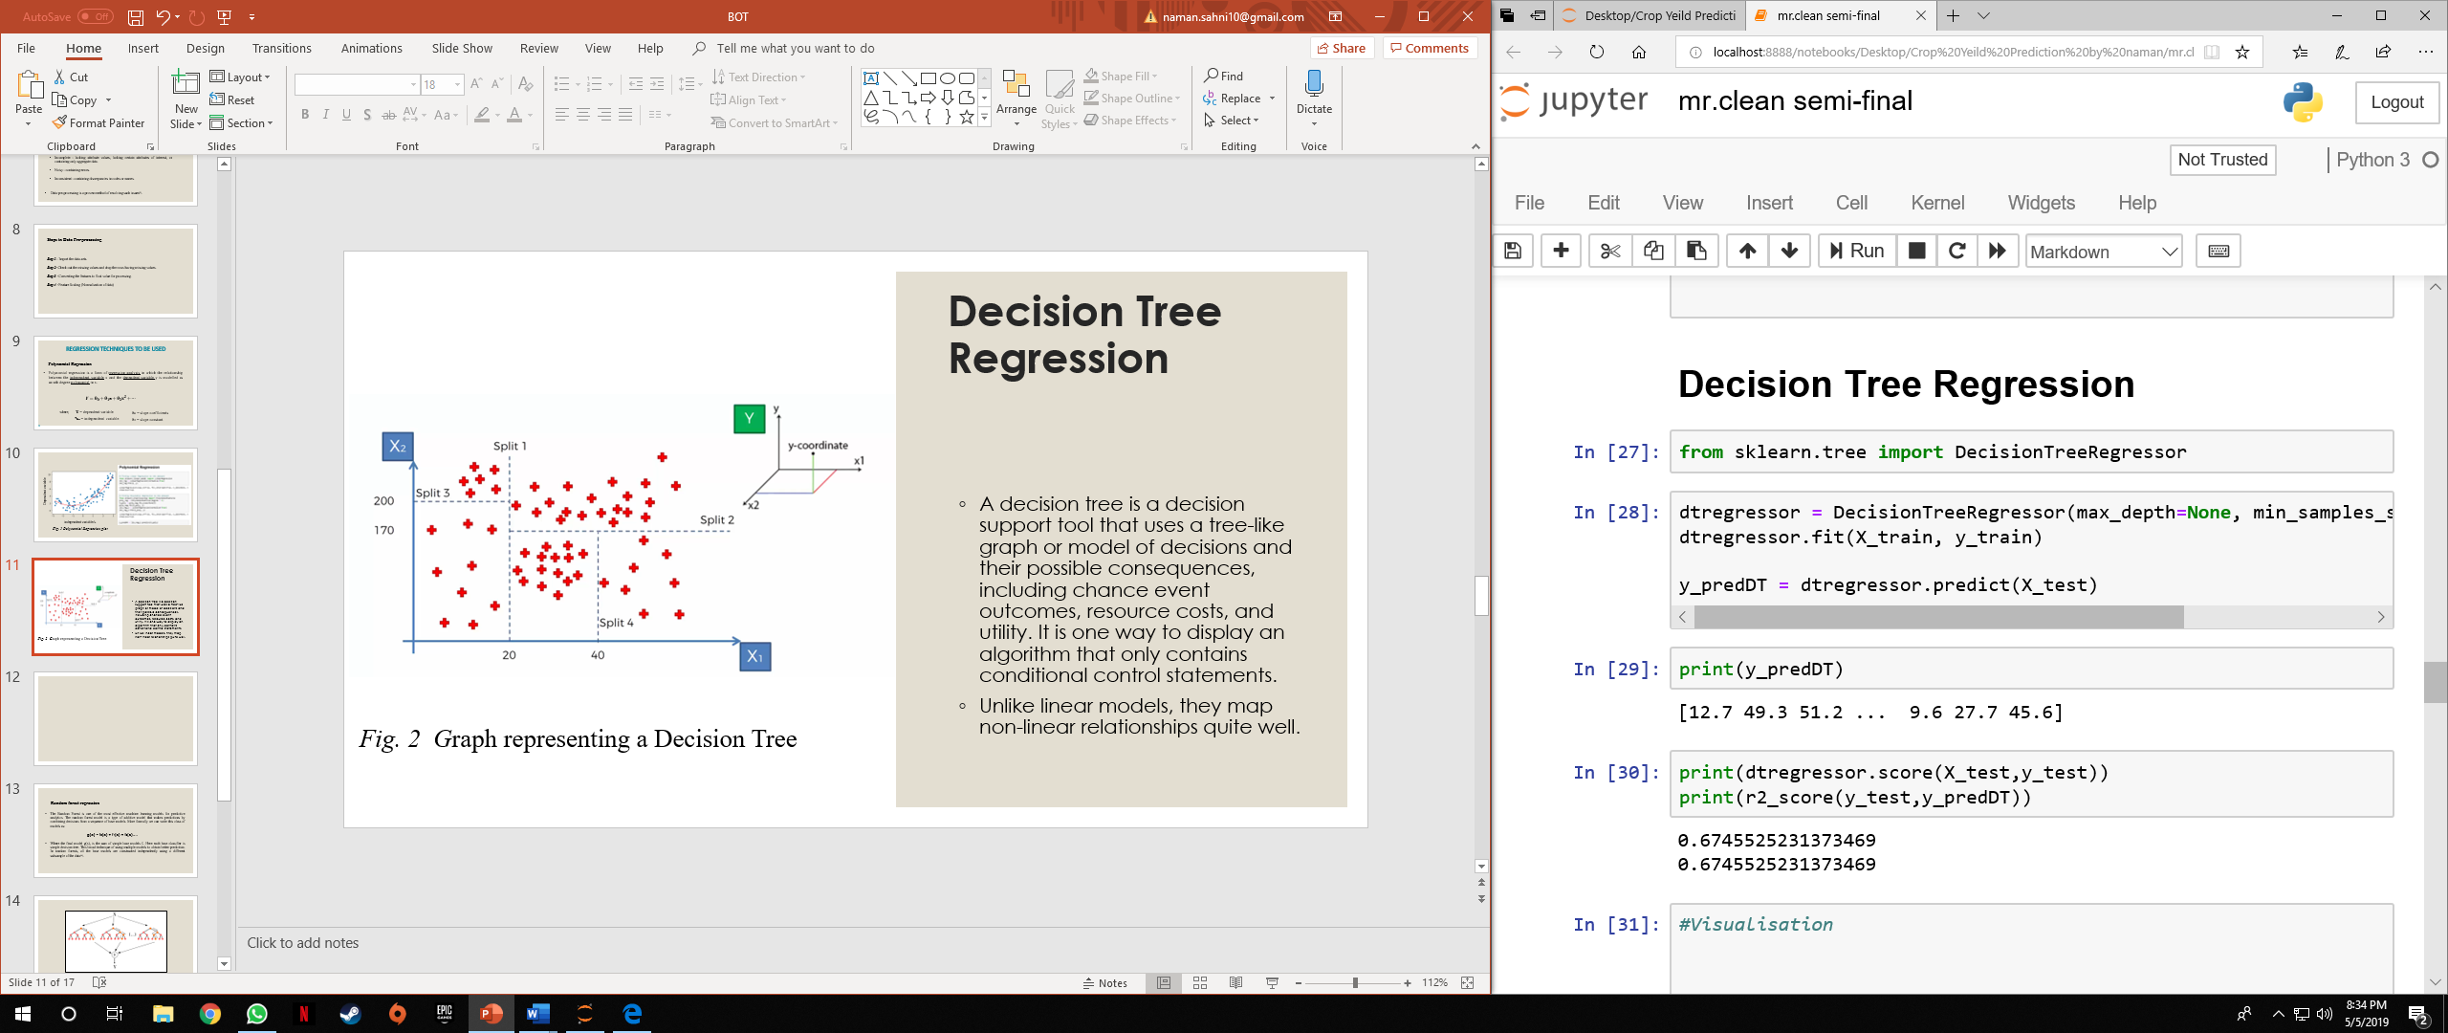
Decision Tree Implementation

Slide 15
Random forest regression
The Random Forest is one of the most effective machine learning models for predictive analytics. The random forest model is a type of additive model that makes predictions by combining decisions from a sequence of base models. More formally we can write this class of models as:
g(x) = f₀(x) + f₁(x) + f₂(x)….
Where the final model g(x), is the sum of simple base models f_{i}. Here each base classifier is simple decision tree. This broad technique of using multiple models to obtain better prediction. In random forests, all the base models are constructed independently using a different subsample of the data^{[4]}.

Slide 16
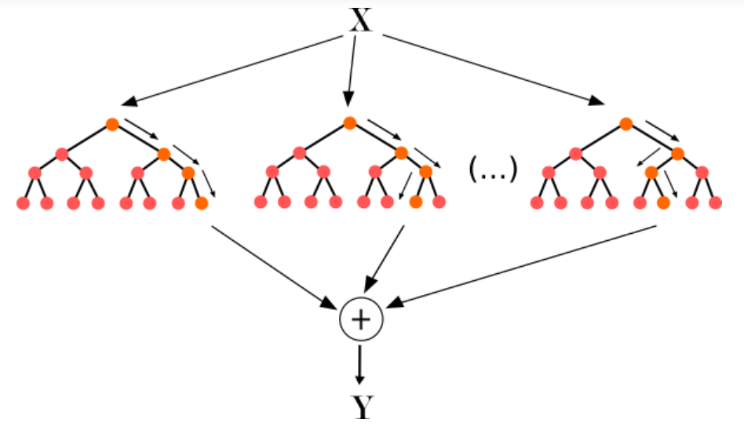
Fig. 3 Random Forest Representation^{[5]}

Slide 17
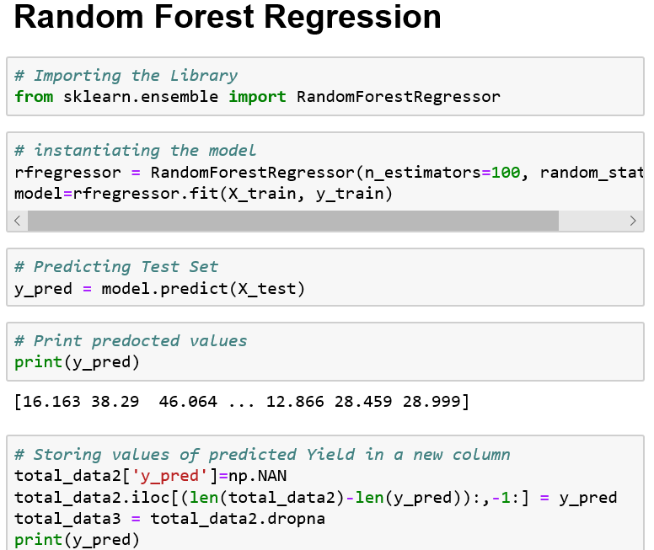
Random Forest Implementation

Slide 18
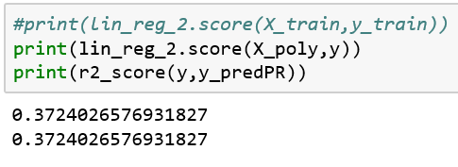
RESULTS
After successful training and the testing of dataset we moved further for finding the accuracy the model. The accuracy of the model shows that how we have predicted the yield of the crop in compare to original data the more the accuracy of the model the it is near to the original yield value.
Polynomial Regression Model : 37.24%
We can infer from the polynomial regression accuracy that the yield is not much linearly or polynomially dependent on the observed parameters, so we needed to use better suited algorithms for our data.

Slide 19
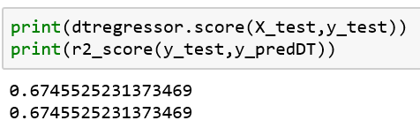
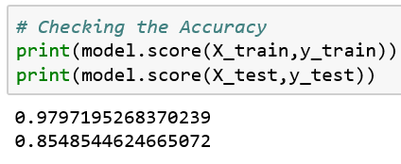
Decision Trees Model : 67.45%
By fitting our model using Decision Trees, we were able to significantly improve the accuracy obtained for predicting crop yield. However, there still was some scope of improvement.
Random Forest Model : 85.48%
By fitting our model using Random Forest, we achieved an accuracy of ~85.5%, which is ideal for predicting crop yield.

Slide 20
CONCLUSION
This project presents a Machine learning framework for the task of crop yield prediction.
It allows for real time forecasting throughout the year and is applicable world-wide, especially for developing countries where field surveys are hard to conduct.
We developed models to predict wheat yield and examined a variety of confounding factors that affect model performance.
The model provides us with the state-of-the-art prediction accuracy and will have great impact in sustainable agriculture and food security.

Slide 21
FUTURE SCOPE
Some of the future scopes that can be included in our project are:
1. A web-based application that can be made for our work in future.
2. We can improve our system that can deal with dataset with similar correlation.
3. We can work on deep learning methods to improve our model.

Slide 22
REFERENCES
[1] Ramesh A. Medar,Vijay S. Rajpurohit, “A survey on Regression Techniques for crop yield prediction”, International Journal of Advance Research in Computer Science and Management Studies.Volume 2 , Issue 9, Sept 2014.
[2] https://aerialintel.blob.core.windows.net/recruiting/datasets/wheat-2013-supervised.csv
[3] D Ramesh , B Vishnu Vardhan, “Data mining technique and applications to agriculture yield data”, International Journal of Advanced Research in Computer and Communication Engineering Vol. 2, Issue 9, September 2013 .
[4] P.muthaiah, Dr.S.Jyothi, “Predicting yield of crop using Machine Learning Algorithms”, IJCSNS International Journal of Computer Science and Network Security, VOL.9 No.8, August 2009
[5] Kuwata, K. and Shibasaki, R. (2015), Estimating crop yields with deep learning and remotely sensed data, Proceedings of 2015 IEEE International Geoscience and Remote Sensing Symposium, 26-31 July, Milan, Italy, pp. 858-861.

