Slide 1
Predict Machine Failure Using Sensor Data
Kaggle case study: https://www.kaggle.com/nphantawee/pump-sensor-data
Xiaxia Xu
xiaxia.xu@outlook.com
Hamburg, 21.10. 2021

Slide 2
Agenda
Problem overview
Project goal
Platform and main libraries
Exploratory analysis
Machine learning strategy
Conclusion
1
2
3
CONTENTS
4
5
6

Slide 3
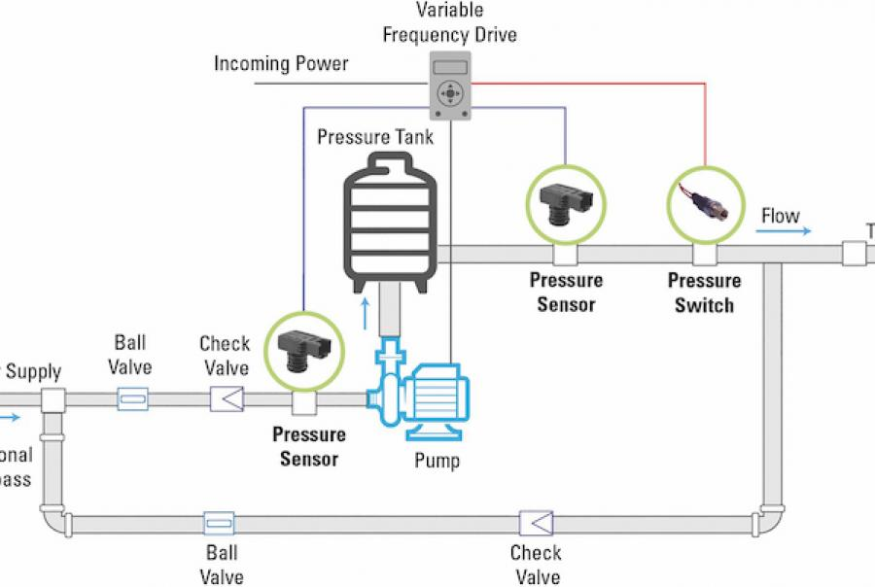
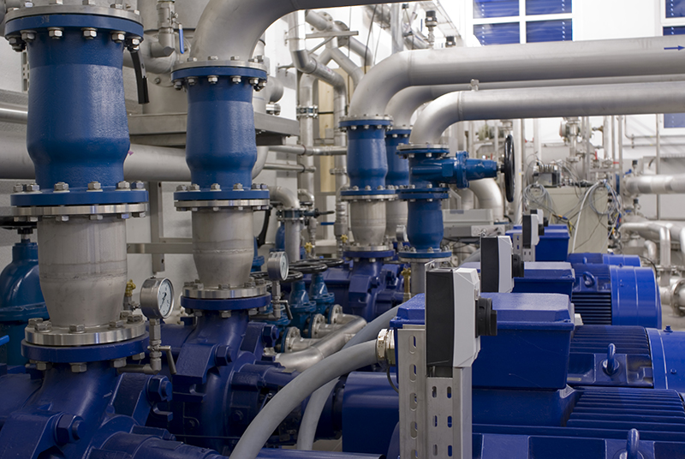
Problem overview
A water supply company faced a serious machine failure problem.
Sensors:
pressure, temperature, humidity, etc.
https://constructionreviewonline.com/top-companies/top-water-pumps-manufacturers-in-the-world/
https://www.wqpmag.com/commercial-water/how-variable-speed-pumps-pressure-sensors-can-improve-water-systems

Slide 4

Problem overview
Can these sensor data be used to gain valuable insights?
Can we predict the machine failure using sensor data?

Slide 5

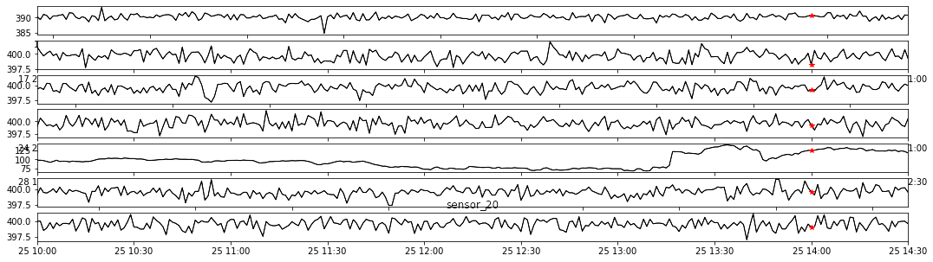
Build a machine learning model to predict the machine failure in advance.
Project goal
predict
machine failure

Slide 6
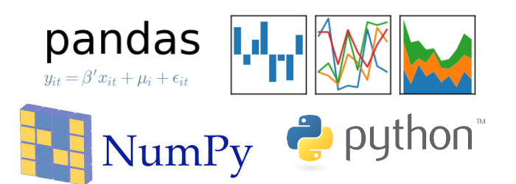






Platform and main libraries
Google colab with Jupyter notebook
Python3
Numpy
Pandas
Matplotlib.pyplot
Plotly
Scikit-learn
Tensorflow

Slide 7
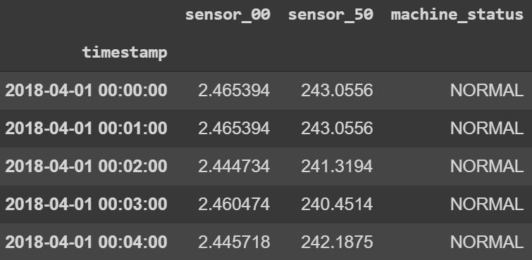
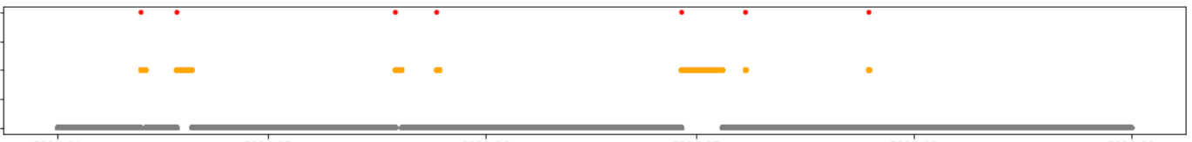
Exploratory analysis
... ...
a column named timestamp
every 1 min, no missing timestamps
51 columns of sensor data
no meaning, no unit
a column of machine status
normal, broken, recovering
Data
220320 timestamps from 2018-04-01 to 2018-08-31;
7 machine failure events in 5 months;
About 34.45h (mean) to recover after one failure;
failure
recovering
normal
2018-04
2018-05
2018-06
2018-07
2018-08
2018-09
Notes:
I will first show you some exploratory analysis …

Slide 8
Exploratory analysis
The null values during the recovering time is not important.
The null values not during the recovering time, need to fill (pd. interpolate with backward method).
The range of sensors varies greatly.
Some sensors are similar to each other.
* Failure

Slide 9
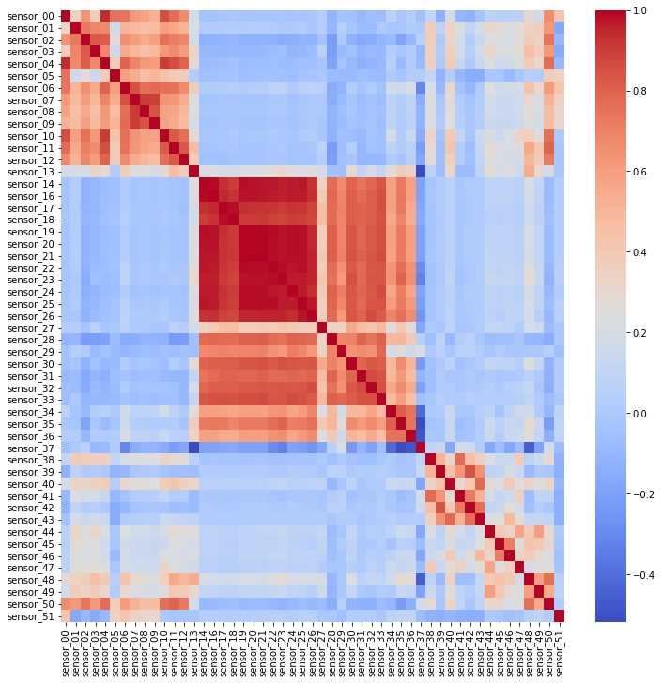
Heatmap of correlations between sensors
Exploratory analysis
Many sensors are highly correlated!
For ML, this will be a problem. Principal component analysis (PCA) is required for dimensionality reduction.

Slide 10
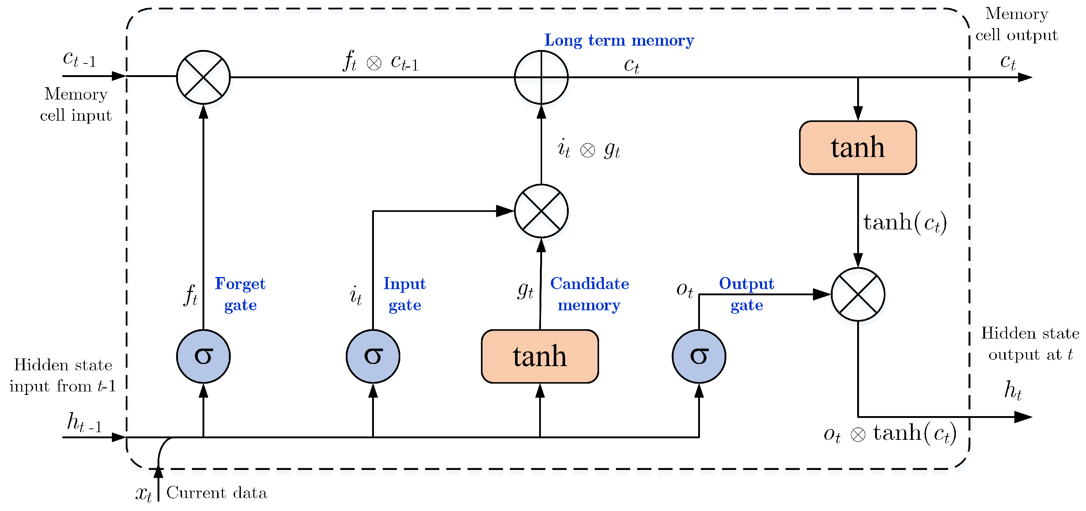
Machine learning strategy
Long short term memory model (LSTM)
automatically learn the temporal dependencies present in time series;
adapt directly to the data without any prior assumptions;
LSTM neuron
Mekruksavanich et. al., Sensor (2021)

Slide 11
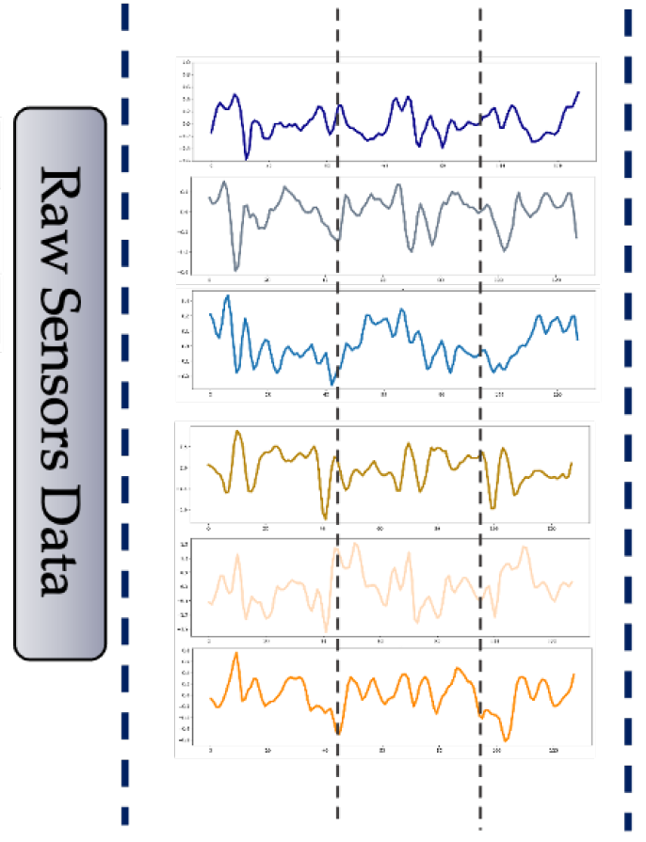


Proposed Methodology Framework
Machine learning strategy
Machine learning strategy
Change the problem to a time series supervised learning classification problem.
Preprocessing
Model
Classification
LSTM
Alarm
LSTM
Input
Dense
Output
LSTM
No alarm
LSTM

Slide 12
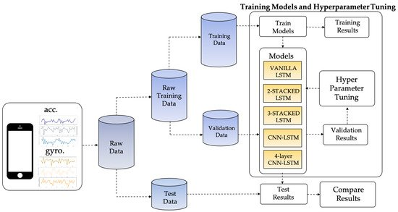
Machine learning strategy
Preprocessing
Train model
Training dataset
Training samples
Standardize
Hyper
parameter
tunning
Train model
PCA
Segmentation
20 data points
Validationdataset
Validationsamples
Raw dataset
LSTMs
Validation results
Test
dataset
Test
samples
Trained LSTMs
Predict alarm

Slide 13
Machine learning strategy
Step1: Label the data
I assume that the engineers need at least 5 minutes for operation if there is a failure.
Alarm window (red)
Normal window (green)
12h-5min ahead
alarm window
96h-12h ahead, normal window
failure time
Objective
not too many false alarms
give alarms

Slide 14
Machine learning strategy
Step2: separate train, validation, test data set.
test (failure1)
Train (failure 3-7)
validation (failure2)
Step3: standardization and PCA.
Step4: segmentation of time series (length of the sequence is 20)
96h
12h
5min
len=20, shift=5
4828 (58%, normal states)
len=20, shift=1
3483 (42%, alarm states)
Train
60h
Validation
Test
len=20, shift=1
len=20, shift=1
Notes:
If show the client, this slide I will not explain.

Slide 15
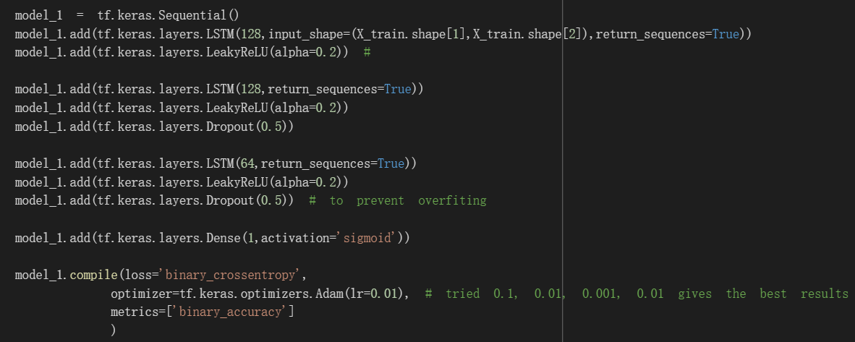
Machine learning strategy
Step5: build the model.
Hyper parameters:
* 3 layers of LSTM.
* 128, 128, ,64 units in each LSTM layer.
* Slope for Leaky ReLU is set at 0.2.
* A dropout rate = 0.5 is set to avoid overfitting. * Activation function of the output layer is set to 'sigmoid’.

Slide 16
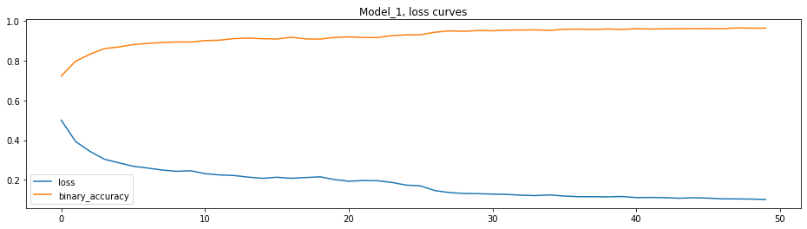
Machine learning strategy
Step6: train the model.
Training samples 8311= 4828 (58%, normal states) + 3483 (42%, alarm states)
The loss and accuracy curves during training
binary_accuracy: 0.9639
loss: 0.1017
epochs
During training, the loss of the learning curve decreases while the accuracy increases.

Slide 17
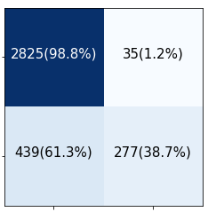
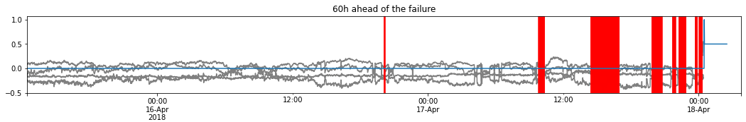
The model performs well on test data set.
Machine learning strategy
Step7: evaluate the model.
The model can make 277 alarms within the alarm window (23 alarms/h), This is enough to inform the engineer to check whether there is a problem.
The model does not give too many false alarms. This is good, the engineer does not need to do unnecessary checking.
normal
True
alarm
normal
alarm
Predict

Slide 18
Conclusions
The proposed LSTM model is suitable to predict the machine failure at least 5 mins before the failure.
Almost 40 % of the alarm windows were detected, which is sufficient for the problem.
The false-positive rate is low and the few false-positives might be caused by the labelling. As the labeling is not the ground truth.
Benefits for the company:
Implementation of this model gives the company the opportunity to notice the problem ahead of the machine failure (rather than “fix when fail” approach).
The presented model does not require expert knowledge of the sensors.
Improvement ideas:
Can the model predict even longer ahead of the failure?
However, the current case study just have 4 failures with longer than 96h normal states ahead of the failure.
The current model will have problems even one sensor fails.
Given that many sensors are highly correlated, one of the possibilities for optimizing the model may be group sensors into several groups based on the correlation and the domain knowledge of the sensor data. Then select one sensor from each group to train the model. If one sensor fails, choose another one from its group.

Slide 19
Thanks for your attention!

