Slide 1
Finding Fraudsters
Using focused outlier detection to guide investigation of scientific fraud

Slide 2
The problem
How to detect fraud

Slide 3
The complication: incentives
“When a measure becomes a target,
it ceases to be a good measure”
– Goodrich
Metrics for showing academic excellence become a target
Metrics can be improved by attacking the publication process

Slide 4
Assumption
Reasons for outliers:
  Scientific excellence
  Fraud
  ...other(?)
We do not distinguish between these

Slide 5
Current approaches
Attack Defense
  Plagiarism → Ithenticate
  Manipulation of images → ORI’s Forensic Droplets
  Manipulation / fabrication
  of data →Individual investigators
  Manipulating metrics →no structural effort

Slide 6
Weakness current approach
Certain attacks remains undetectable:
  Reviewing own work (e.g. Moon)
  Forcing to cite work (no publicly known examples)

Slide 7
A generic approach fails
[Tielenburg17]: a generic approach
  Outlier detection: manually devised heuristics
  Dataset: DBLP + some info from Google Scholar
No success:
  Some heuristics trigger for some candidates…
  ...but combining heuristics → still not an outlier

Slide 8
What went wrong?
Comparing to entire group
  Someone may be an outlier within a subgroup...
    e.g., editor publishing frequently in own journal
  ...but not within the entire group
    Non-editors also target journal; other editors restrain themselves
Not enough data for specific attacks
  E.g., review turn-around time missing
  E.g., reviewer/editor names not available
  E.g., venues that cite paper

Slide 9
Outliers that smell of fraud
Significantly more citations from own journal than other editors
Significantly more papers than other PC members at venue
Significantly less publication lag than other papers
… etc

Slide 10

Lightbulb

Slide 11
New approach
Outlier detection, but in groups
  Case studies:
    PC members
      publishing in their venue
      Cited by their venue
    Editors (ACM)
      #Coauthors outside journal vs #coauthors inside
      Distributie #coauteur+papercount
      ...etc
Groups not readily identifiable Enrich data model
  Get public data from other sources
  Case studies:
    Elsevier: publication lag
    Springer: PC membership

Slide 12
Our research
Base: datamodel of JM17
  Roughly captured by DBLP
Extend this datamodel
  PC members
  Review times
  … etc.
Acquisition of data to fill this datamodel
  Springer LNCS (PC members)
  OpenCitations (citations)
  Elsevier journals (publication lag)
  ACM (editors)
Zoom in on specific groups (people / articles)
  PC members
  Editors
  Low publication lag
Apply outlier detection on these groups
  Identify cases for manual investigation
Manual validation
Data acquisition per use case?
JA!!!

Slide 13
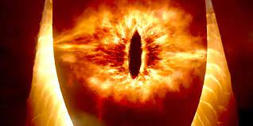
Ideal situation
Data model
One datasource to rule them all

Slide 14
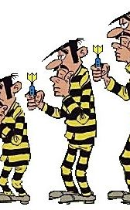



reality
Data model

Slide 15
Data integration: Theory vs practice
Integration of datasources are not straight forward
Unique identification of people is tough
  Orcid exists; but
    Same person has multiple orcid
    Not all source have an complete set of orcid
  More people with same name
  DBLP acknowledge this problem, working on solution, but we found examples the solution is not working (father publishes with son)
Same with articles:
  DOI should be unique (we found a few examples where this is not the case.
  Not all sources contain DOI

Slide 16
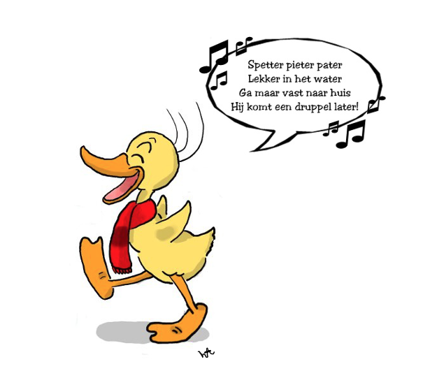
Data integration
Alfred Jodocus Kwak
Alfred J Kwak
A J Kwak
Alfred Kwak
A Kwak

Slide 17
Case study #1
Springer LNCS:
PC members vs. articles
(in their conf)

Slide 18

Case 1: Springer LNCS PC members
With great power comes great responsibility
- Uncle Ben (Spiderman)
(also: McKinley, Churchill, Roosevelt)

Slide 19
Motivation
Use case → LNCS
PC Members are in a position with power
  Power of this group indicated with NIPS experiment
  Decision who gets published, implicit who succeeds
Possible to exploit this power
Metrics from this group:
  # publications in own conference (risk: self-approved publishing)
  # publications that cites work of the PC member (risk: forced citing)

Slide 20
Data acquisition
Use case → LNCS
Source | goal | method
CORE | Determine top conferences | Webscraping
DBLP | doi of proceedings of top conferences | API
Springer LNCS | proceedings, articles and authors | Webscraping
Front matter | Extract PC Members | PDF download *
OpenCitations | citations | Download
* Interpretation and parsing explained in next slides

Slide 21
Extract data from PDF
Hoe krijg je de data van Springer LNCS in je datamodel?
  Scrape front matter
  Parse front matter
  Insert data into DB

Slide 22
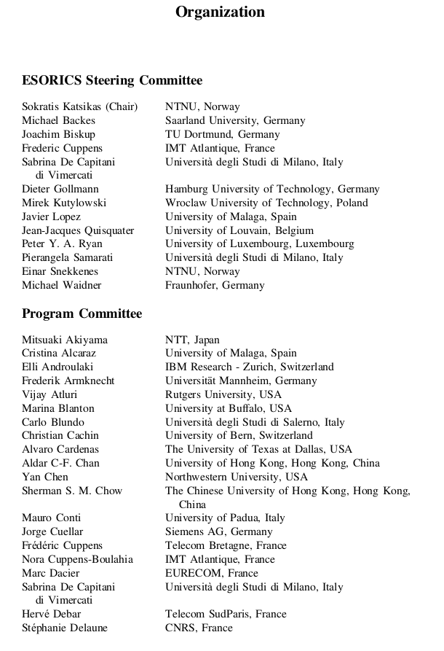
Use case → LNCS → Data acquisition
Front matter example
(ESORICS 2019 front matter)
Steering committee
PC members
Additional reviewers (next page)

Slide 23
Model
Use case → LNCS
Focus: People with a relationship to the conference in the role of PC Member
Conference
Proceeding
People
Article
referentie

Slide 24
Model
Use case → LNCS
PC member publicing in own proceeding
Conference
Proceeding
People
Article
referentie

Slide 25
Front matter
Use case → LNCS → Data acquisition
Challenge:
  PDF Meant for humans to read, not for systems
  No standard used Different layouts of presenting PC Members
Solution:
  Custom software to interpret the PDF’s
  Focus on extensibility
  Iterative improvement of the software

Slide 26
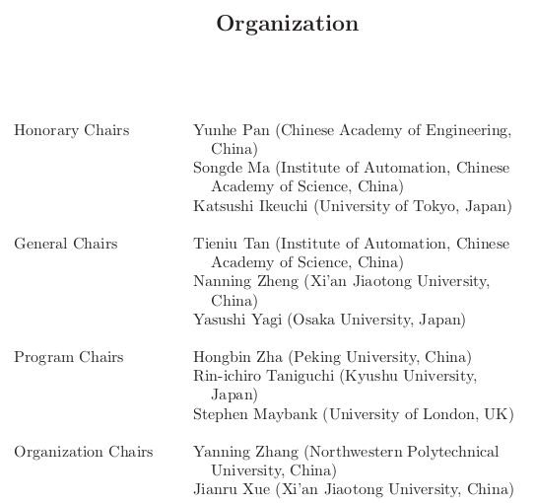
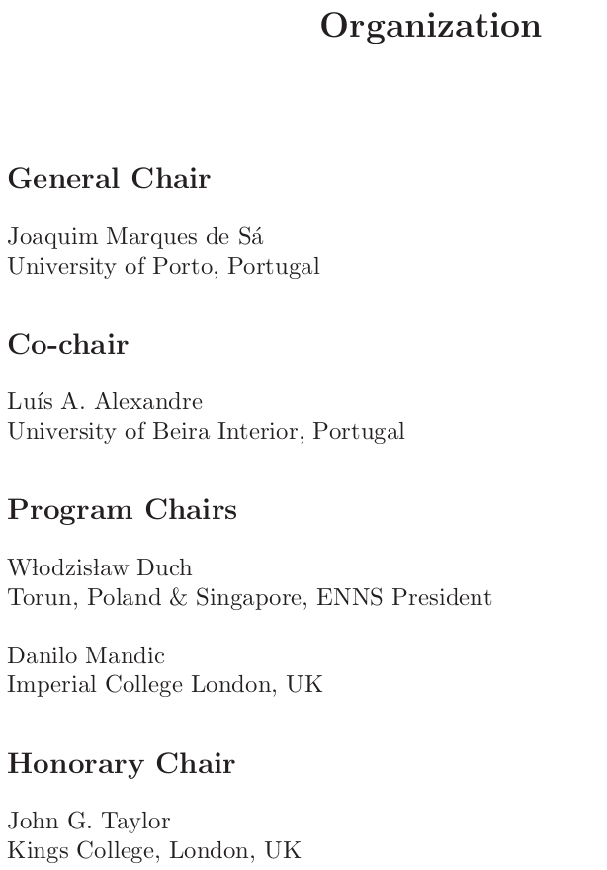
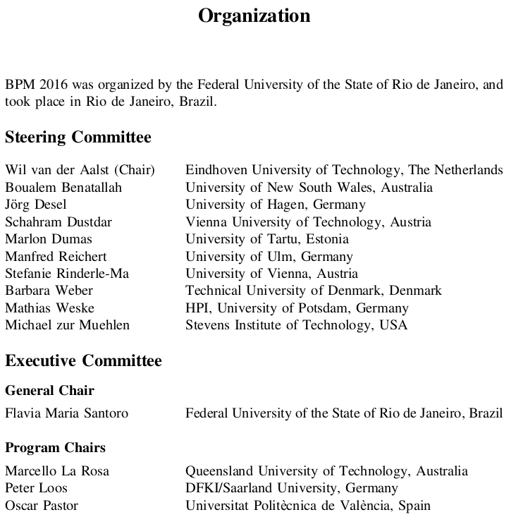
Use case → LNCS → Data acquisition
Different structures
ACCV 2009-3
ICANN 2007-1
BPM 2016

Slide 27
What to extract

Slide 28
Structures
Role <separator0>
  Name <separator1>
  affiliation + country <separator2>
  end of entry <separator3>

Slide 29
Data storage
Front Matters are PDF files
No common structure used for all front matters
:(

Slide 30
Added value of front matter
Use case → LNCS → Data acquisition
Adding this data to publicly available datasets gives us:
  Members who publish in their own proceeding
  Members who are being cited by publications in their own proceeding
Not necessarily exceptional…
...unless exceptional within their specific subgroup!

Slide 31
Use case → LNCS → Data integration
Data integration
How to link newly acquired data to previously acquired data?
  DOI?
  Name of authors?
  Name of paper?

Slide 32
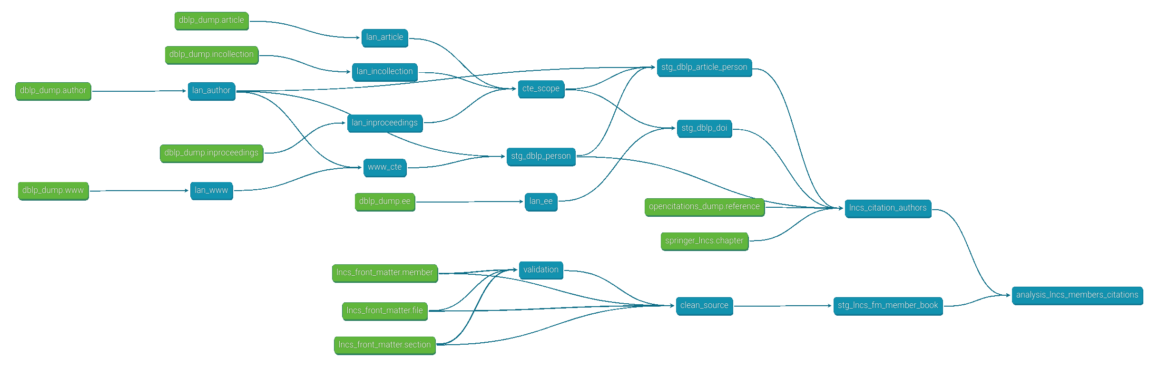
Use case → LNCS → Data integration
Data integration
DBLP
Open Citations
Springer website
Front matter
Pragmatic choices:
- opencitiation is based on doi; articles without doi are left out
- joining persons is based on raw name; we did not perform any cleaning here
- only validated data from front matter is used

Slide 33
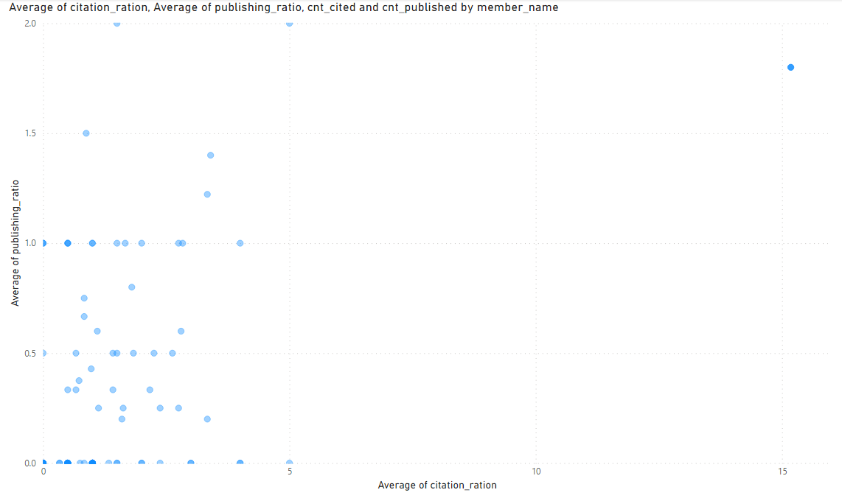
Use case → LNCS → Data analysis
Data analysis String Processing and Information Retrieval (Spire)

Slide 34
Use case → LNCS → Data acquisition
Data integration
Springer website
Chapter (articles)
doi
DBLP
doi
dblp article key
DBLP
Article person
Opencitations
doi

Slide 35
Case study #2
Elsevier: publication lag per author

Slide 36
Elsevier
A big publisher for scientific journals and articles

Slide 37
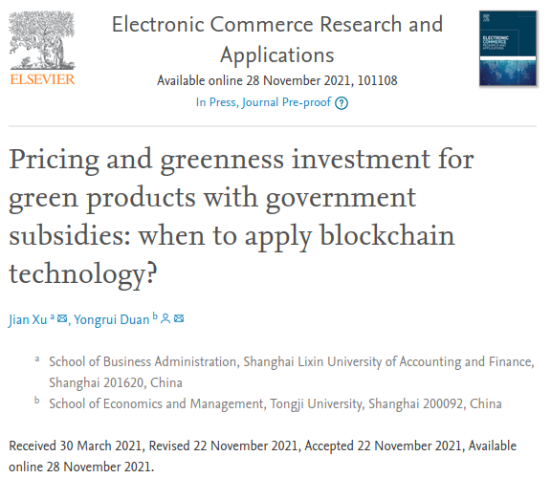
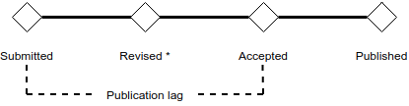
Elsevier: added value
Elsevier provides dates of publication process

Slide 38
Elsevier: Data acquisition
Challenge: The whole site is built to prevent scraping
Normal GET requests won’t work; used selenium (a lot of content is dynamically built)

Slide 39
Case study #2
ACM:
Editors & co-authorship
(in their journal)

Slide 40
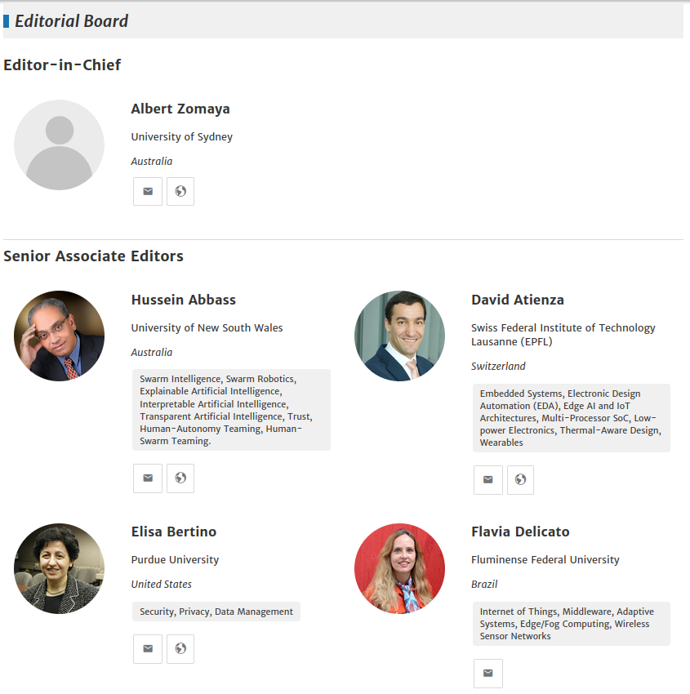
ACM

Slide 41
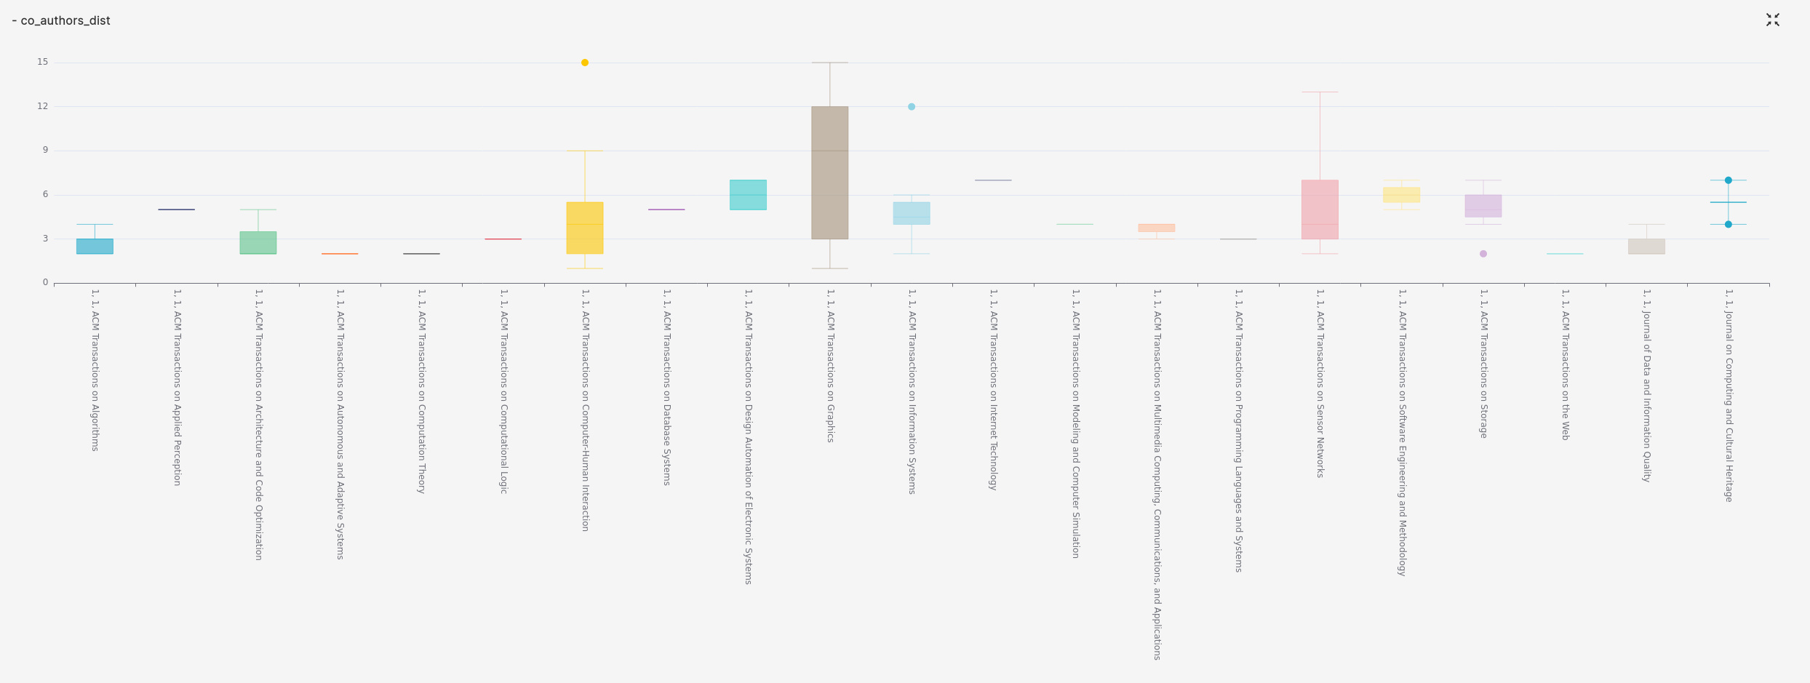
ACM

Slide 42
Validation

Slide 43
Conclusion

