Slide 1
New York City Taxi Fare Prediction
Qixiang Zhou
Yujun Xie

Slide 2
Use Case
Estimate taxi fare when doing travel plan
Embed in web page for website like Booking, TripAdvisor.
Compare the price with bus, Uber, Lyft.

Slide 3
Methodology
Ingest data set to data model with Scala
Build data(ML) model with Spark APIs
Run the system with training data set
Input test data set and generate successful prediction rate
Build a web page, with Google Map API to present the trained model

Slide 4

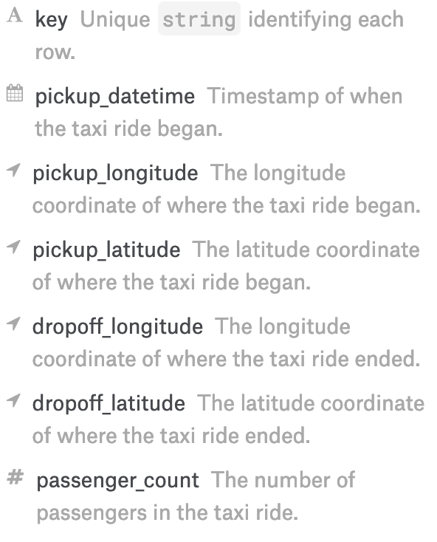
Data Description
From Kaggle: https://www.kaggle.com/c/new-york-city-taxi-fare-prediction/data
File size: 5.7 GB
# of rows: 1,300,000 lines (we will take 30% since the performance of PC)
Columns features

Slide 5
Milestones
Start project and build Git repository(week 10)
Configure working environment and do research about Spark APIs (week 11)
Ingest taxi fare data(week 12)
Build machine learning model(week 12)
Test data model and get result(week 13)
Build web page to present the work(week 14)

Slide 6
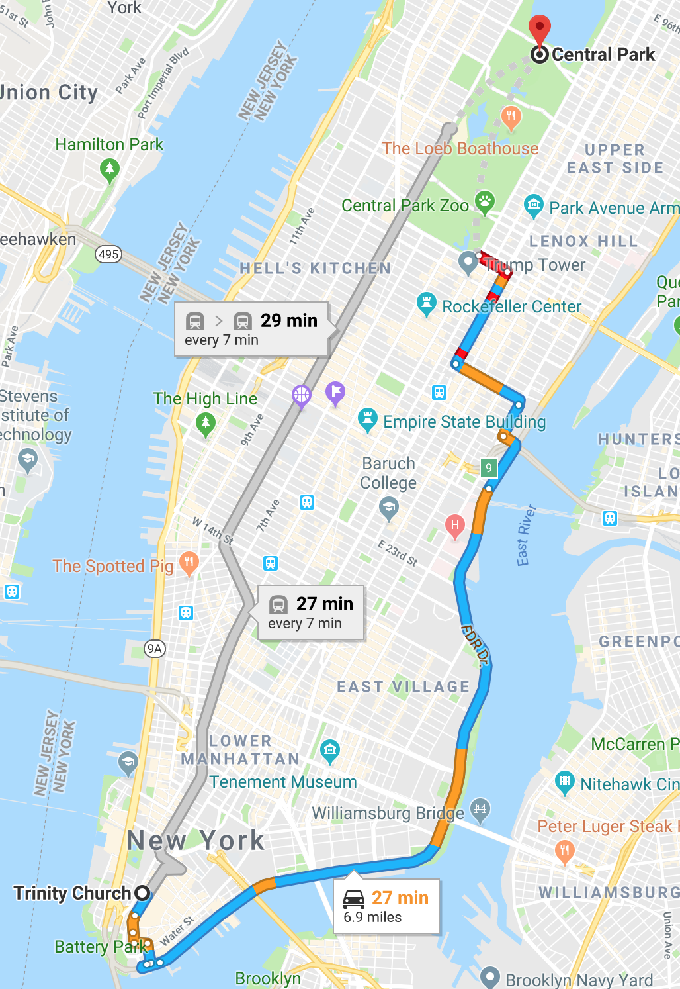
Sample
Base on:
1. trained model
2. Start point and end point
We will give taxi fare prediction

Slide 7
Repository
Github: https://github.com/JIMsZHOU/CSYE7200_FinalProject_Team8
The whole project will be majority code in Scala (based on Spark, and Play-2.0) and with some HTML, JavaScript and Java.

Slide 8
Acceptance Criteria
Root mean squared error will less than 5
The web we use base on trained model will react within five seconds.

Slide 9
Goal
Build a stable web system, separate training page and application page.
Add user feedback to adjust trained model by user input correct taxi fare and use this input as training data.

