Slide 1
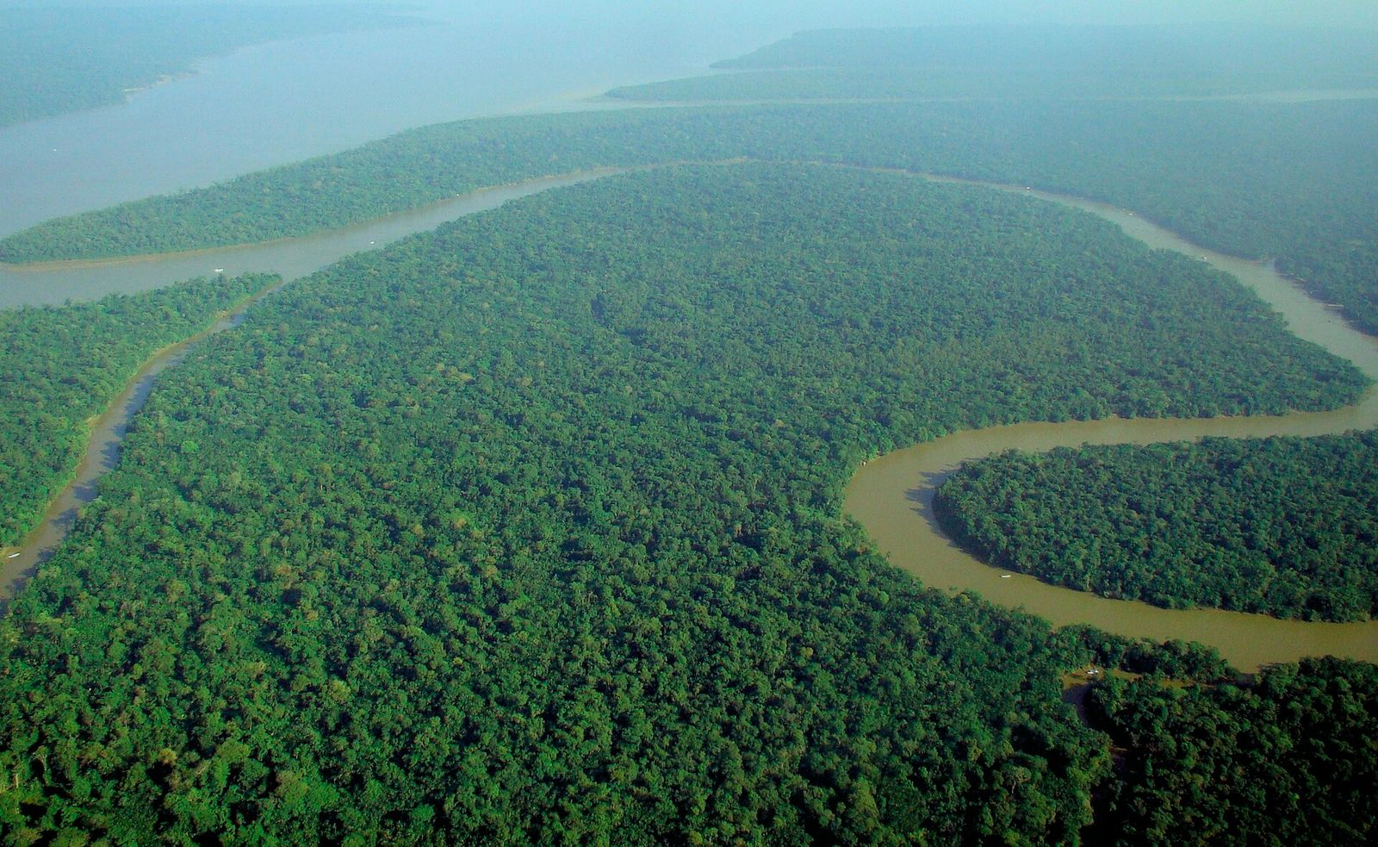
BIODIVERSITY / CLIMATE / CONTINUITY
AMAZON
The living climate engine
A forest where species, water and atmosphere are one connected system.
A visual field guide
Notes:
[Sources] WWF — About the Amazon: https://wwf.panda.org/discover/knowledge_hub/where_we_work/amazon/about_the_amazon/ Image: canopy.jpg — lubasi, CC BY-SA 2.0; see sources.txt.

Slide 2
01 / SCALE
Biodiversity is the Amazon’s operating system
~10%
EMERGENT
sun, wind, giant crowns
of the world’s known species are associated with the Amazon.
CANOPY
most leaves, flowers and animal life
6.7 million km²
UNDERSTORY
shade-adapted plants and predators
A biome roughly twice the size of India.
FOREST FLOOR
fungi, detritivores and rapid recycling
Four layers. Millions of interactions. One interdependent system.
02
Notes:
[Sources] WWF — About the Amazon: biome extent and ~10% known-species context: https://wwf.panda.org/discover/knowledge_hub/where_we_work/amazon/about_the_amazon/ Forest-layer descriptions are qualitative synthesis for this presentation.

Slide 3
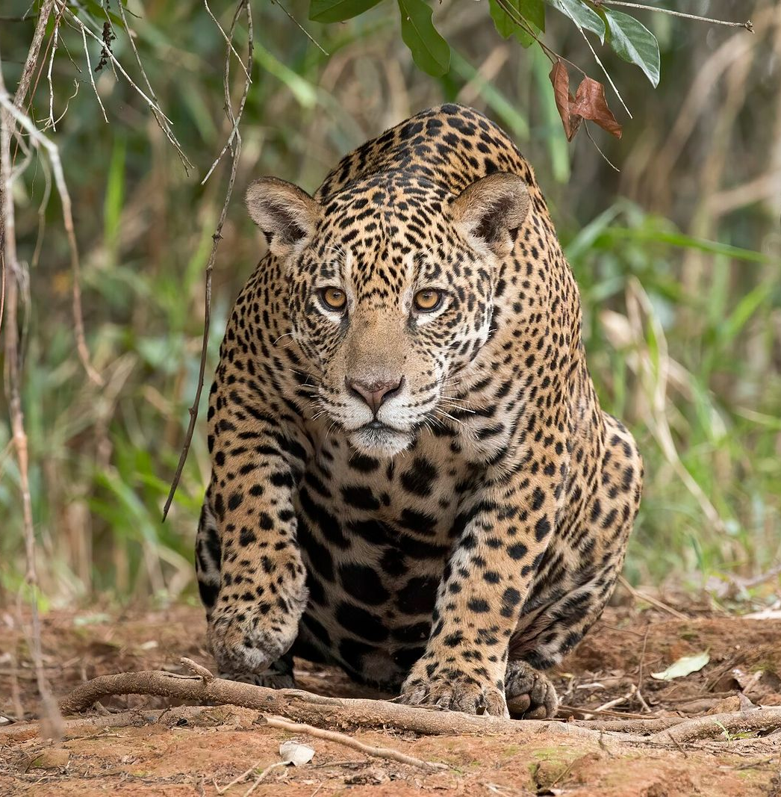
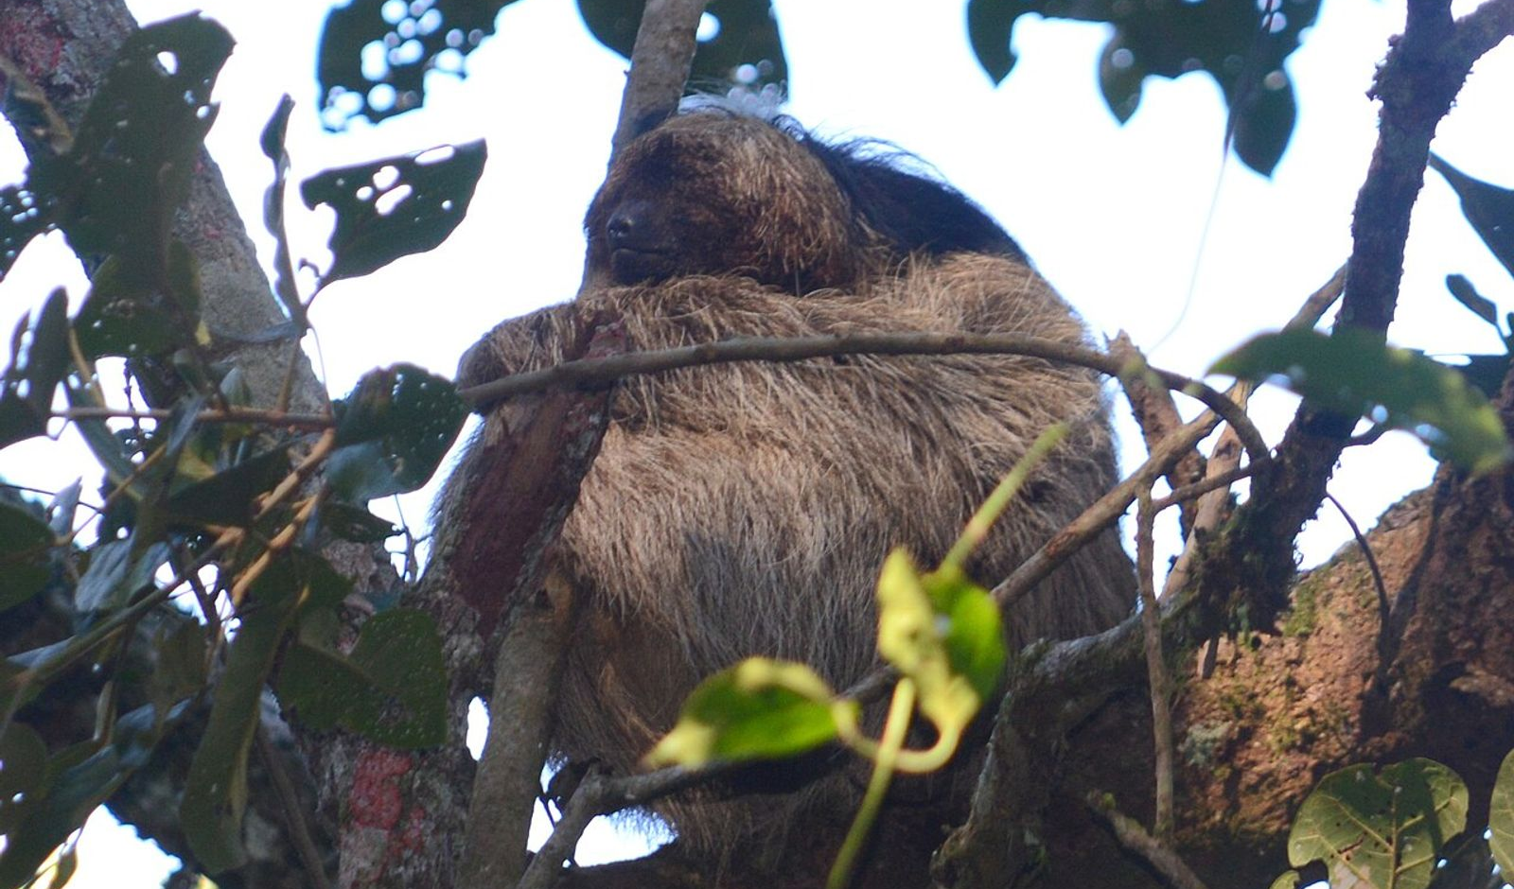
02 / MAMMALS
Three ways to inhabit a forest
SLOTH
A moving microhabitat
Slow metabolism, canopy camouflage and a coat shared with algae and invertebrates.
JAGUAR
Keeps food webs dynamic across vast connected ranges.
Apex predator
PINK RIVER DOLPHIN
Navigates flooded forest by sound.
03
Notes:
[Sources] WWF — Jaguar: https://www.worldwildlife.org/species/jaguar WWF — Amazon River Dolphin: https://www.worldwildlife.org/species/amazon-river-dolphin Pauli et al. (2014) — sloth fur micro-ecosystem: https://doi.org/10.1098/rspb.2013.3006 Image: jaguar.jpg — Charles J. Sharp, CC BY-SA 4.0; see sources.txt. Image: sloth.jpg — deboas, CC BY 4.0; see sources.txt.

Slide 4
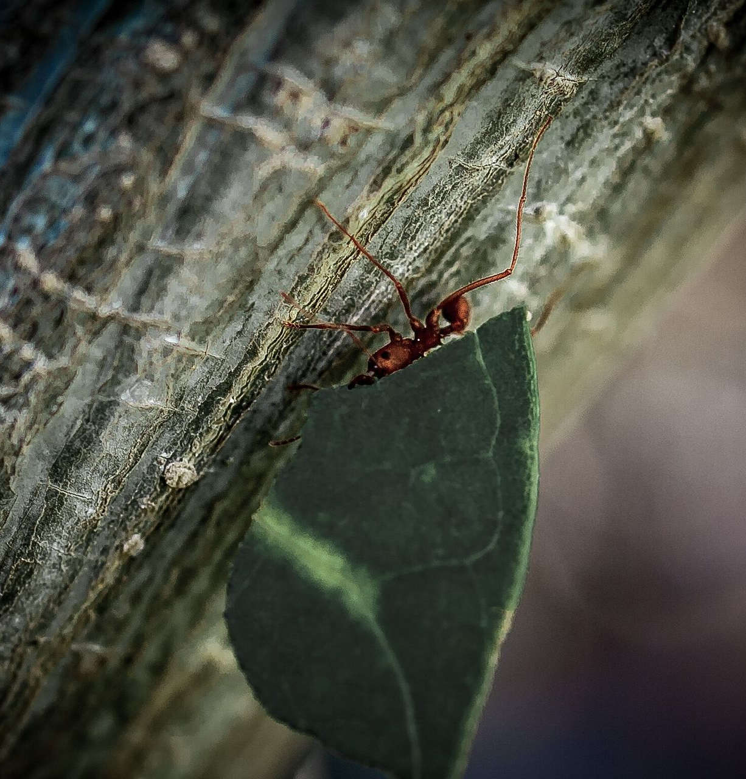
03 / INVERTEBRATES
The small species do the heavy work
Leafcutter ants are not leaf eaters.
They harvest leaves to cultivate fungus—the colony’s food supply.
1
CUT
fresh vegetation
2
CULTIVATE
fungus gardens
3
HARVEST
fungus as colony food
04
Notes:
[Sources] Smithsonian National Zoo — Leafcutter Ant: fungus cultivation and colony ecology: https://nationalzoo.si.edu/animals/leafcutter-ant Image: ants.jpg — Matheysil, CC BY-SA 4.0; see sources.txt.

Slide 5
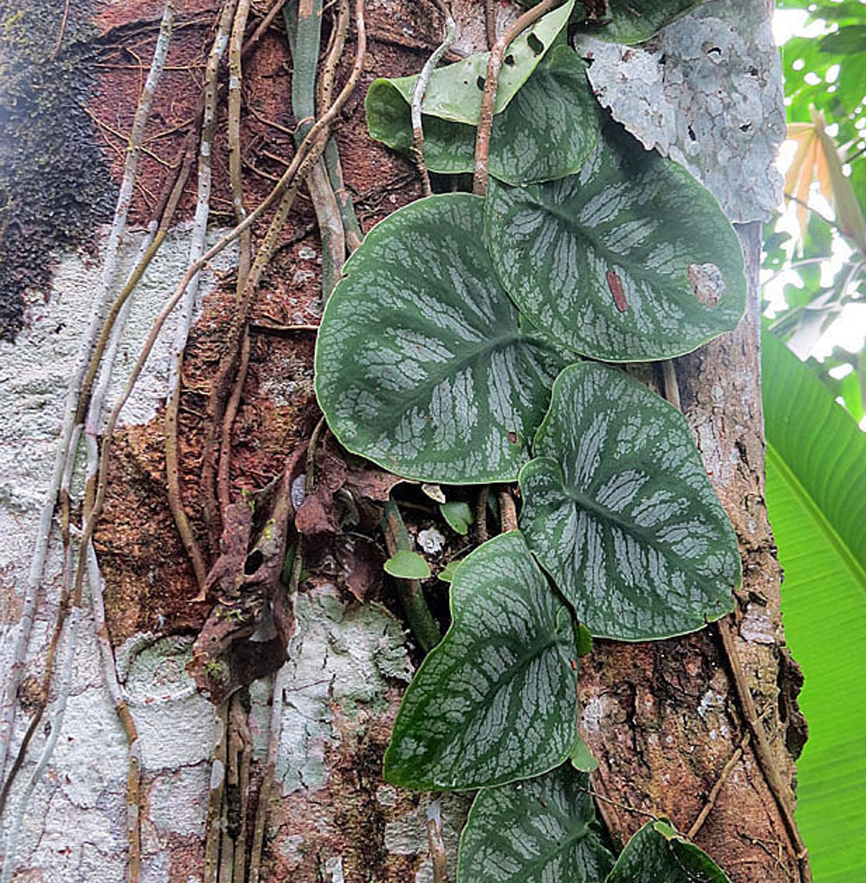
04 / PLANTS
The forest is a vertical city
~390
billion trees
~16,000
tree species
Diversity is uneven
A small set of “hyperdominant” trees accounts for a large share of stems—yet rare species hold irreplaceable genetic options.
Light is the scarce currency.
Trees race upward; lianas borrow trunks; epiphytes build gardens in the canopy.
05
Notes:
[Sources] ter Steege et al., Science (2013) — ~390 billion trees and ~16,000 tree species: https://doi.org/10.1126/science.1243092 Image: plants.jpg — Dick Culbert, CC BY 2.0; see sources.txt.

Slide 6
05 / PLANETARY ROLE
The Amazon moves water before it stores carbon
FOREST
LEAVES
AIR
RAIN
release moisture
transports vapor
feeds rivers + farms
RECYCLED MOISTURE RETURNS
At the same time, living biomass locks up carbon—until clearing and fire reverse the flow.
06
Notes:
[Sources] NASA Earth Observatory — The Amazon’s Vicious Cycles: moisture recycling, drought, fire, and land-use feedbacks: https://earthobservatory.nasa.gov/features/AmazonFire IPCC AR6 WGII Chapter 12: https://www.ipcc.ch/report/ar6/wg2/chapter/chapter-12/

Slide 7
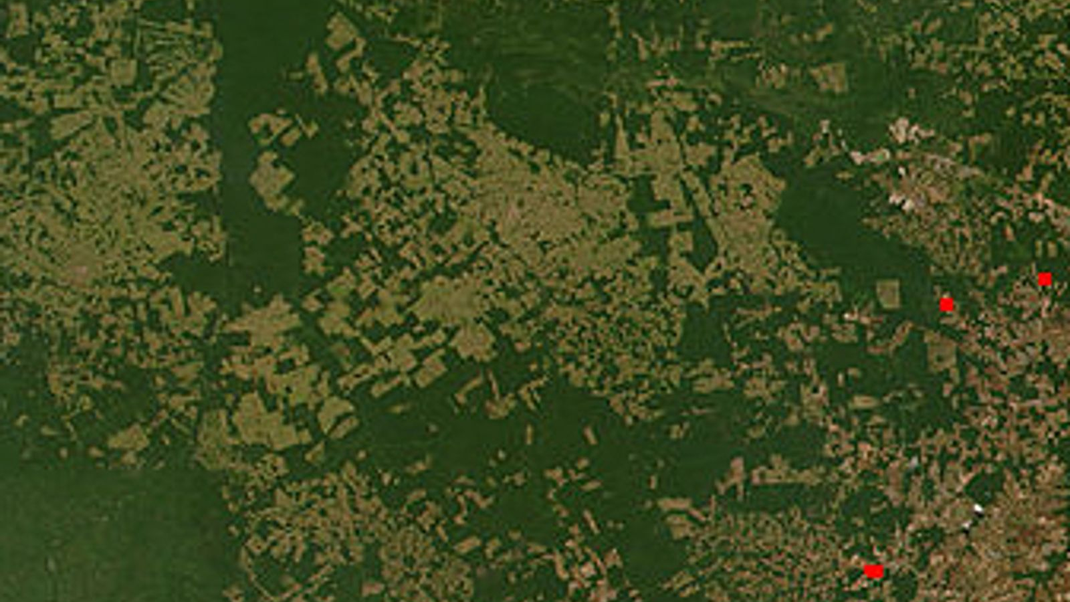
06 / THREAT
Deforestation becomes a feedback loop
Clearing removes habitat once. Drying and fire can keep removing it.
LOSE
BURN
species + resilience
DRY
fire releases carbon
FRAGMENT
edges lose moisture
CLEAR
edges heat + dry
The risk is cumulative
habitat removed
roads + extraction + heat + fire
07
Notes:
[Sources] NASA Earth Observatory — The Amazon’s Vicious Cycles: https://earthobservatory.nasa.gov/features/AmazonFire IPCC AR6 WGII Chapter 12: https://www.ipcc.ch/report/ar6/wg2/chapter/chapter-12/ Global Forest Watch — Brazil forest-change dashboard: https://www.globalforestwatch.org/dashboards/country/BRA/?category=forest-change Image: deforestation.jpg — NASA LANCE FIRMS / ESDIS, public domain; see sources.txt.

Slide 8
07 / RESPONSE
Protect continuity—not isolated fragments
The strongest strategy keeps ecological processes connected across landscapes and generations.
01
RIGHTS
Secure Indigenous and local-community stewardship.
02
ENFORCEMENT
Stop illegal clearing, mining and wildlife trade.
03
RESTORATION
Reconnect riverbanks, corridors and degraded edges.
04
MARKETS
Trace commodities and reward standing forest.
A living Amazon is infrastructure for life.
08
Notes:
[Sources] IPCC AR6 WGII Chapter 12 — conservation, adaptation, and land-use context: https://www.ipcc.ch/report/ar6/wg2/chapter/chapter-12/ Global Forest Watch — monitoring context: https://www.globalforestwatch.org/dashboards/country/BRA/?category=forest-change Action framing is a presentation synthesis, not a ranked policy assessment.

