Slide 1
Designing a Noise Reduction Filter
for Voice Signals
A simulated public-announcement case study using frequency-domain analysis and a basic low-pass filter.
ECE0402 • Signals, Systems & Probability
Insert team names here
ECE0402 • Slide 1

Slide 2
Why this problem matters
Motivation
Voice recordings and public announcements often lose clarity when background noise is present.
High-frequency hiss is a useful starting point because it is common in recording chains and easier to analyze.
A simple, explainable filter is enough to show how Signals and Systems ideas work in a real application.
Real problem
Controllable model
Explainable system
ECE0402 • Slide 2

Slide 3
Problem statement
Input, output, and goal
Input: noisy voice corrupted by high-frequency hiss.
Output: a cleaner voice signal after filtering.
Goal: suppress hiss while keeping speech as understandable as possible.
clean voice
+
hiss noise
noisy voice
=
→
filtered voice
Main design question: where should the filter cut off to reduce noise without making speech sound too dull?
ECE0402 • Slide 3

Slide 4
Simulated application scenario
Why we use a controlled setup
We use a station/public-announcement background as the story, but we simulate the signal instead of recording a complex real environment.
This keeps the noise characteristics controllable, the experiment repeatable, and the result easier to explain.
The setup still preserves the real-world intuition: speech + recording-chain hiss + system processing.
Scene framing
A short public-announcement style voice sample is corrupted by high-frequency hiss and then processed by a simple digital filter.
ECE0402 • Slide 4

Slide 5
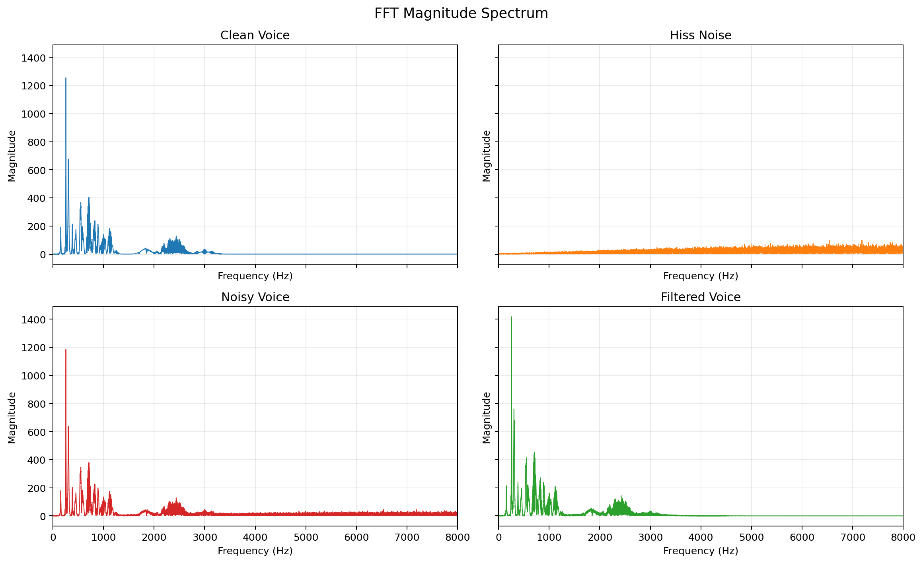
Signal characteristics
Voice and hiss do not occupy frequency space in the same way
The simulated hiss raises high-frequency energy in the noisy voice, creating a clean target for basic low-pass filtering.
ECE0402 • Slide 5

Slide 6
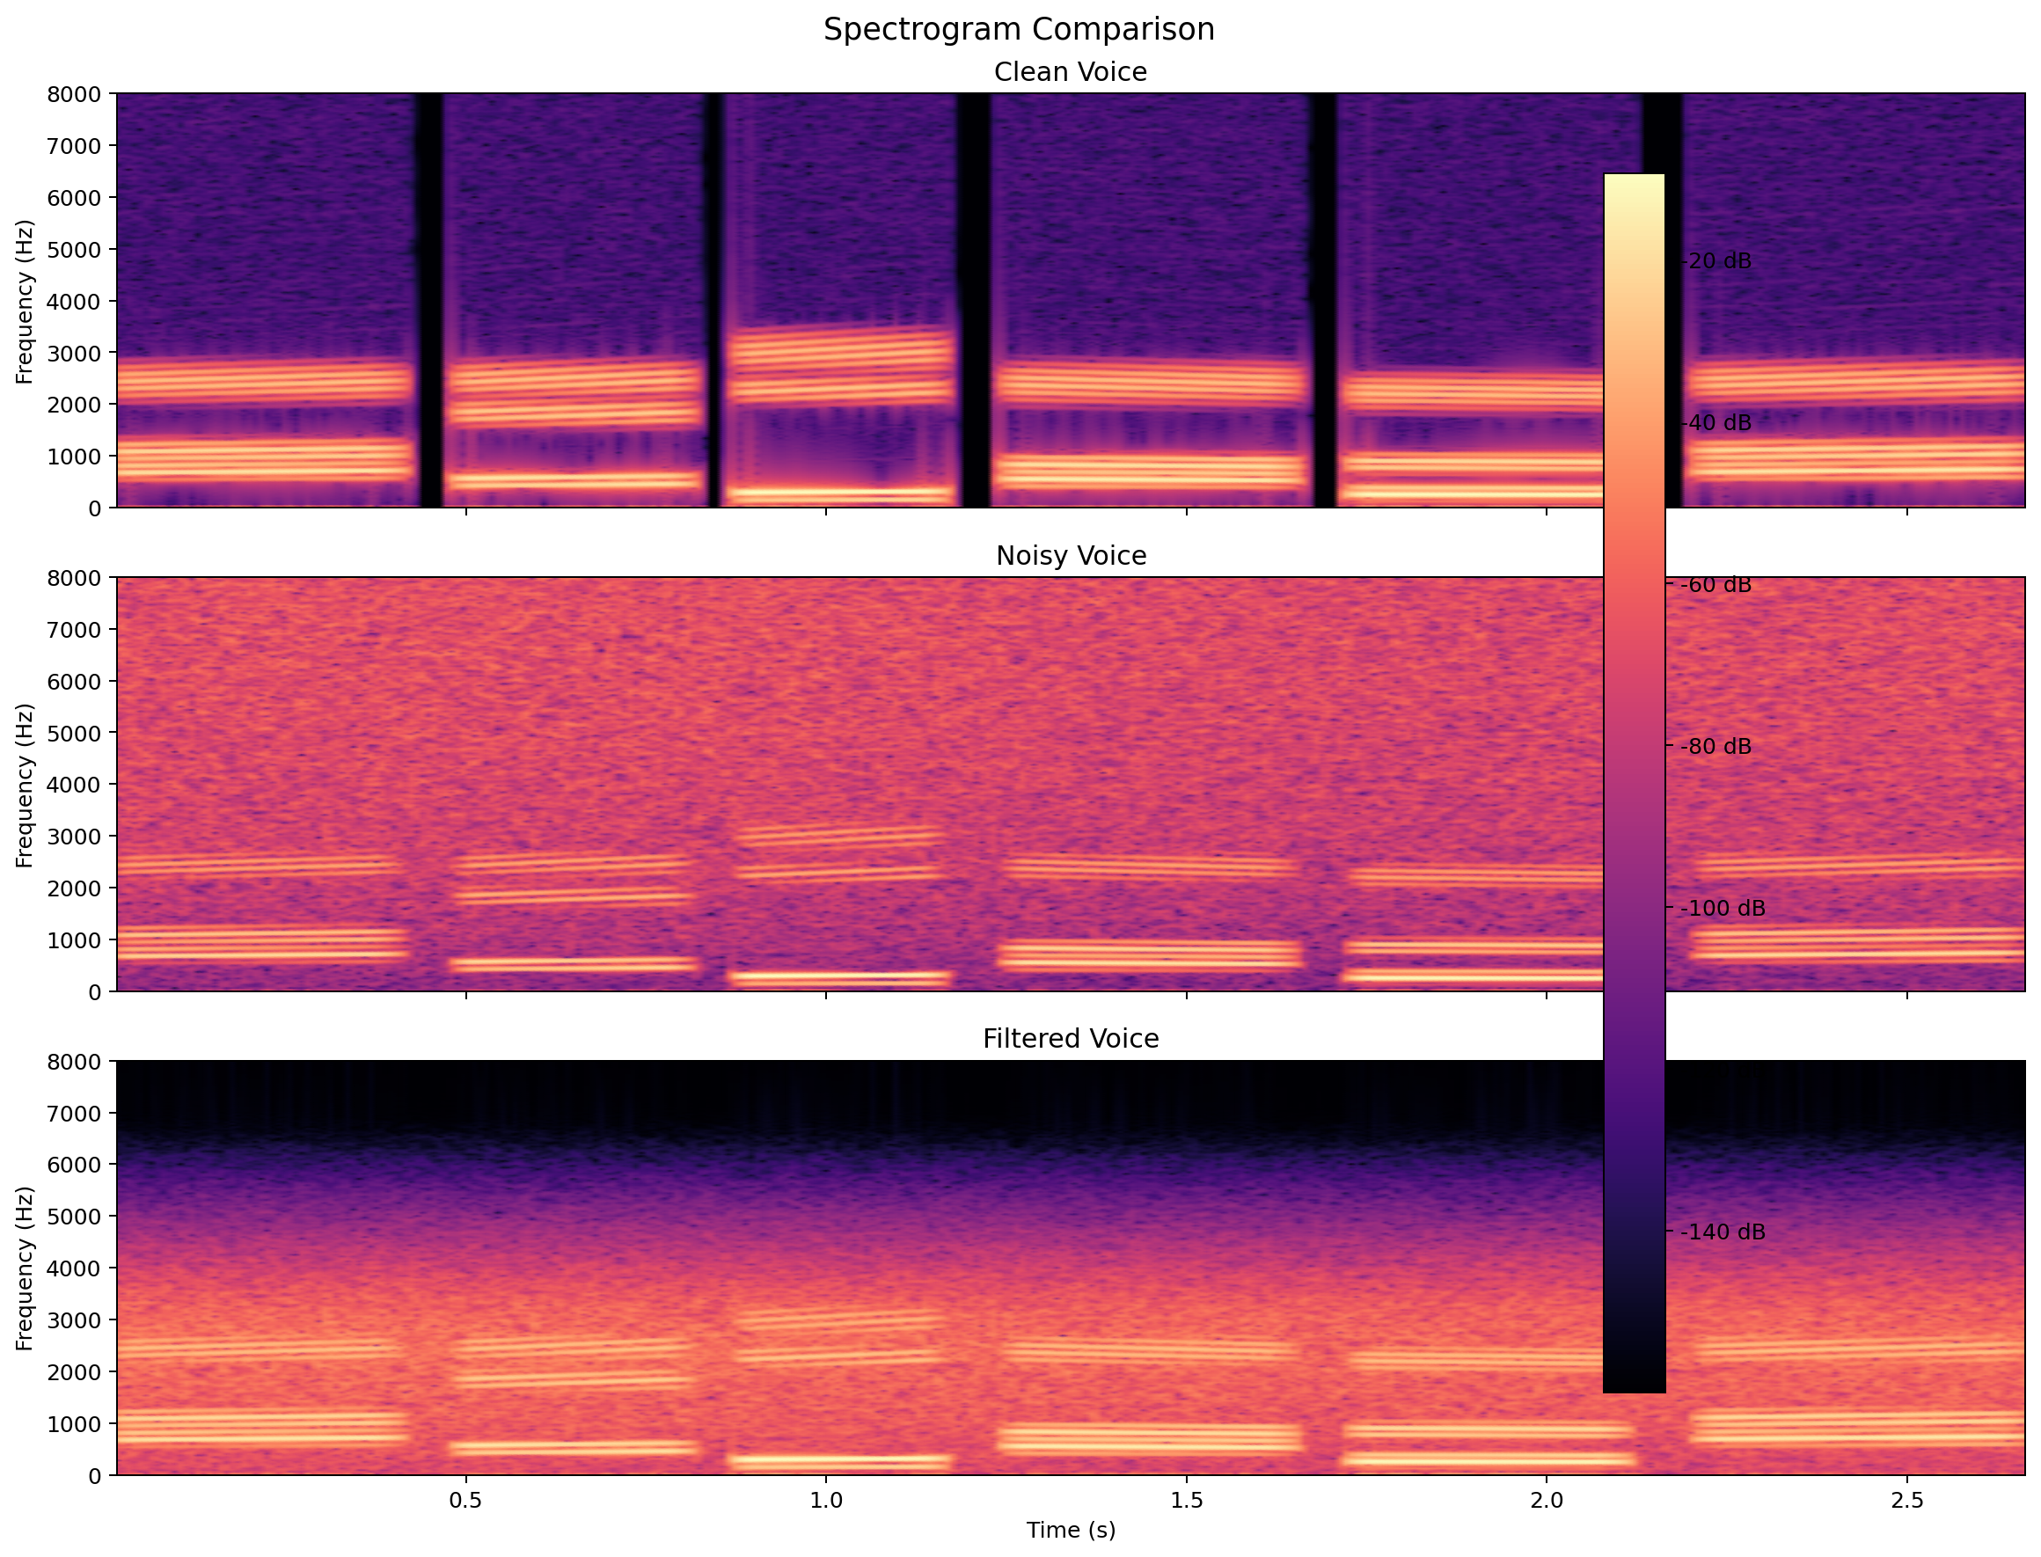
Why Fourier Transform helps
From waveform to frequency-domain evidence
In the time domain, speech and noise are mixed together and hard to separate directly.
The Fourier Transform shows where energy is concentrated across frequencies.
That frequency view tells us why a low-pass filter is reasonable in this specific hiss scenario.
High-frequency regions become visibly brighter after noise is added and are reduced again after filtering.
ECE0402 • Slide 6

Slide 7
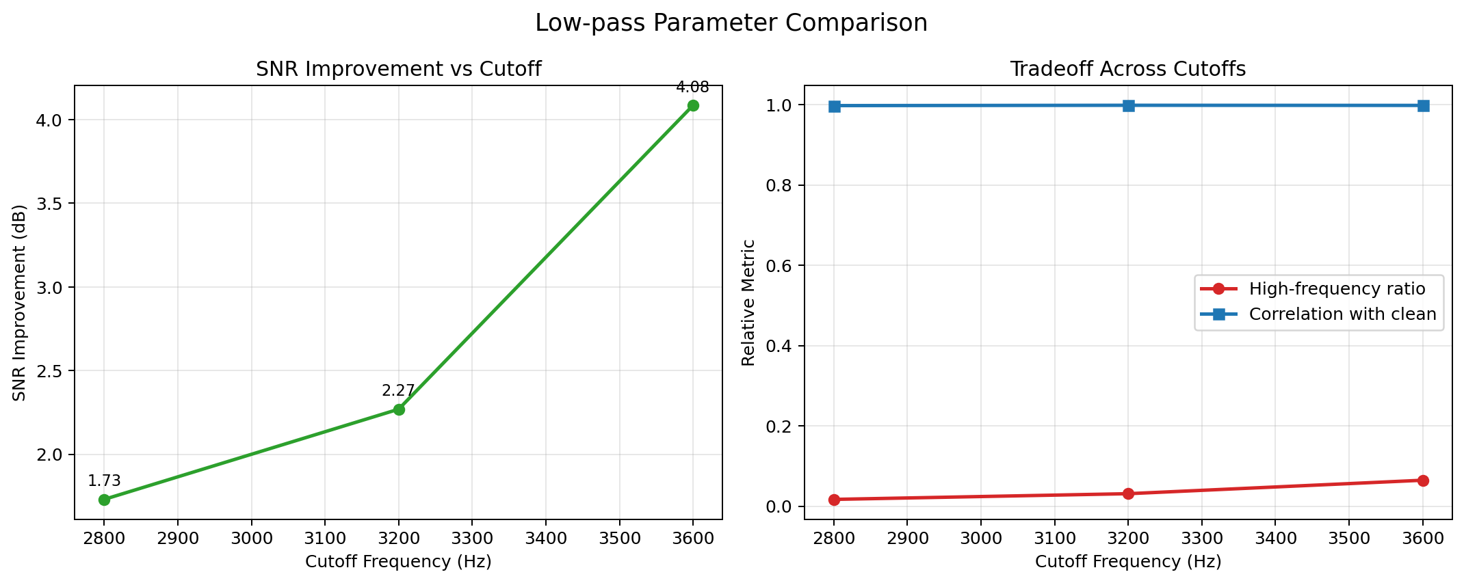
Filter design idea
Why 3200 Hz becomes the main demo cutoff
2800 Hz removes more hiss, but speech starts sounding dull.
3600 Hz preserves more speech detail, but leaves more high-frequency noise behind.
3200 Hz gives the best presentation balance between audible improvement and naturalness.
We keep 3600 Hz as a comparison version, but 3200 Hz is easier to defend as the classroom demo choice.
ECE0402 • Slide 7

Slide 8
System workflow
A complete input-output view
clean voice
→
hiss noise
→
noisy voice
→
low-pass filter
→
filtered voice
This is not just a software call: the project includes scenario modeling, frequency analysis, parameter comparison, system design, and evaluation.
Model a realistic but controllable scenario
Observe the signal in the frequency domain
Design and compare candidate filter parameters
Evaluate the result with audio and figures
ECE0402 • Slide 8

Slide 9
Demo setup
Audio will be inserted manually later
Clean Voice
Insert clean_voice.wav
Use the same short sample for all three clips.
Play in the order: clean → noisy → filtered.
Then explain the change with waveform and spectrogram evidence.
Noisy Voice
Insert noisy_voice.wav
Filtered Voice
Insert filtered_voice.wav
Leave these placeholders intact for manual audio insertion in PowerPoint.
ECE0402 • Slide 9

Slide 10
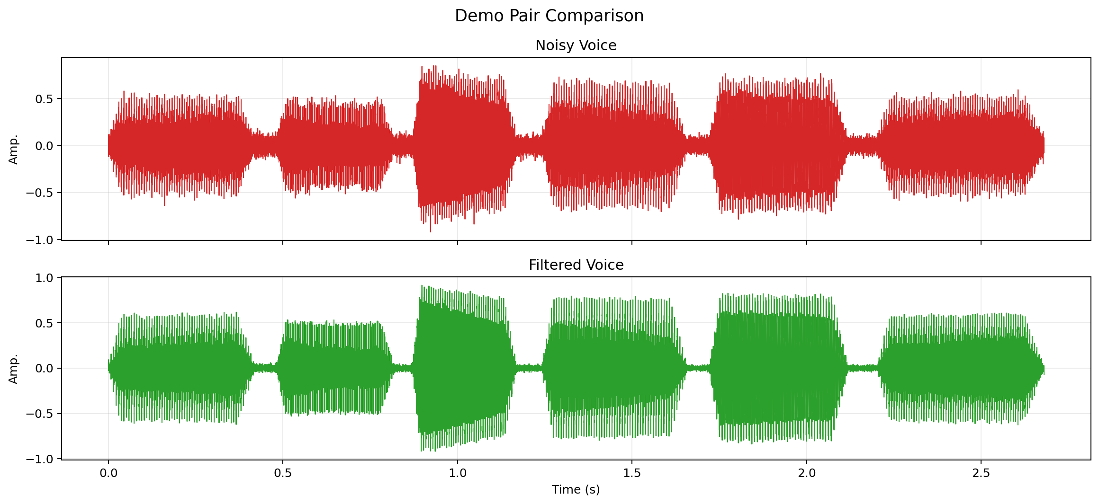
Results
Audible improvement supported by visual evidence
Waveform comparison
High-frequency hiss is visibly reduced after filtering.
Speech remains understandable in the processed output.
The improvement is clear, but some high-frequency speech detail is softened.
Spectrogram comparison
ECE0402 • Slide 10

Slide 11
Discussion and limitations
Why the result is useful but not perfect
The low-pass filter works because the simulated hiss is mainly high-frequency.
The same mechanism also removes some useful high-frequency speech detail.
A more realistic station environment would contain broader and more complex noise, which basic low-pass filtering cannot handle as cleanly.
Suppression
Preservation
Tradeoff
The project is strongest as a controlled case study, not as a full solution for every real-world noise environment.
ECE0402 • Slide 11

Slide 12
A simple filter can explain a lot.
We modeled a voice-noise problem, used frequency-domain analysis to guide the design, and showed that a basic low-pass filter can reduce hiss while preserving intelligibility.
Q&A
ECE0402 • Slide 12

